Slide 1



CLASS : NURSERY
DATE : 01.12.2021
SUBJECT :
MATHS
TOPIC :
:NUMBER-14 IN NT BK

Slide 2






Identify the given number

Slide 3

Identification of number 13

Slide 4

Identify and count the objects

Slide 5
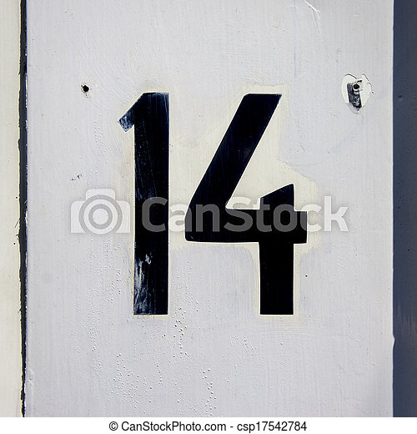

Identification of number 14

Slide 6

Counting the objects

Slide 7

HI children

Slide 8

IN BK PG NO-14
NUMBER-14 ACTIVITY IN NT BK
Notes:
Note book work

Slide 9
Circle and colour number 14
HW
13 12 14 13 14
14 13 14 10 11
13 14 12 14 13

Slide 10

1 .Practice counting 1-5
ASSIGNMENT
01/12/21
1.Practice counting 11 to20
2.Complete bk pg no -68,69
Notes:
2.Do bk pg no-63

Slide 11
THANKING YOU
ODM EDUCATIONAL GROUP

