Slide 1



CLASS : NURSERY
DATE : 09.11.2021
SUBJECT :
MATHS
CHAPTER NUMBER- BK PG NO -,58,59
SUB-TOPIC :
NUMBER-9

Slide 2







IDENTIFY THE GIVEN NUMBERS

Slide 3

Count and say rrthe correct number

Slide 4


Identification of number-9

Slide 5
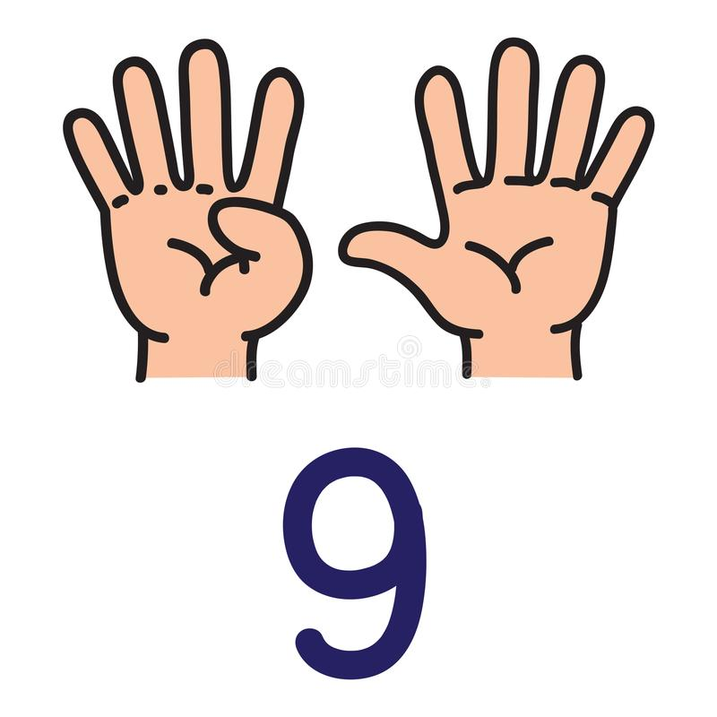

Slide 6

Counting the objects

Slide 7

Number-9 in nt bk
Notes:
Note book work

Slide 8

Number-9
CW
09/11/21

Slide 9

Trace and write number-9
CW
09/11/21
Notes:
CW

Slide 10

Count and color -9 apples
HW
09/11/21
Notes:
09/11/21

Slide 11

1 .Practice counting 1-5
ASSIGNMENT
09/11/21
1.Practice counting 11 to20
2.Do the given assignment
Notes:
Do the given assignment

Slide 12
THANKING YOU
ODM EDUCATIONAL GROUP

