Slide 1



CLASS : NURSERY
DATE : 08.11.2021
SUBJECT :
MATHS
CHAPTER NUMBER- BK PG NO -,58,59
SUB-TOPIC :
NUMBER-9

Slide 2


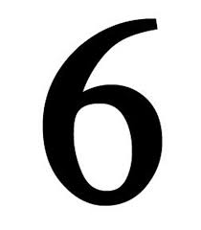




IDENTIFY THE GIVEN NUMBERS

Slide 3

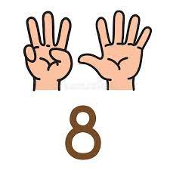
NUMBER-8

Slide 4

Count and say rrthe correct number

Slide 5


Identification of number-9

Slide 6
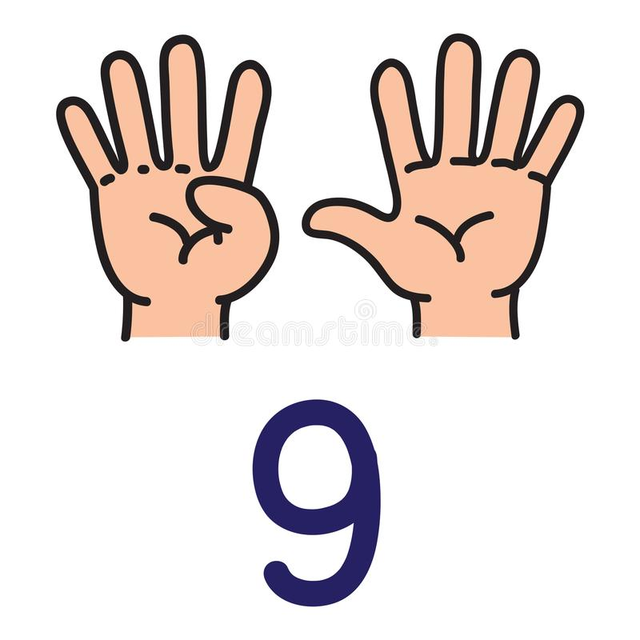

Slide 7

Counting the objects

Slide 8
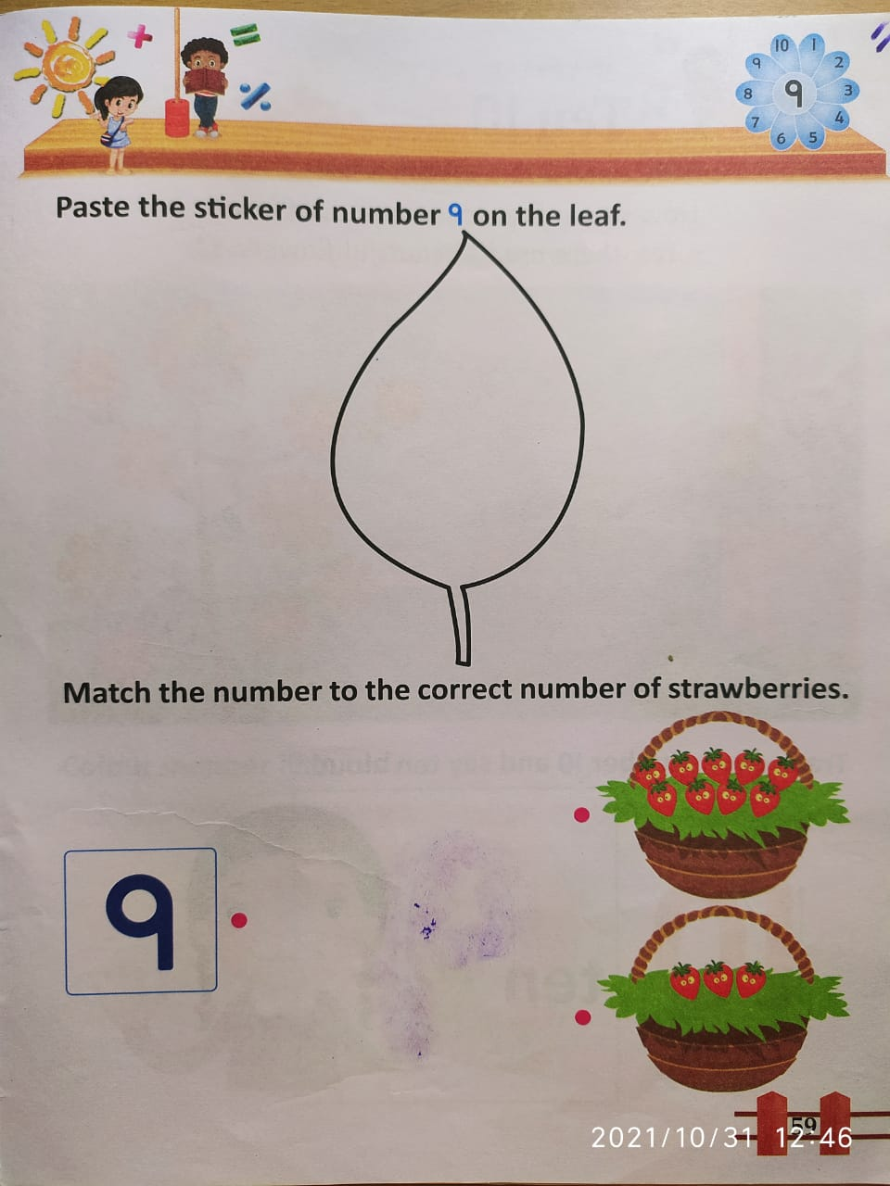
In bk pg no 59
CW
08/11/21
CW
08/11/21
Notes:
CW

Slide 9

1 .Practice counting 1-5
ASSIGNMENT
08/11/21
1.Practice counting 11 to15
Notes:
2.practice the activity done today

Slide 10
THANKING YOU
ODM EDUCATIONAL GROUP

