Slide 1



CLASS : NURSERY
DATE : 07.12.2021
SUBJECT :
MATHS
TOPIC :
:NUMBER-15 ACTIVITY IN NT BK

Slide 2





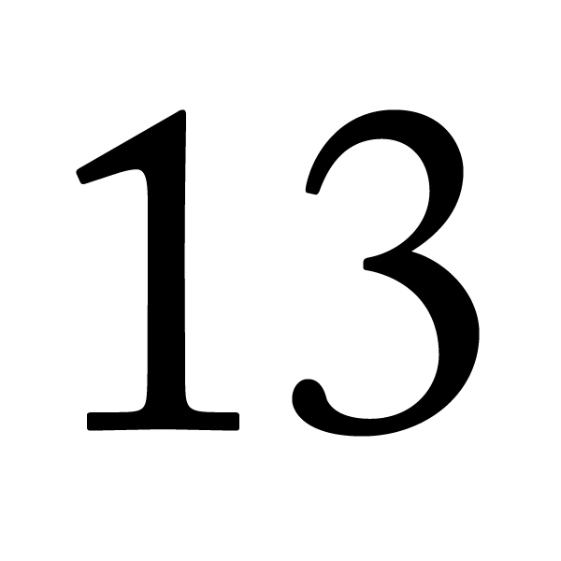

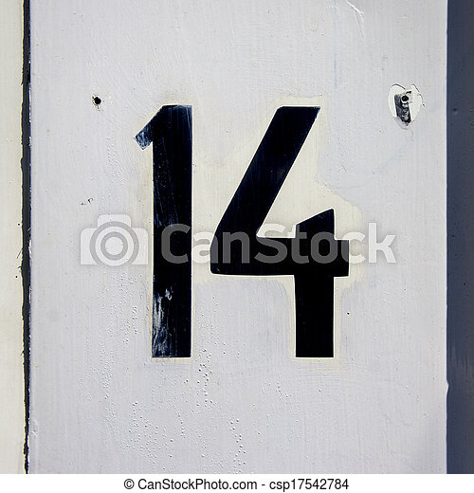
Identify the given number

Slide 3

NUMBER 15

Slide 4
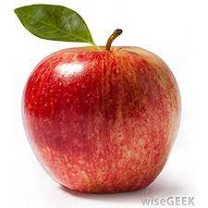

Slide 5

HI children

Slide 6

IN BK PG NO-15
NUMBER-15 IN NT BK
Notes:
Note book work

Slide 7

Colour the cup having number 15 written in it .
CW
07/12/21
12
15
13
15
11
15
10
15
15
10
15
14

Slide 8

1 .Practice counting 1-5
ASSIGNMENT
07/12/21
1.Practice counting 11 to20
2.Complete the work given in nt bk
Notes:
2.Do bk pg no-63

Slide 9
THANKING YOU
ODM EDUCATIONAL GROUP

