Slide 1



CLASS : NURSERY
DATE : 07.09.2021
SUBJECT :
MATHS
CHAPTER NUMBER- BK PG NO -52,53
SUB-TOPIC :
NUMBER-7

Slide 2







IDENTIFY THE GIVEN NUMBERS

Slide 3


Identification of number-7

Slide 4


Slide 5
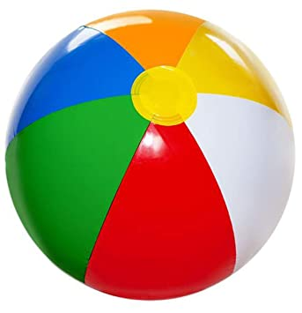

Slide 6
NUMBER -7

Slide 7


TRACE AND WRITE NUMBER-7
CW
07/09/21
Notes:
07/09/21

Slide 8
SAY AND WRITE
HW
07/09/21
Notes:
07/09/21

Slide 9

1 .Practice counting 1-5
ASSIGNMENT
07/09//21
1.Practice counting 11 to15
2.Do bk pg no-52,53
Notes:
2.practice the activity done today

Slide 10
THANKING YOU
ODM EDUCATIONAL GROUP

