Slide 1



CLASS : NURSERY
DATE : 06.12.2021
SUBJECT :
MATHS
TOPIC :
:NUMBER-15 IN NT BK

Slide 2






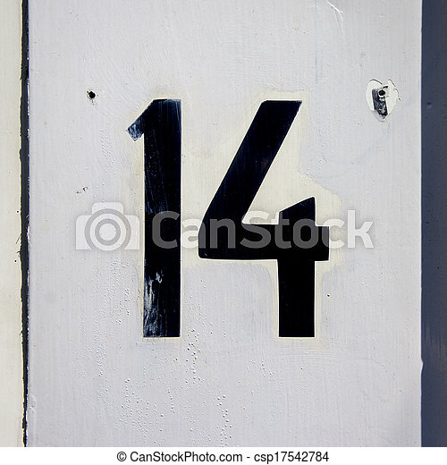
Identify the given number

Slide 3

Identification of number 14

Slide 4

Identify and count the objects

Slide 5



Slide 6
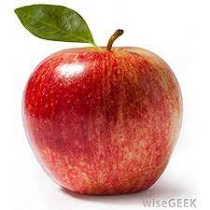

Slide 7

HI children

Slide 8

IN BK PG NO-15
NUMBER-15 IN NT BK
Notes:
Note book work

Slide 9
Number-15
cw
06/12/21

Slide 10
Say and write
cw
06/12/21

Slide 11
Circle and colour number 15
HW
06/12/21
11 12 15 13 15
15 13 15 12 11
12 15 13 15 11

Slide 12

1 .Practice counting 1-5
ASSIGNMENT
06/12/21
1.Practice counting 11 to20
2.Complete the work given in nt bk
Notes:
2.Do bk pg no-63

Slide 13
THANKING YOU
ODM EDUCATIONAL GROUP

