Slide 1



CLASS : NURSERY
DATE : 06.09.2021
SUBJECT :
MATHS
CHAPTER NUMBER- BK PG NO -48,49
SUB-TOPIC :
NUMBER-7

Slide 2







IDENTIFY THE GIVEN NUMBERS

Slide 3
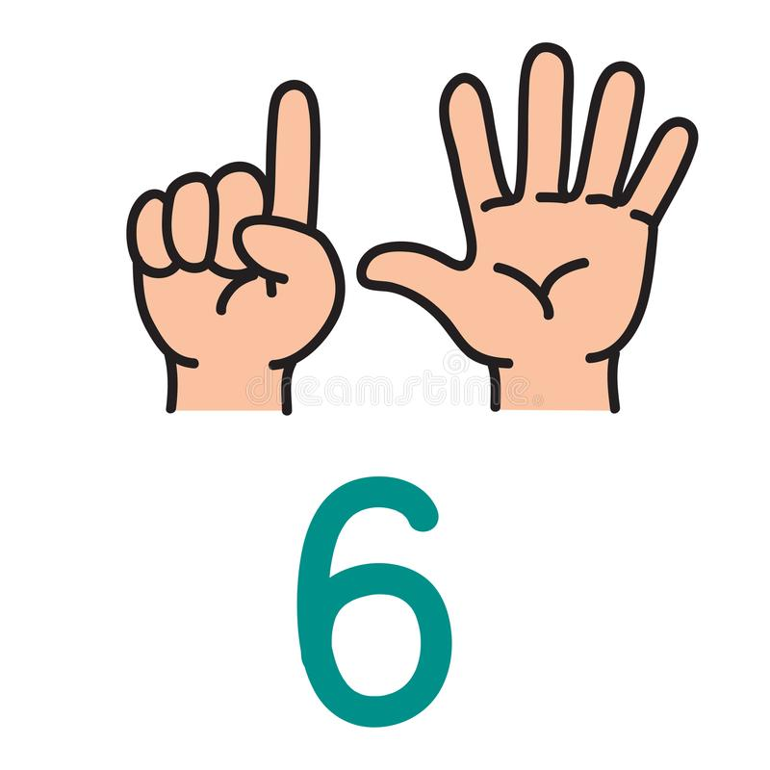

COUNTING IN FINGERS

Slide 4


Slide 5


Slide 6


Slide 7

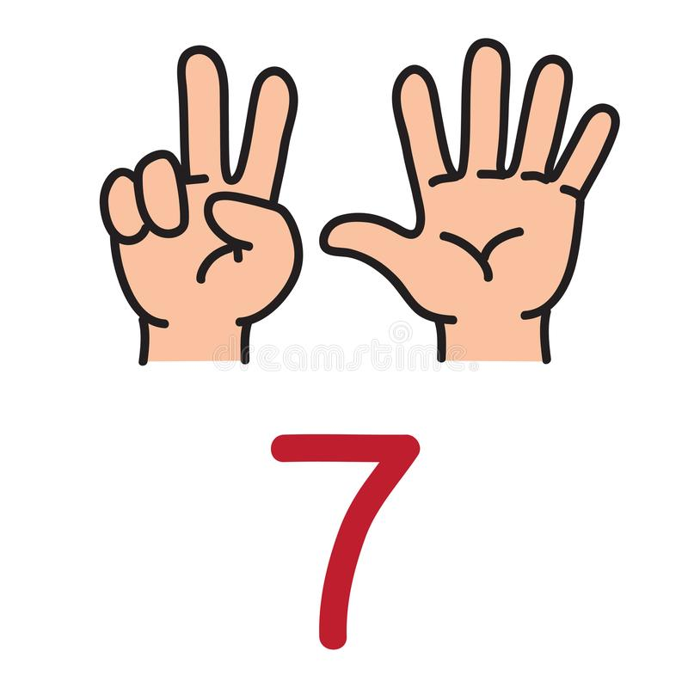
Identification of number-7

Slide 8
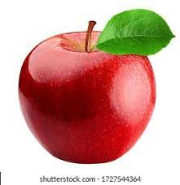

Slide 9
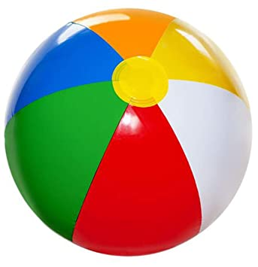

Slide 10
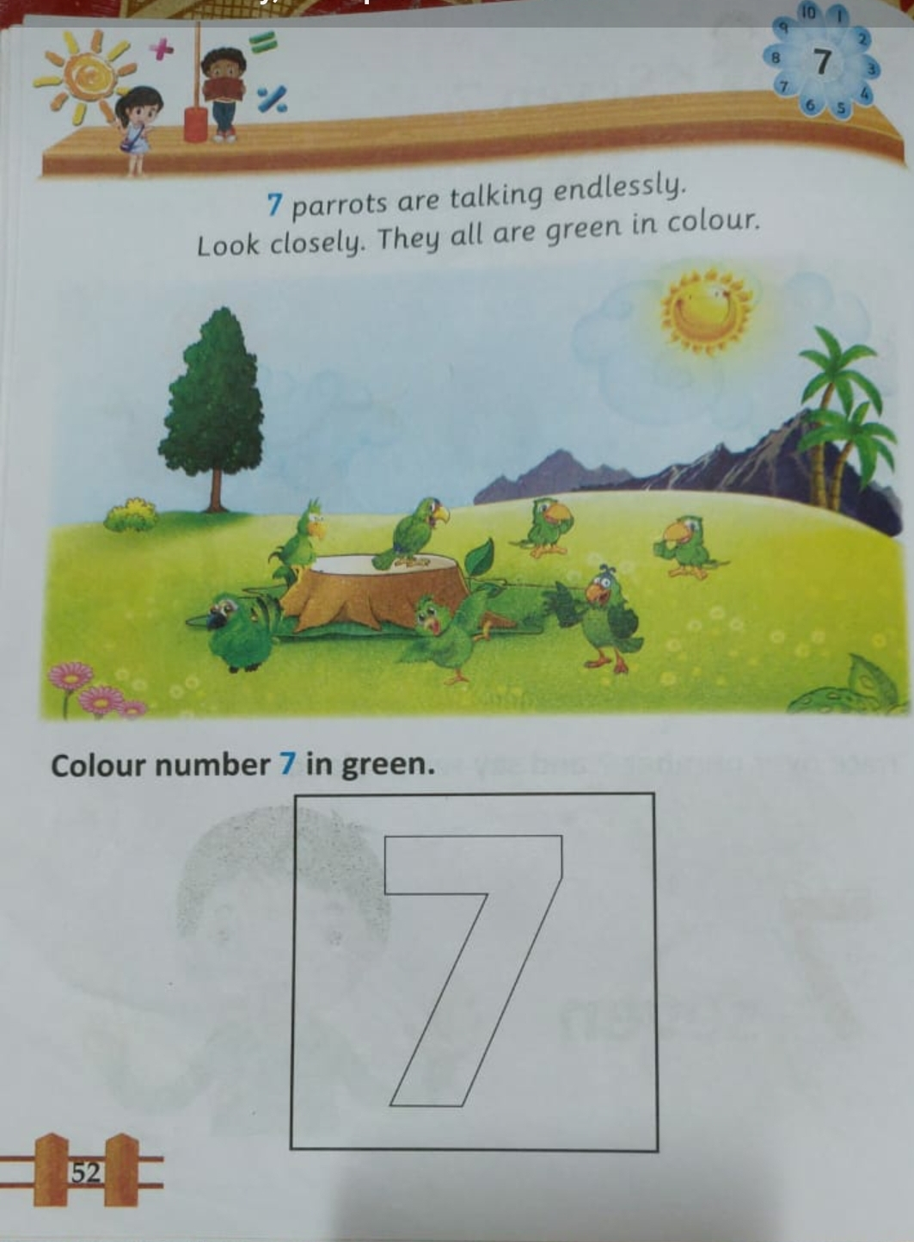
CW
06/09/21
Notes:
CW

Slide 11

1 .Practice counting 1-5
ASSIGNMENT
06/09//21
1.Practice counting 11 to15
2.Do bk pg no-52,53
Notes:
2.practice the activity done today

Slide 12
THANKING YOU
ODM EDUCATIONAL GROUP

