Slide 1



CLASS : NURSERY
DATE : 06.01.2022
SUBJECT :
MATHS
TOPIC :
NUMBER-17 IN NT BK

Slide 2





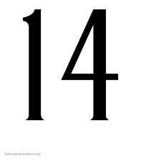
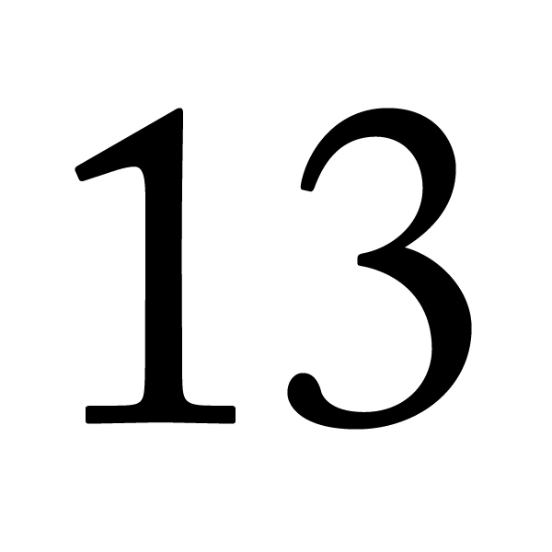

Identify the given number

Slide 3


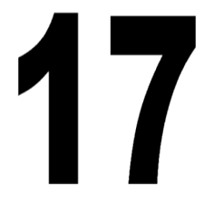
Introduction of number-17

Slide 4
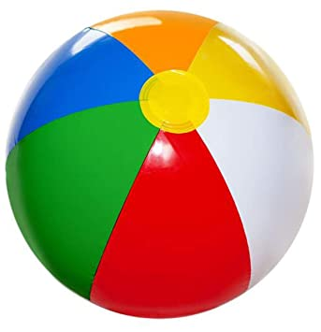
NUMBER-17

Slide 5

Song on numbers-1-20

Slide 6

HI children

Slide 7

IN BK PG NO-17
NUMBER-17 IN NT BK
Notes:
Note book work

Slide 8
NUMBER-17 (IN NTBK)
CW
06/01/22

Slide 9
Count say and write Number-17
CW
06/01/22

Slide 10

1 .Practice counting 1-5
ASSIGNMENT
06/01/22
1.Practice counting 11 to20
2.Complete the work given in nt bk
Notes:
2.Do bk pg no-63

Slide 11
THANKING YOU
ODM EDUCATIONAL GROUP

