Slide 1



CLASS : NURSERY
DATE : 05.08.2021
SUBJECT :
MATHS
CHAPTER NUMBER- BK PG NO -43
SUB-TOPIC :
NUMBER-5 IN NT BK
Notes:
comparisson

Slide 2





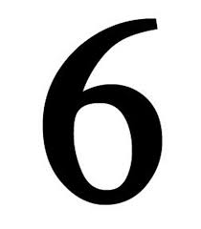

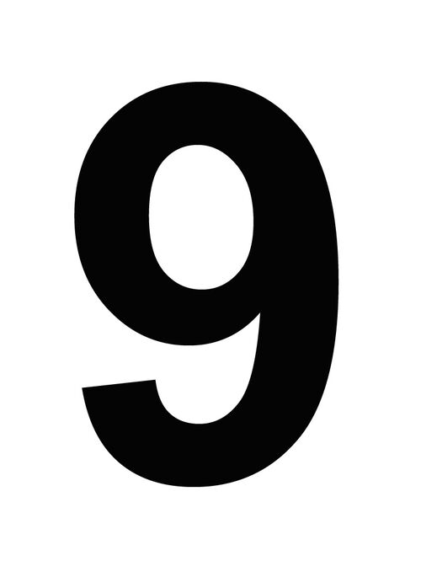
IDENTIFY THE GIVEN NUMBERS

Slide 4
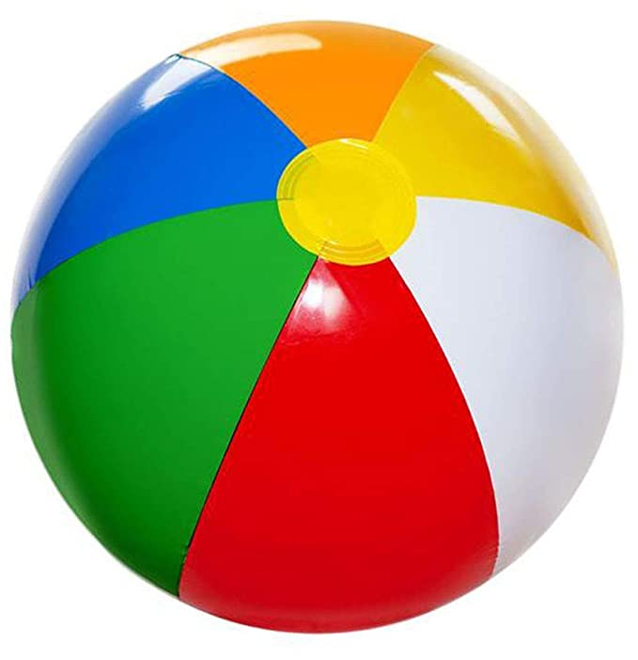

Identify and count the given pictures
2
/
3
Notes:
2

Slide 5

Count the object and tell the correct number
4
/
5
Notes:
5

Slide 6
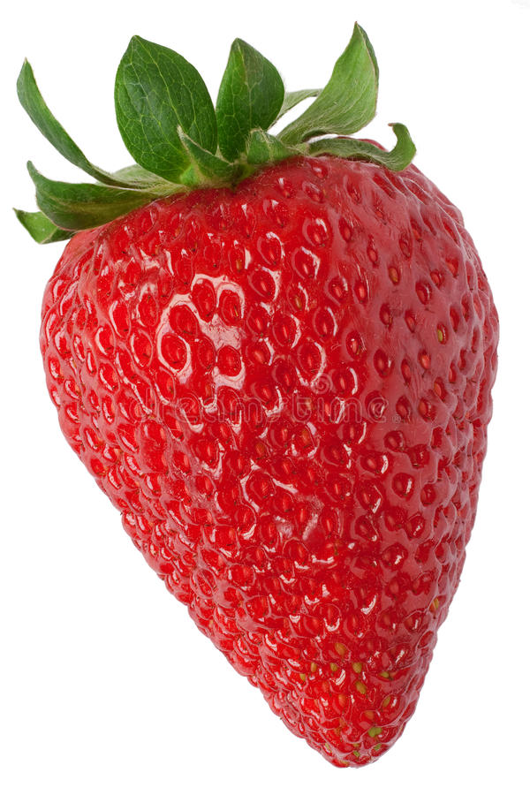
Identify and count the given pictures
2
/
5
Notes:
2

Slide 7


Recpitulation of number-5

Slide 8
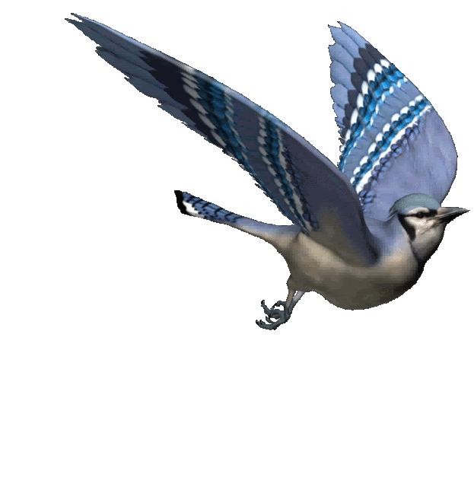

Slide 9
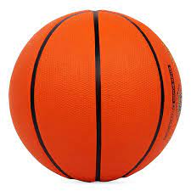
Number-5
CW
05/08/21
Notes:
04/08/21

Slide 10

TRCE AND WRITE NUMBER-5
CW
05/08/21

Slide 11

1 .Practice counting 1-5
05/08//21
ASSIGNMENT
1.Practice counting 1 to10
2.Complete the Work given in nt bk
Notes:
2.practice the activity done today

Slide 12
THANKING YOU
ODM EDUCATIONAL GROUP

