Slide 1



CLASS : NURSERY
DATE : 05.01.2022
SUBJECT :
MATHS
TOPIC :
NUMBER-17 ACTIVITY IN NT BK

Slide 2





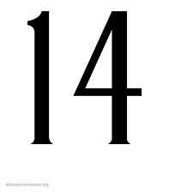


Identify the given number

Slide 3


Identification of number -16

Slide 4

Identify and count the objects
CW
05/01/22

Slide 5


Introduction of number-17

Slide 6
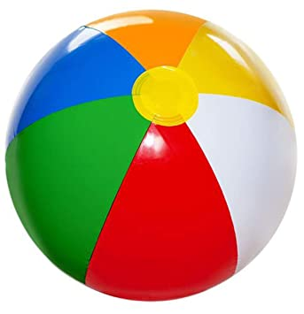
NUMBER-17

Slide 7

HI children

Slide 8

IN BK PG NO-17
NUMBER-17 IN NT BK
Notes:
Note book work

Slide 9
Circle and colour number 17
CW
05/01/22
17 10 10 17 16
13 17 15 16 17
17 12 17 14 12

Slide 10
Say and write the given number
HW
05/01/22
11 | 12 | 13 | 14 | 15
16 | 17

Slide 11

1 .Practice counting 1-5
ASSIGNMENT
05/01/22
1.Practice counting 11 to20
2.Complete the work given in nt bk
Notes:
2.Do bk pg no-63

Slide 12
THANKING YOU
ODM EDUCATIONAL GROUP

