Slide 1



CLASS : NURSERY
DATE : 04.01.2022
SUBJECT :
MATHS
TOPIC :
:NUMBER-16 IN NT BK

Slide 2
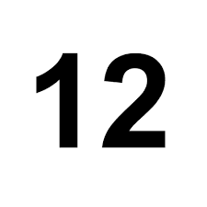





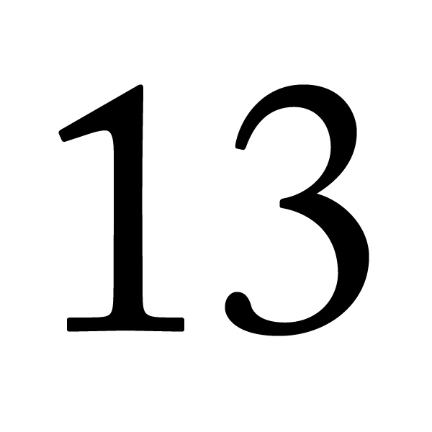
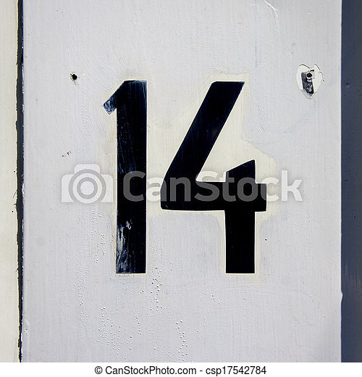
Identify the given number

Slide 3



Slide 4
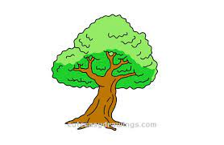
Identify and count the objects

Slide 5

HI children

Slide 6

NUMBER-16 IN NT BK
Notes:
Note book work

Slide 7
Number-16(In nt bk)
CW
04/01/22

Slide 8
Say and write
CW
04/01/22

Slide 9

1 .Practice counting 1-5
ASSIGNMENT
04/01/22
1.Practice counting 11 to20
2.Complete the work given in nt bk
Notes:
2.Do bk pg no-63

Slide 10
THANKING YOU
ODM EDUCATIONAL GROUP

