Slide 1



CLASS : NURSERY
DATE : 02.09.2021
SUBJECT :
MATHS
CHAPTER NUMBER-ACTIVITY
SUB-TOPIC :
ACTIVITY IN NOTE BK

Slide 2







IDENTIFY THE GIVEN NUMBERS

Slide 3
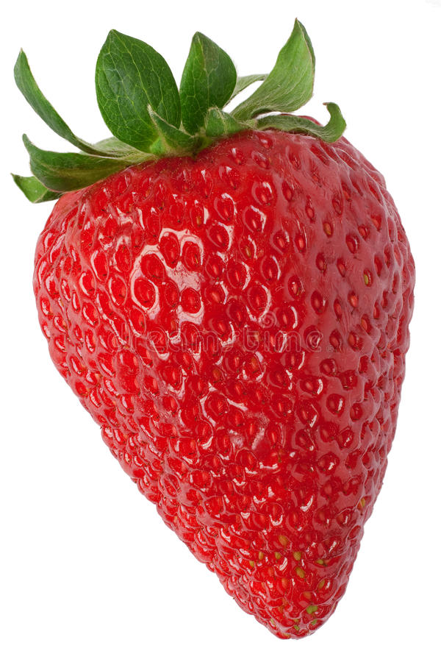
Identify and count the given pictures

Slide 4
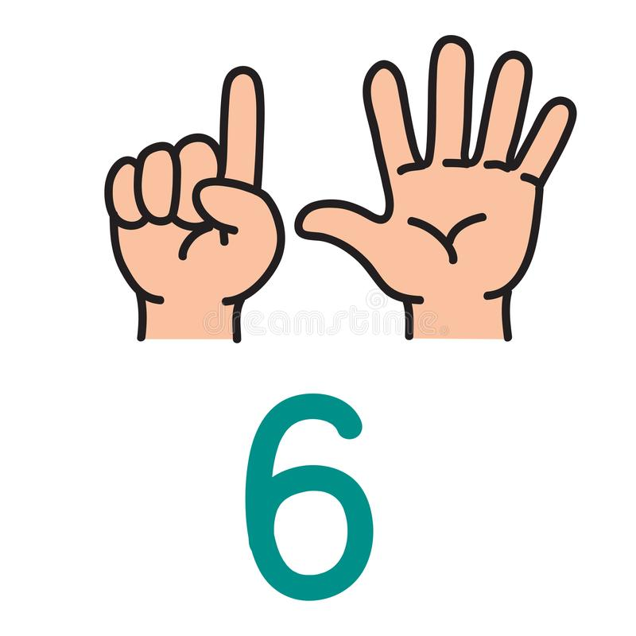

COUNTING IN FINGERS

Slide 5


Slide 6


Slide 7
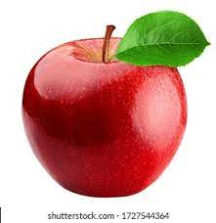
NUMBER-6
CW
02/09/21
Notes:
CW

Slide 8

TRACE AND WRITE
CW
02/09/21
Notes:
02/09/21

Slide 9
SAY AND WRITE
HW

Slide 10




ACTIVITY
HW
02/09/21
Color the picture as per the given number
3
4
2
1
Notes:
02/09/21

Slide 11

1 .Practice counting 1-5
ASSIGNMENT
02/09//21
1.Practice counting 1 to10
2.DO THE HW GIVEN IN NOTE BK.
Notes:
2.practice the activity done today

Slide 12
THANKING YOU
ODM EDUCATIONAL GROUP

