Slide 1



CLASS : NURSERY
DATE : 02.08.2021
SUBJECT :
MATHS
CHAPTER NUMBER- BK PG NO -42
SUB-TOPIC :
NUMBER-5
Notes:
comparisson

Slide 2


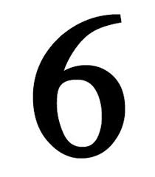




IDENTIFY THE GIVEN NUMBERS

Slide 3
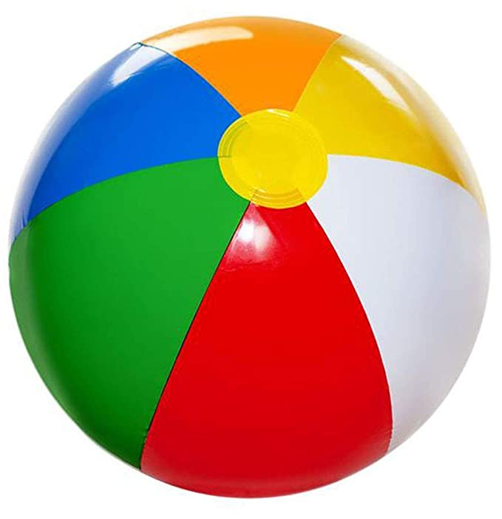

Identify and count the given pictures
3
/
4
Notes:
3

Slide 4

Count the object and tell the correct number
3
/
4
Notes:
/

Slide 5
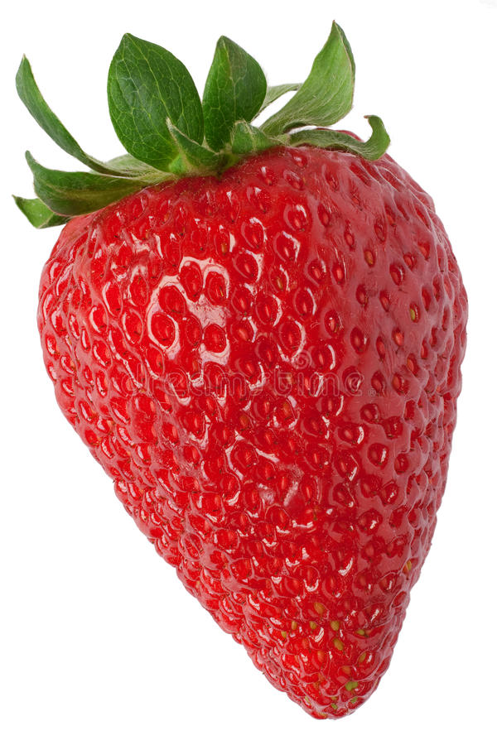
Identify and count the given pictures

Slide 6
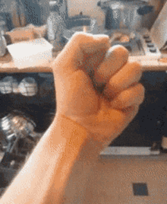

Identification of number-5

Slide 7

NUMBER-5

Slide 8
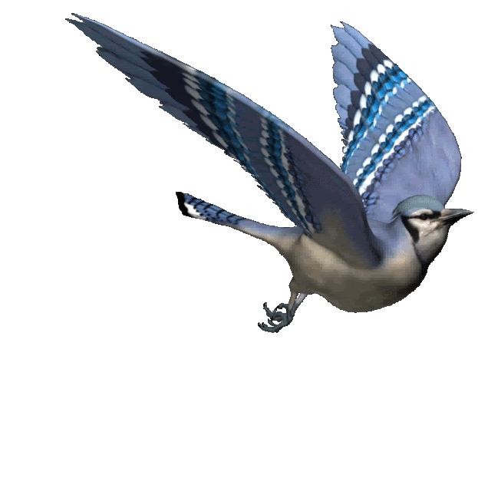

Slide 9
Circle and color number-5
CW
02/08/21
5
3
5
4
5
6
5
2
1
5
4
3
5
6
5
Notes:
02/08/21

Slide 10

1 .Practice counting 1-5
ASSIGNMENT
02/08//21
1.Practice counting 1 to10
2.Complete the work given in note bk
Notes:
2.practice the activity done today

Slide 11
THANKING YOU
ODM EDUCATIONAL GROUP

