Slide 1


CLASS : UKG
SUBJECT :MATHS
CHAPTER :21
TOPIC :MONEY
SUB TOPIC :NOTEBOOK WORK

Slide 2



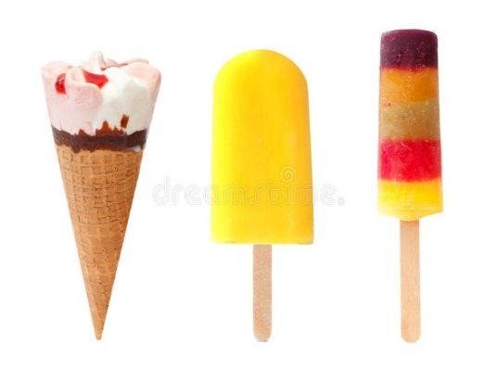
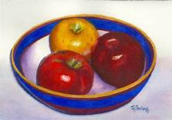

RECAP-
A paise or rupee are unit of measurement of money in India.
The symbol of rupee is -
We use money in term of coins and notes to purchase different things-

Slide 3
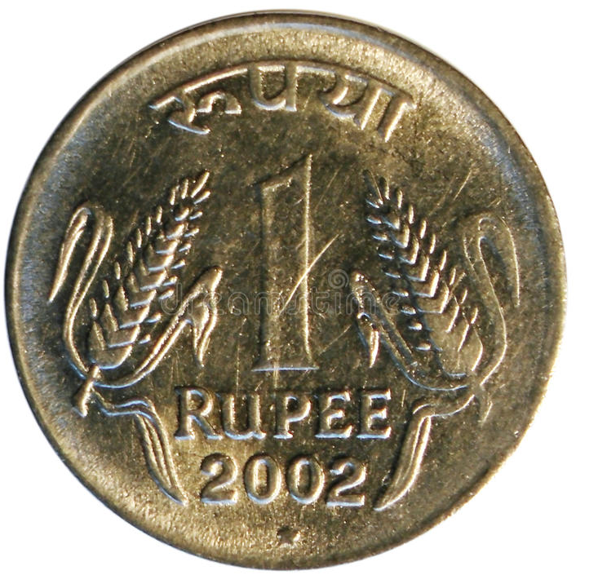
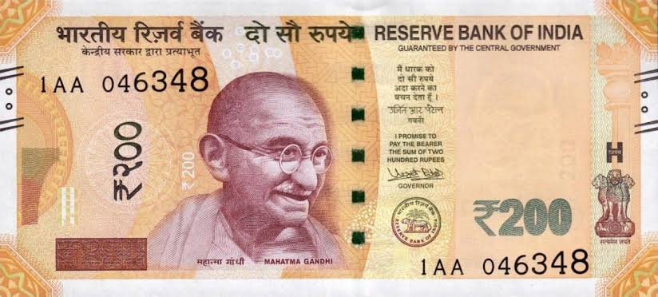
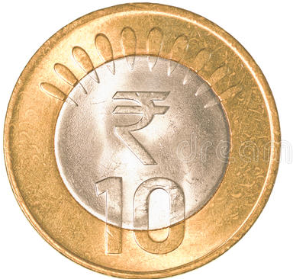
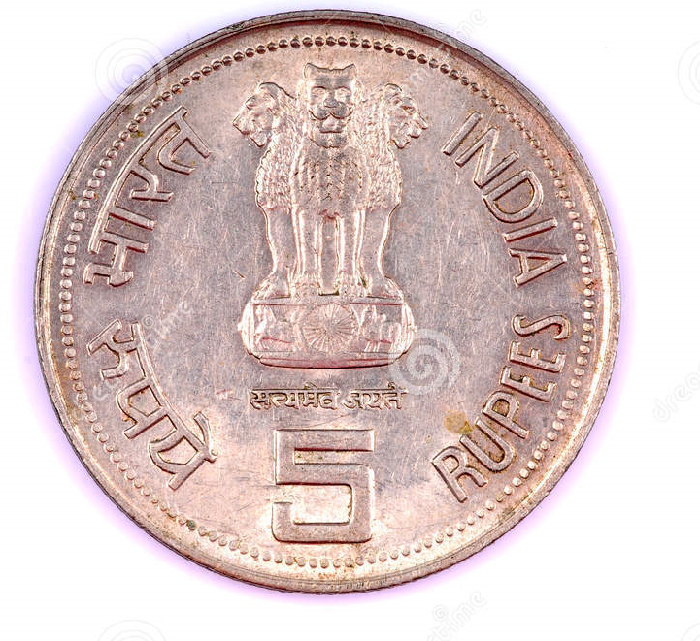
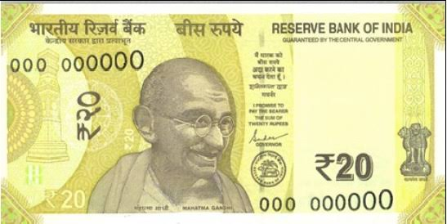
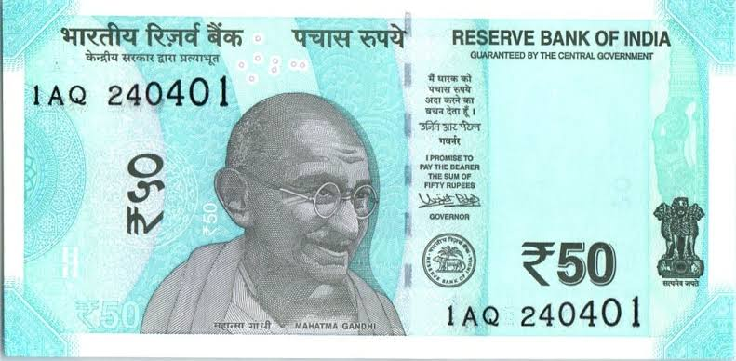
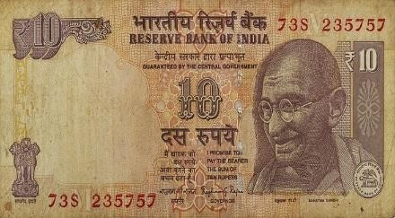
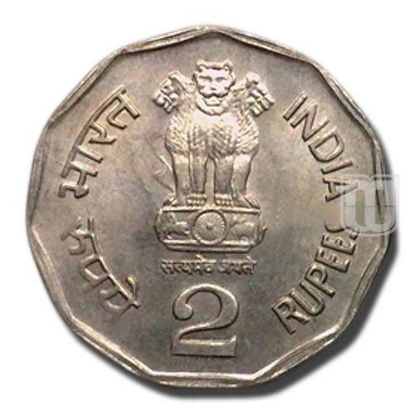
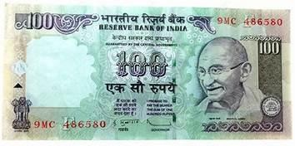
IDENTIFY THE COINS AND NOTES
1 RUPEE
200 RUPEES
10 RUPEES
5 RUPEES
20 RUPEES
50 RUPEES
10 RUPEES
2 RUPEES
100 RUPEES

Slide 4




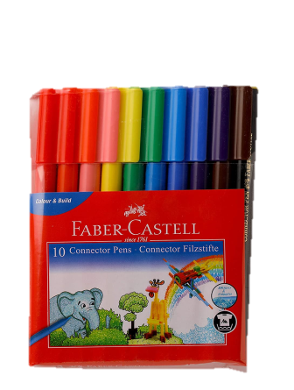


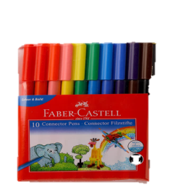
LOOK AT THE PICTURES AND SAY THE COST OF EACH OBJECT.
80
100
30
50
10
200
5
80
50
100
30
10
200
5

Slide 5



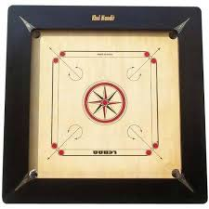

C.W
06/01/22
20
50
10
200
100
What is the cost of the given items ?

Slide 6
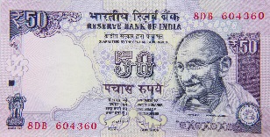


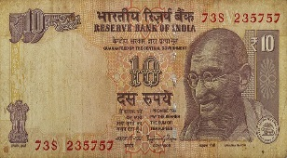

H.W
06/01/22
Match the price with the correct money.
20
a.
10
b.
100
c.
50
d.
200
e.

Slide 7
THANKING YOU
ODM EDUCATIONAL GROUP

