Slide 1


WELCOME TO ODM ONLINE CLASS
CLASS-UKG
SUBJECT-MATHEMATICS
T0PIC- EQUAL TO
(BK PG 60 TO 61)

Slide 2




SAY WHICH 2 FACES ARE SAME ?

Slide 3
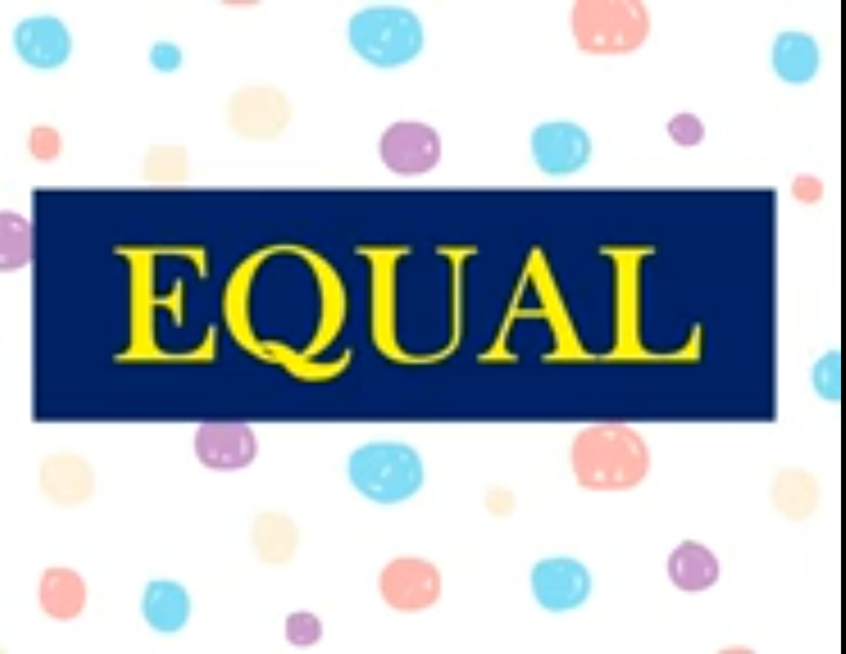
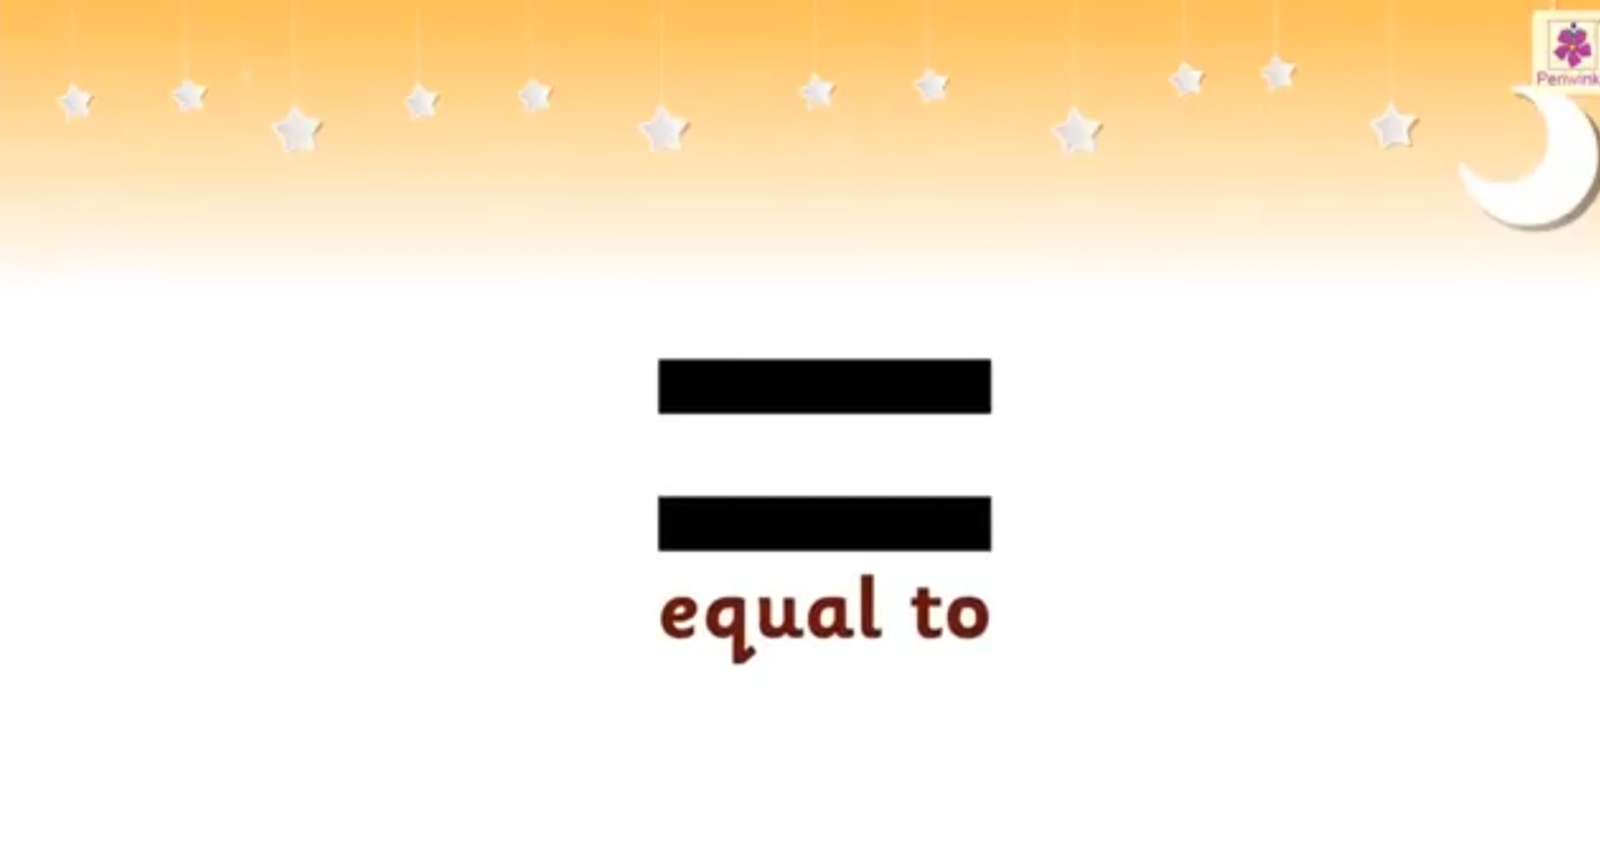
TODAY’S TOPIC
SIGN OF EQUAL TO

Slide 4
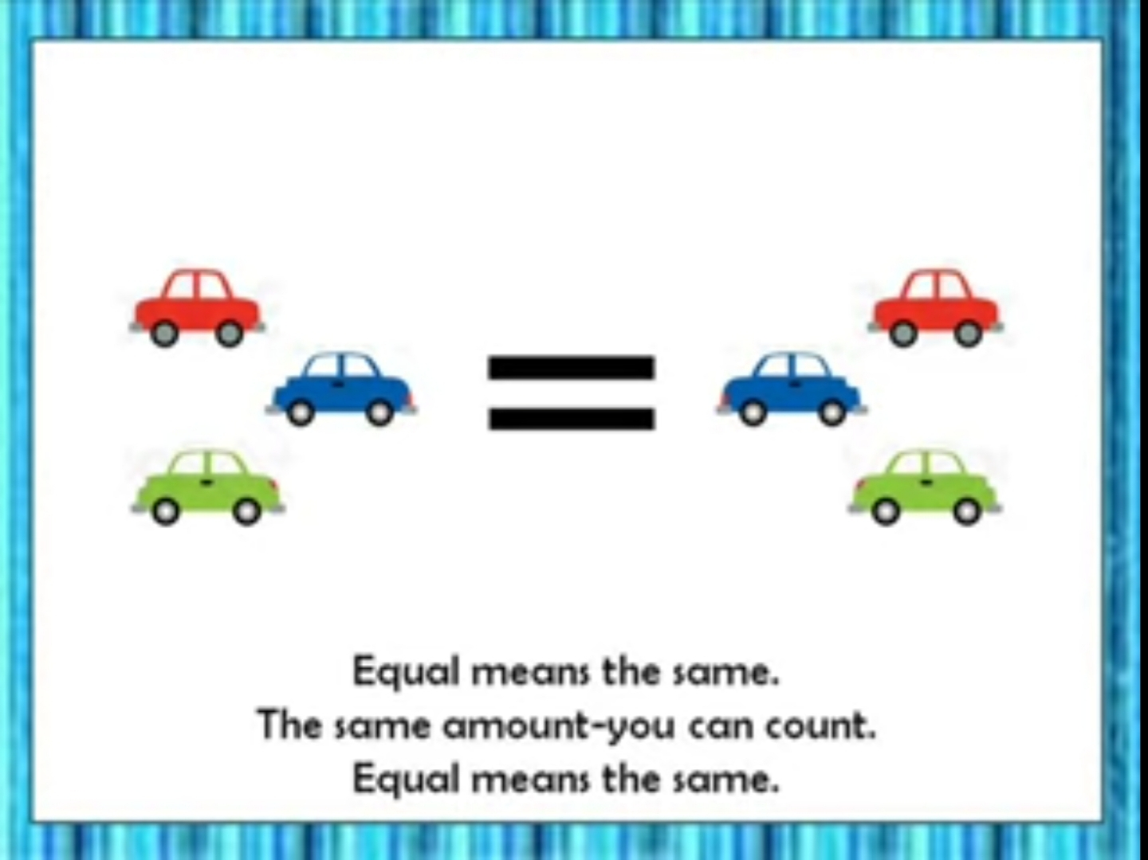
Equal means the same. When 2 groups have same number of things, the 2 groups are same.

Slide 5
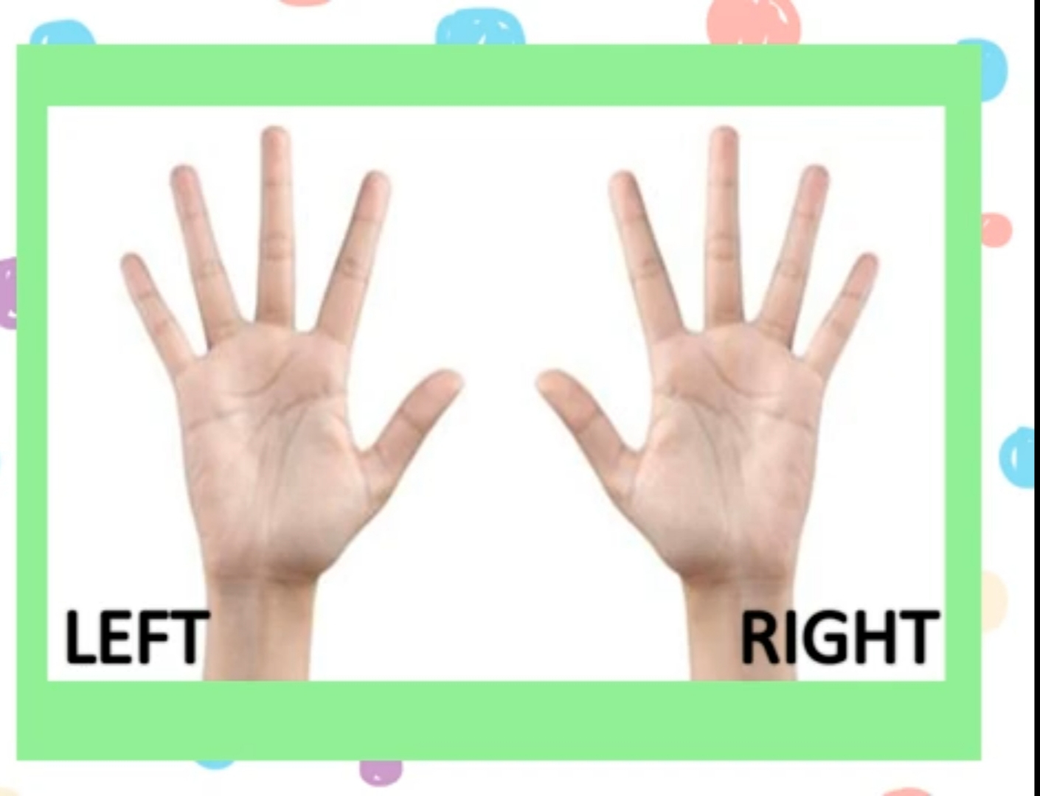
EQUAL TO

Slide 6
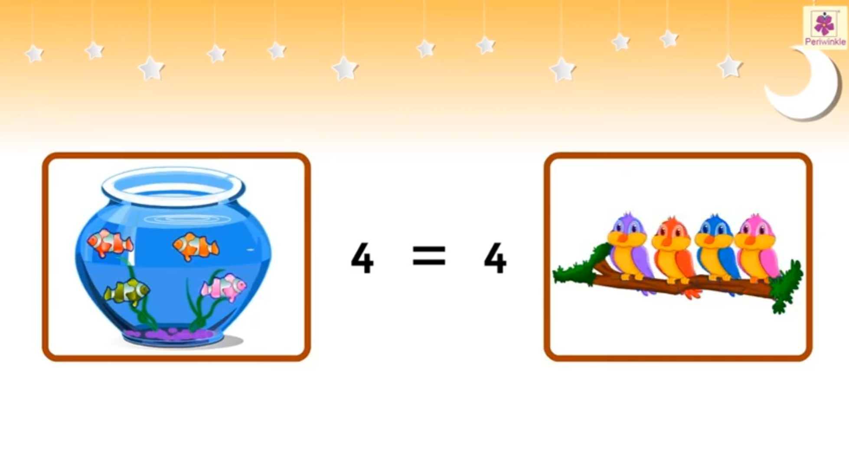
COUNT AND SAY EQUAL TO
4
=
4

Slide 7
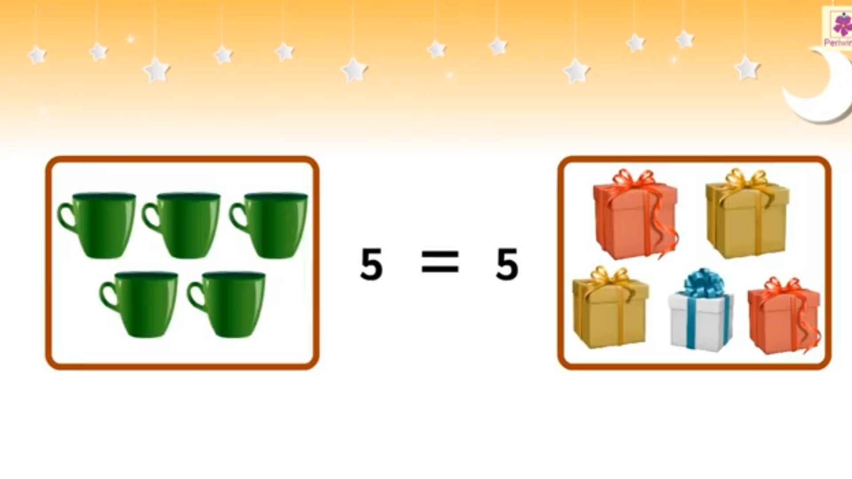
COUNT AND SAY EQUAL TO
5
=
5

Slide 8
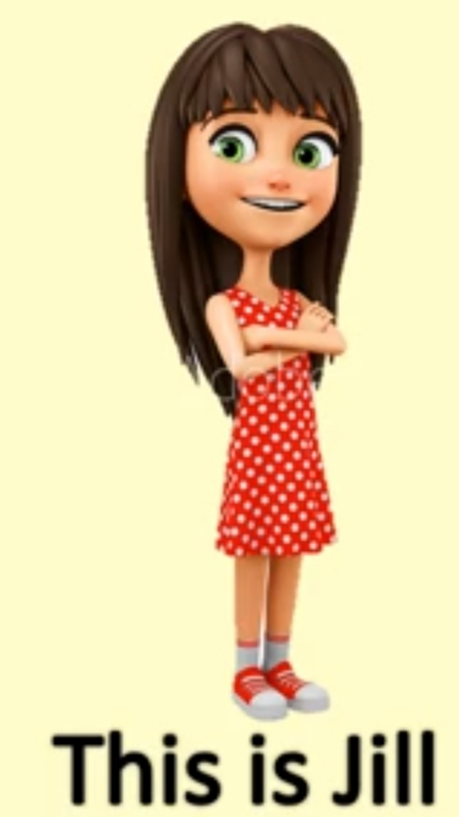
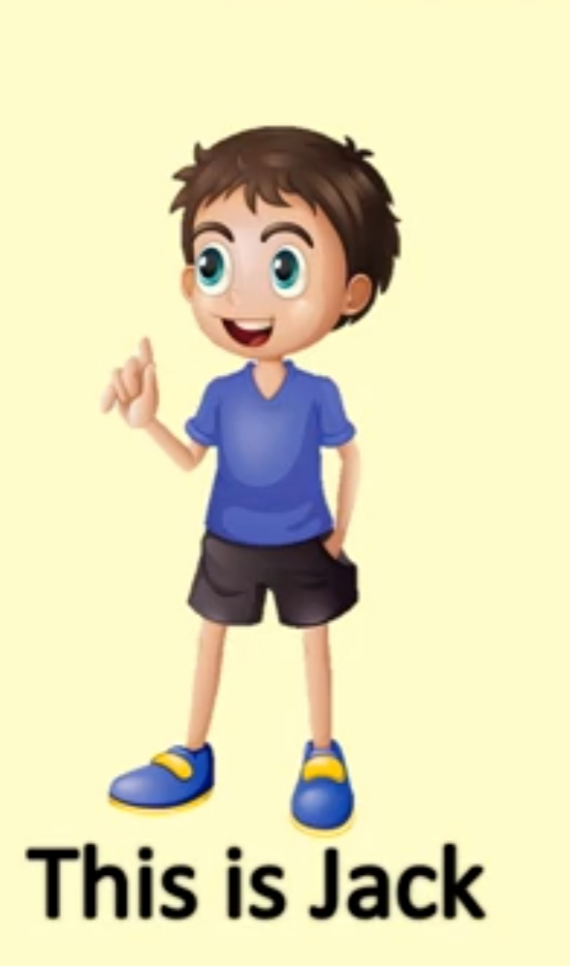


6
COUNT AND SAY EQUAL TO
=
6

Slide 9
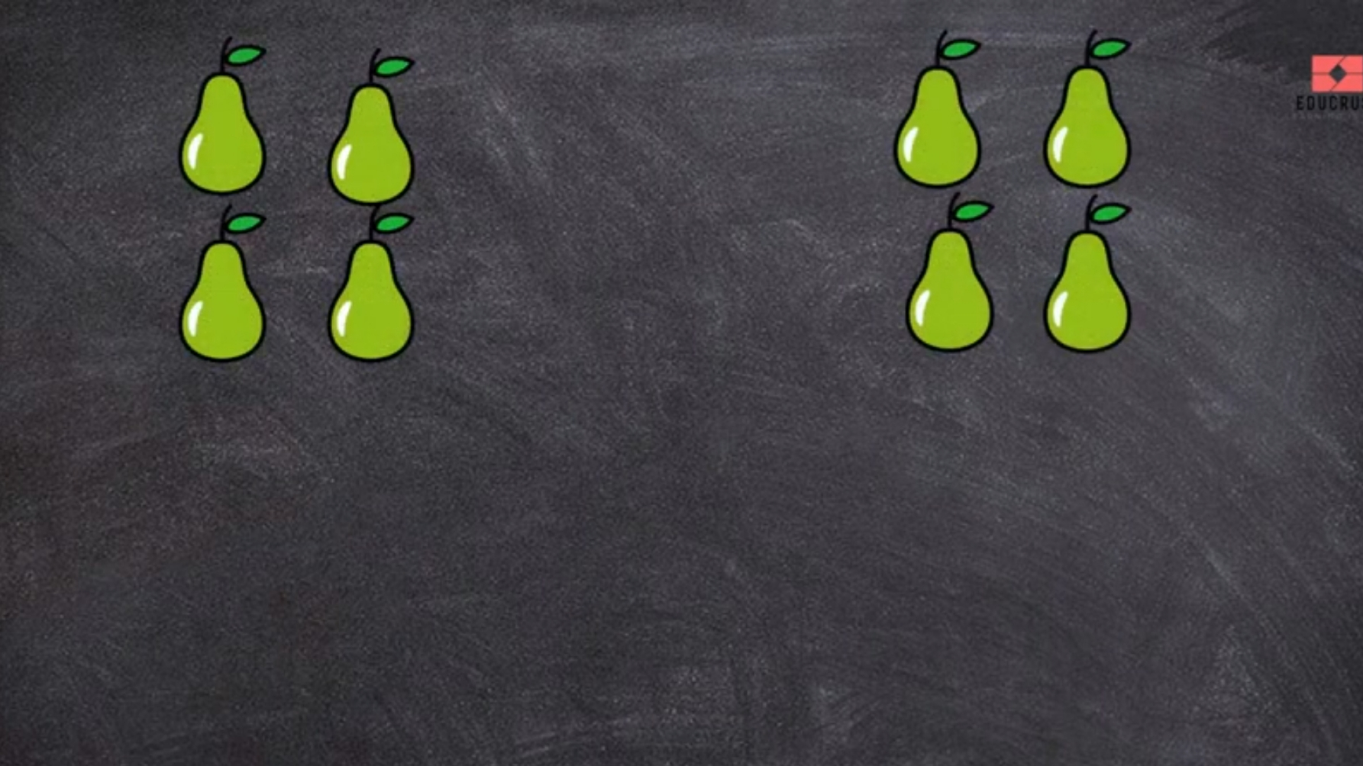
=
4
4

Slide 10
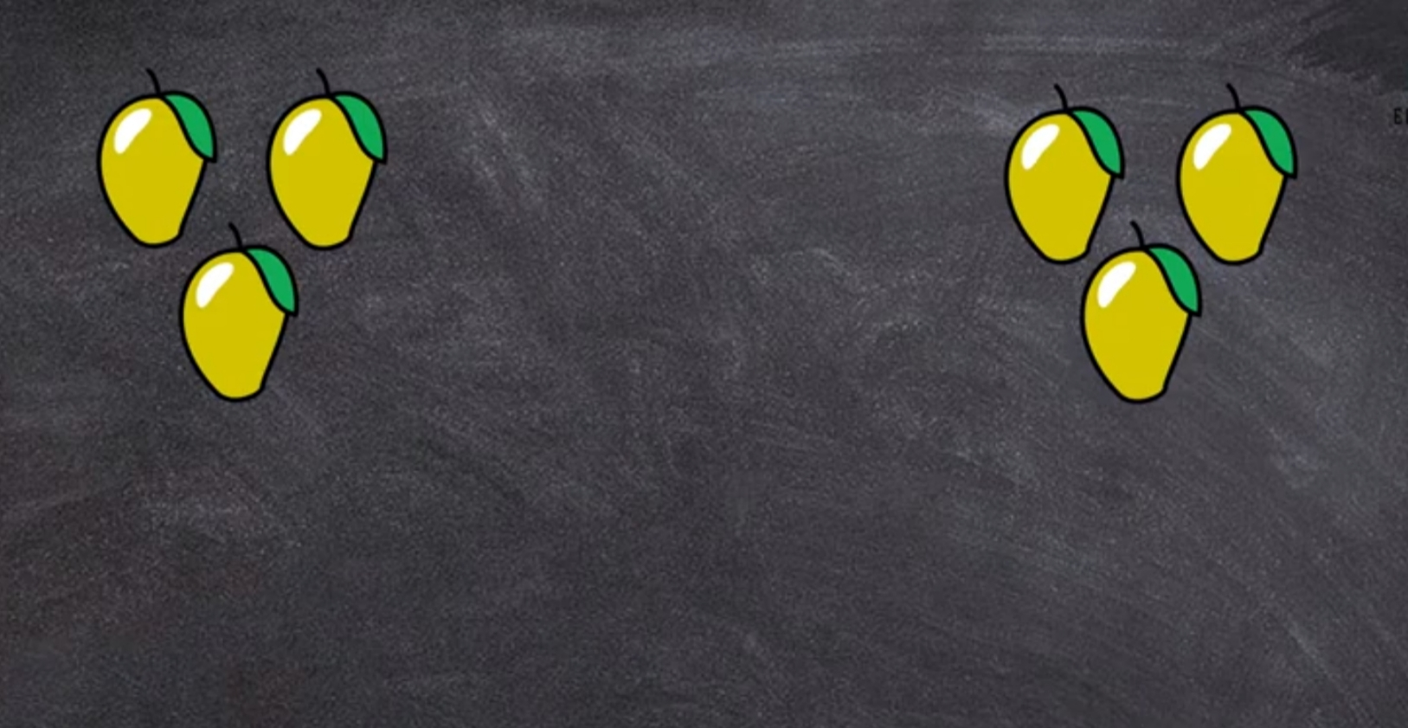
=
3
3

Slide 11
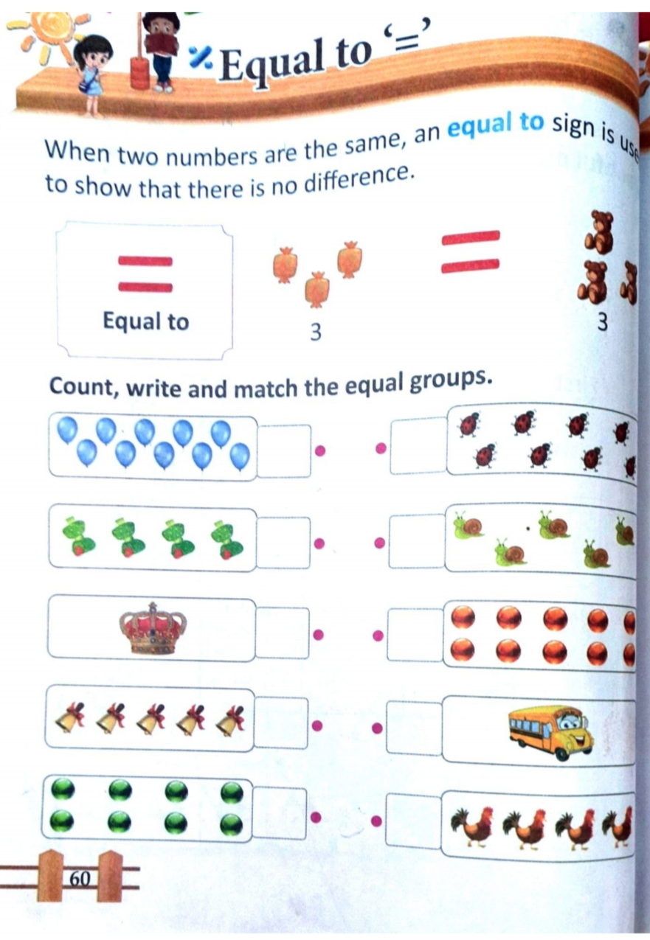
CW
10/8/21

Slide 12
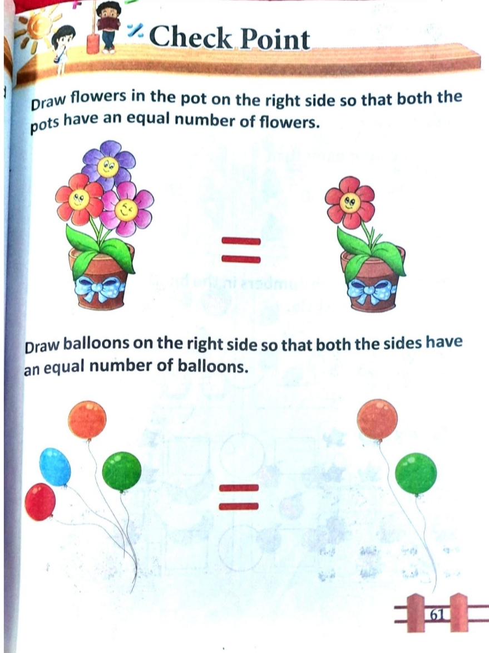
SYMBOL OF EQUAL TO
HW
10/8/21

Slide 13
THANKING YOU
ODM EDUCATIONAL GROUP

