Slide 1


CLASS : UKG
SUBJECT : MATHS
CHAPTER : 20
TOPIC : SUBTRACTION
SUB TOPIC: Bk pg (146 – 148)

Slide 2
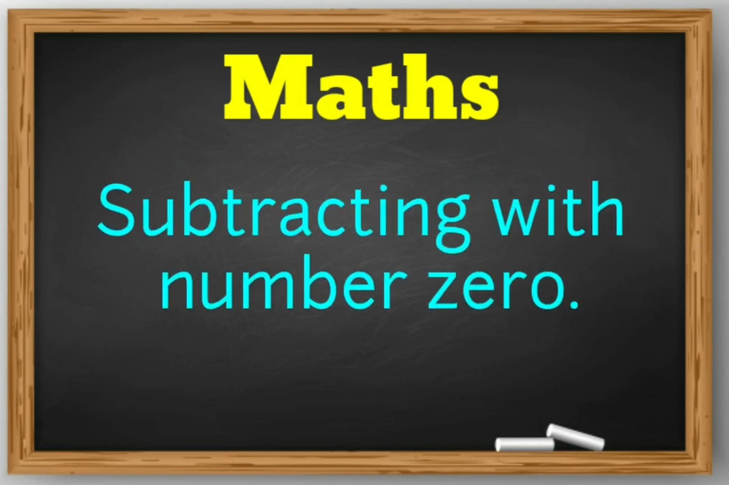
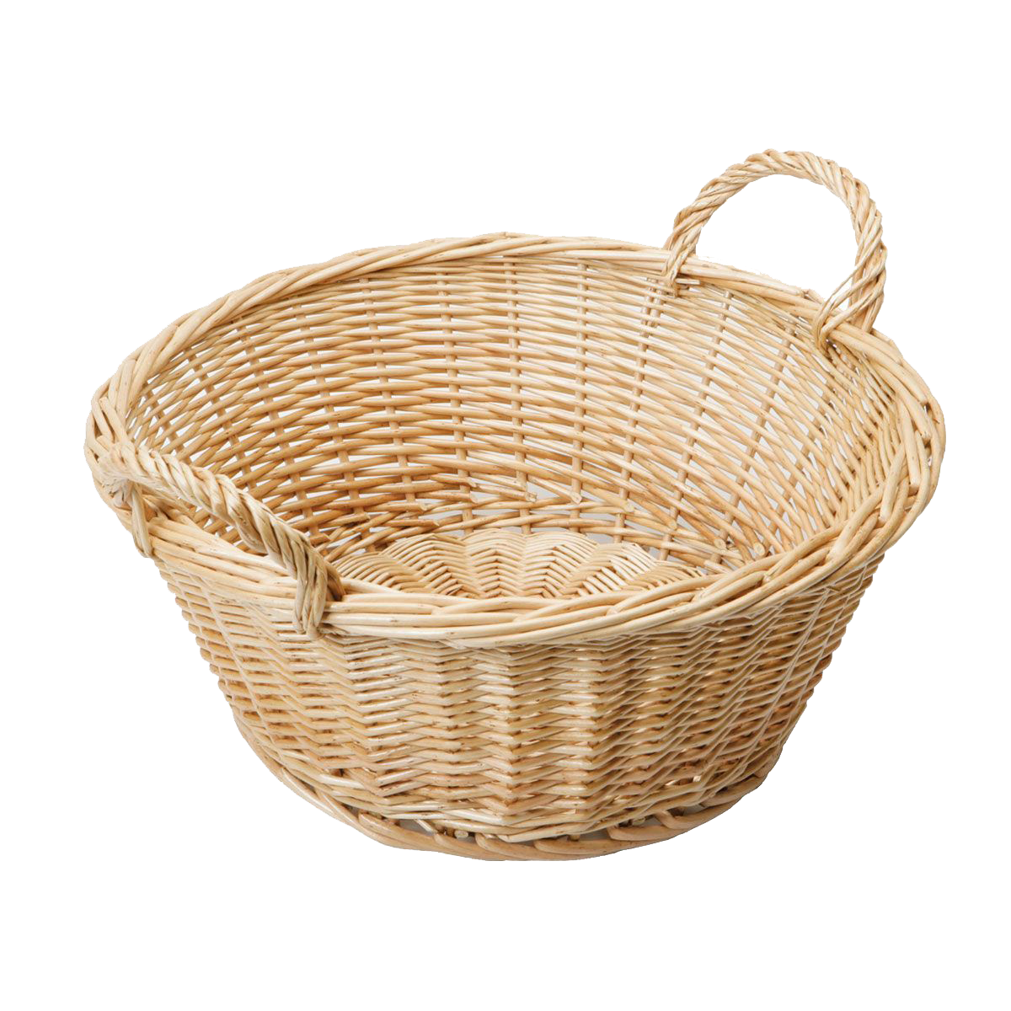

TODAY’S TOPIC
SUBTRACTING WITH NUMBER ZERO
ZERO NOTHING
OR
NO OBJECT
ZERO

Slide 3
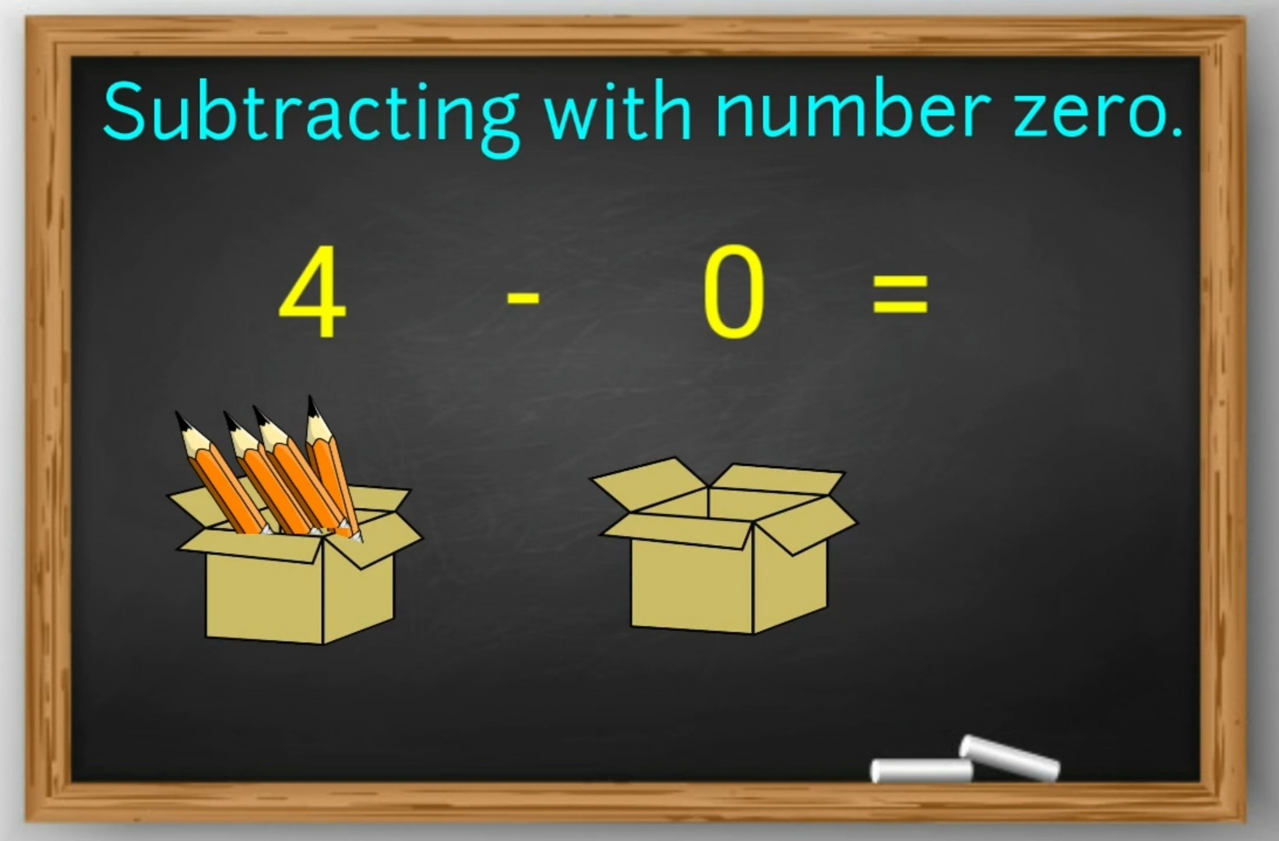

EXAMPLE-
4
-
0
=
4

Slide 4
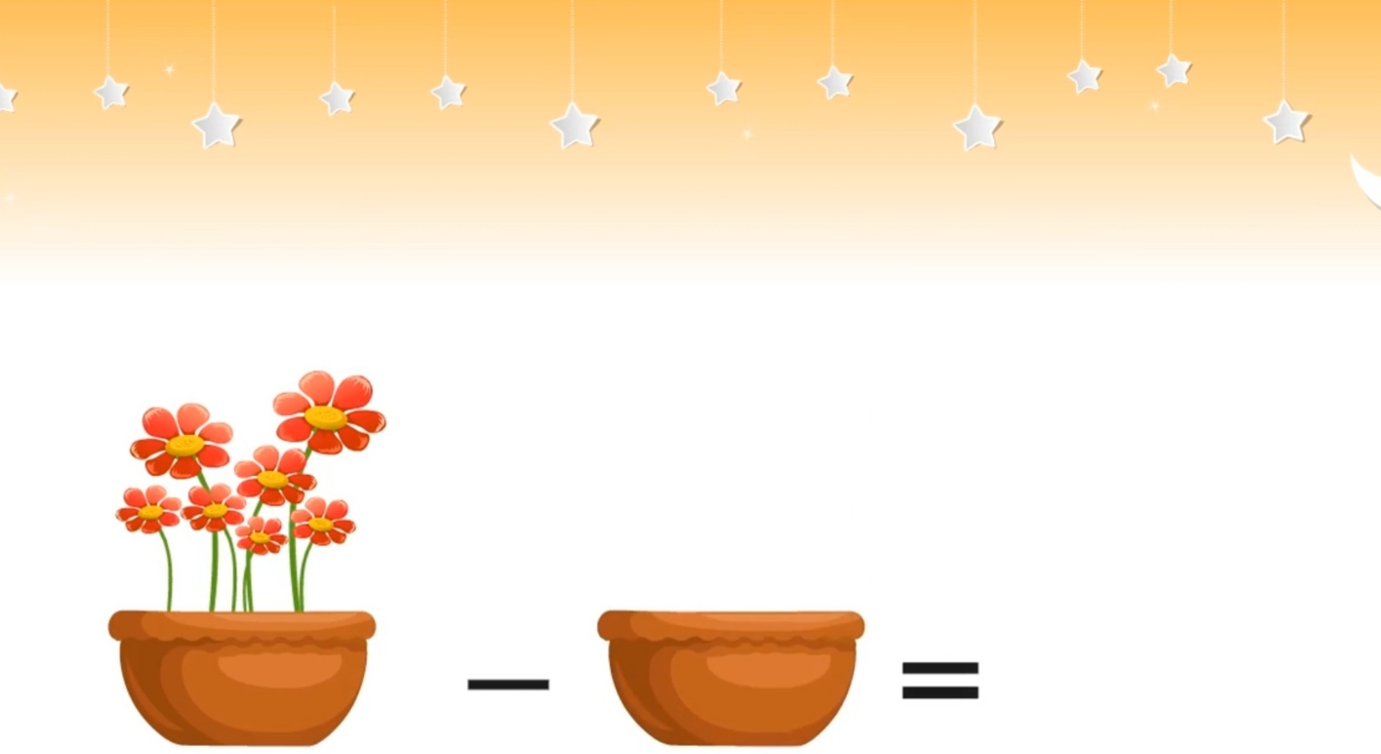

SUBTRACTING WITH NUMBER ZERO.
7 - 0 =
7

Slide 5
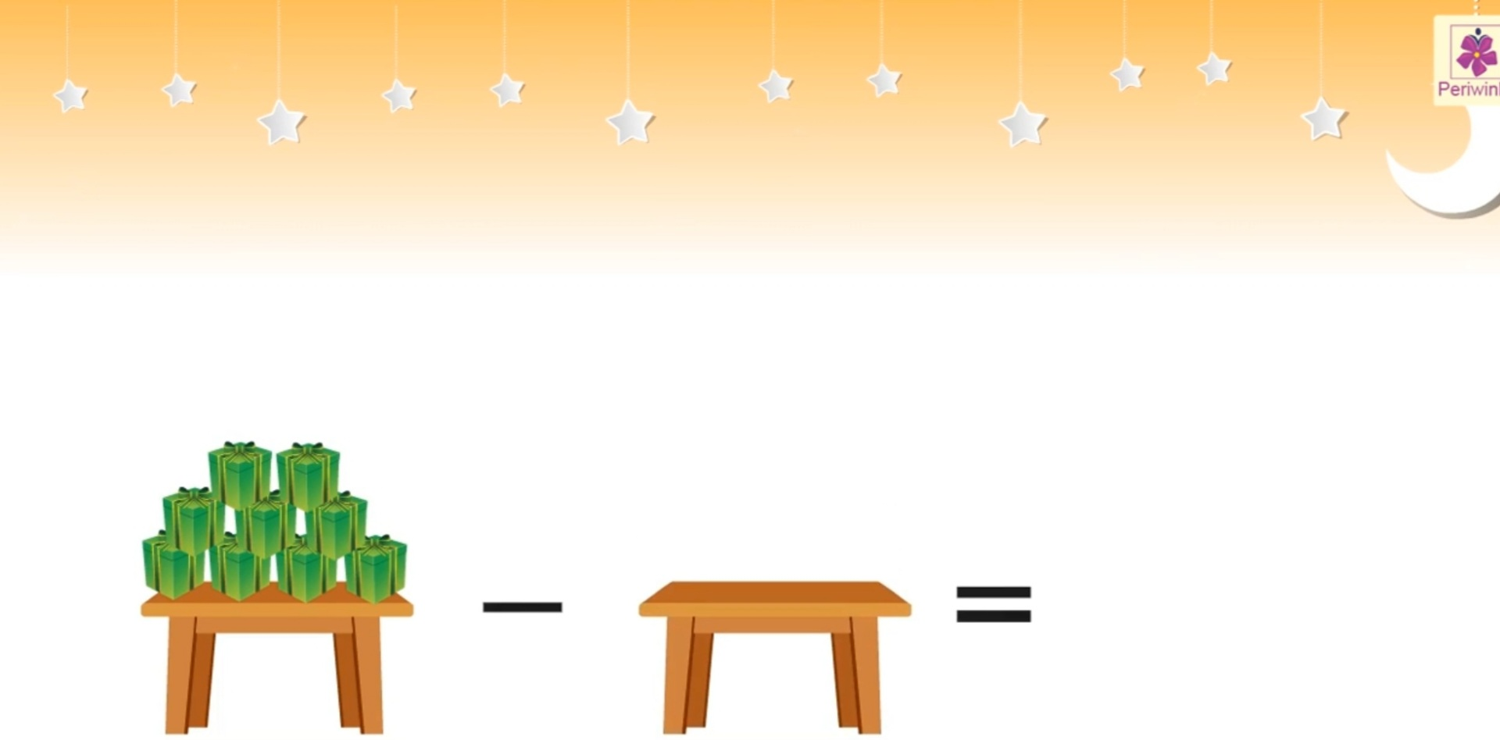
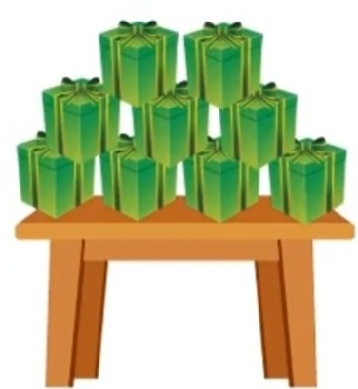
SUBTRACTING WITH NUMBER ZERO.
9
-
0
=
9

Slide 6
LET’S PRACTICE
7
34
7 - 0 =
34 - 0 =
18
16
18 - 0 =
16 - 0 =
50 - 0 =
12
50
12 - 0 =
19 - 0 =
19
10 - 0 =
10
6
6 - 0 =
9
9 - 0 =
When zero(0) is subtracted from a number the difference or answer is the number itself.

Slide 7


  COUNT, CROSS AND WRITE THE NUMBER
  WITH NUMBER NAME.
7 - 5 =
Two
2
6 - 1 =
5
Five

Slide 8
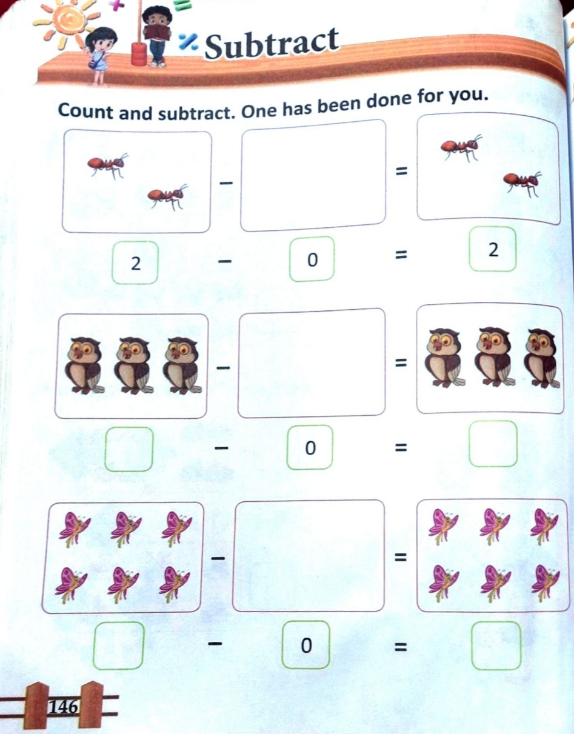
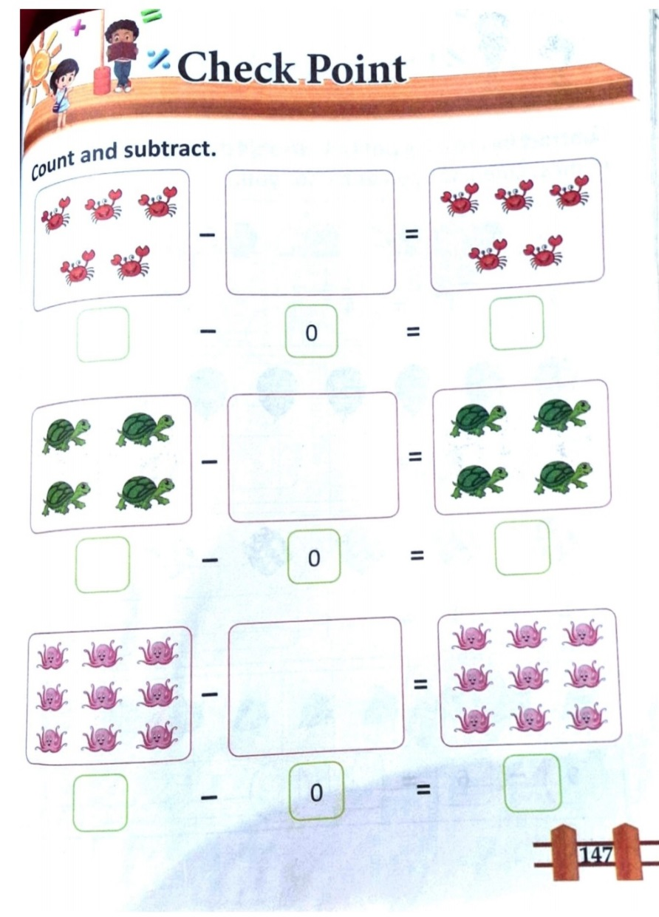
TODAY’S CLASSWORK
C.W
8.12.21

Slide 9
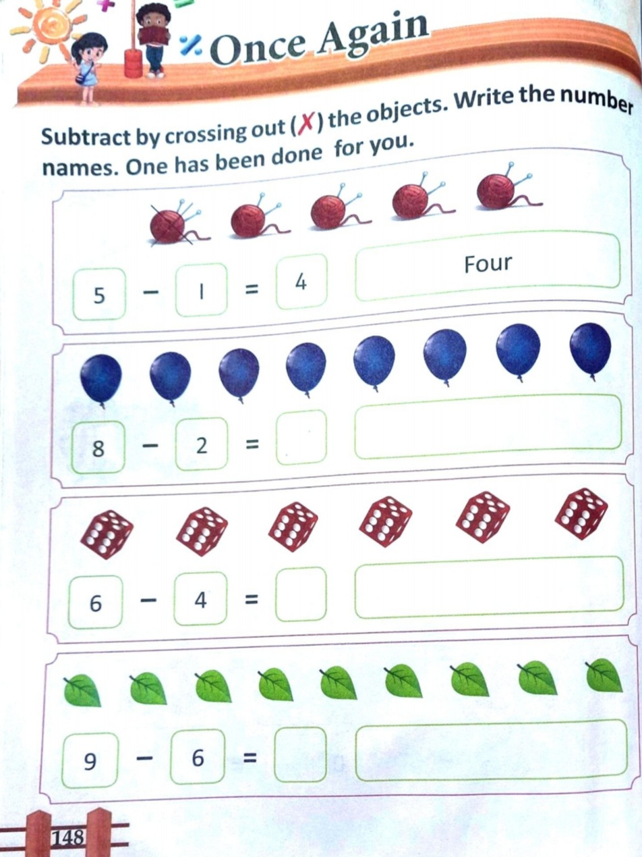
HOME ASSIGNMENT
H.W
8.12.21

Slide 10
THANKING YOU
ODM EDUCATIONAL GROUP

