Slide 1


CLASS : UKG
SUBJECT : MATHS
CHAPTER : 20
TOPIC : SUBTRACTION
SUB TOPIC: Bk pg (143 – 145)

Slide 2


LET’S HAVE A RECAP
What is subtraction?
Subtraction means TAKE AWAY a number of things from a group.
We use the symbol MINUS ( - ) for Subtraction.

Slide 3

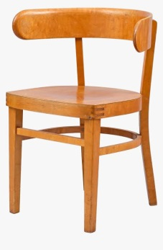

HOW MANY CHAIRS ARE UNOCCUPIED ?
3

Slide 4
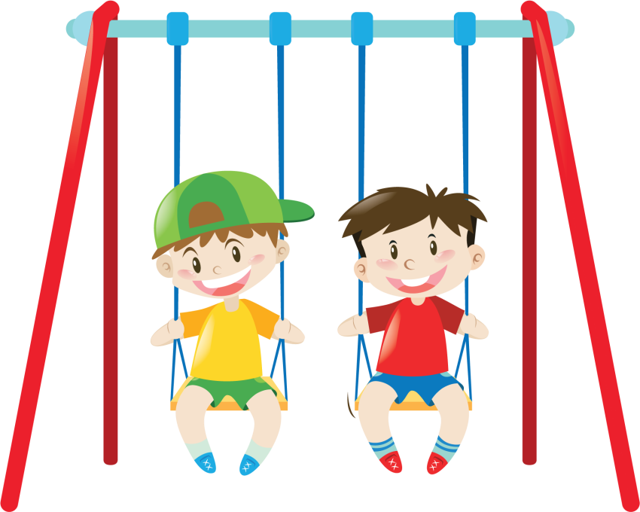
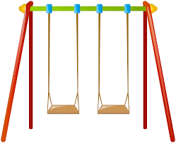

HOW MANY SWINGS ARE UNOCCUPIED ?
4

Slide 5


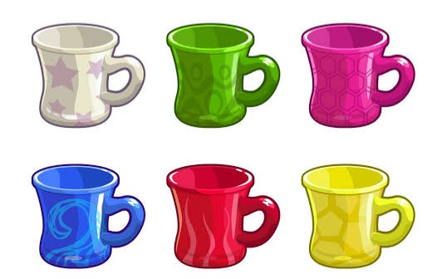


HOW MANY WILL YOU DRAW TO SUBTRACT ?
-
=
-
=

Slide 6






MATCH WITH THE SUBTRACTION SUM AND WRITE THE ANWER.
2
4
3
8 - 4
4 - 2
6 - 3

Slide 7
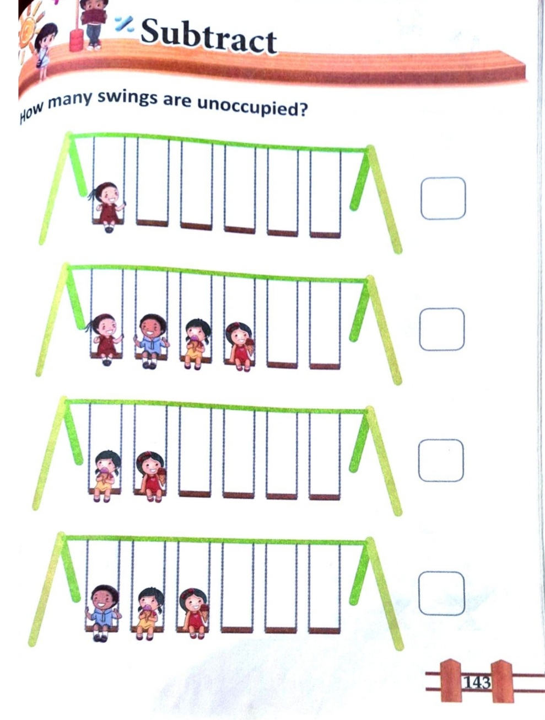
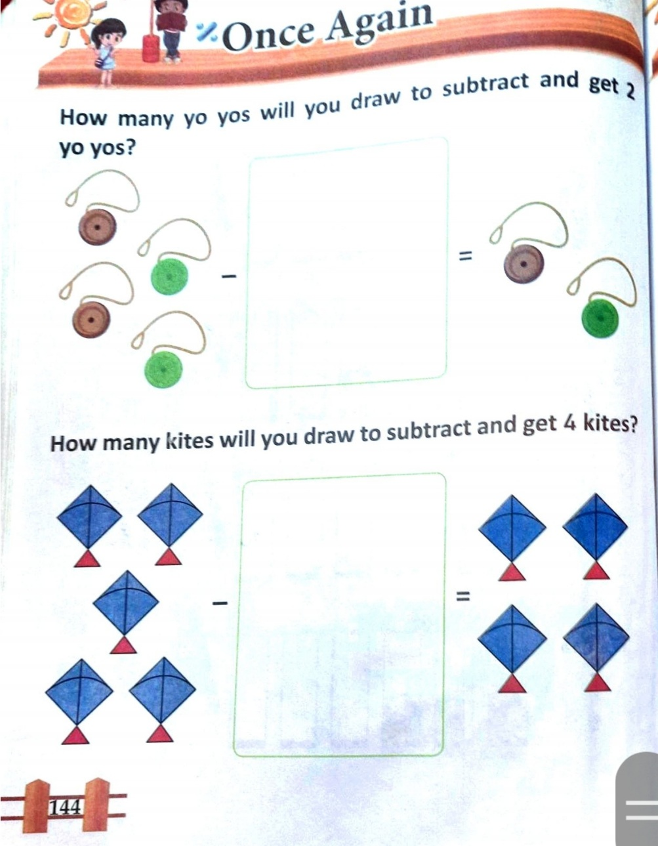
TODAY’S CLASSWORK
C.W
7.12.21

Slide 8
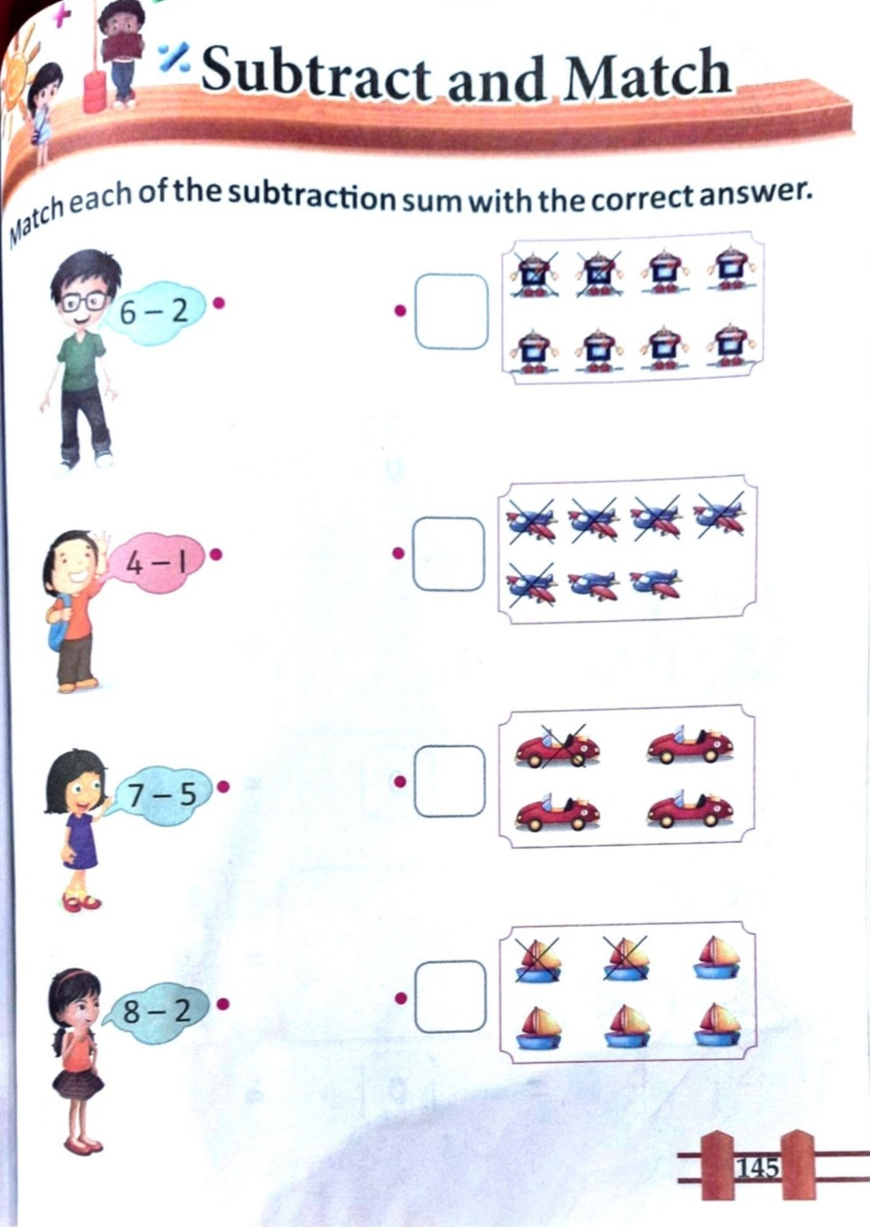
HOME ASSIGNMENT
H.W
7.12.21

Slide 9
THANKING YOU
ODM EDUCATIONAL GROUP

