Slide 1

WELCOME TO ONLINE CLASS
CLASS - UKG
SUBJECT – MATHS
REVISION- MORE OR LESS,
LEFT, RIGHT & MIDDLE,
ZERO

Slide 2



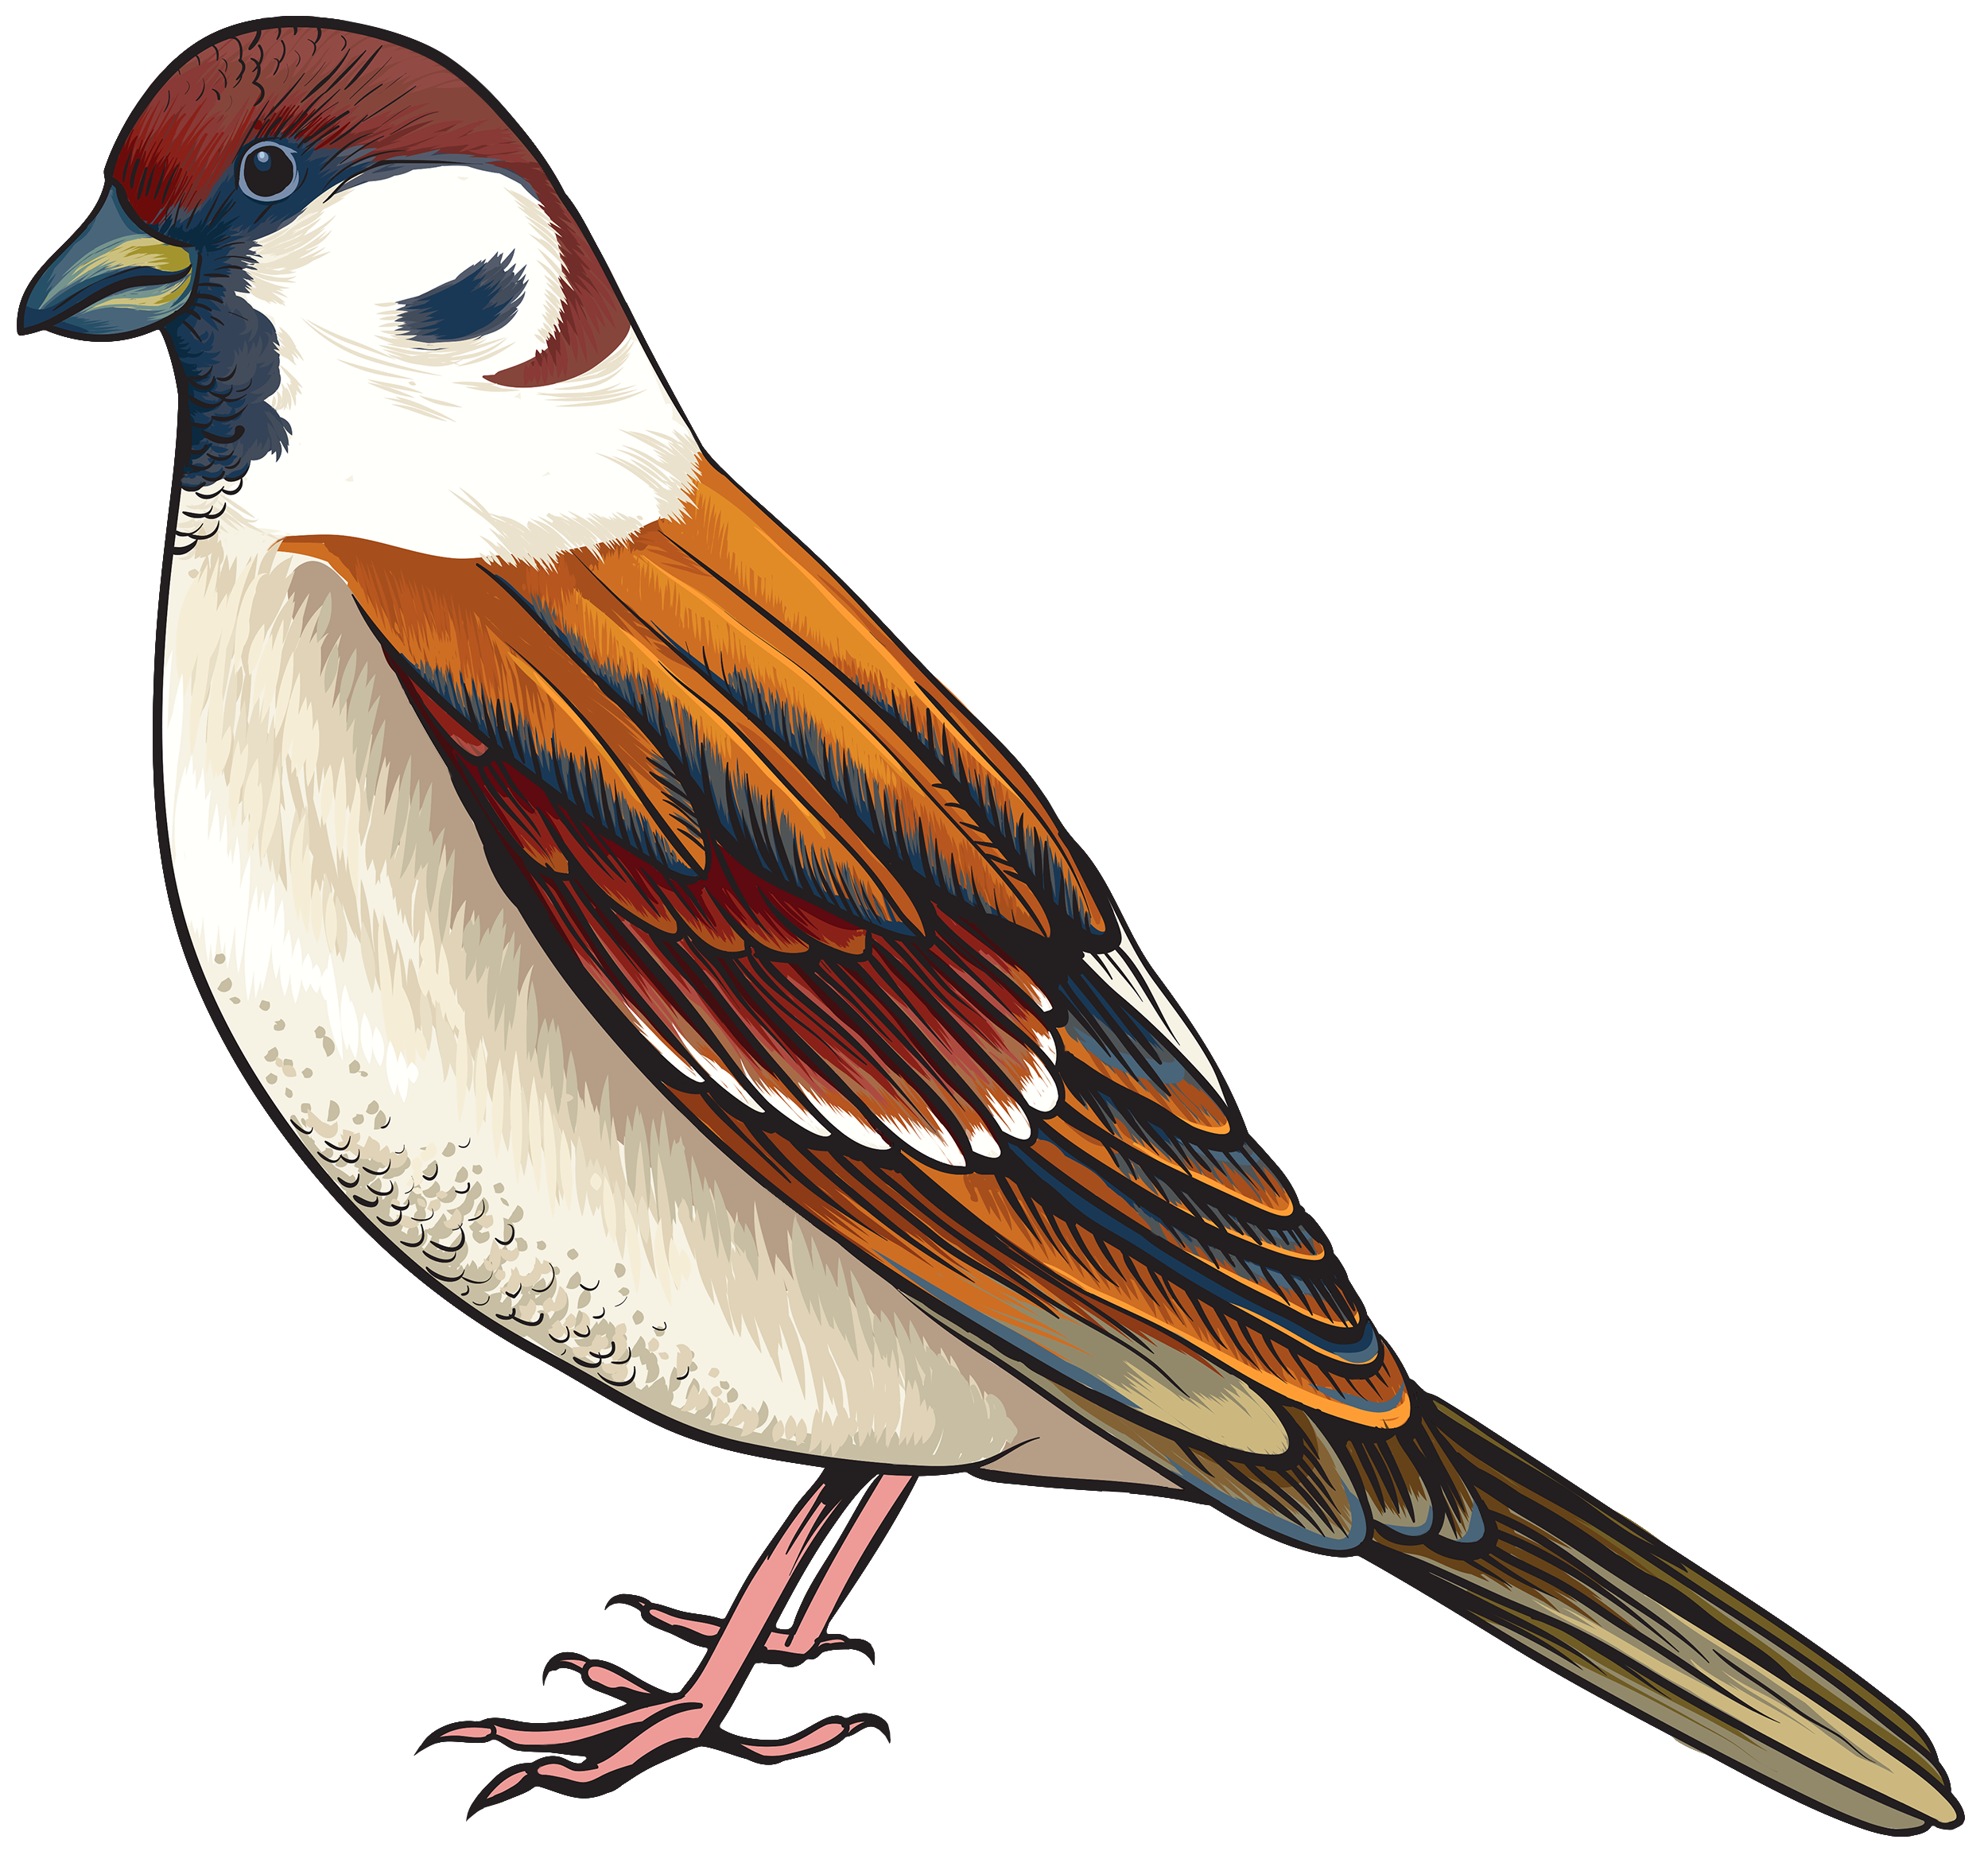





REVISION-
Count the birds and say which colour birds are more in number.
yellow brown

Slide 3
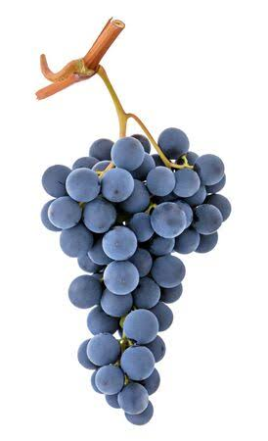
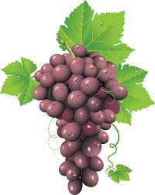
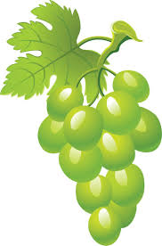
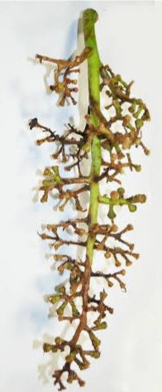
Observe the grape bunches and say which number grape bunch is having zero grapes.
1
2
3
4

Slide 4
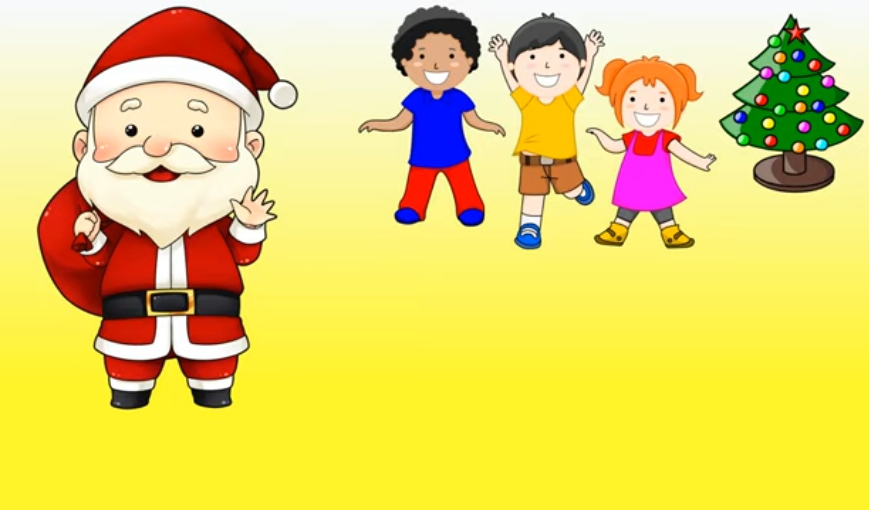



Observe the picture and say how many gifts are left
with santa.
0

Slide 5
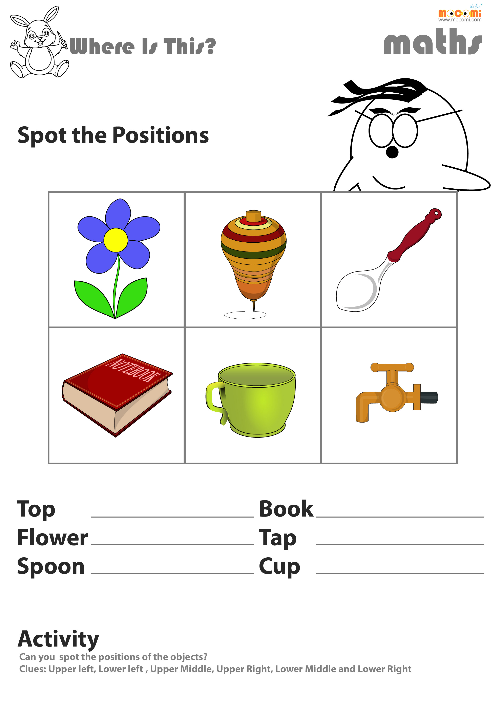

Observe the following pictures and say R for right, L for left & M for middle.
M
L
R
L
R
M

Slide 6


Count and colour the set yellow having more objects and red for the set having less objects.
CW
22/9/21

Slide 7
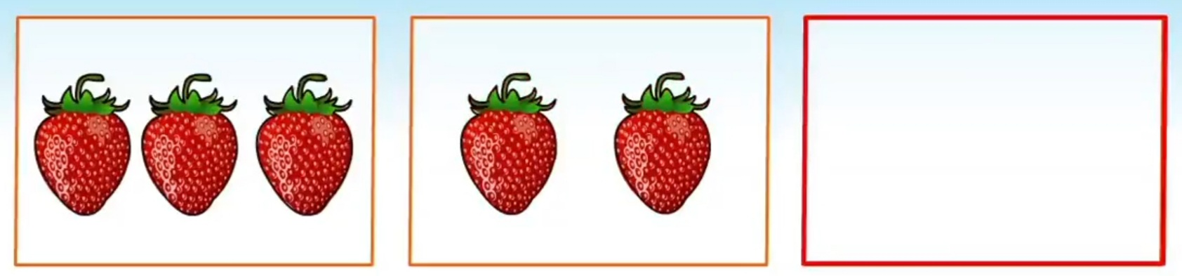
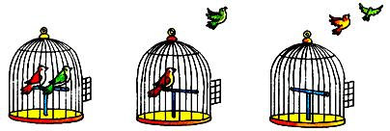
HW-22/9/21
Cross out the set having zero objects.
Draw a bird on the left side and a flower on the right side of the cage.

Slide 8

THANKING YOU
ODM EDUCATIONAL GROUP

