Slide 1


CLASS : UKG
SUBJECT :MATHS
CHAPTER : 19
CHAPTER NAME- ADDITION
TOPIC : COUNT,ADD AND WRITE (NOTEBOOK WORK)

Slide 2
TODAY’S TOPIC - ADDITION
ADDITION MEANS JOIN TOGETHER OR PUTTING TOGETHER

Slide 3
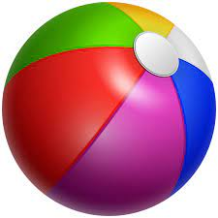
RECAP
Count, add and write:
+
=
10 + 1 = 11
+
=
10 + 3 = 13
+
=
10 + 8 = 18

Slide 4


Count, add and write:
+
=
10 + 2 = 12
+
=
10 + 3 = 13
+
=
10 + 6 = 16

Slide 5









Count, add and write:
+
=
10 + 4 = 14
+
=
10 + 5 = 15
+
=
10 + 7 = 17

Slide 6
CW
22.11.21
Count, add and write:
1.
+
=
2.
+
=
3.
=
+

Slide 7
HW
22.11.21
FILL IN THE BLANKS :
1 0 + 2 = ________
1 0 + 10 = ________
1 0 + 5 = ________
1 0 + 7 =_________
1 0 + 3 = ________
1 0 + 4 = ________
1 0 + 6 = ________
1 0 + 8 = _________
1 0 + 9 = ________
1 0 + 1 = _______

Slide 8
THANKING YOU
ODM EDUCATIONAL GROUP

