Slide 1


CLASS : UKG
SUBJECT :MATHS
CHAPTER : 19
CHAPTER NAME- ADDITION
TOPIC : COUNT,ADD AND WRITE (BOOK PAGE-124 TO 127)

Slide 2
TODAY’S TOPIC - ADDITION
ADDITION MEANS JOIN TOGETHER OR PUTTING TOGETHER

Slide 3

ADDITION
HORIZONTAL
VERTICAL
Now we will learn an another way of addition , called addition table.

Slide 4


9 and 1 IS EQUAL TO 10
9 + 1 = 10
+
=
11
+
=
13
+
=
15
+
=
17

Slide 5
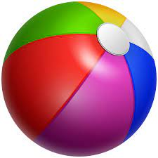
Activity:
Count, add and write:
+
=
10
+
1
=
11
+
=
10
+
=
2
12

Slide 6




+
=
10
+
7
=
17
+
=
10
+
10
=
20

Slide 7
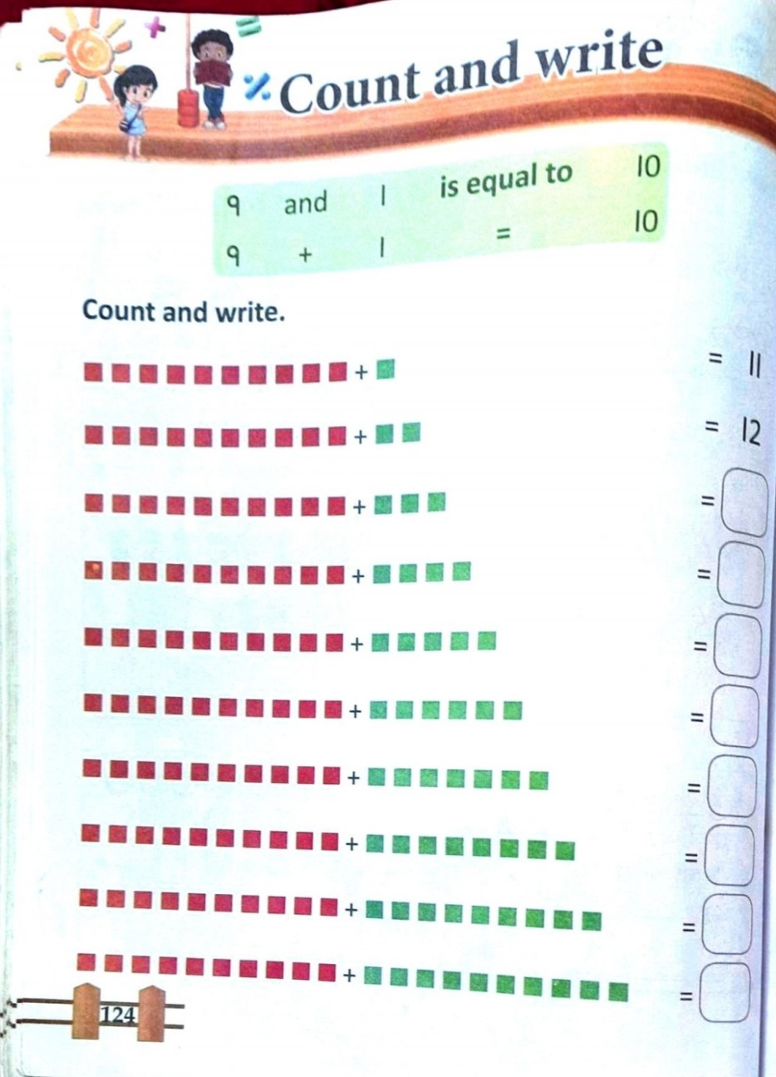
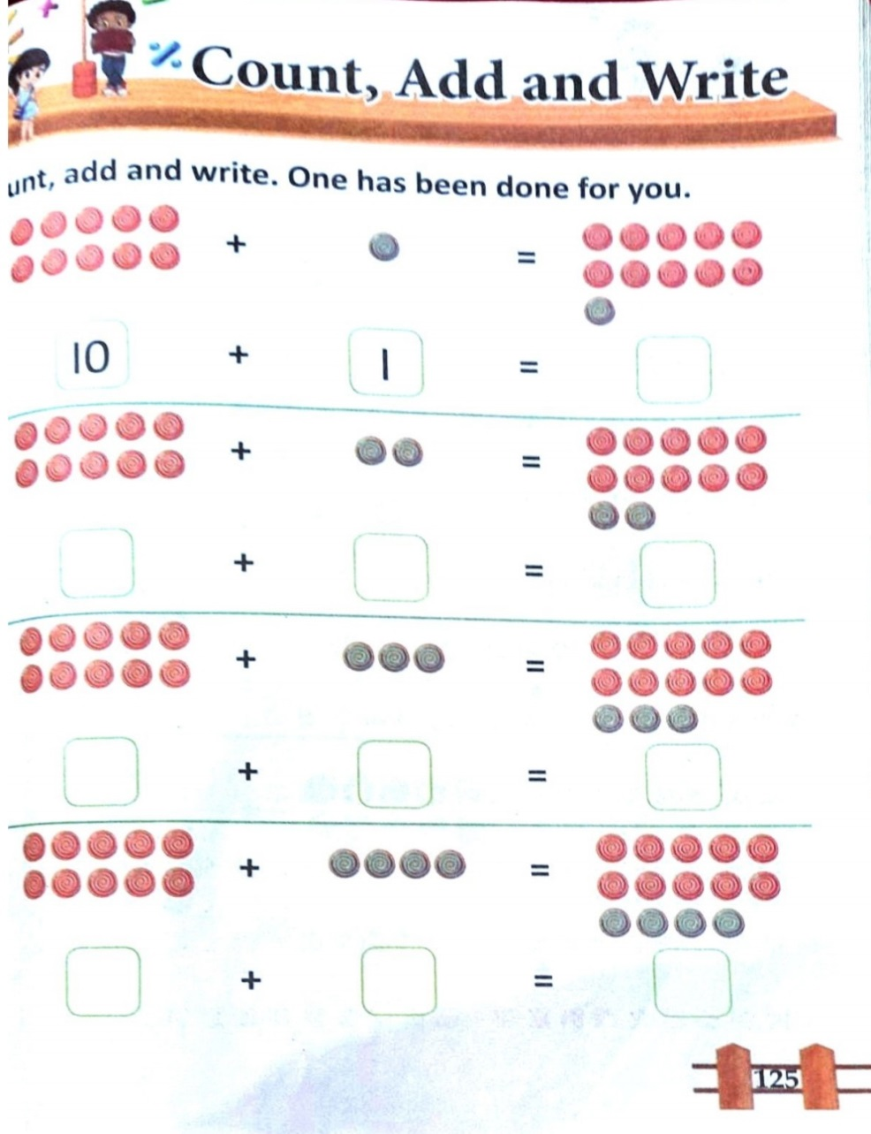
C/W
18.11.21

Slide 8
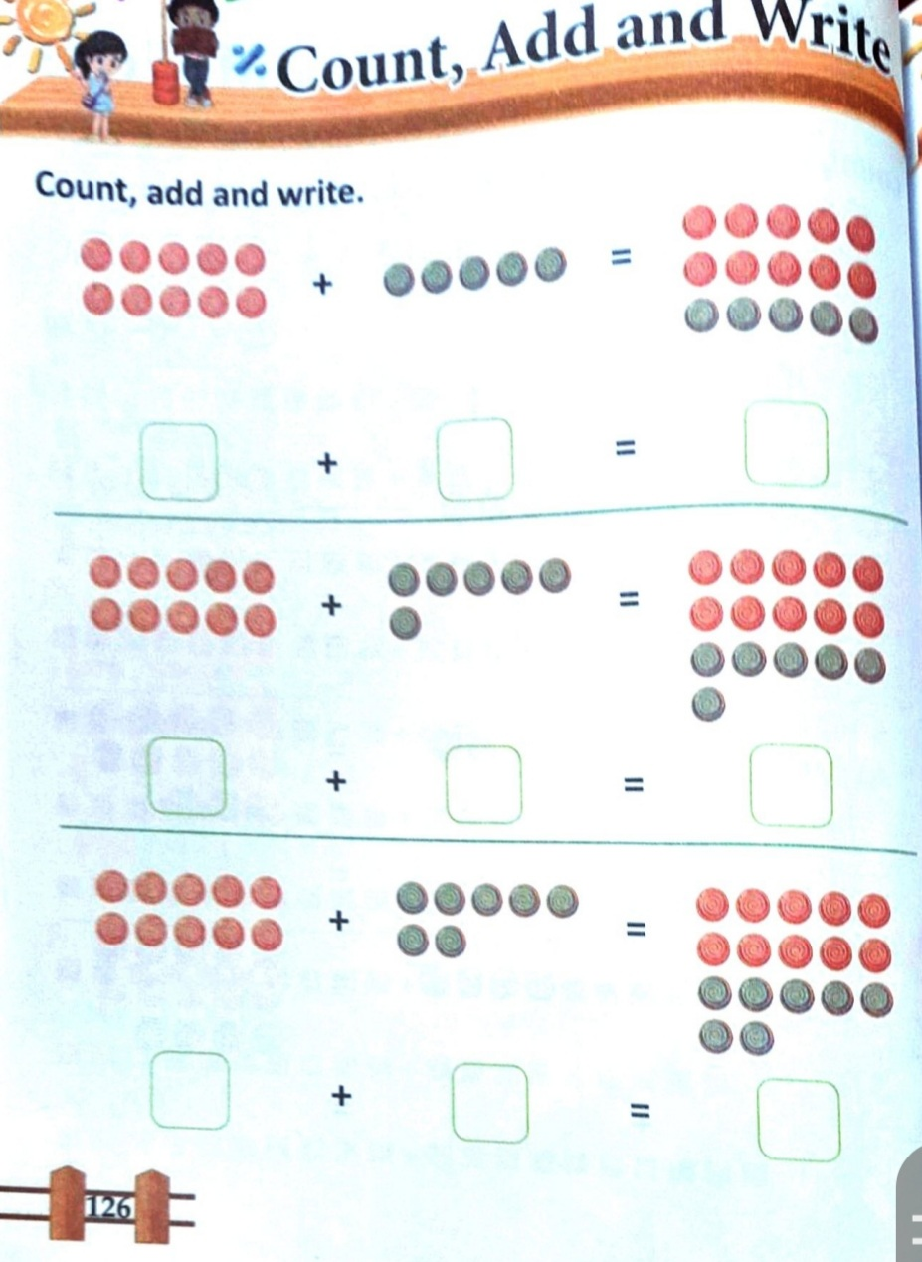
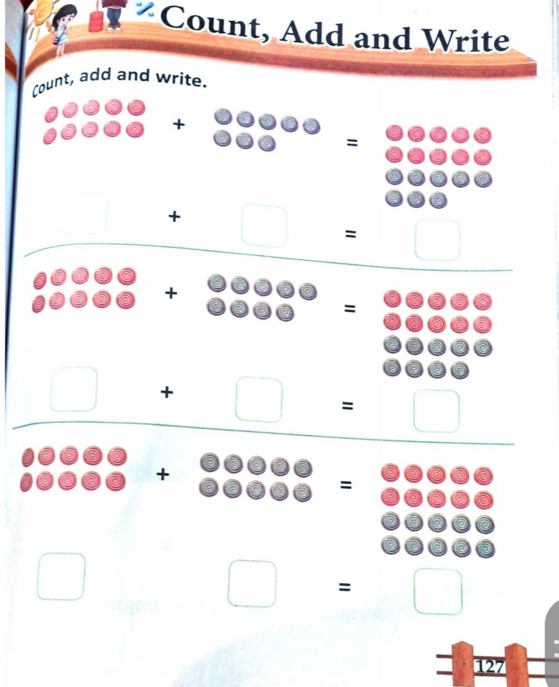
H/W
18.11.21

Slide 9
THANKING YOU
ODM EDUCATIONAL GROUP

