Slide 1

WELCOME TO ONLINE CLASS
CLASS : UKG
SUBJECT : MATHS
CHAPTER : TOPIC : INTRODUCTION OF
ADDITION

Slide 2
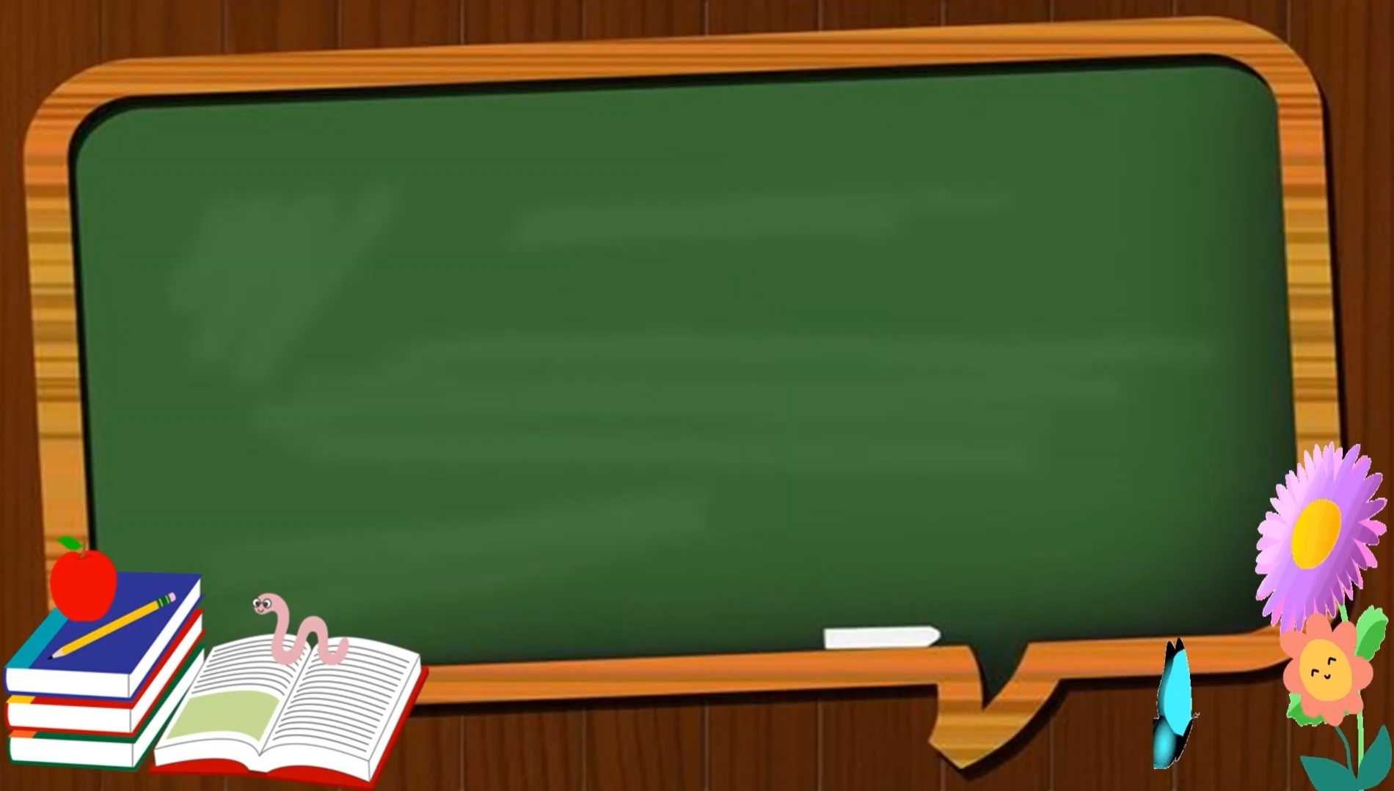
TODAY’S TOPIC
ADDITION

Slide 3


So now I have 3 balloons in total.
WHAT IS ADDITION ?
FOR EXAMPLE: I HAVE A BALLOON.
FATHER GIVES TWO MORE.
HOW MANY BALLOONS DO I HAVE IN TOTAL ?
ADDITION MEANS “JOIN TOGETHER OR PUTTING TOGETHER.” SYMBOL OF ADDITION IS “+”.
1 BALLOON
2 BALLOONS
1 + 2 = 3
1 balloon and 2 balloons equal to 3

Slide 4
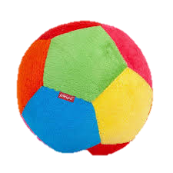
Count and say
+
+
=
3
2
5
5

Slide 5

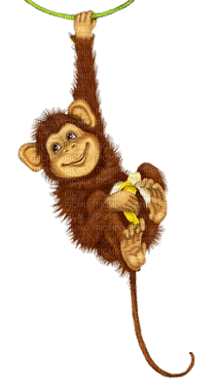
+
3
=
3
6

Slide 6


Count,add and say
+
2
4
2
=

Slide 7
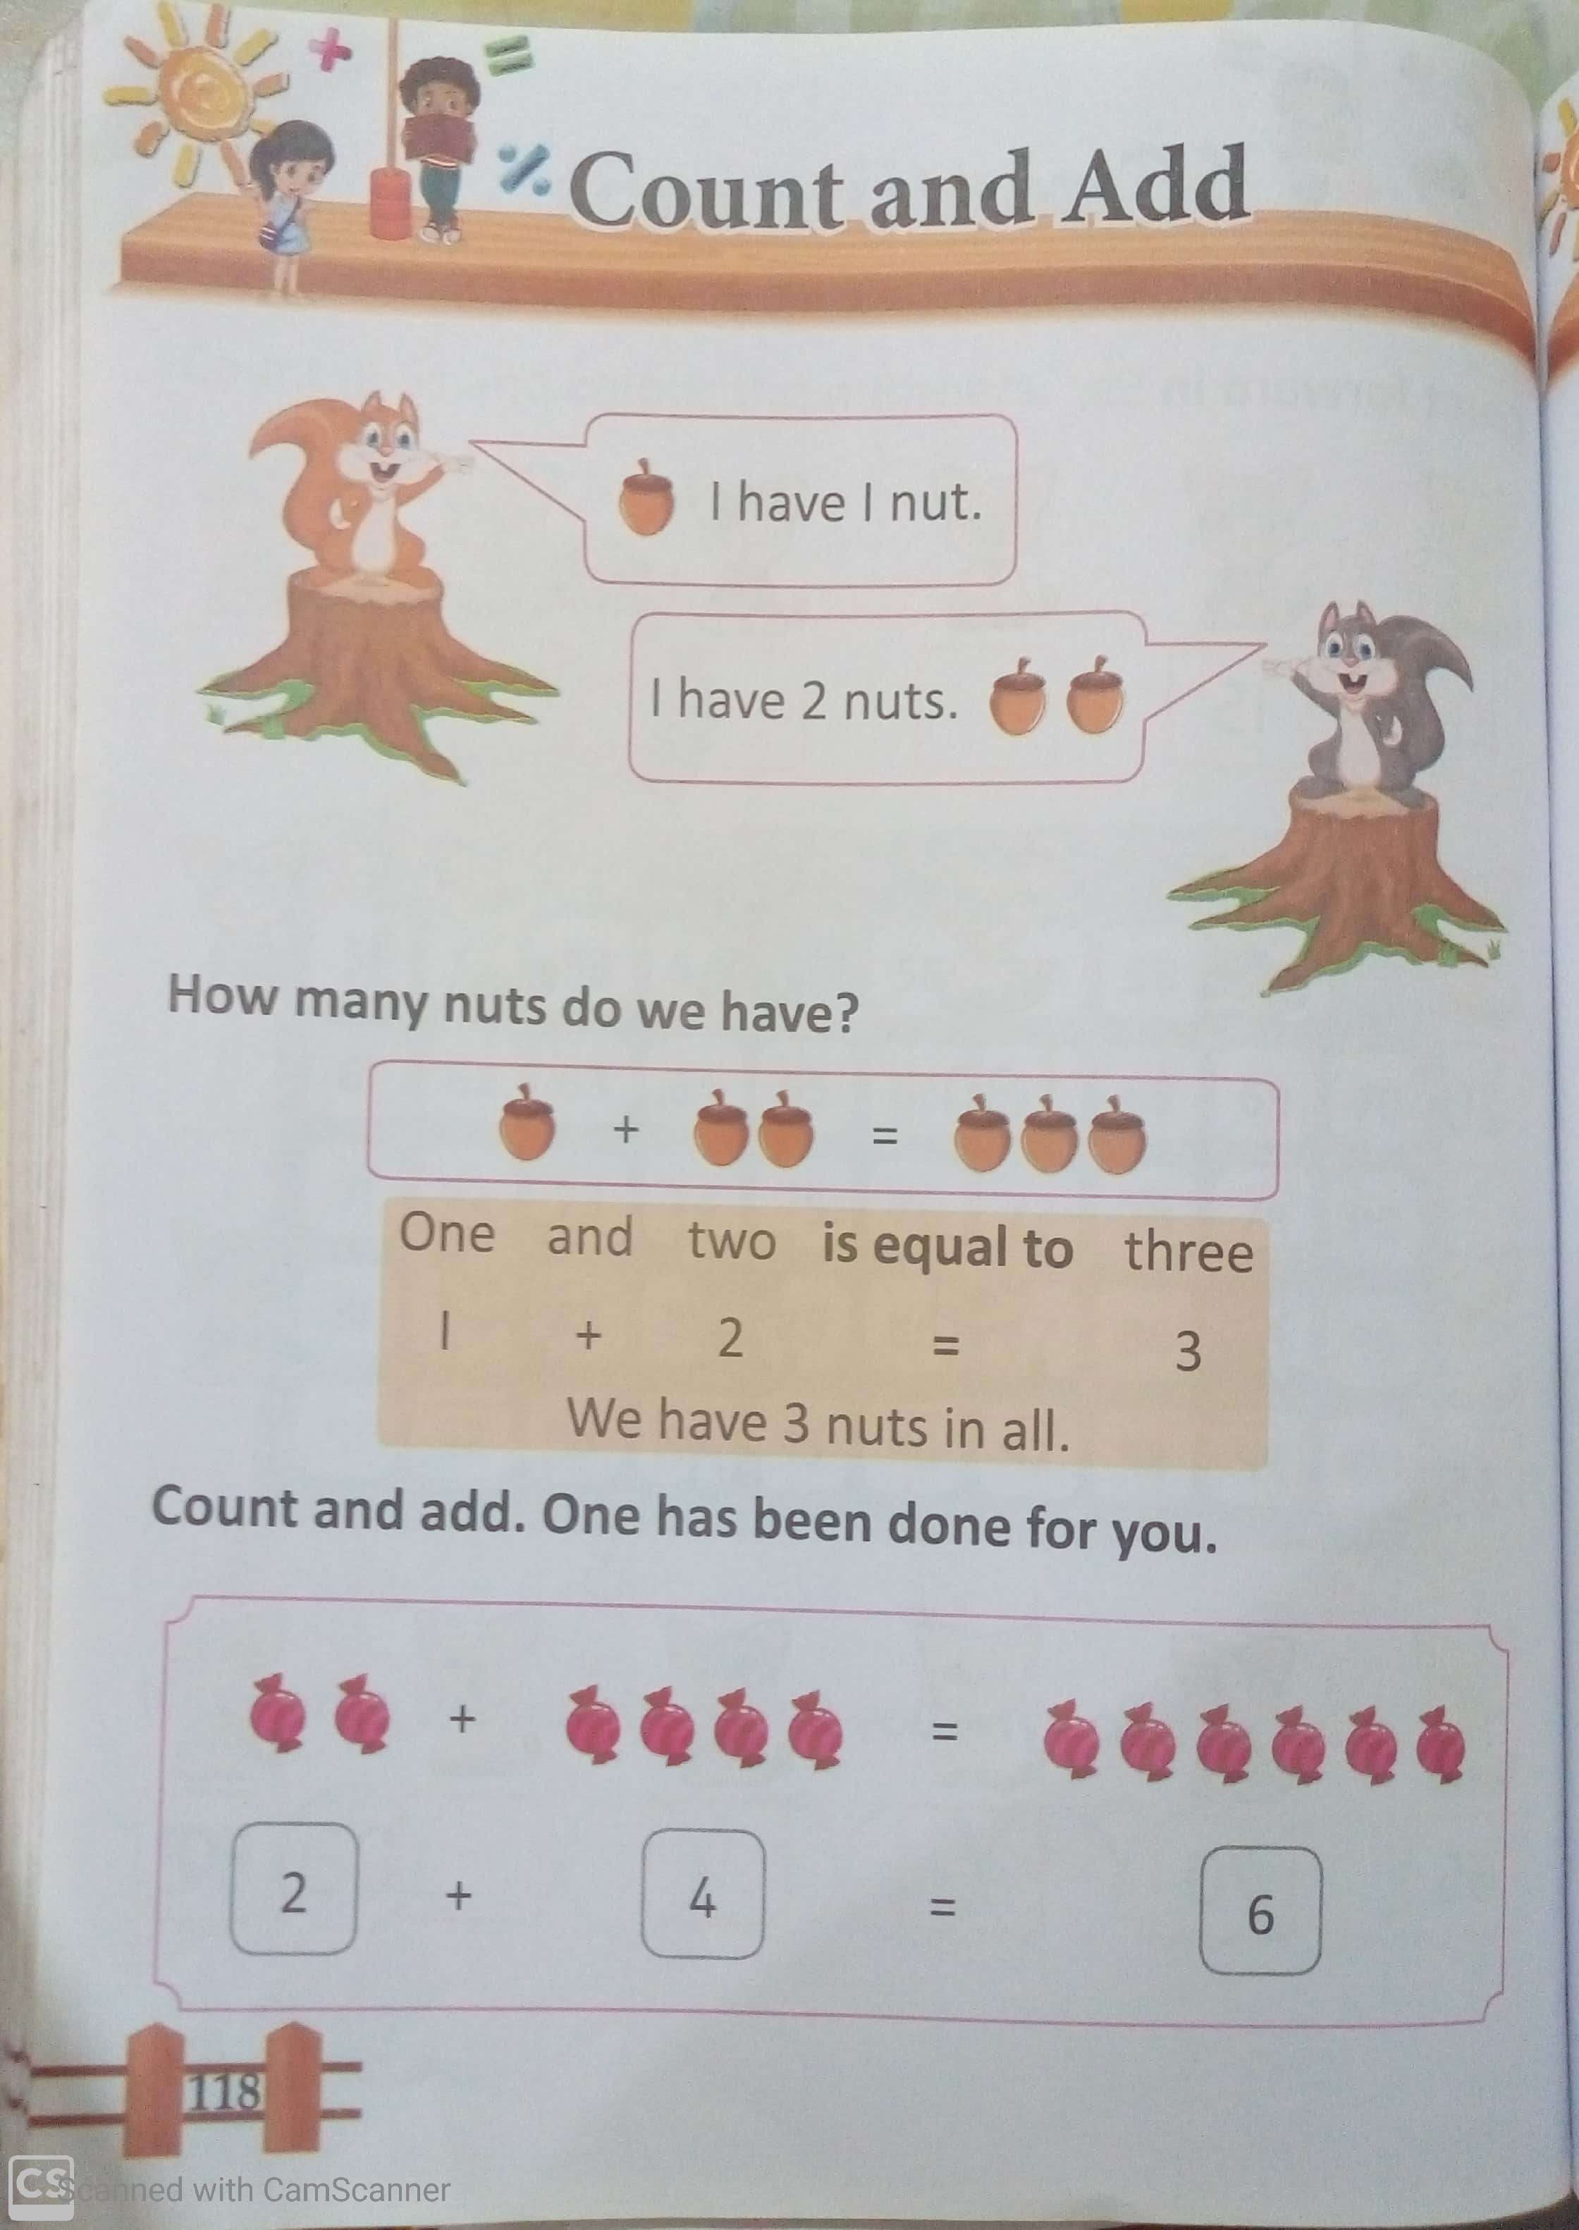
C.W
15.11.21

Slide 8
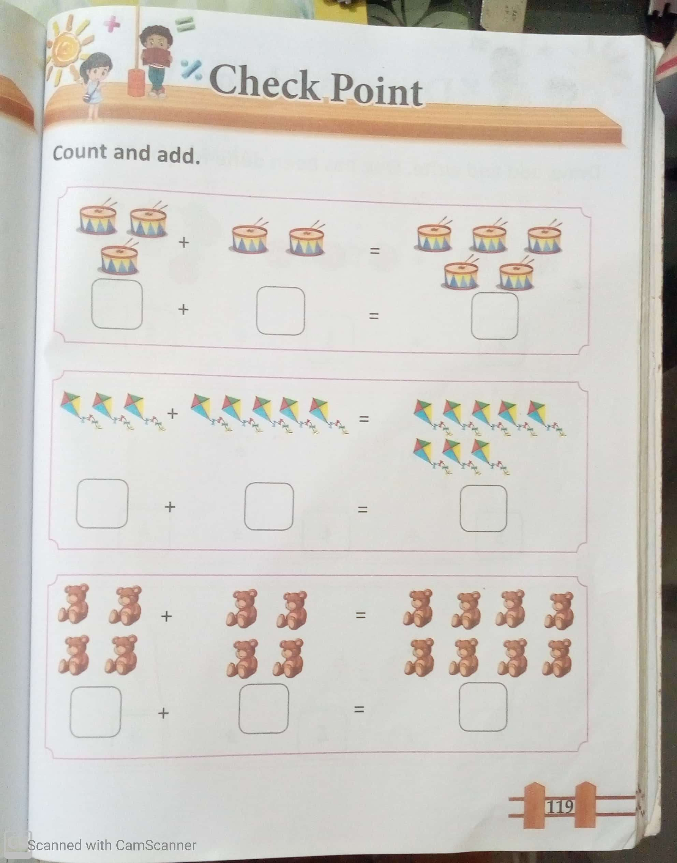
3
2
5
C.W
15.11.21
3
5
8
4
4
8

Slide 9


Count, add and write.(Notebook work)
+
=
H.W
15.11.21
+
=

Slide 10

THANKING YOU
ODM EDUCATIONAL GROUP

