Slide 1


CLASS : UKG
SUBJECT :MATHS
CHAPTER : 20
CHAPTER NAME- SUBTRACTION
TOPIC : HOW MANY ARE LEFT (NOTEBOOK WORK)
BOOK PAGE -135 TO 138

Slide 2
TODAY’S TOPIC - SUBTRACTION
SUBTRACT MEANS TO TAKE AWAY FROM A NUMBER OF THINGS. WHEN WE SUBTRACT, THE NUMBER OF THINGS IN THE GROUP BECOME LESS.

Slide 3
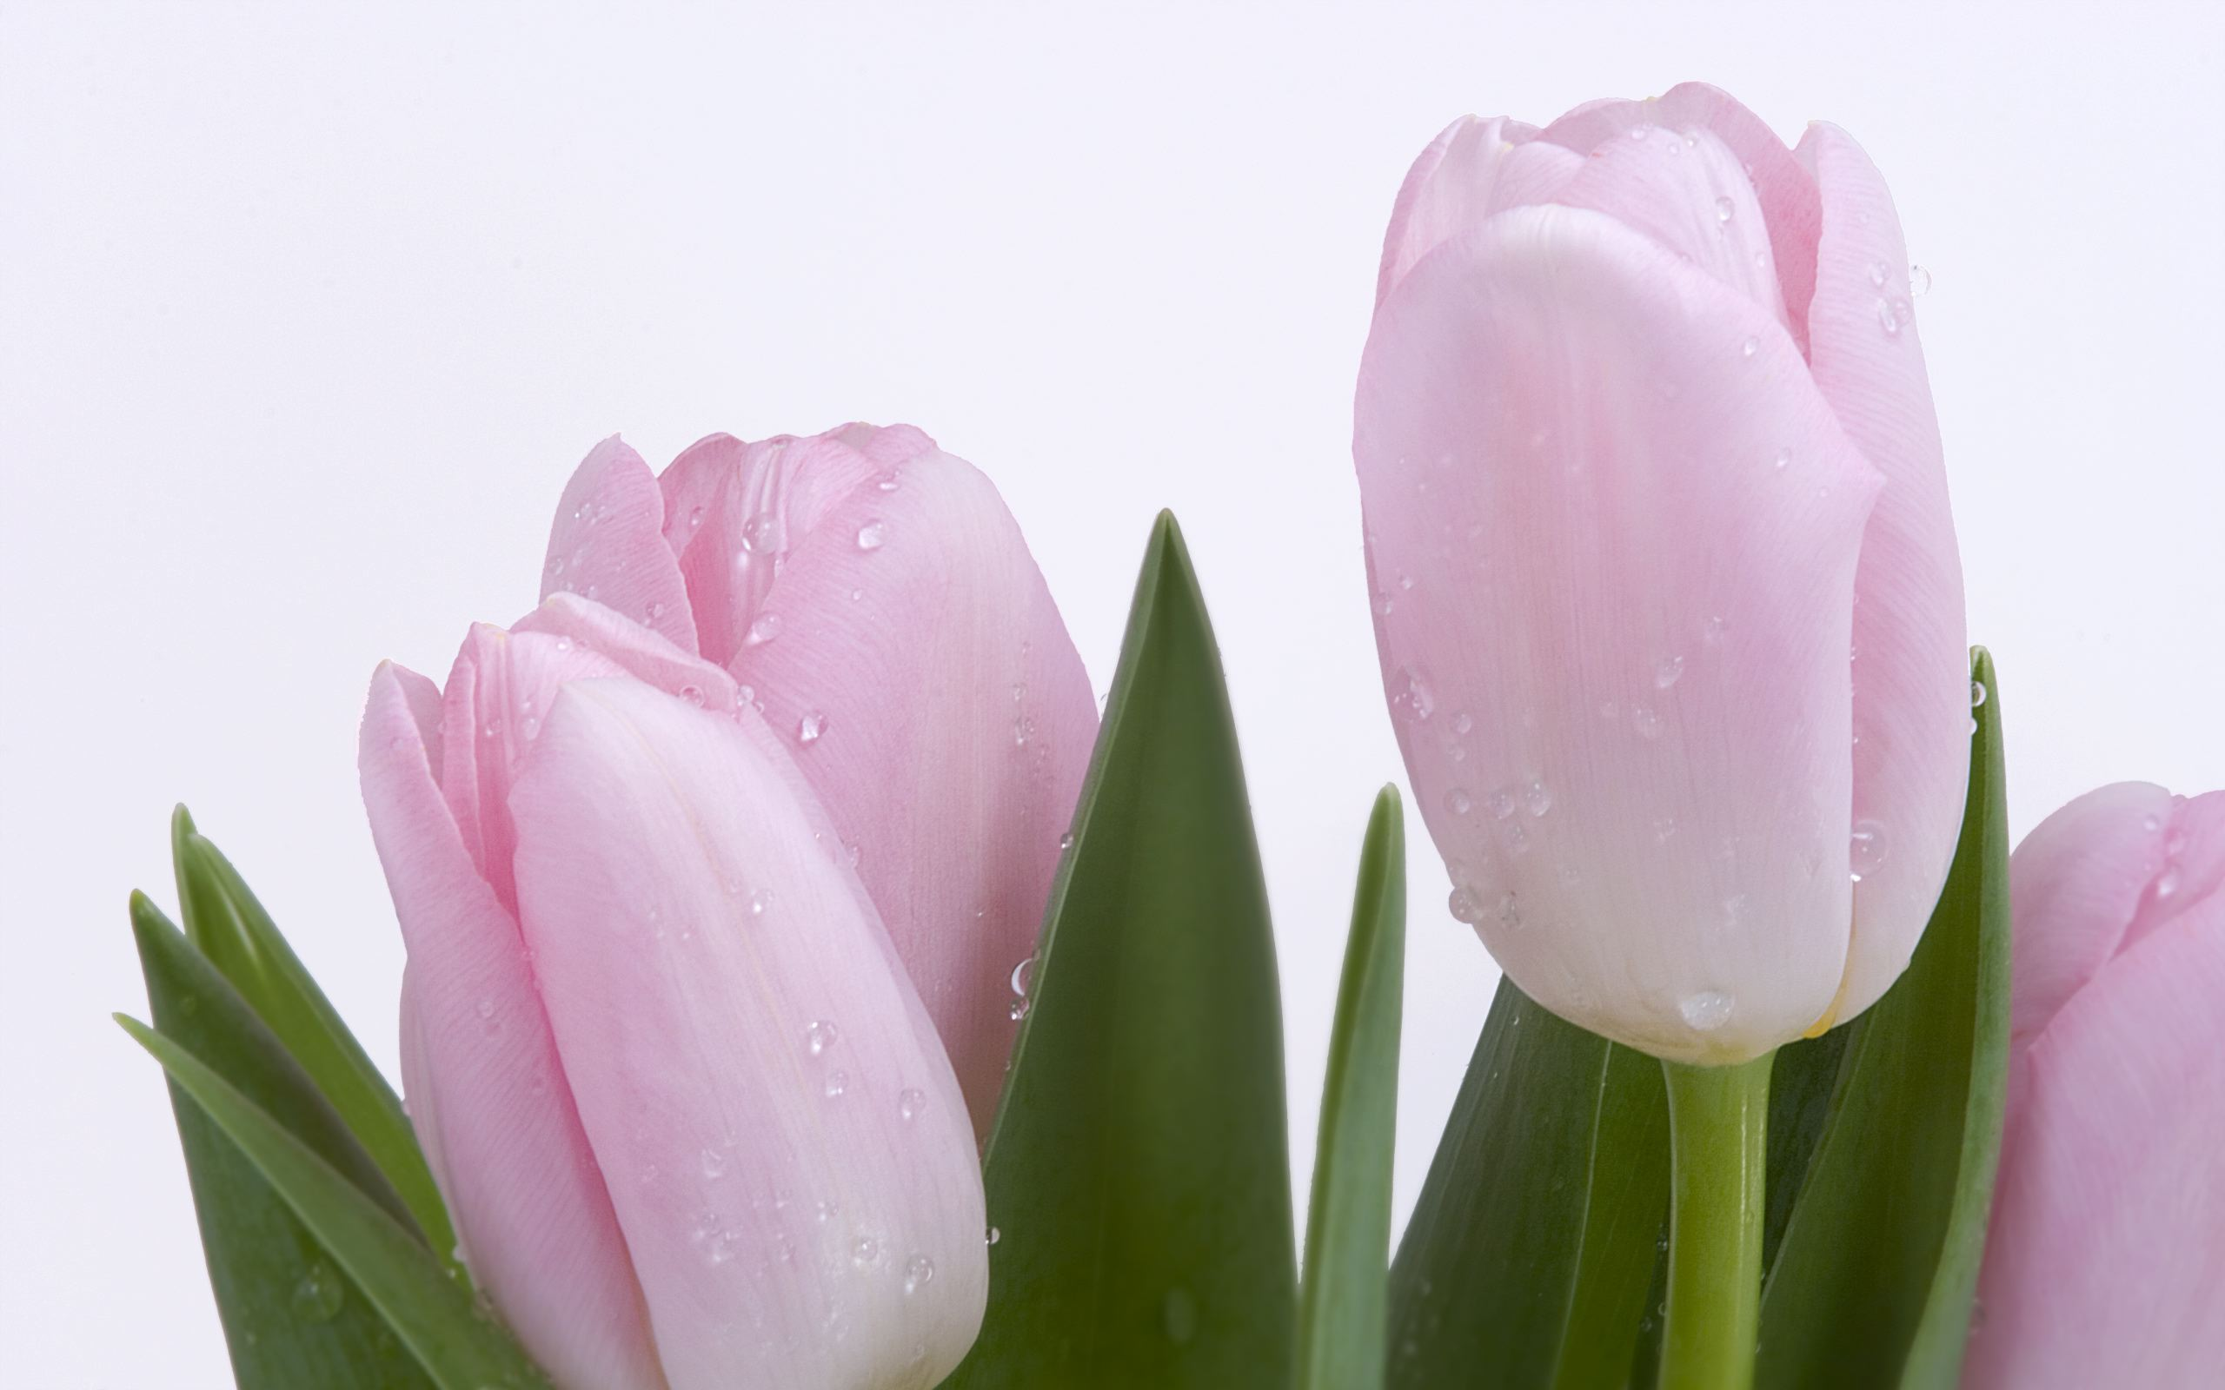
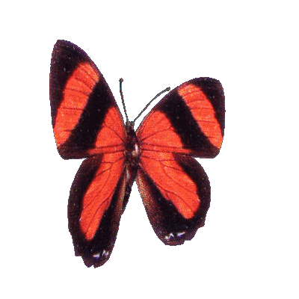


ACTIVITY:
How many butterflies are left?
There are 3 butterflies left.

Slide 4
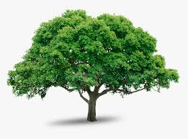
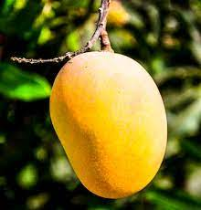
How many mangoes are left?
There are 6 mangoes left.

Slide 5
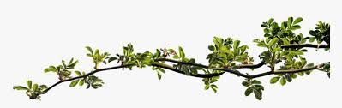
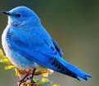
How many birds are left?
8-5=
3
Let's sing!
Eight little blue birds sitting on a tree,
Five flew away, and then there were three.

Slide 6
c/w
1.12.21
How many balloons are left?
8 – 4 =
There are ___ balloons left.

Slide 7
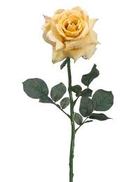
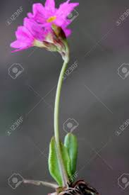


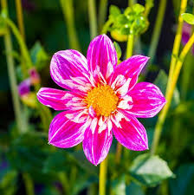
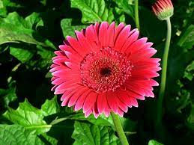
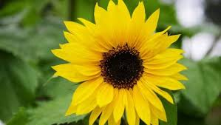
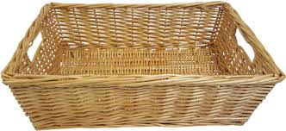
How many flowers are left?
10 – 7 =
There are __ flowers left.

Slide 8
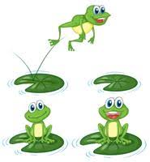
H/w
1.12.21
How many frogs are left?
1-
3-1=
There are ___frogs left.
2- Rima has 8 candies. Her sister takes away 2 candies from her. Now how many candies Rina has?

Slide 9
THANKING YOU
ODM EDUCATIONAL GROUP

