Slide 1



CLASS : NURSERY
DATE : 31.08.2021
SUBJECT :
MATHS
NUMBERS
CHAPTER NUMBER-
SUB-TOPIC-NUMBERS 1-5 IN NT BK
Notes:
BIG AND SMALL

Slide 2





Recapitulation
Identify the given numbers
Notes:
Identify the given numbers

Slide 3

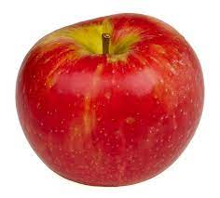
Count and say the correct number
/
Notes:
/

Slide 4

/

Slide 5
/

Slide 6

/

Slide 7


ACTIVITY IN NOTE BK BK
Notes:
IN BK PG NO-9

Slide 8
Re-arrange the given numbers
CW
31/08/21
Notes:
31/08/21

Slide 9
Write numbers 1-5 under T.U
HW
T | O

Slide 10

ASSIGNMENT
31/08/21
1.Learn to count numbers 1-10
2.Write numbers 1-10 under T.O
Notes:
Write numbers 1-10 under T.O

Slide 11
THANKING YOU
ODM EDUCATIONAL GROUP

