Slide 1



CLASS : NURSERY
DATE : 26.08.2021
SUBJECT :
MATHS
NUMBERS
CHAPTER NUMBER-
SUB-TOPIC- IN NOTE BK(Activity)
Notes:
BIG AND SMALL

Slide 2
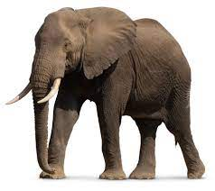
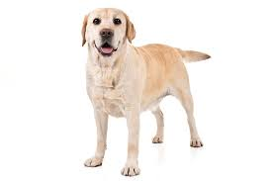

BIG
SMALL
Notes:
SMALL

Slide 3
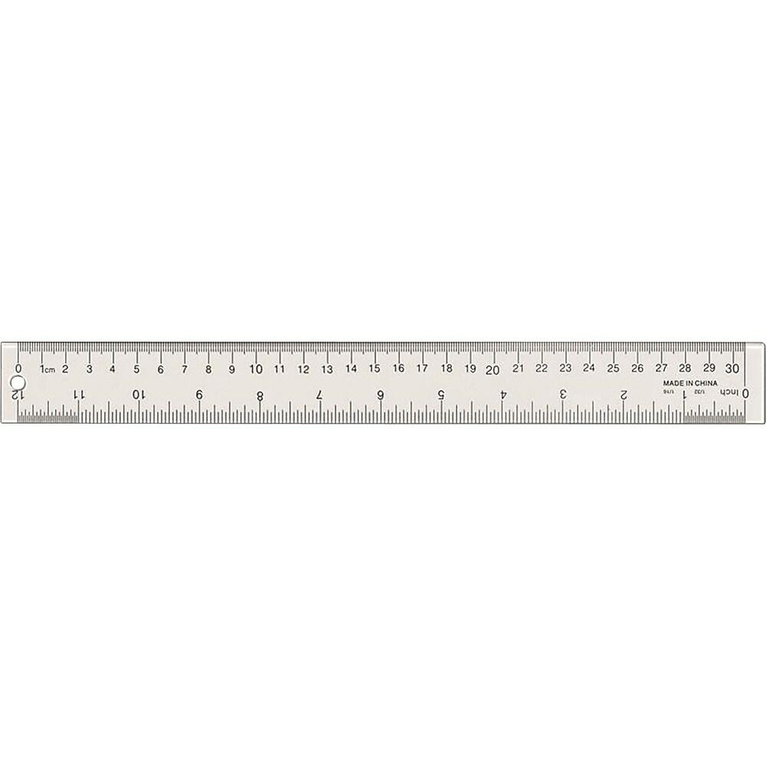

LONG
SHORT

Slide 4
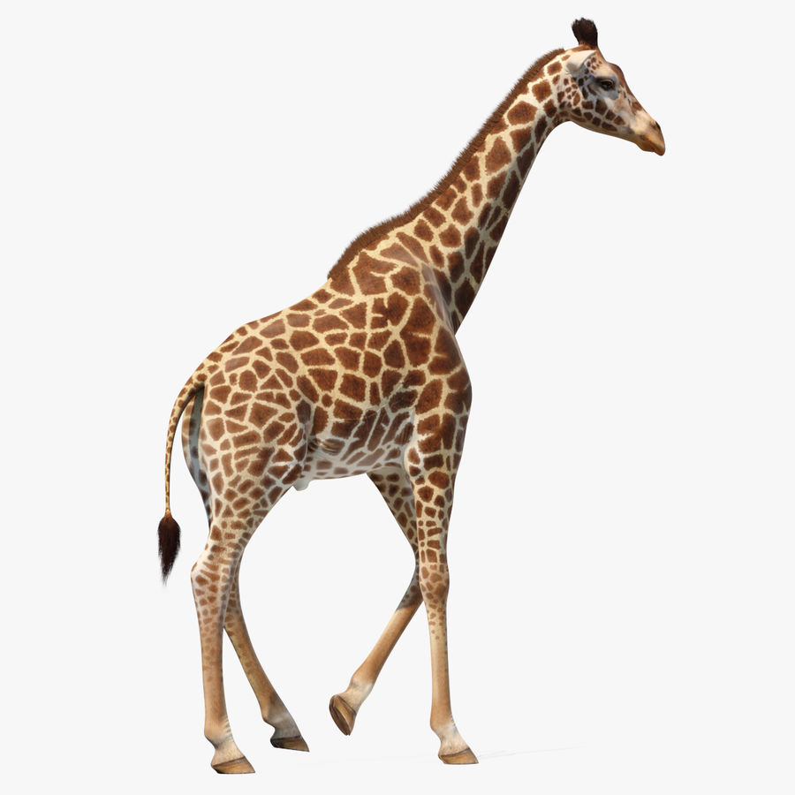
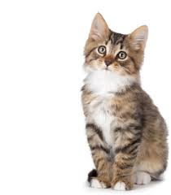
TALL
SHORT
Notes:
TALL SHORT

Slide 5





Recapitulation
Identify the given numbers
Notes:
Identify the given numbers

Slide 6

ACTIVITY IN NOTE BK BK
Notes:
IN BK PG NO-9

Slide 7


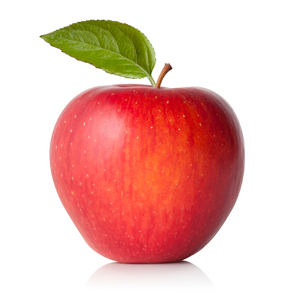
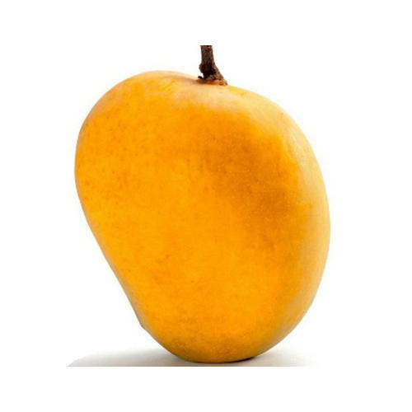
Count the object and match with correct number
4
2
5
3

Slide 8

26/08/21
ASSIGNMENT
1.Learn to count numbers 1-10
Notes:
3.

Slide 9
THANKING YOU
ODM EDUCATIONAL GROUP

