Slide 1



CLASS : NURSERY
DATE : 23.08.2021
SUBJECT :
MATHS
CHAPTER NUMBER-
BK PG NO10
SUB-TOPIC : -TALL & SHORT
Notes:
BIG AND SMALL

Slide 2






Recapitulation
Identify the given numbers
Notes:
Identify the given numbers

Slide 3
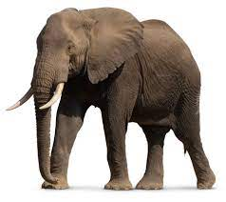
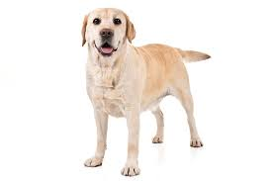

BIG
SMALL
Notes:
SMALL

Slide 4
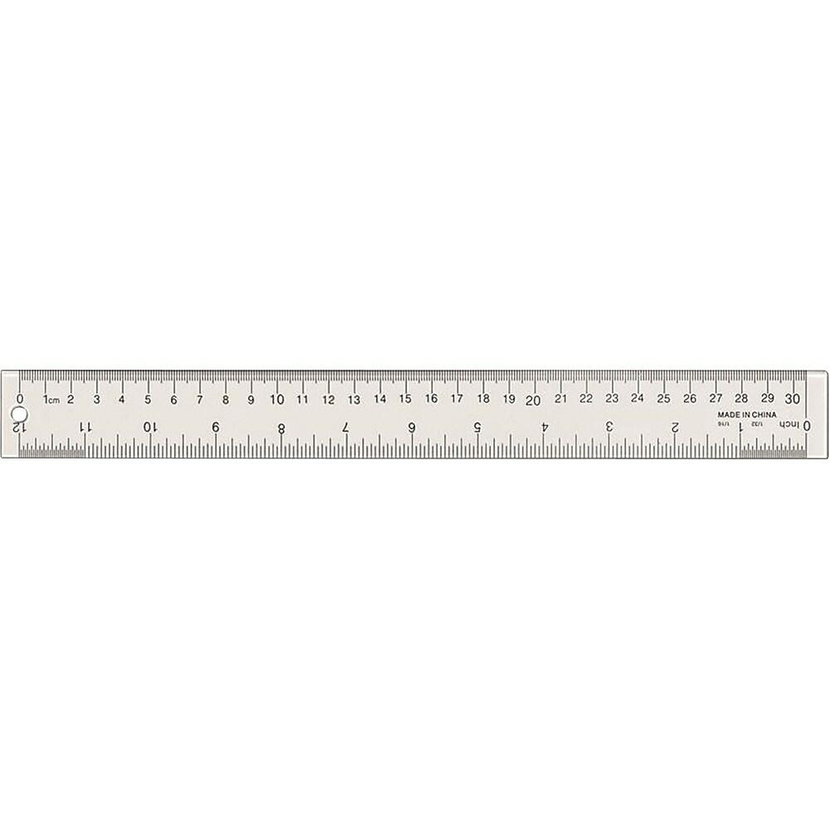

LONG
SHORT

Slide 5
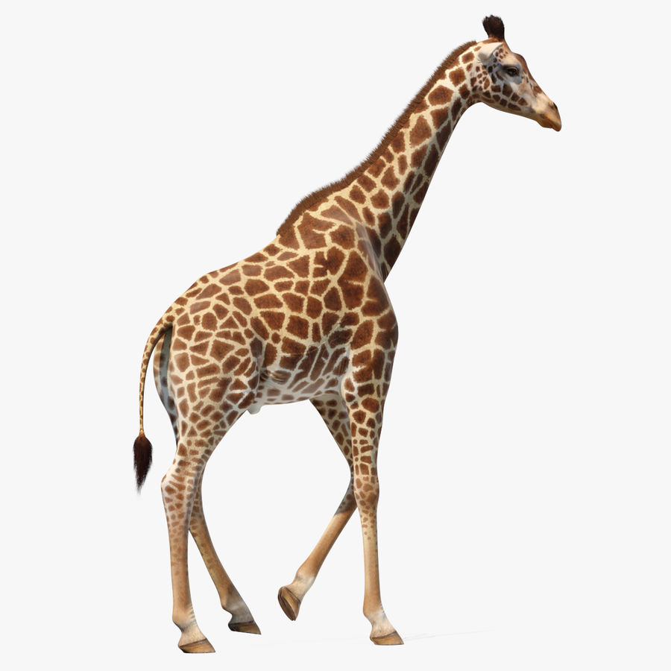
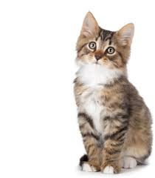
TALL
SHORT
Notes:
TALL SHORT

Slide 6

ACTIVITY IN NOTE BK BK
Notes:
IN BK PG NO-9

Slide 7



In note bk
CW
23/08/21
Color the Tall picture & circle the short
Notes:
23/08/21

Slide 8

23/08/21
ASSIGNMENT
1.Complete the given activity
2.Learn to count numbers 1-10
3.Paste /Draw the picture of one Long and short object in nt bk
Notes:
3.Paste /Draw the picture of one and short object

Slide 9
THANKING YOU
ODM EDUCATIONAL GROUP

