Slide 1



CLASS : NURSERY
DATE : 18.08.2021
SUBJECT :
MATHS
CHAPTER NUMBER-
BK PG NO-8,9,10
SUB-TOPIC : - REVISION
Notes:
BIG AND SMALL

Slide 2
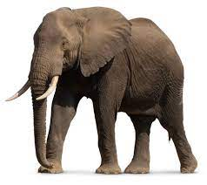
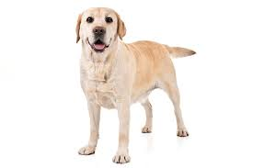

BIG
SMALL
Notes:
SMALL

Slide 3
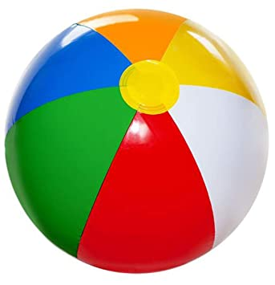

BIG
SMALL
Notes:
BIG

Slide 4
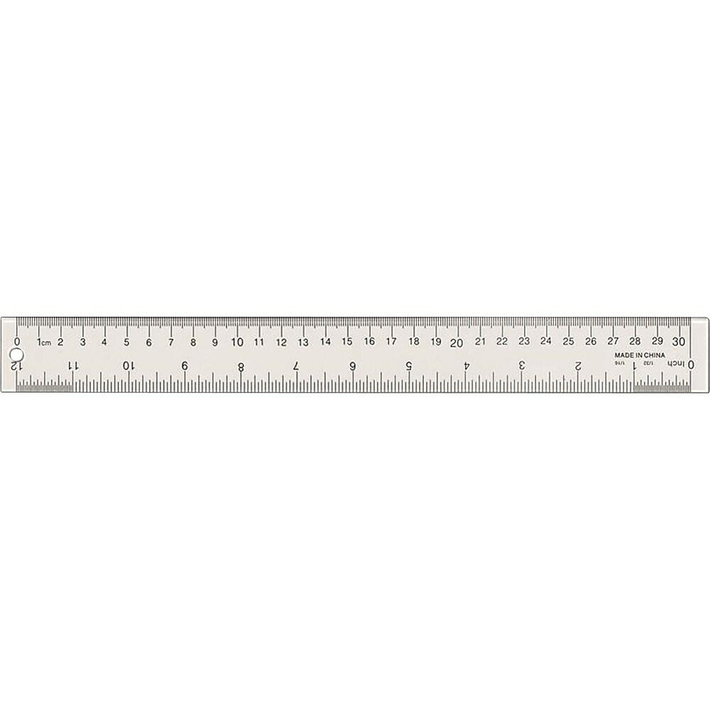

LONG
SHORT

Slide 5


LONG
SHORT
Notes:
SHORT

Slide 6
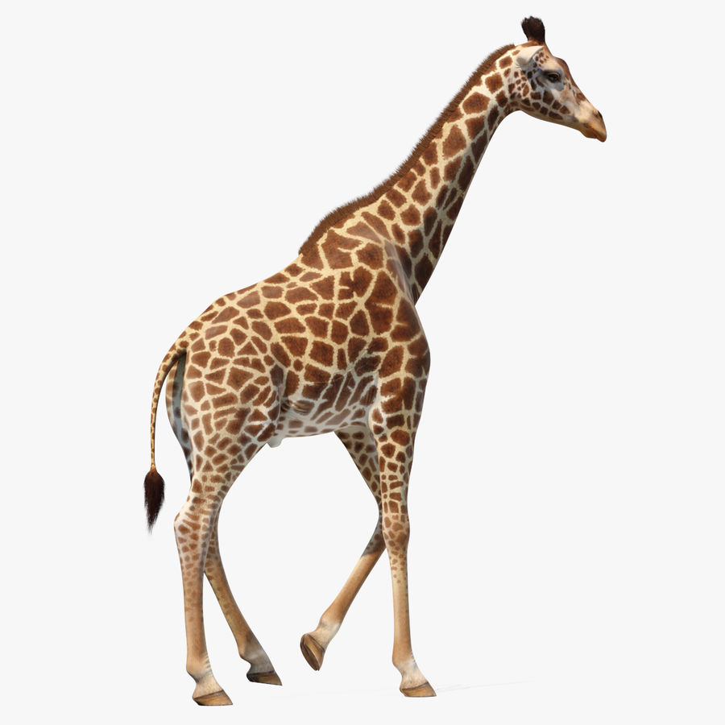
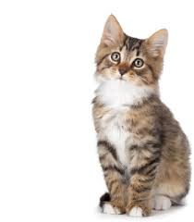
TALL
SHORT
Notes:
TALL SHORT

Slide 7

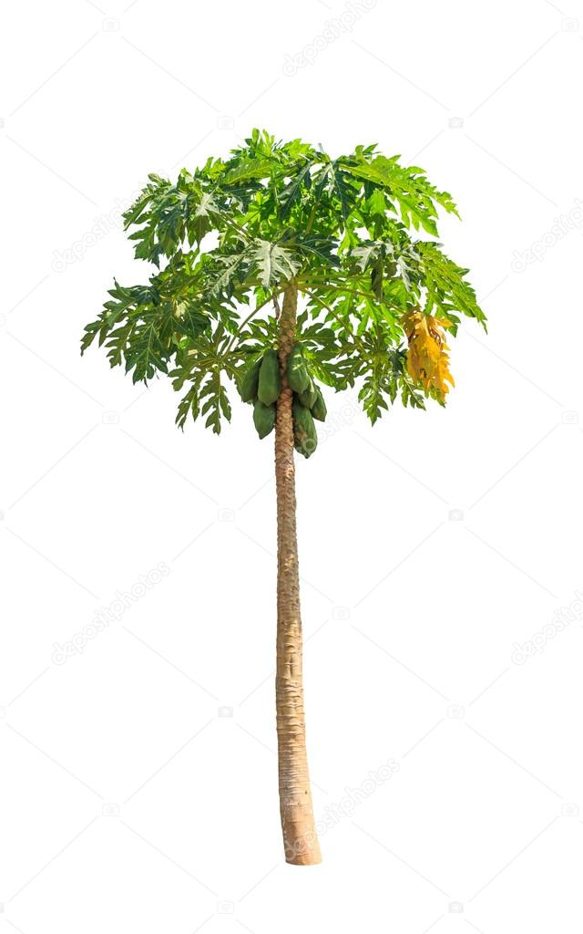
TALL
SHORT

Slide 8
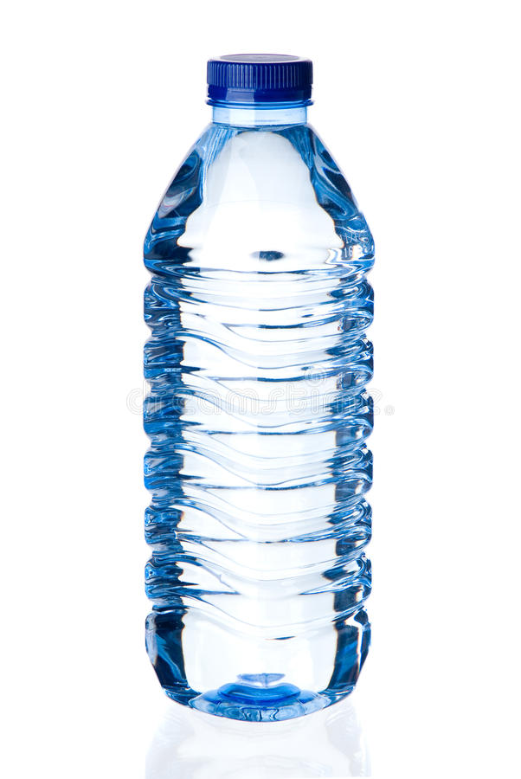
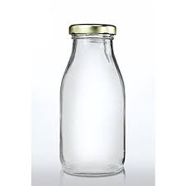
TALL
SHORT

Slide 9


TALL
SHORT

Slide 10

ACTIVITY IN NOTE BK BK
Notes:
IN BK PG NO-9

Slide 11
MATCH WITH SAME SIZE

Slide 12
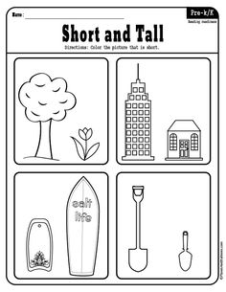
Colour the picture that is short

Slide 13

18/08/21
ASSIGNMENT
1.Complete the given activity
Notes:
Paste one Tall and Short picture in your nt bk

Slide 14
THANKING YOU
ODM EDUCATIONAL GROUP

