Slide 1



CLASS : NURSERY
DATE : 16.08.2021
SUBJECT :
MATHS
CHAPTER NUMBER-
BK PG NO-10
SUB-TOPIC :
TALL & SHORT IN NOTE BK
Notes:
BIG AND SMALL

Slide 2
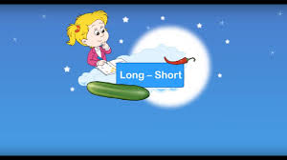

Slide 3
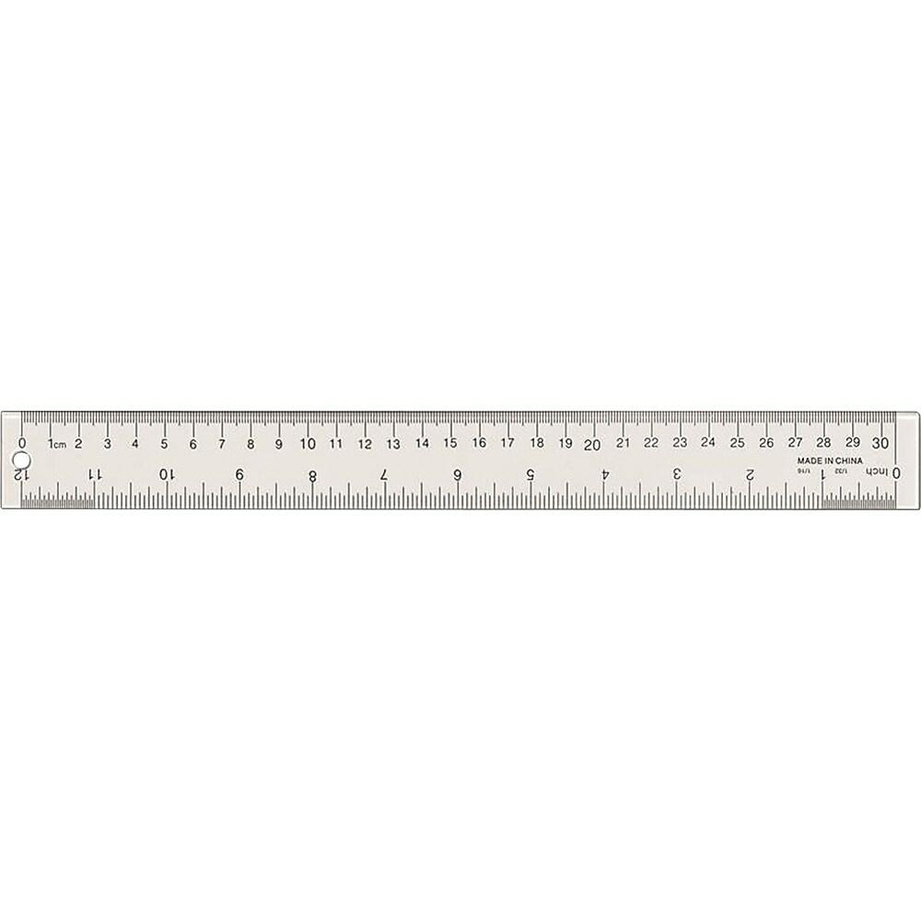


Identification of the concept long &short
LONG
SHORT

Slide 4


Slide 5

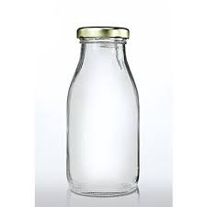
TALL
SHORT

Slide 6


TALL
SHORT

Slide 7



Who one is tall?

Slide 8

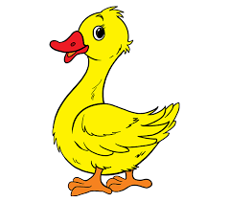
Who is short?

Slide 9
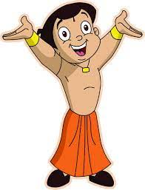
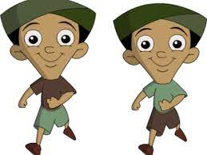
Who is tall ?

Slide 10

IN NT BK LONG & SHORT
Notes:
IN BK PG NO-9

Slide 11

Tick and colour the Tall one
CW
17/08/21
Notes:
17/08/21

Slide 12

17/08/21
ASSIGNMENT
1.Complete the work given in nt bk
Notes:
Paste one Tall and Short picture in your nt bk

Slide 13
THANKING YOU
ODM EDUCATIONAL GROUP

