Slide 1



CLASS : NURSERY
DATE : 12.08.2021
SUBJECT :
MATHS
CHAPTER NUMBER-
BK PG NO-9
SUB-TOPIC :
LONG & SHORT
Notes:
BIG AND SMALL

Slide 2



BIG
SMALL
Notes:
SMALL

Slide 3

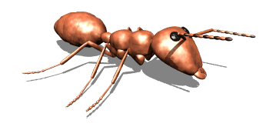
BIG
SMALL

Slide 4
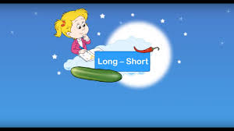

Slide 5
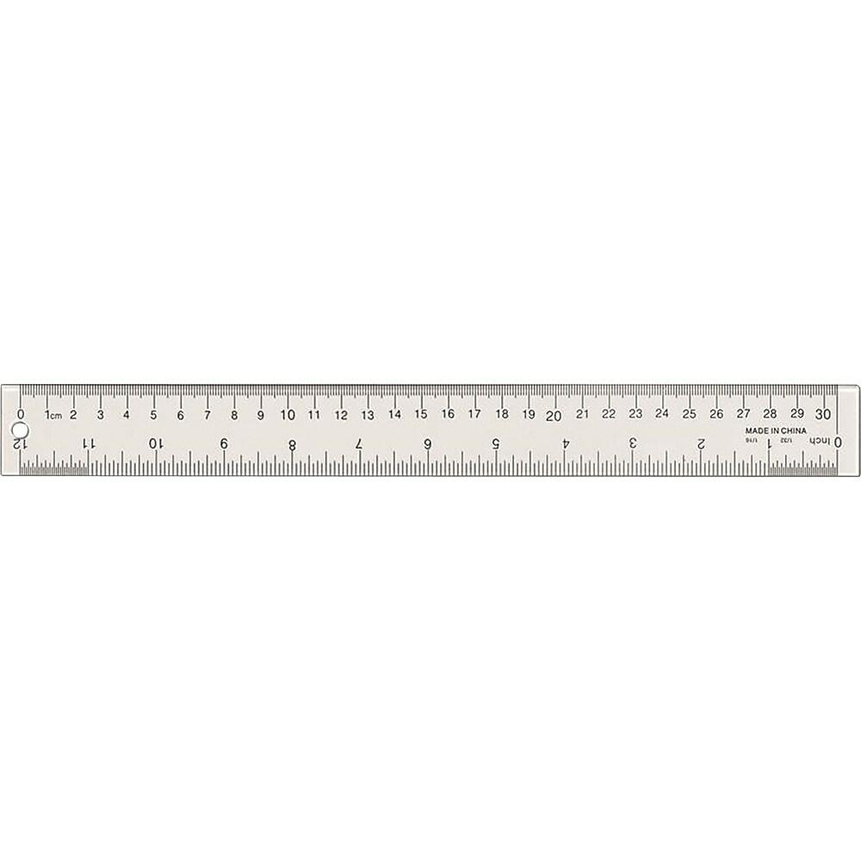


Identification of the concept long &short
LONG
SHORT

Slide 6


LONG
SHORT
Notes:
SHORT

Slide 7


LONG
SHORT

Slide 8

IN NOTE BK
Notes:
IN BK PG NO-9

Slide 9


Color the long one and circle the short one
CW
12/08/21
Notes:
12/08/21

Slide 10
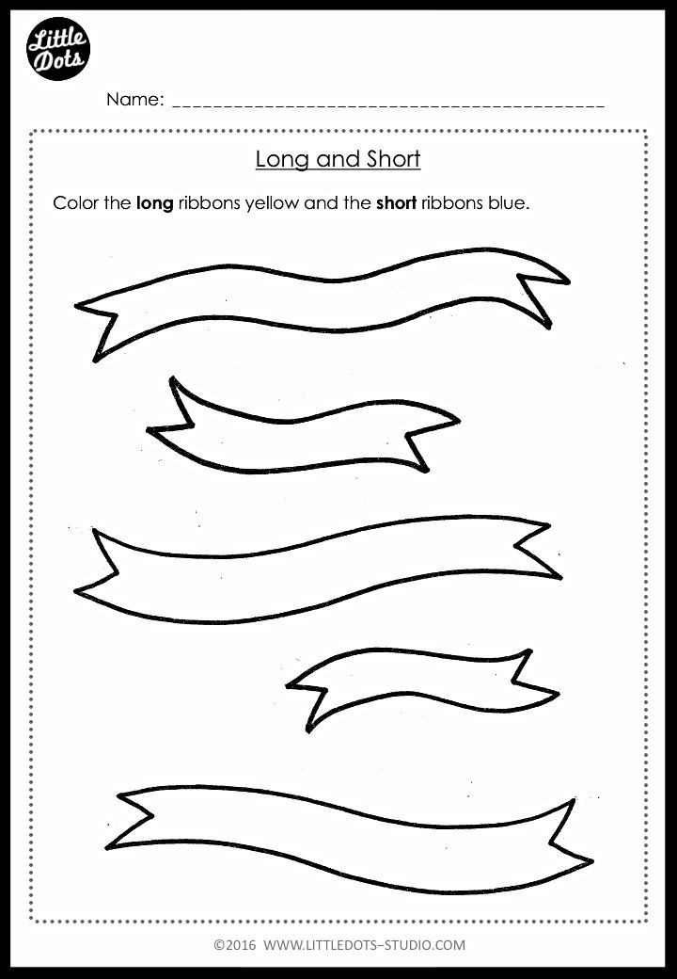
HW
WORK SHEET
CI
Notes:
HW

Slide 11

12/08/21
ASSIGNMENT
1.COMPLETE THE GIVEN WORK SHEET
Notes:
COMPLETE BK PG NO-8

Slide 12
THANKING YOU
ODM EDUCATIONAL GROUP

