Slide 1



CLASS : NURSERY
DATE : 10.08.2021
SUBJECT :
MATHS
CHAPTER NUMBER-
BK PG NO,34
SUB-TOPIC :
BIG AND SMALL- IN NT BK
Notes:
BIG AND SMALL

Slide 2




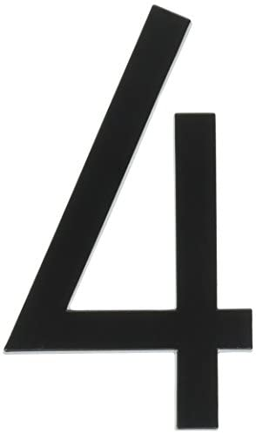
Identify the given number

Slide 3


Slide 4



BIG
SMALL
Notes:
SMALL

Slide 5
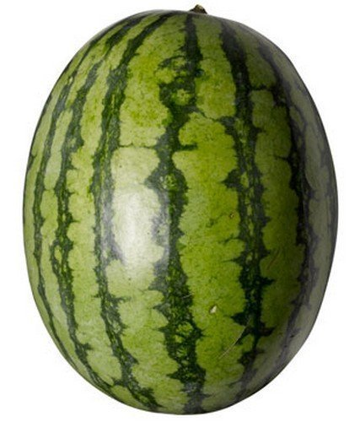

BIG
SMALL

Slide 6
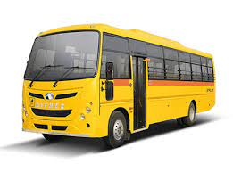
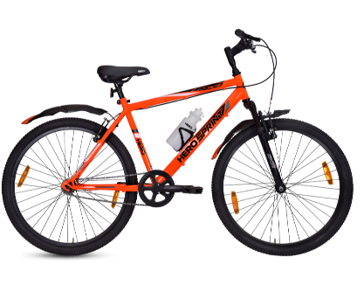
BIG
SMALL

Slide 7
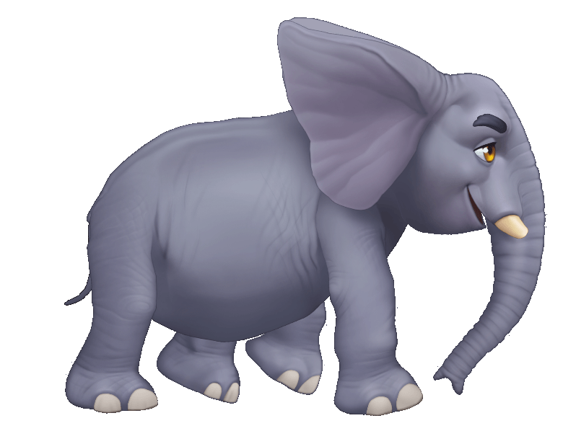
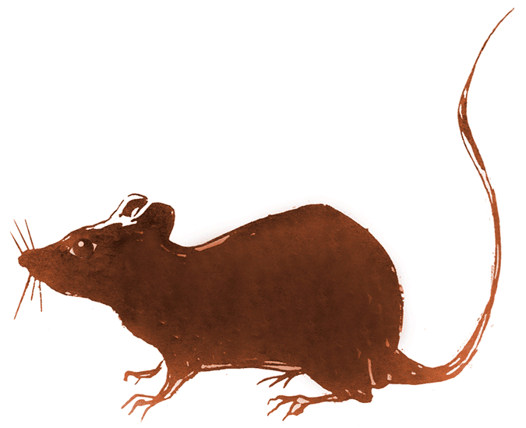
BIG
SMALL
Notes:
SMALL

Slide 8

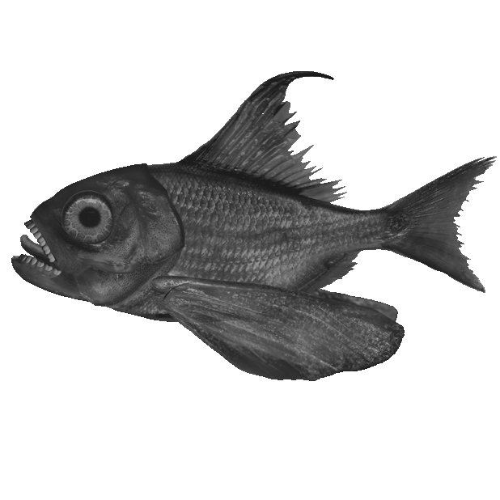
BIG
SMALL

Slide 9

Colour the big one and tick the small
CW
10/08/21
Notes:
10/08/21 CW

Slide 10
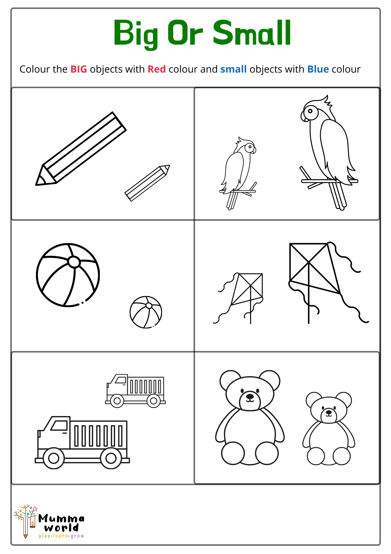
WORK SHEET
HW
Notes:
HW

Slide 11

10/08/21
ASSIGNMENT
1.Do the given work sheet
Notes:
COMPLETE BK PG NO-8

Slide 12
THANKING YOU
ODM EDUCATIONAL GROUP

