Slide 1



CLASS : NURSERY
DATE : 09.08.2021
SUBJECT :
MATHS
CHAPTER NUMBER-
BK PG NO33,34
SUB-TOPIC :
BIG AND SMALL
Notes:
BIG AND SMALL

Slide 2




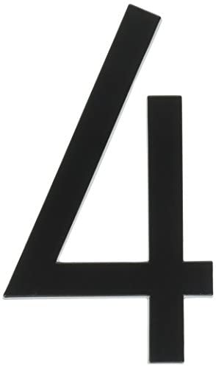
Identify the given number

Slide 3


Slide 4
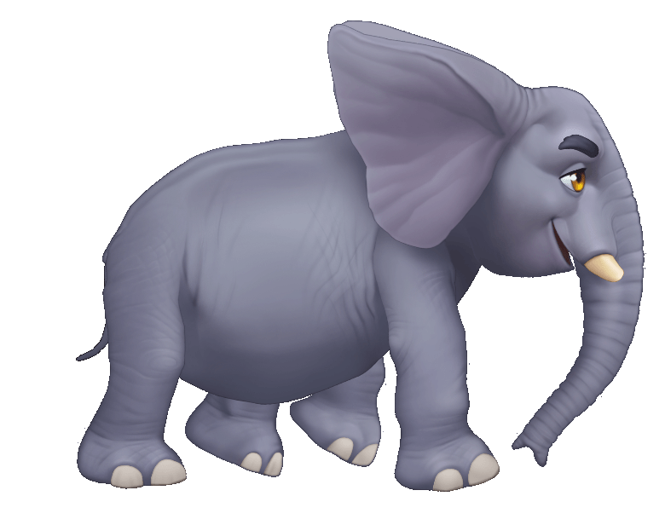
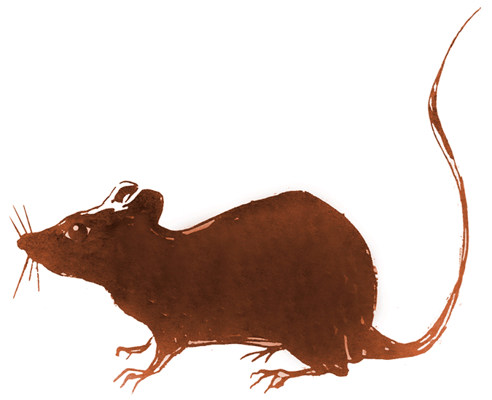

BIG
SMALL
Notes:
SMALL

Slide 5


BIG
SMALL

Slide 6

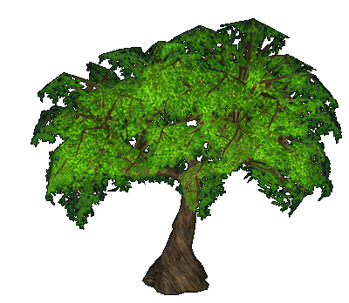
BIG
SMALL

Slide 7
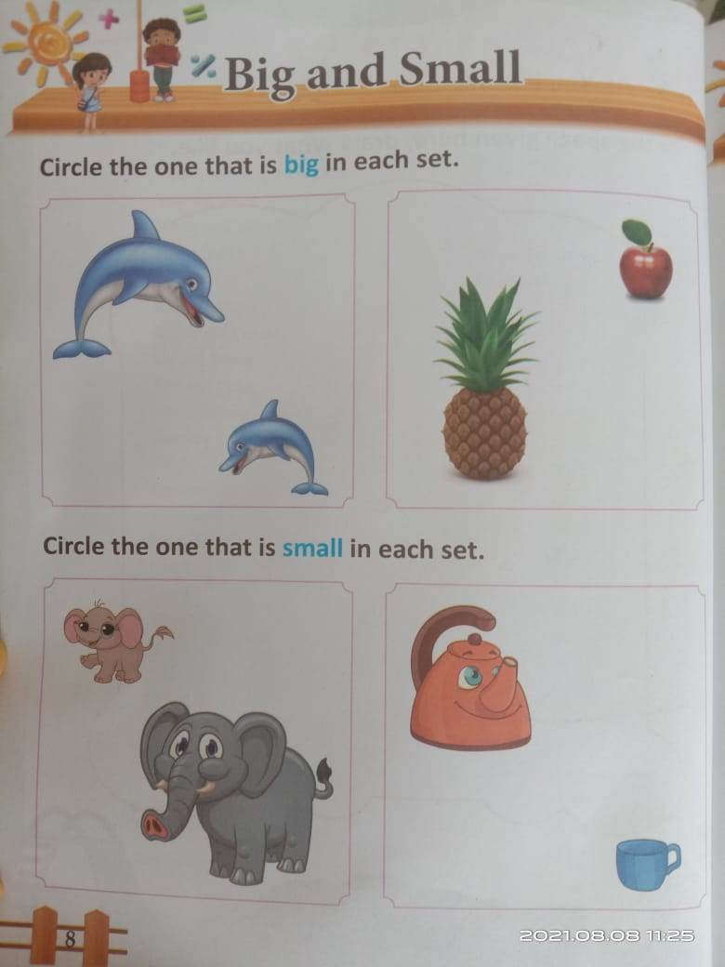
BK PG NO-8
CW
09/08/21
Notes:
09/08/21

Slide 8

09/08/21
ASSIGNMENT
1.COMPLETE BK PG NO-8
Notes:
COMPLETE BK PG NO-8

Slide 9
THANKING YOU
ODM EDUCATIONAL GROUP

