Slide 1

WELCOME TO ON LINE CLASS
CLASS-UKG
SUBJECT-MATHS
TOPIC-PATTERNS
(NOTEBOOK WORK)

Slide 2
PATTERN
A pattern is an arrangement of lines, shapes,objects especially a design in which the same is repeated at regular intervals over a surface.
A pattern is something that happens or appears in a regular & repeated way

Slide 3
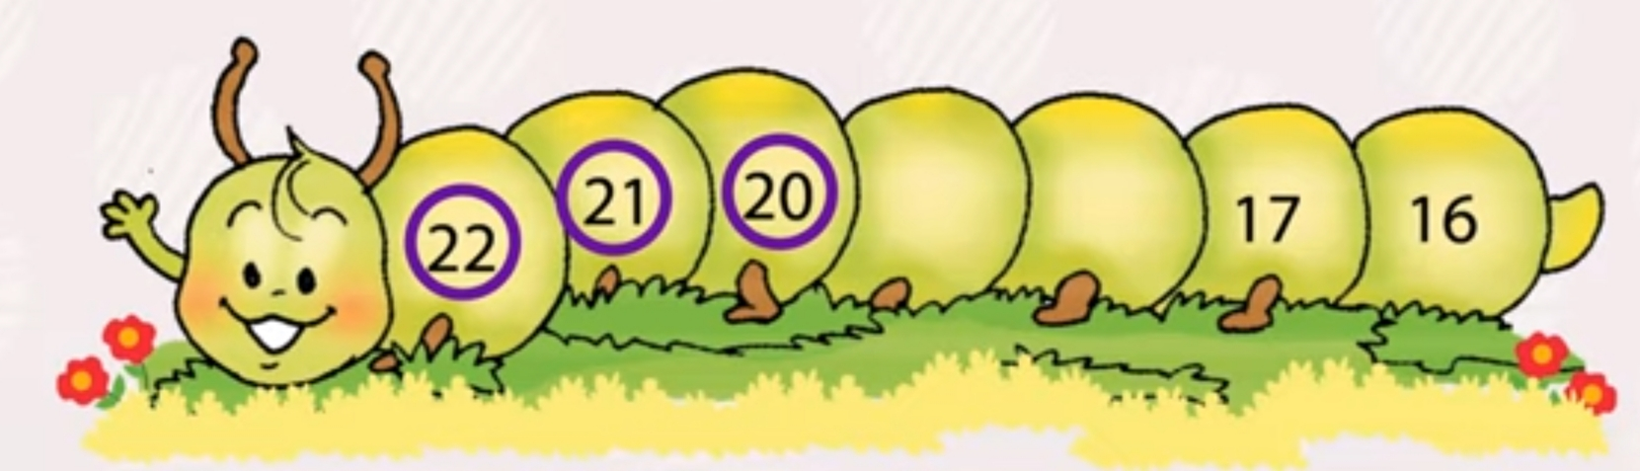
COMPLETE THE PATTERN BY COUNTING FORWARD.
16
17
20
18
19
21
15

Slide 4

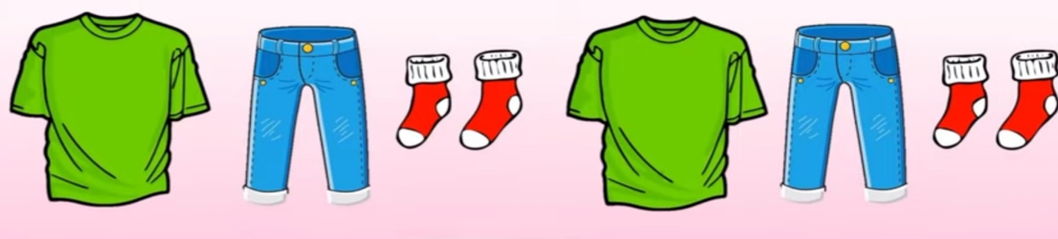

DRAW THE MISSING PATTERN

Slide 5
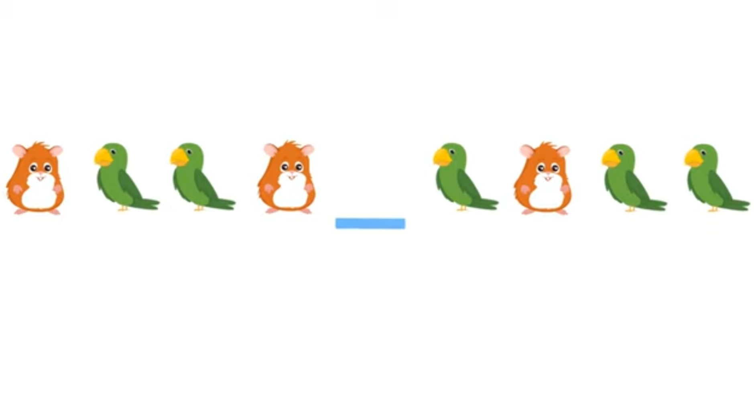


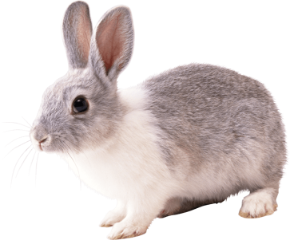

WHO IS NEXT ?

Slide 6



DRAW AND COLOUR THE MISSING PATTERN
CW
31.8.21
_________ ________
_________ ________
_________ _______

Slide 7
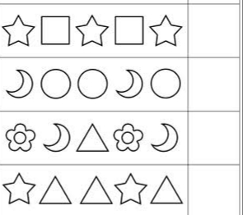
DRAW THE NEXT PATTERN
HW
31.8.21

Slide 8

THANKING YOU
ODM EDUCATIONAL GROUP

