Slide 1

WELCOME TO ON LINE CLASS
CLASS-UKG
SUBJECT-MATHS
TOPIC-PATTERNS
(BKPG-82-85)

Slide 2
PATTERN
A pattern is an arrangement of lines, shapes,objects especially a design in which the same is repeated at regular intervals over a surface.
A pattern is something that happens or appears in a regular & repeated way

Slide 3
Arrange the bins-

Slide 4


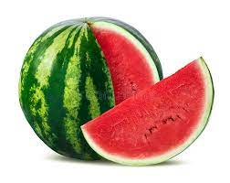








Arrange the fruits-

Slide 5
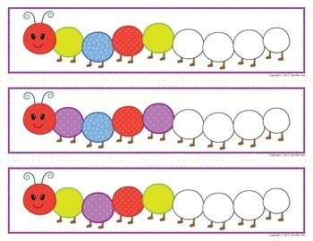
Colour my body in same pattern-

Slide 6
Arrange the triangles in a pattern-

Slide 7
Activity for patterns-
Say the next shape-

Slide 8


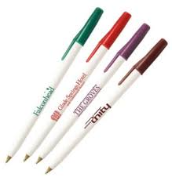
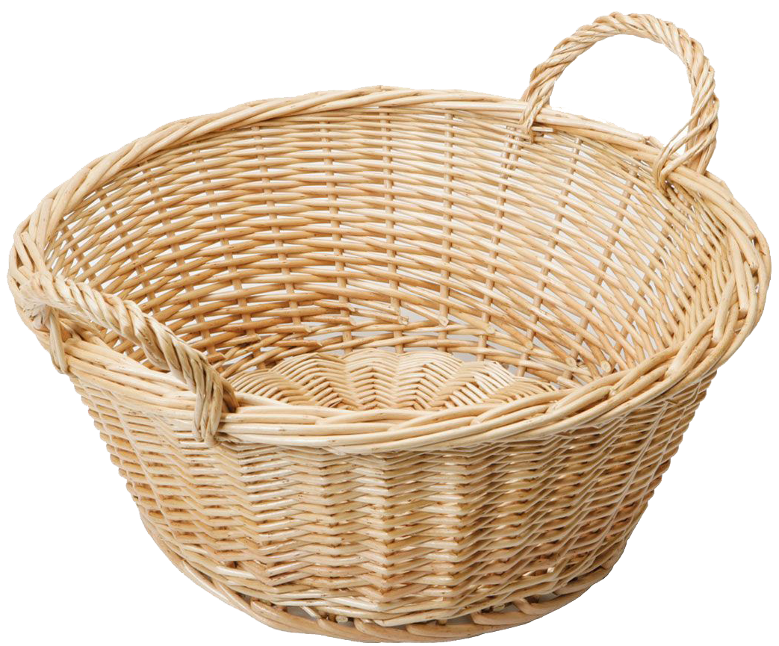

Match the same patterns-

Slide 9




Who is next ?

Slide 10
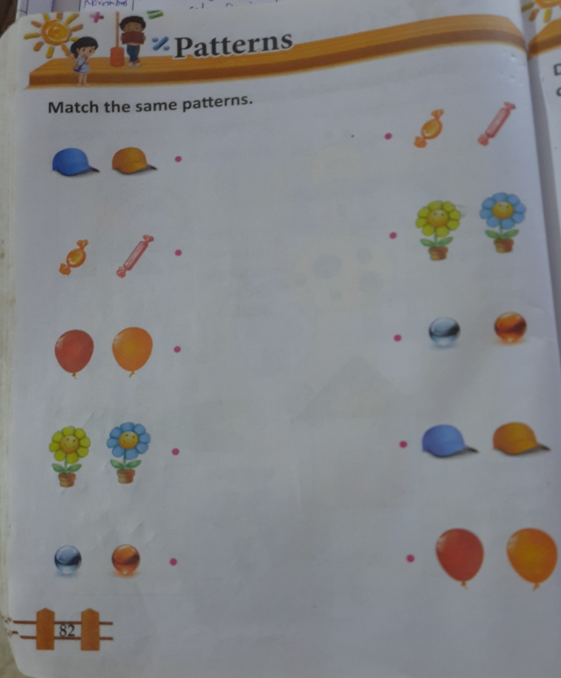
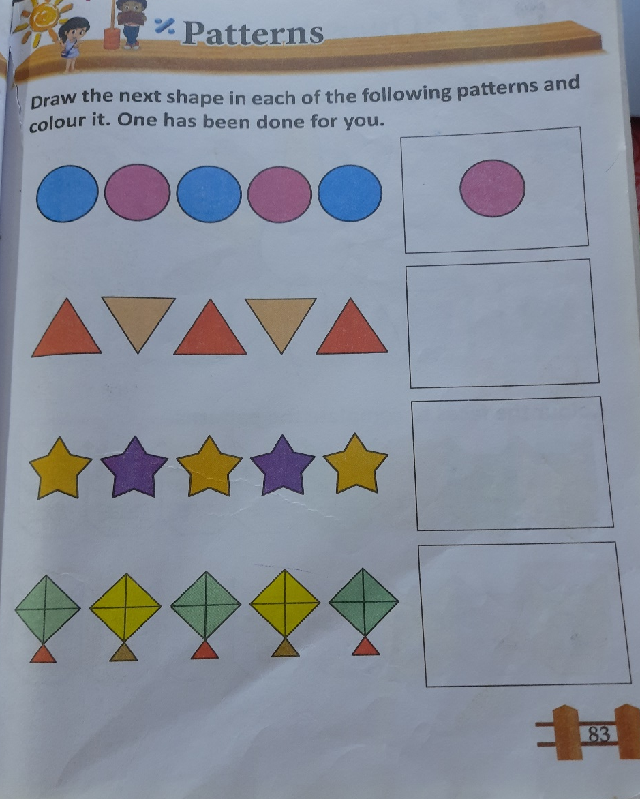
CW
26.8.21

Slide 11
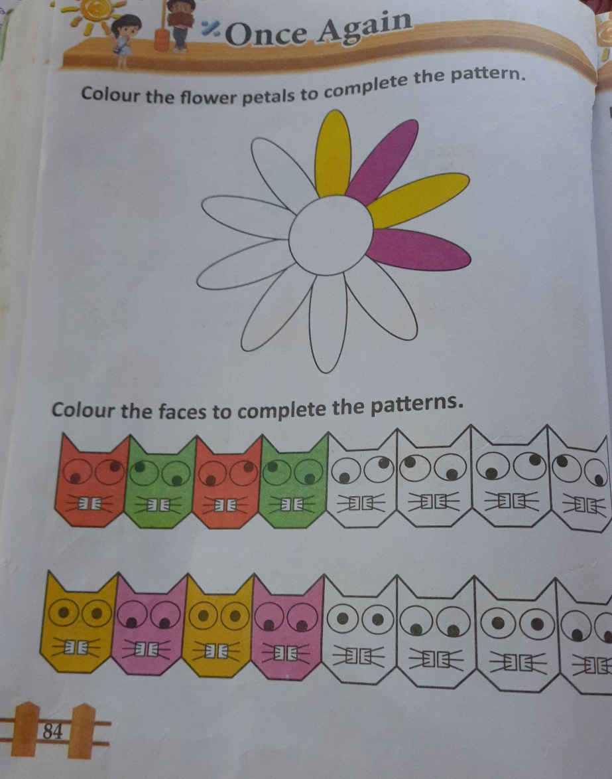
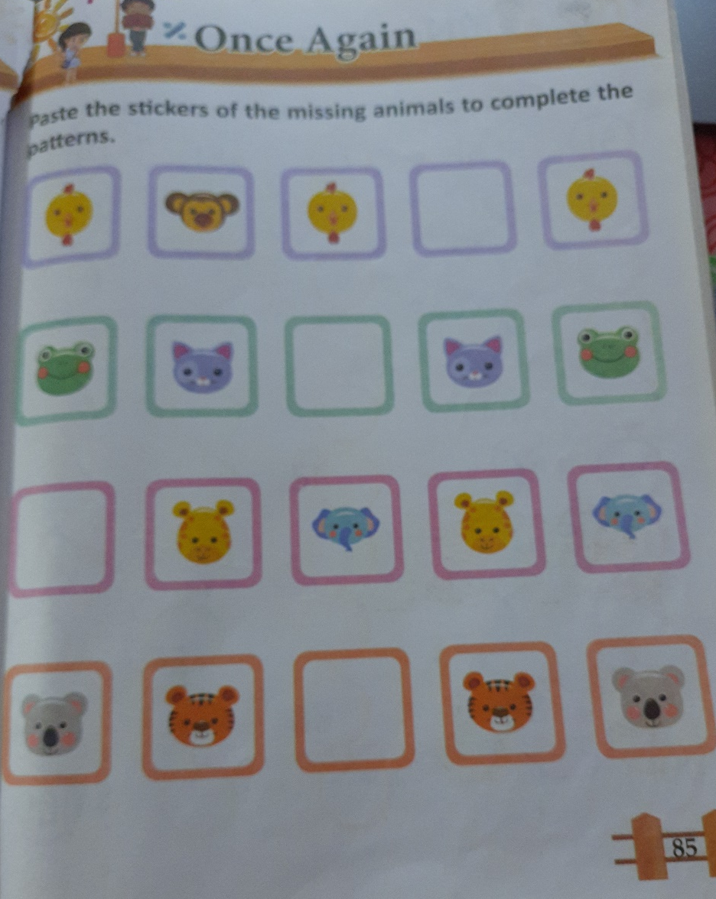
HW
26.8.21

Slide 12

THANKING YOU
ODM EDUCATIONAL GROUP

