Slide 1


LIGHT ENERGY
SUBJECT-PHYSICS CHAPTER NUMBER-5

Slide 2

POINTS TO BE COVERED
Spherical mirrors
Kinds of spherical mirrors
Terms related to spherical mirrors
Rules for drawing ray diagrams
Ray diagrams:

Slide 3
LEARNING OUTCOMES
Students will be able to
Identify different types of mirrors.
They can draw ray diagrams and illustrate formation of image by spherical mirrors.
Differentiate between real and virtual images.
State the rules for drawing ray diagrams
Draw ray diagrams.

Slide 4
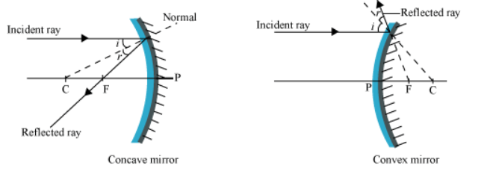
RULES FOR DRAWING RAY DIAGRAMS RULE:1
https://youtu.be/BuYkp5kuPHE

Slide 5
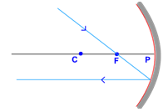
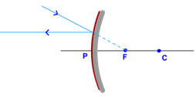
RULES FOR DRAWING RAY DIAGRAMS RULE:2

Slide 6
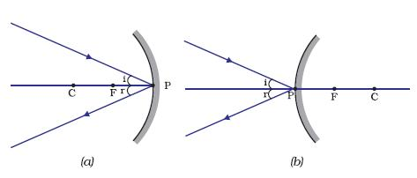
RULES FOR DRAWING RAY DIAGRAM RULE:3

Slide 7
RULES FOR DRAWING RAY DIAGRAMS:
https://youtu.be/BuYkp5kuPHE

Slide 8
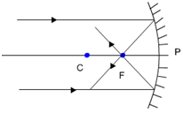
IMAGE FORMATION BY A CONCAVE MIRROR
When the object is at infinity:

Slide 9
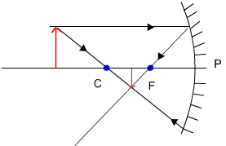
2. When the object is beyond C

Slide 10
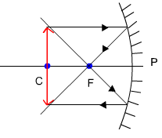
3. When the object is at C:

Slide 11
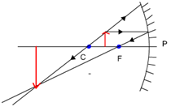
4. When the object is between C and F;

Slide 12
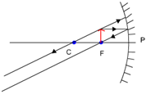
5. Object at Principal Focus (F):

Slide 13
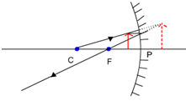
6. Object between F and C:

Slide 14
RAY DIAGRAMS (CONCAVE MIRROR)
https://youtu.be/OHXOwz1NLh0

Slide 15
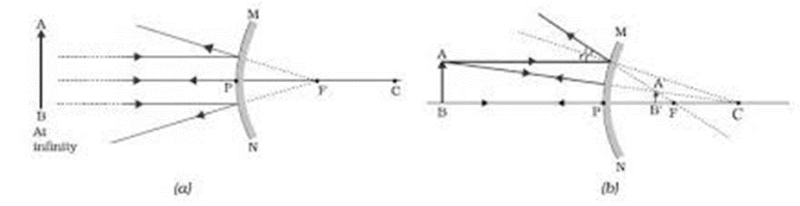
Ray diagrams for convex mirror

Slide 16
Home Assignment
1. Where is the image formed when the object is placed
At Infinity
Beyond C
At C
Between C and F
At F
Between F and C of a concave mirror.

Slide 17
THANKING YOU
ODM EDUCATIONAL GROUP

