Slide 1


LIGHT ENERGY
SUBJECT-PHYSICS CHAPTER NUMBER-5

Slide 2

POINTS TO BE COVERED
Spherical mirrors
Kinds of spherical mirrors
Terms related to spherical mirrors

Slide 3
LEARNING OUTCOMES
Students will be able to
Identify different types of mirrors.
They can draw ray diagrams and illustrate formation of image by spherical mirrors.
Differentiate between real and virtual images.

Slide 4
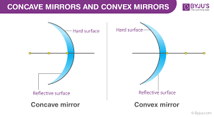
Spherical mirrors : The mirrors which are the part of a sphere.
Types of spherical mirror
Concave mirror
Convex mirror.
Concave Mirror: The mirror whose reflecting surface is curved inwards is called a concave mirror.
Convex Mirror: The mirror whose reflecting surface is curved outwards is known as a convex mirror.

Slide 5
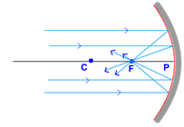
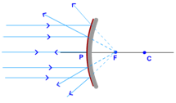
Concave mirror and convex mirror

Slide 6
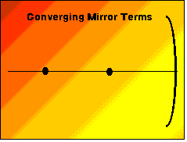
Concave mirror

Slide 7
Terms related to spherical mirrors
Pole
Focus
Focal Length
Centre of curvature
Radius of curvature
Principal Axis

Slide 8
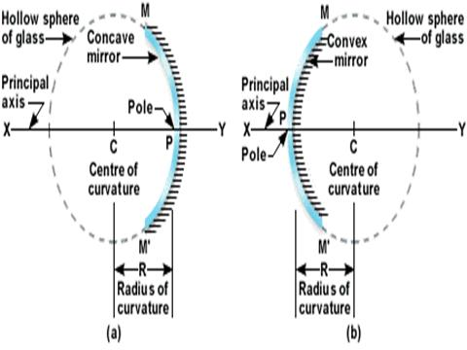
Terms related to spherical mirrors

Slide 9
Terms related to spherical mirrors:
Pole: The geometric centre of the spherical surface of the mirror is called the pole of the mirror.
Centre of curvature: It is the centre of the sphere of which the mirror is a part.
Radius of curvature: It is the radius of the sphere of which the mirror is a part.
Principal Axis: The imaginary line joining the pole and the centre of curvature.
Focal length: The distance between the focus and the pole of the mirror is called the focal length of the mirror.
Focal length = ½ x Radius of curvature.
Focus of a concave mirror: A point on the principal axis at which the light rays incident parallel to the principal axis converge after reflection from the mirror.
Focus of a convex mirror: A point on the principal axis at which the light rays incident parallel to the principal axis appear to meet after reflection from the mirror.

