Slide 1

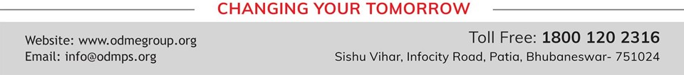
LIGHT ENERGY
SUBJECT-PHYSICS CHAPTER NUMBER-5

Slide 2

POINTS TO BE COVERED
Prism
Refraction through a prism
Dispersion of white light
Cause of dispersion

Slide 3
LEARNING OUTCOMES
Students will be able to
State the laws of refraction.
Explain about relative speed of light in different media.
Solve problems related to refractive index..

Slide 4
Refraction through glass prism , dispersion.
Prism is a transparent refracting medium bounded by at least two lateral surfaces , inclined to each other at a certain angle.
It has two triangular bases and three rectangular lateral surfaces.
The angle between two lateral surfaces is called angle of prism.

Slide 5
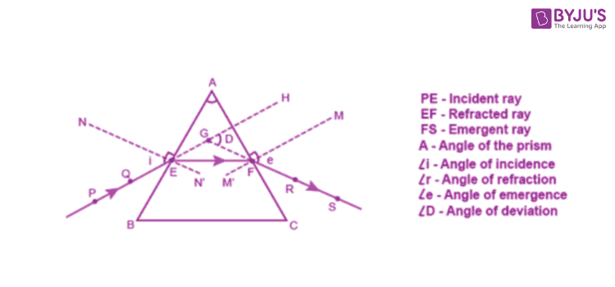
Refraction through a glass prism

Slide 6
Refraction through a glass prism
https://youtu.be/cQhO88edWxU
https://youtu.be/YN1-2Fat4Lw

Slide 7
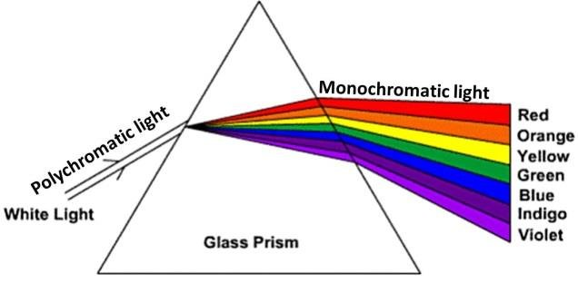
Dispersion of white light

Slide 8
Dispersion
The phenomenon of splitting of white light into its constituent colors when passes through a prism is called dispersion
The band of seven colors obtained are
Violet
Indigo
Blue
Green
Yellow
Orange
Red.
This band of seven colors obtained by dispersion of light is called spectrum

Slide 9
Causes of dispersion
Explain the causes of dispersion:
Light rays of different colours , travel with the same speed in vacuum and air but in any other medium they travel with different speeds and bend through different angles which leads to dispersion of light.

Slide 10
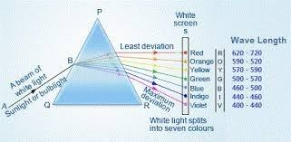
Dispersion and rainbow formation
The phenomenon of splitting of white light into its constituent seven colours is called as dispersion.

Slide 11
THANKING YOU
ODM EDUCATIONAL GROUP

