Slide 1

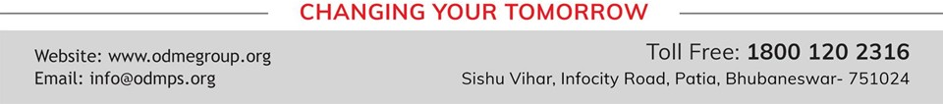
LIGHT ENERGY
SUBJECT-PHYSICS CHAPTER NUMBER-5

Slide 2

POINTS TO BE COVERED
Laws of Refraction.
Refractive Index.

Slide 3
LEARNING OUTCOMES
Students will be able to
State the laws of refraction.
Explain about relative speed of light in different media.
Solve problems related to refractive index..

Slide 4
RECAPITULATION OF PREVIOUS TOPIC
Define refraction.
What happens when a ray of light goes from a rarer medium to a denser medium?
What happens when a ray of light travels from a denser medium to a rarer medium?

Slide 5

LAWS OF REFRACTION:
https://youtu.be/v5SuSB_93FM
https://youtu.be/4l2thi5_84o

Slide 6
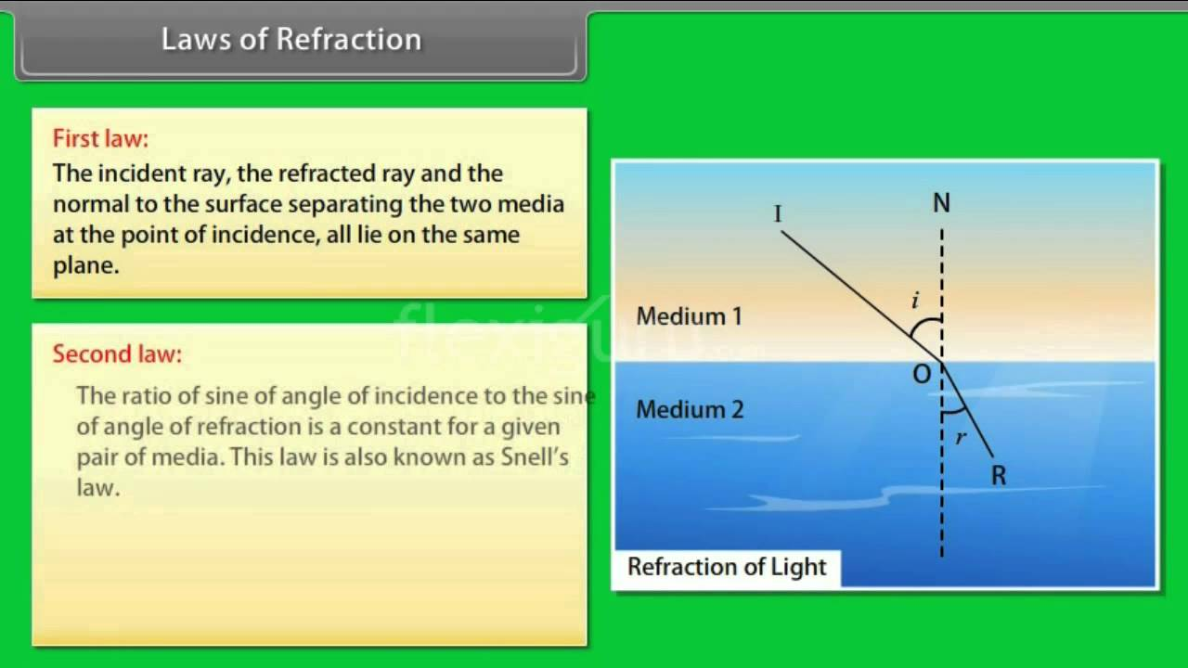
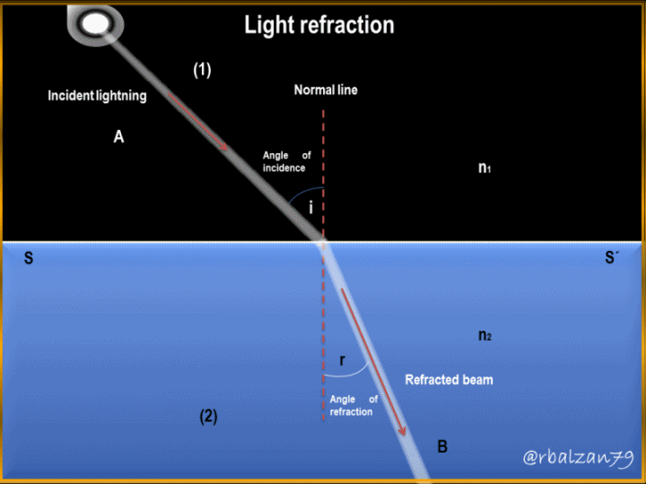
Refraction of light.

Slide 7


REFRACTIVE INDEX
The ratio of sine of angle of incidence to sine of angle of refraction is known as refractive index

Slide 8
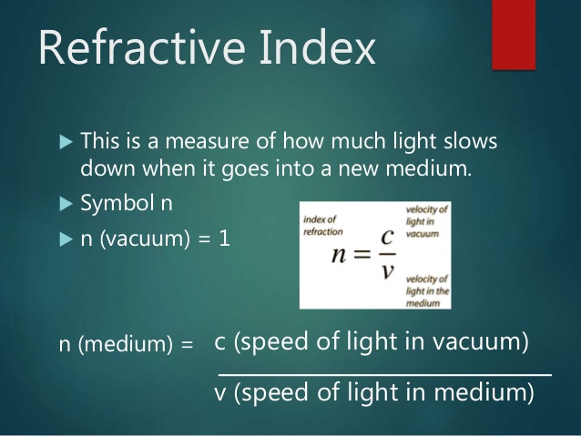
ABSOLUTE REFRACTIVE INDEX

Slide 9
SOLVE
The angle of incidence in medium A is 60⁰ and the angle of refraction in medium B is45⁰.Find the refractive index of the medium B with respect to medium A.
Given refractive index of glass for light going from air to glass is 3/2. Find the refractive index of air for light going from glass to air.

Slide 10
SOLVE
Light enters from air to glass having refractive index 1.50. What is the speed of light in glass? The speed of light in vacuum is 3 x 10⁸ ms⁻¹.
C = 3 x 10⁸ ms⁻¹.
n = 1.5
n = c/v
1.5 = 3 x 10⁸ ms⁻¹ /v
V = 3 x 10⁸ ms⁻¹ /1.5
= 2 x 10⁸ ms⁻¹

Slide 11
HOME ASSIGNMENT
The absolute refractive index if glass and water are 4/3 and 3/2, respectively. If the speed of light in glass is 2 x 10⁸ m/s, calculate the speed of light in
Vacuum
Water
2. The refractive index of glass is 1.54 and the speed of light in air is 3x10 m/s. Calculate the speed of light in water?

Slide 12
THANKING YOU
ODM EDUCATIONAL GROUP

