Slide 1

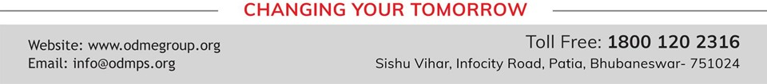
LIGHT ENERGY
SUBJECT-PHYSICS CHAPTER NUMBER-5

Slide 2


LEARNING OBJECTIVE
Students will be able to :
state the laws of reflection.
Draw ray diagram to illustrate formation of image by a plane mirror.
apply the law of reflection to predict the position of images formed by objects in front of a plane mirror.
Identify different types of mirrors.

Slide 3

Recapitulation:
Define refraction.
What is the speed of light in air, water and glass?
How does the speed of light determine the optical density of a medium?
Which is optically denser? Water or air.
Out of air and glass, which is optically rarer?

Slide 4
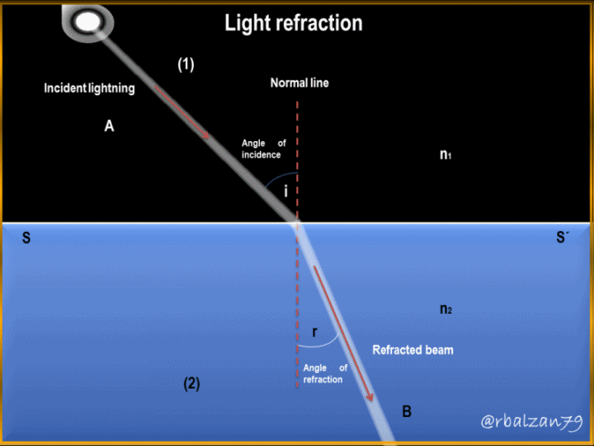

Refraction of light.

Slide 5
Terms related to Refraction of light.
Incident Ray
Refracted ray
Normal
Angle of incidence
Angle of refraction

Slide 6
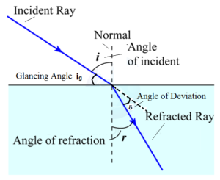
Terms related to Refraction of light.

Slide 7
Terms related to Refraction of light.
Incident Ray: The ray of light falling on the surface separating the two media is called the incident ray.
Refracted ray: The ray of light travelling in other medium in the changed direction is called the refracted ray.
Normal: The perpendicular drawn on the surface separating the two media at the point where the incident ray strikes it.
Angle of incidence: The angle between the incident ray and the normal is called the angle of incidence.
Angle of refraction: The angle between the refracted ray and the normal is called the angle of refraction.

Slide 8
LAWS OF REFRACTION
https://youtu.be/4l2thi5_84o

Slide 9
THANKING YOU
ODM EDUCATIONAL GROUP

