Slide 1

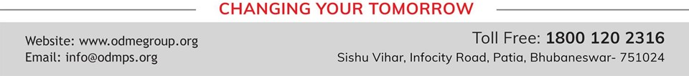
LIGHT ENERGY
SUBJECT-PHYSICS CHAPTER NUMBER-5

Slide 2

POINTS TO BE COVERED
Laws of Refraction.
Refractive Index.
Effects of refraction.

Slide 3
LEARNING OUTCOMES
Students will be able to
State the laws of refraction.
Explain about relative speed of light in different media.
Solve problems related to refractive index..

Slide 4
RECAPITULATION OF PREVIOUS TOPIC
Define refraction.
What happens when a ray of light goes from a rarer medium to a denser medium?
What happens when a ray of light travels from a denser medium to a rarer medium?

Slide 5
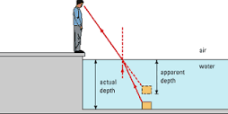
EFFECTS OF REFRACTION (The depth of water in a vessel when seen from air appears to be less)

Slide 6
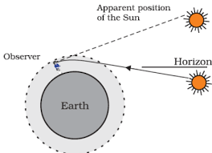
Advance sunrise and delayed sunset:

Slide 7
Advance sunrise and delayed sunset:
The sun is visible to us about two minutes before the actual sun rise and about two minutes after the actual sun set because of atmospheric refraction.
When the sun is slightly below the horizon, the sun light come from less dense to denser air. So it is refracted downwards, due to this sun appears to be raised above the horizon and we can see it before the sun rise.

Slide 8
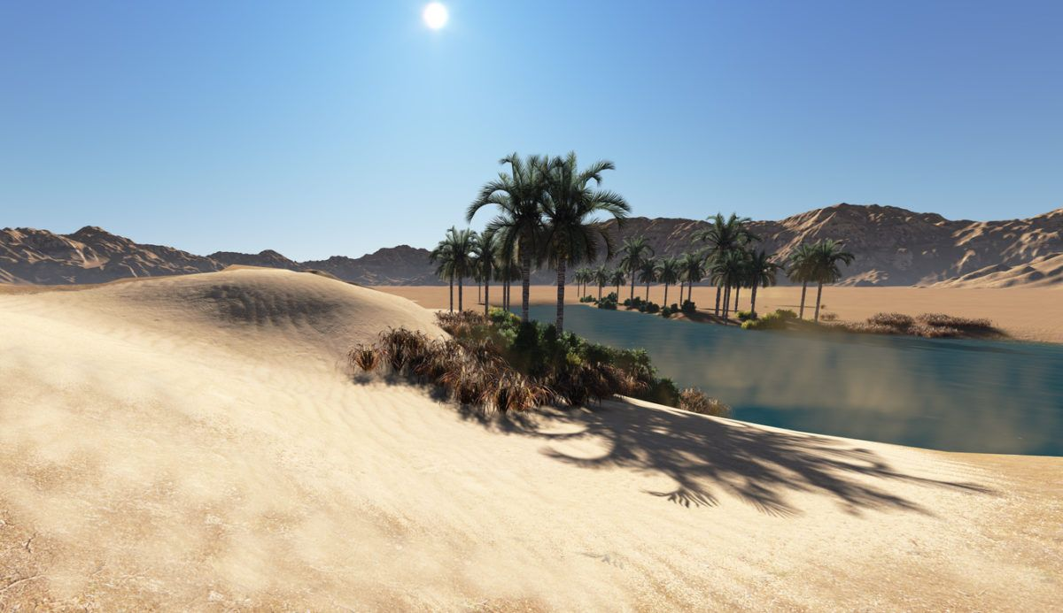
Mirage in a desert

Slide 9
Mirage
Some times in deserts, an inverted image of a tree is seen which gives a false impression of water under the tree. This is called a mirage.
Cause: Refraction of light.

Slide 10
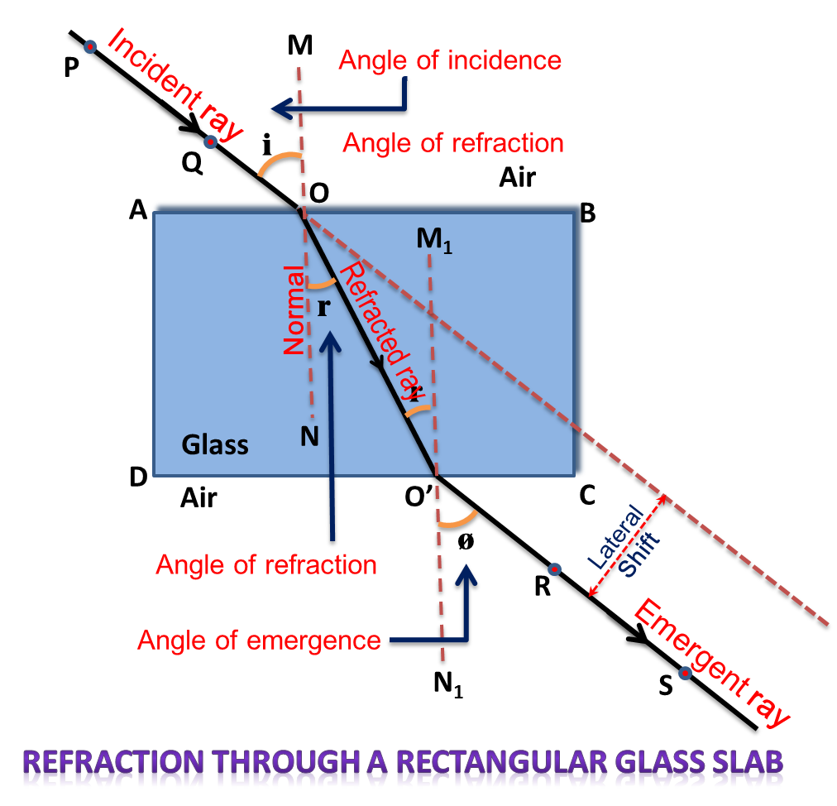
Refraction through a glass slab:

Slide 11
Refraction through a glass slab:
https://youtu.be/el8AUeZaljw

Slide 12
THANKING YOU
ODM EDUCATIONAL GROUP

