Slide 1



CLASS: NURSERY
DATE:16-11-21
SUBJECT:RHYMES
TOPIC: Lare lapa lare lapa
(page no-12)

Slide 2
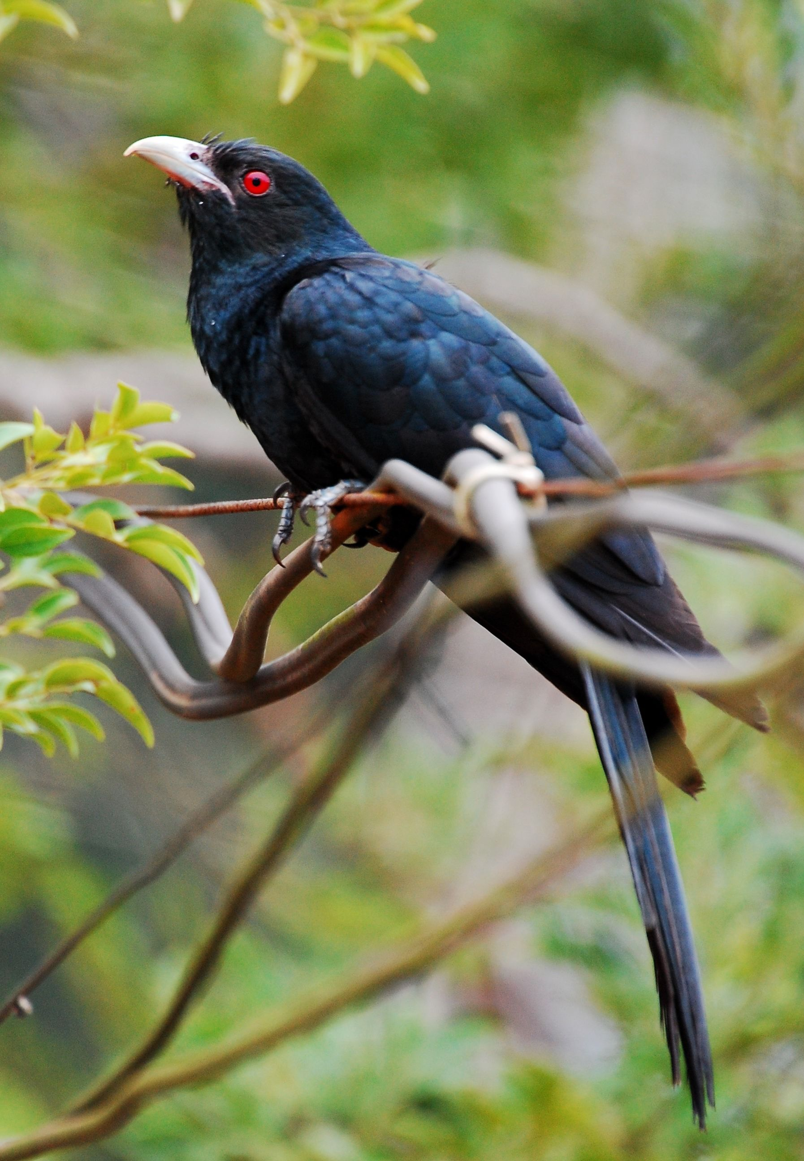
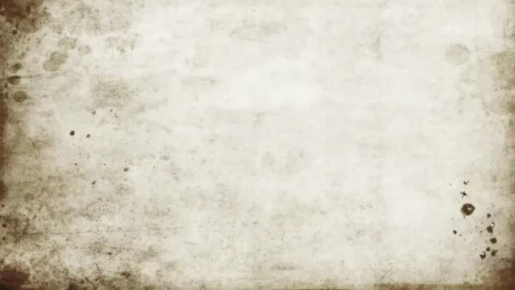

Slide 3
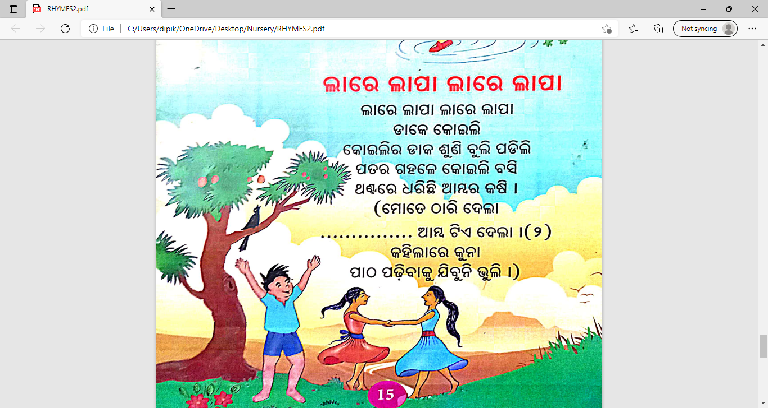

Slide 4
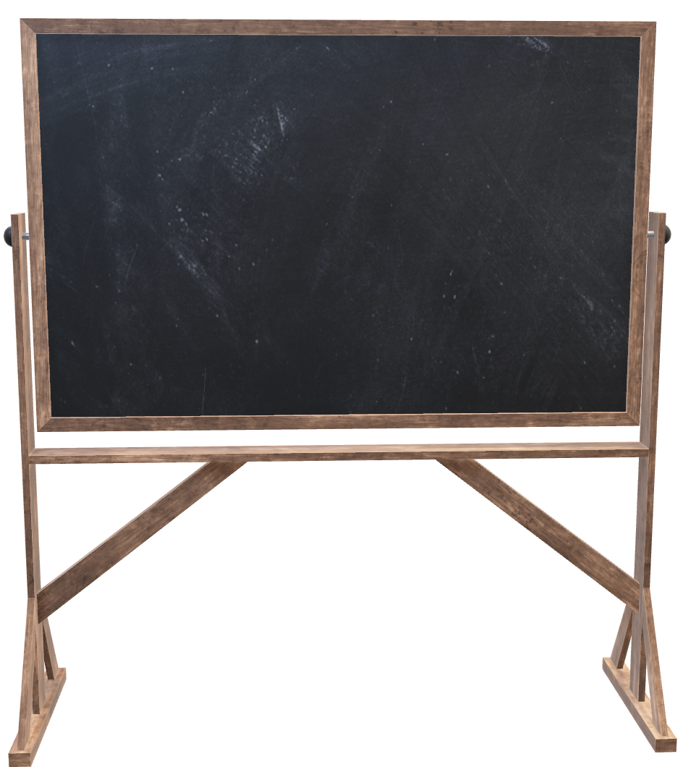
16/11/21
HOME ASSIGNMENT
Practice the ‘Lare lapa lare lapa ’ rhymes with proper tune and action (pg no-12)

Slide 5
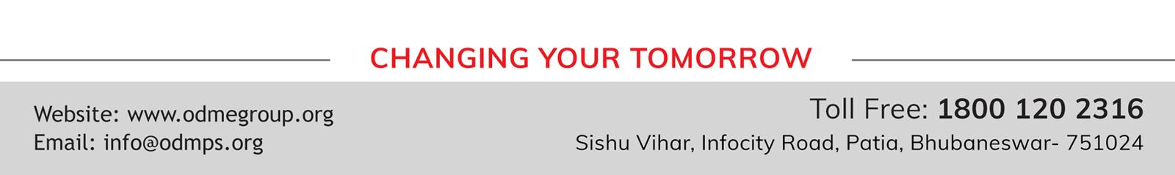
THANKING YOU
ODM EDUCATIONAL GROUP

