Slide 1

LOST SPRING
WRITER:ANEES JUNG
SUBJECT : (ENGLISH)
CHAPTER NUMBER:2ND PROSE(FLAMINGO)

Slide 2
Expected learning outcomes.
Students will be able to relate with the child labour prevailing in our country.
Students will be able to co-relate the importance of education
Students will be familiarized with the plight and pathetic condition of the children living in Seemapuri and Firozabad.
Students will be able to build their perspective on the theme .
Students will be able to reflect on the title of the story.

Slide 3
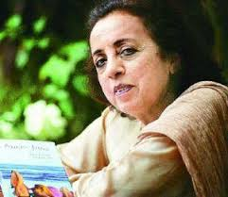
A few facts about the Writer ANEES JUNG:
Was born in Rourkela; brought up in Hyderabad.
Received education in Hyderabad and in the USA.
Began writing career under her writer-parents
Was an Editor, Columnist and Author .
This lesson is an excerpt from her book-”Lost Spring-Stories of Stolen Childhood”.
“Unveiling India” (1987) was her noted work on Indian women

Slide 4
Video Links
https://youtu.be/ZQ-wxr-2K98
(bangle makers of Firozabad)
https://youtu.be/6tECfeOdLIY
(rag-pickers of India –The harsh reality)

Slide 5
Theme of the Lesson:
Child Labor, a national shame
Poor children condemned to a life of exploitation
Grinding Poverty without childhood, innocence, education and enjoyment
Childhood replaced by premature adulthood

Slide 6
Background information on the Lesson:
An Anecdotal account
Writer’s social concern on Child labour
Awareness creation on the issue by - Analysis of the problems involved
- Suggestive solutions

Slide 7
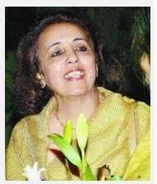
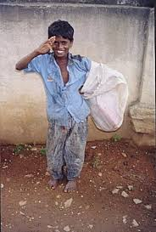
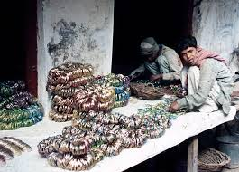
Characters involved
Predominantly Three Characters –
1. Anees Jung, the writer
2. Saheb-e-Alam - a poor boy of ten years - a rag picker by profession - lives in Seemapuri - without the charms of childhood
3. Mukesh - a bangle maker - lives in Firozabad
*Minor Characters – 1. Savita – a bangle-making young girl in Mukesh’ family 2. Grand parents of Mukesh.

Slide 8
Lesson-Contents of LOST SPRING
“Lost Spring”- its metaphorical connotation
And the Lesson B E G I N S…
‘Sometimes I find a Rupee in the garbage’
“Why do you do this?” I ask Saheb whom I encounter every morning scrounging for gold in the garbage dumps of my neighborhood.
… further interactions of Jung with Saheb continues…

Slide 9
Jung-Saheb interactions brought forward…
Saheb’s migration from Bangladesh
Offer of studentship in writer’s School
Actual Name of Saheb unveiled
Chappal context raised…reality pointed out
“I wonder if this is only an excuse to
Explain away a perpetual state of poverty.”
Story of a man from Udipi Seemapuri & 20000 poor rag-pickers
… Seemapuri, a place on the periphery of Delhi
yet miles away from it, metaphorically. … Garbage to them is gold.

Slide 10
Jung-Saheb interaction continues…
…For the children it is wrapped in wonder, for the elders it is a means of survival.
Saheb’s fascination for Tennis… psychological factor
Saheb finally in Milk Booth, but without freedom
-Rises from Rag-picker to Sales boy
(starts working in a tea stalls)
-Earns more
-but loses the Spring of life -CHILDHOOD
SAHEB

Slide 11
Browsing through VOCABULARY ( of hitherto portion of the lesson)
A few new Words for you-
- Encounter - meet (someone) unexpectedly. - Scrounging -searching - Garbage -waste materials
- Abound -heap - desolation -isolated - Transit-temporary

Slide 12
Anees Jung with MUKESH
MUKESH is a child Bangle Make
-An aspirant to be different , to be moneyed “I want to drive a car”
Hails from bangle-making family of Firozabad
Jung visits Mukesh’ house & interacts with his grandparents, Savita
Experience of their horrible life…
- early loss of eye-sight - single room existence with furnace
“… I wonder if she knows the sanctity of the bangles she helps make”
To anything else mean to dare. And daring is not part of his growing up. The author is cheered when she senses a flash of it in Mukesh who wants to be a motor mechanic.

Slide 13
Browsing through VOCABULARY ( of hitherto portion of the lesson)
-Canister –steel container
-Mirage - illusion
-Slog - to work hard and steadily .
-Wobbly -unstable
-Renovate -rebuild
- lineage- ancestry.
-Mounds- large pile or quantity of something
-Unkempt - untidy

Slide 14
May I check up your Comprehension?
Which forces conspire to keep the workers in the bangle industry of Firozabad in poverty?
Which two distinct worlds does the author notice among the bangle –making industry?
What do you perceive about the living reality of Mukesh?

Slide 15
THANKING YOU
ODM EDUCATIONAL GROUP

