Slide 1


PERIOD 4
MATHEMATICS
CHAPTER NUMBER :~ 4
CHAPTER NAME :-LINEAR EQUATION IN TWO VARIABLES

Slide 2
LEARNING OUTCOME:-
1.Students will be able to recapitulate Linear Equation In Two Variables.

Slide 3
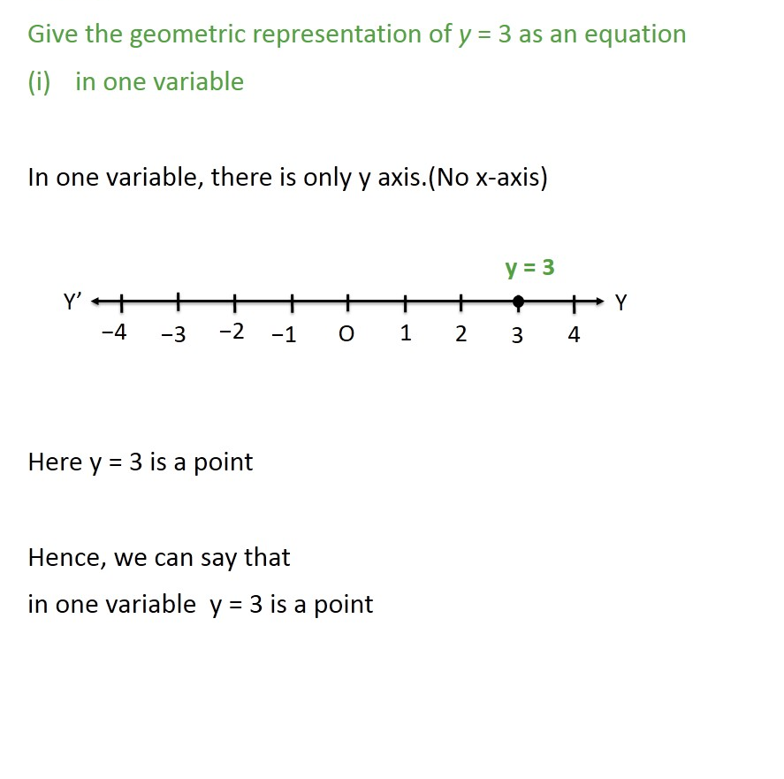


Slide 4
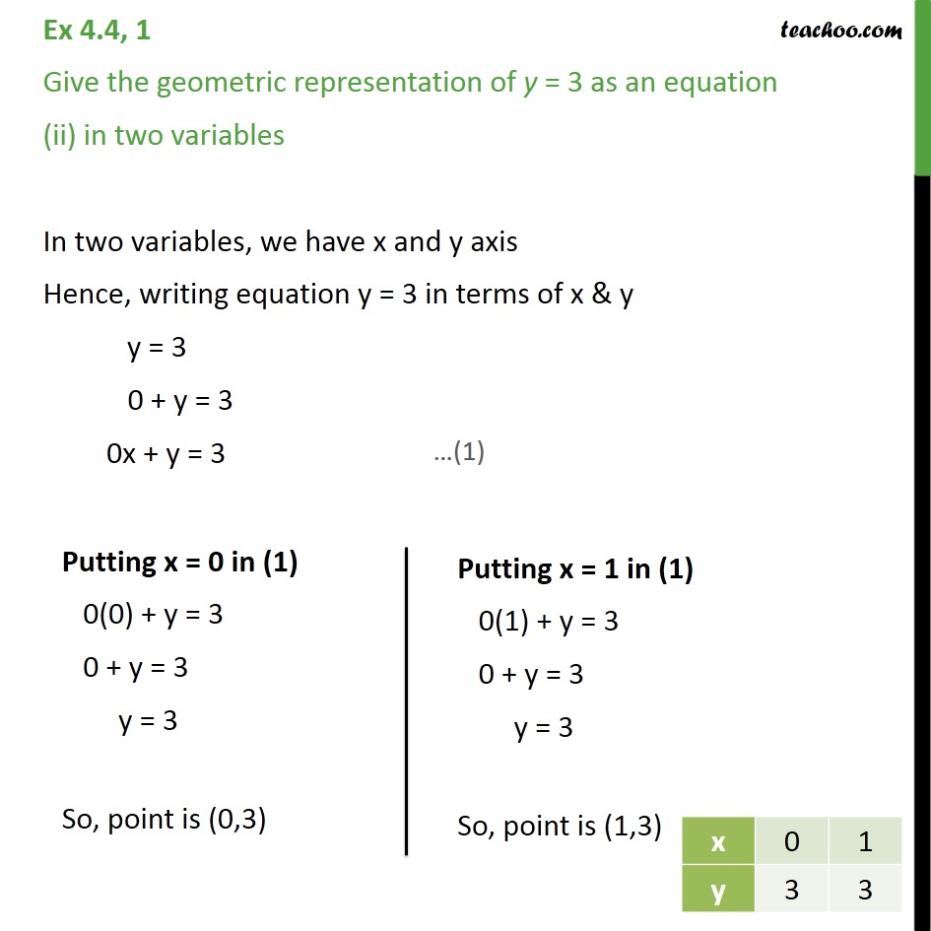

Slide 5
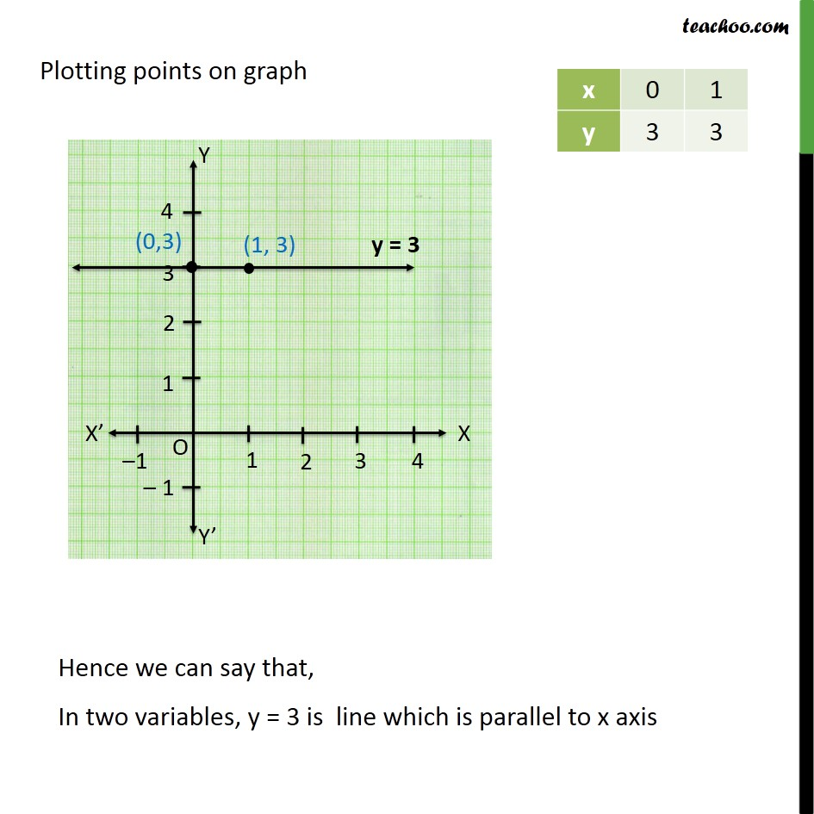

Slide 6
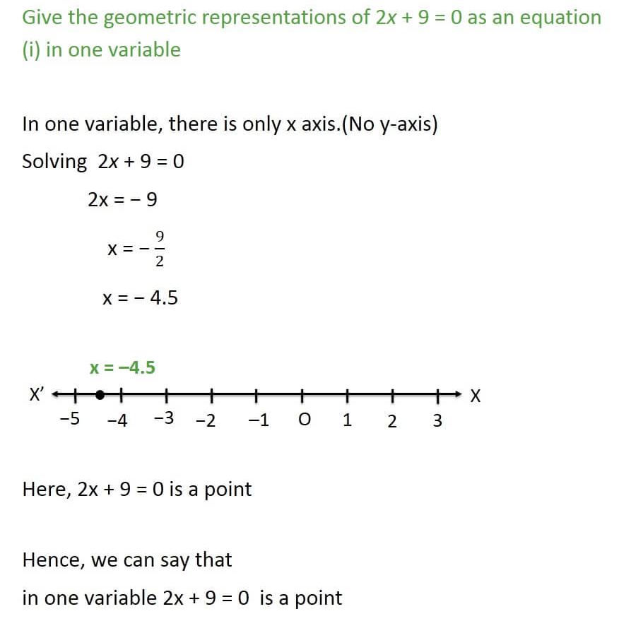


Slide 7
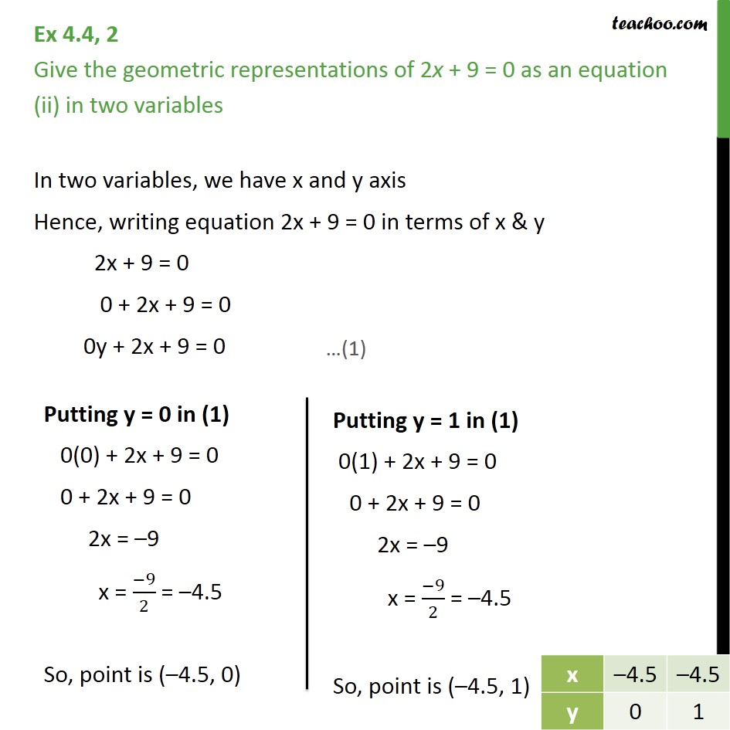


Slide 8
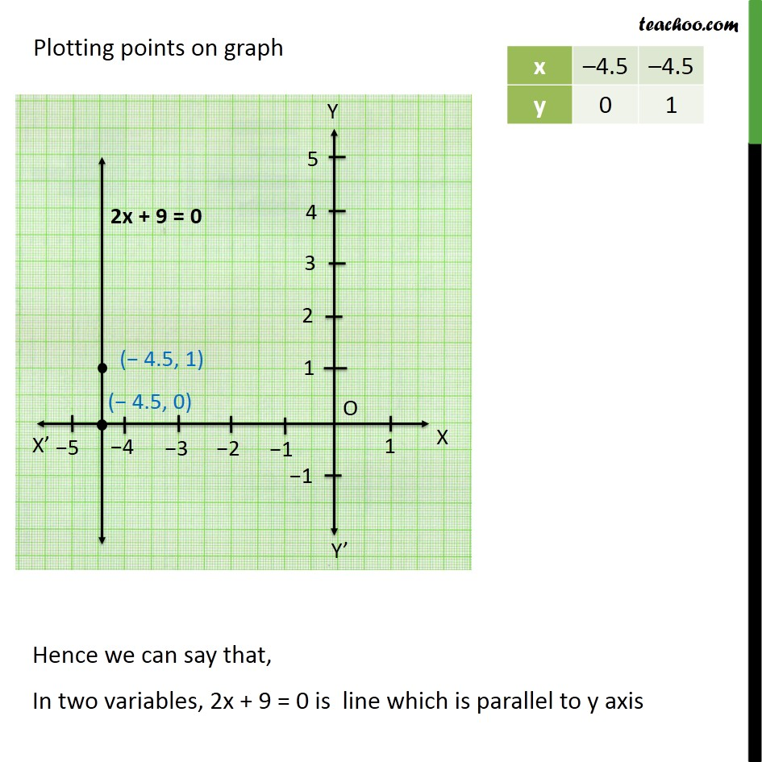

Slide 9
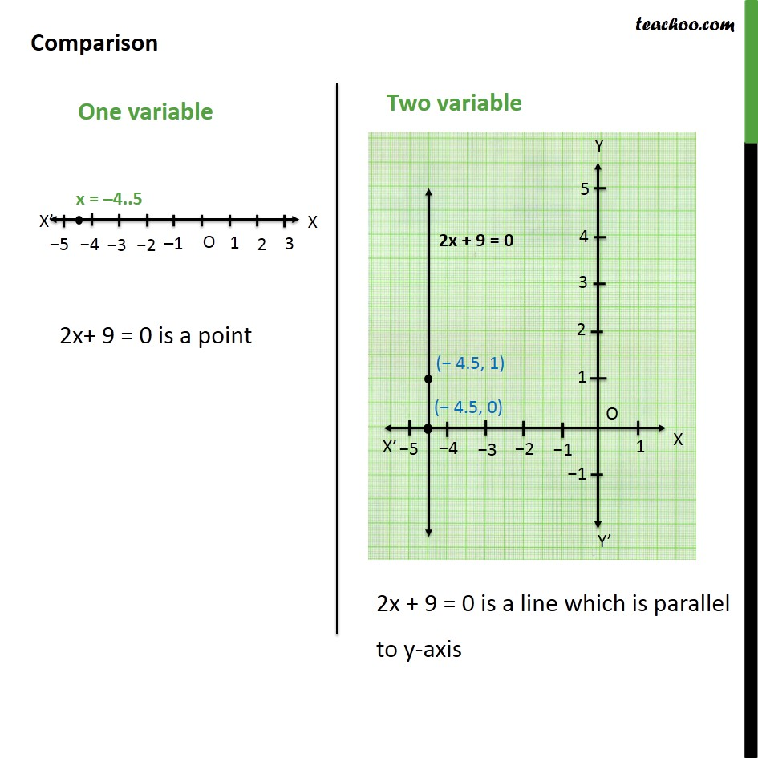


Slide 10
Homework assignment
Exercise 4.4

Slide 11
AHA
1.For the first kilometer ,the auto fare is rs 12 and the subsequent distance is rs 7 per km.Taking distance covered as x km and the total fare as rs y write a linear equation .

Slide 12
THANKING YOU
ODM EDUCATIONAL GROUP

