Slide 1


PERIOD 3
MATHEMATICS
CHAPTER NUMBER :~ 4
CHAPTER NAME :-LINEAR EQUATION IN TWO VARIABLES

Slide 2
LEARNING OUTCOME:-
1.Students will be able to learn to plot graph of Linear Equation In Two Variables.

Slide 3
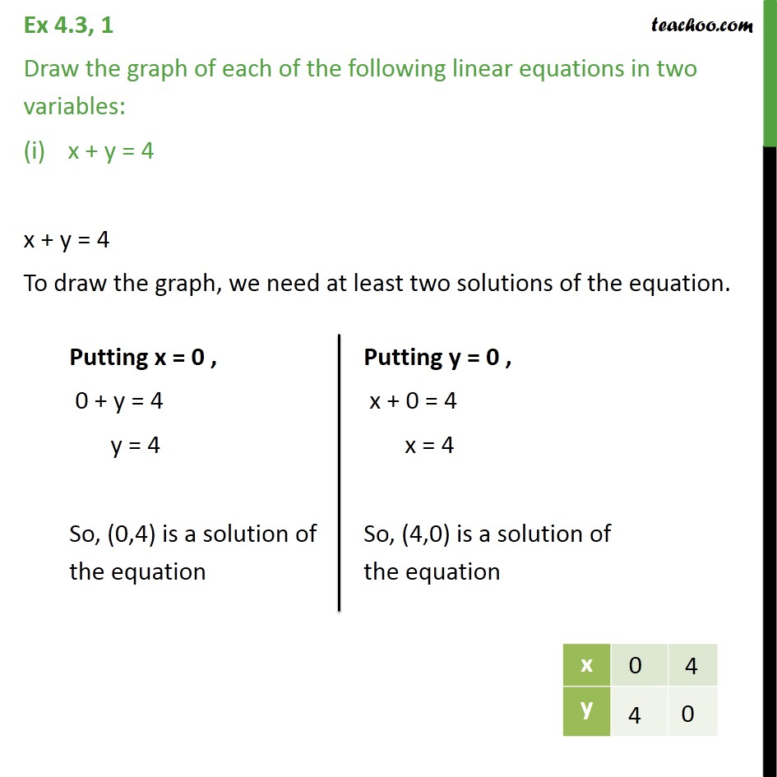


Slide 4
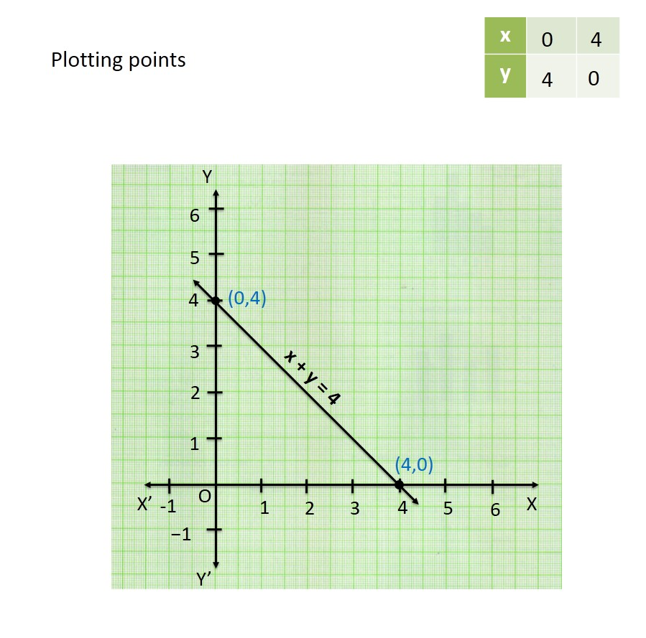

Slide 5
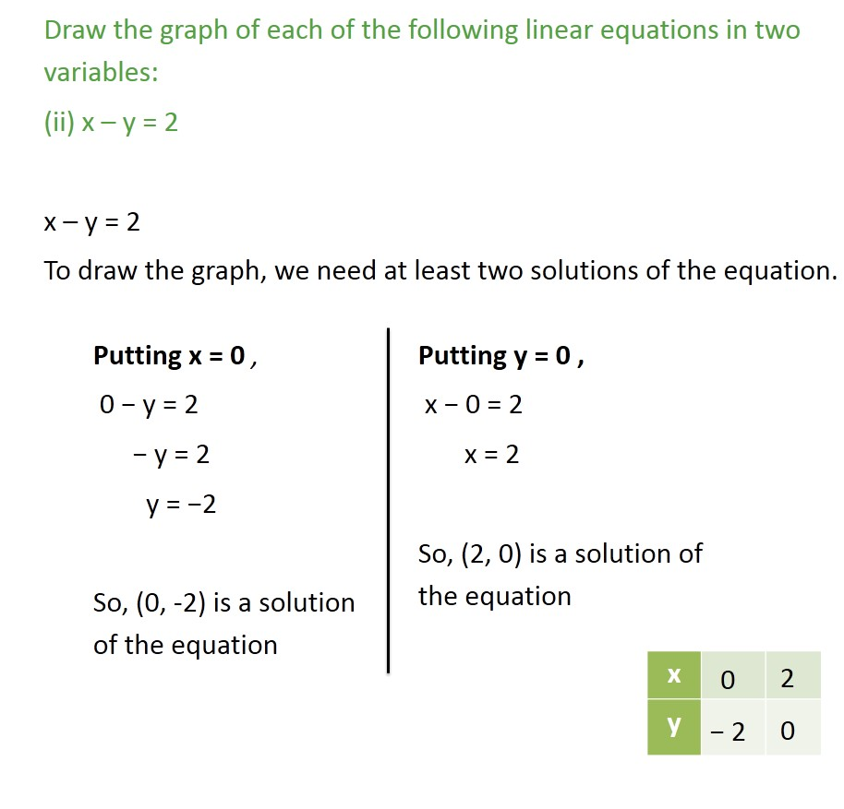

Slide 6
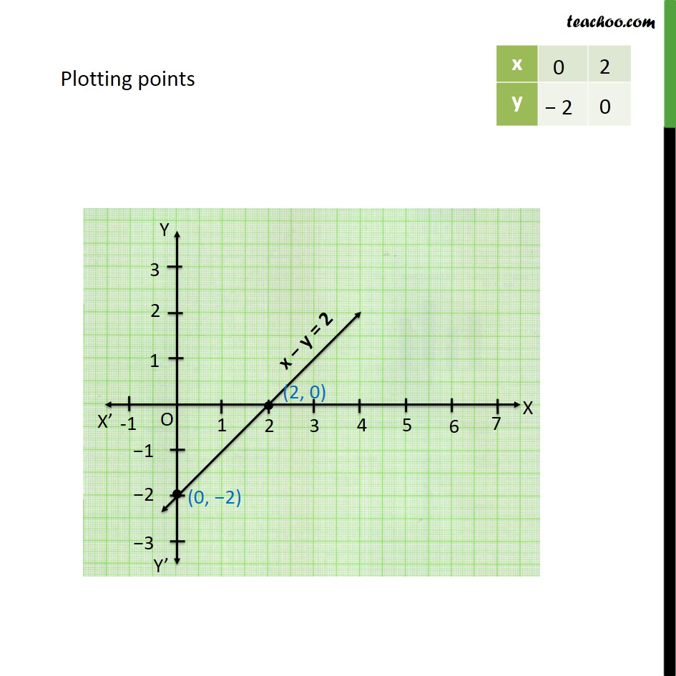


Slide 7
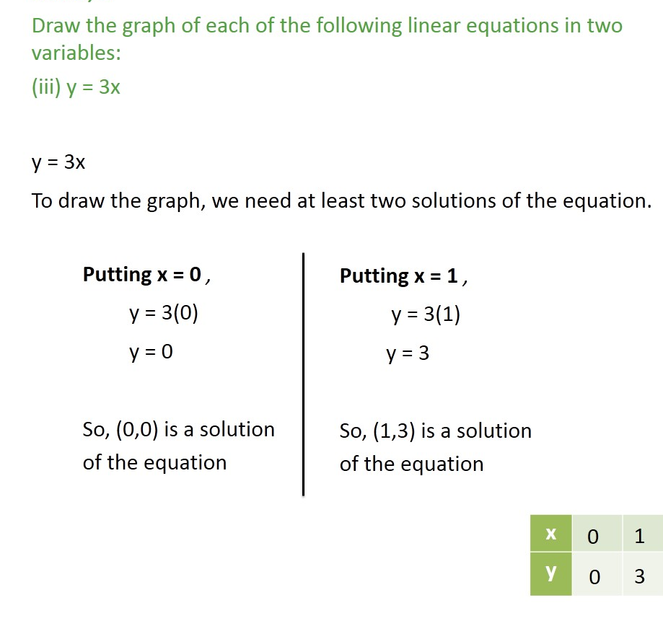


Slide 8
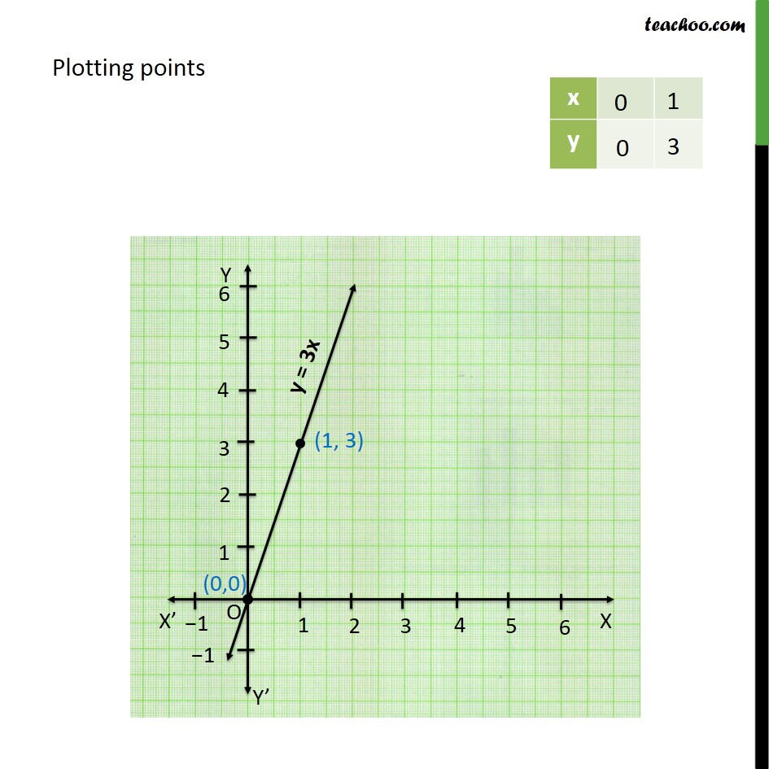


Slide 9
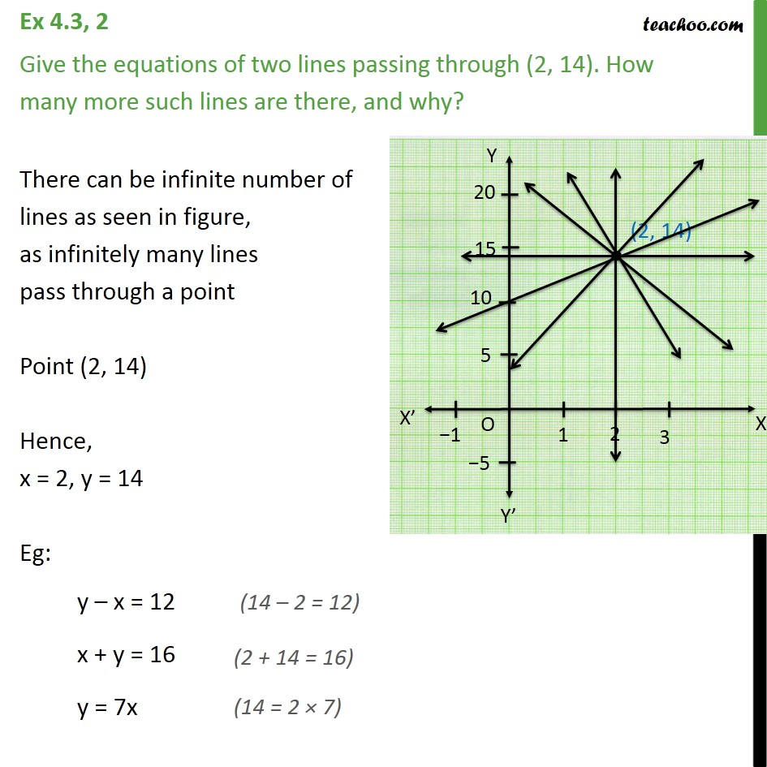

Slide 10
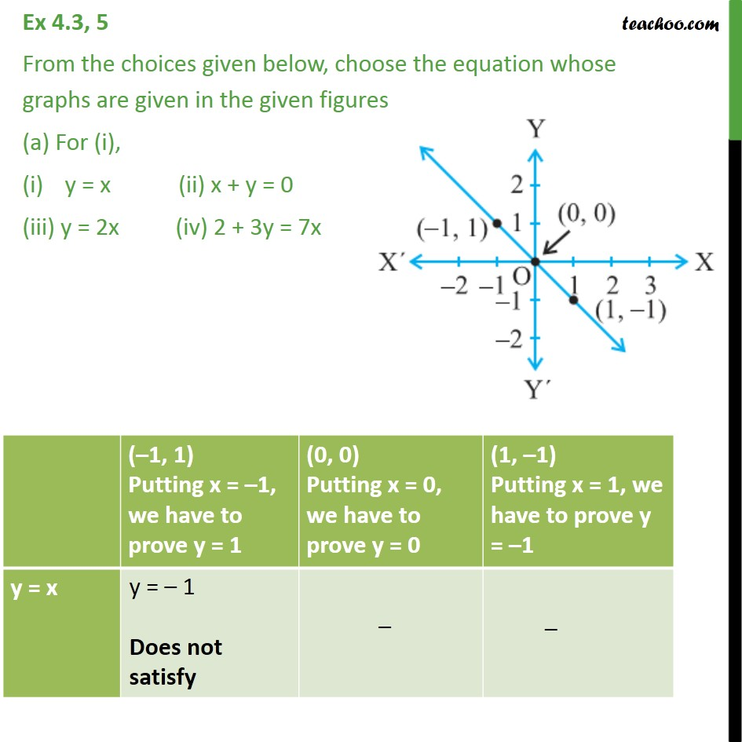

Slide 11
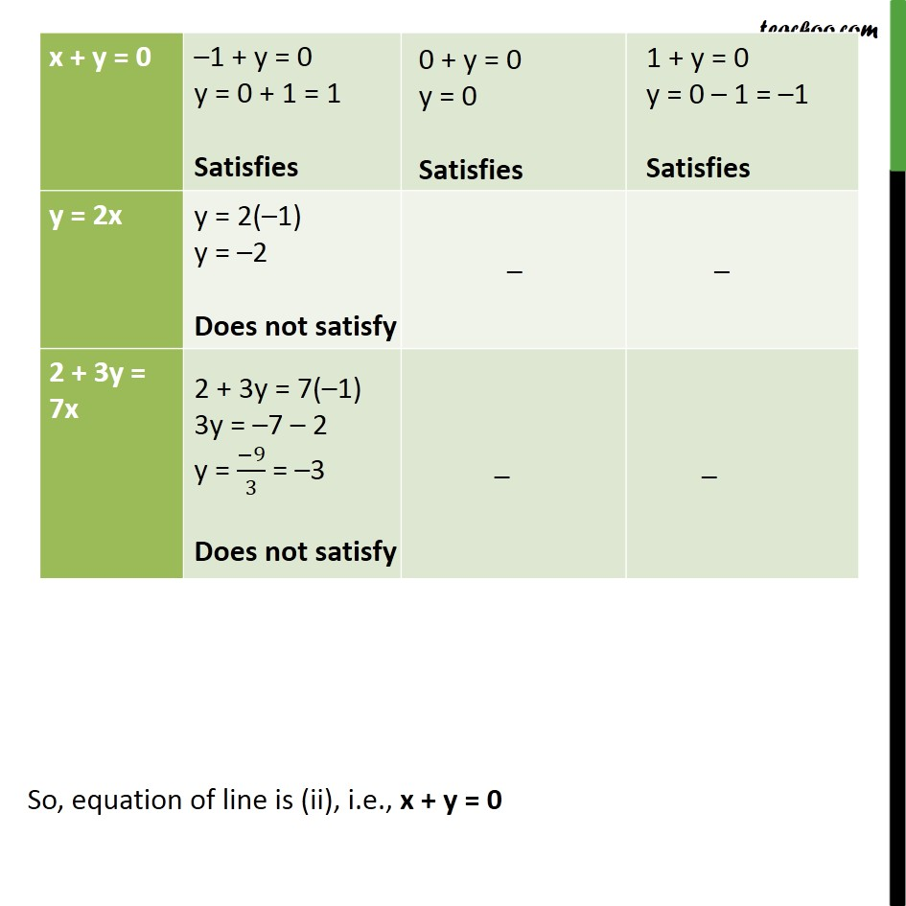

Slide 12
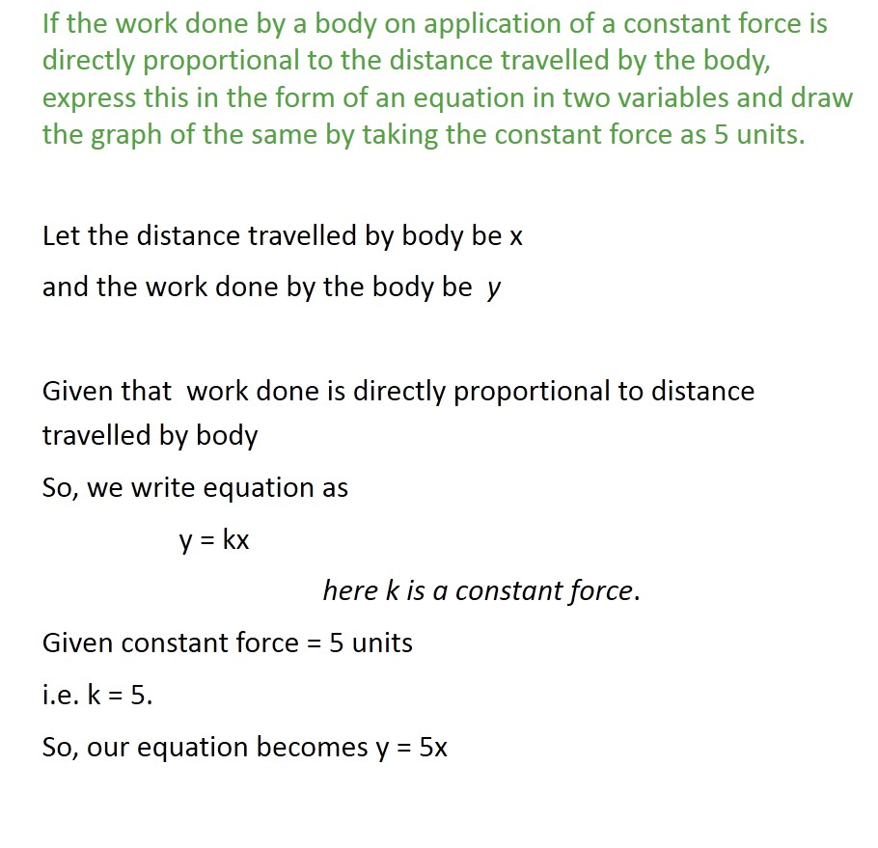

Slide 13
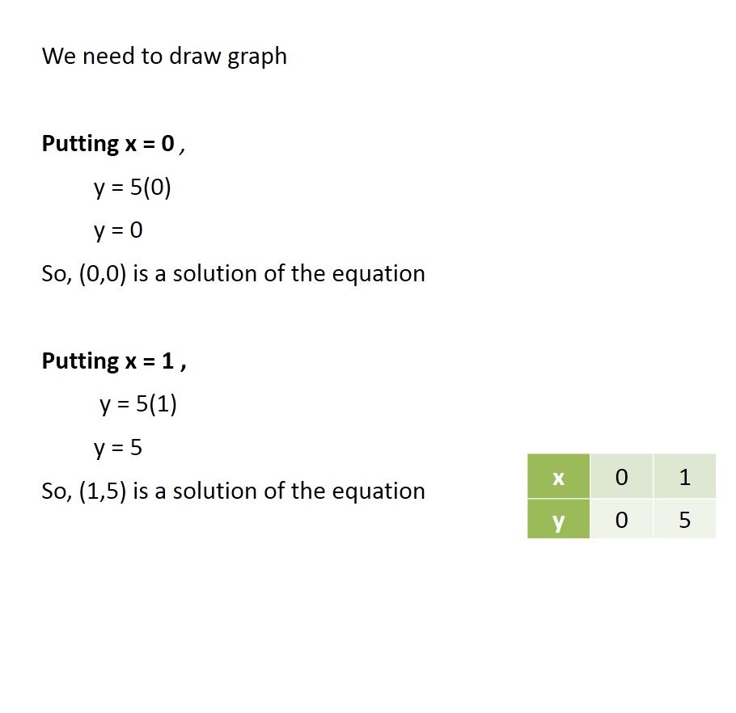


Slide 14
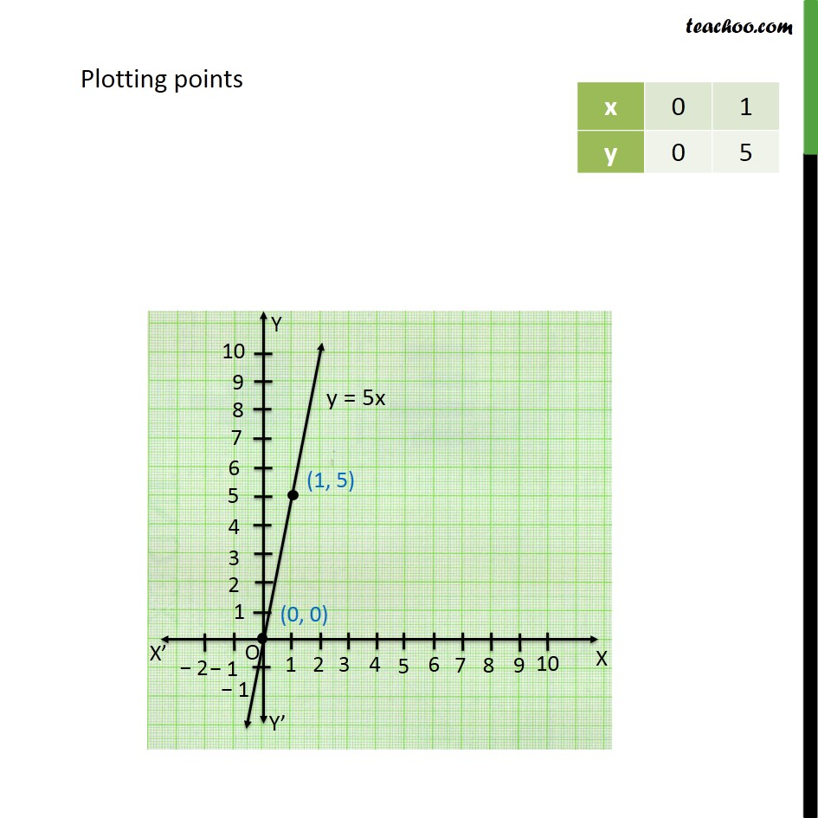


Slide 15
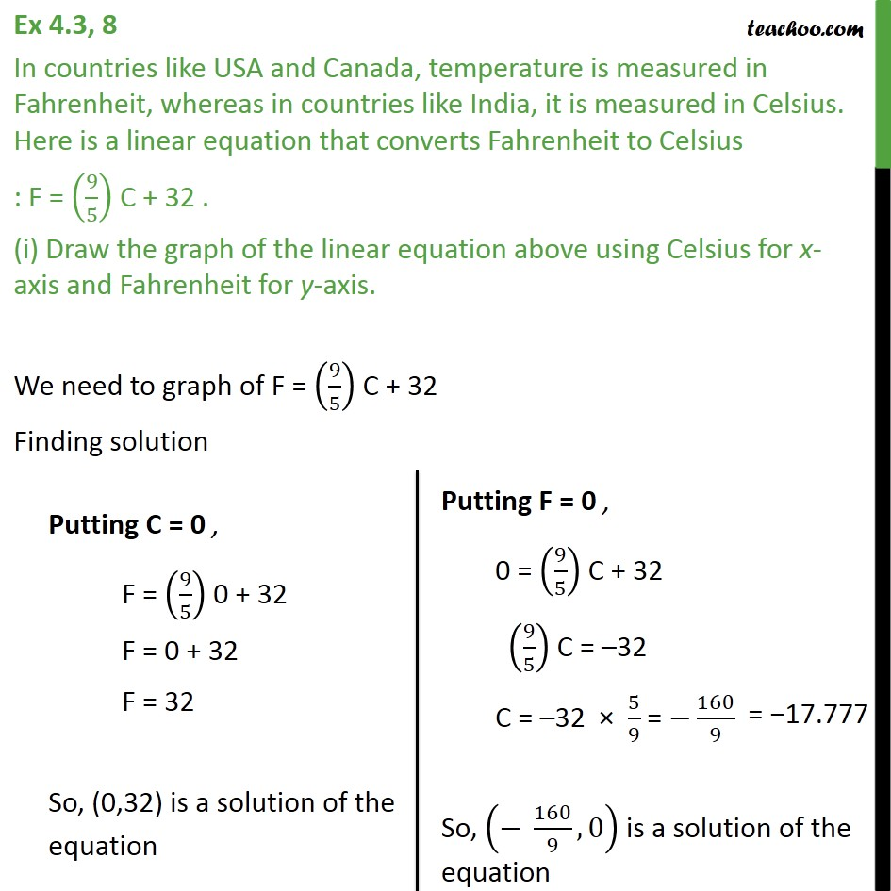

Slide 16
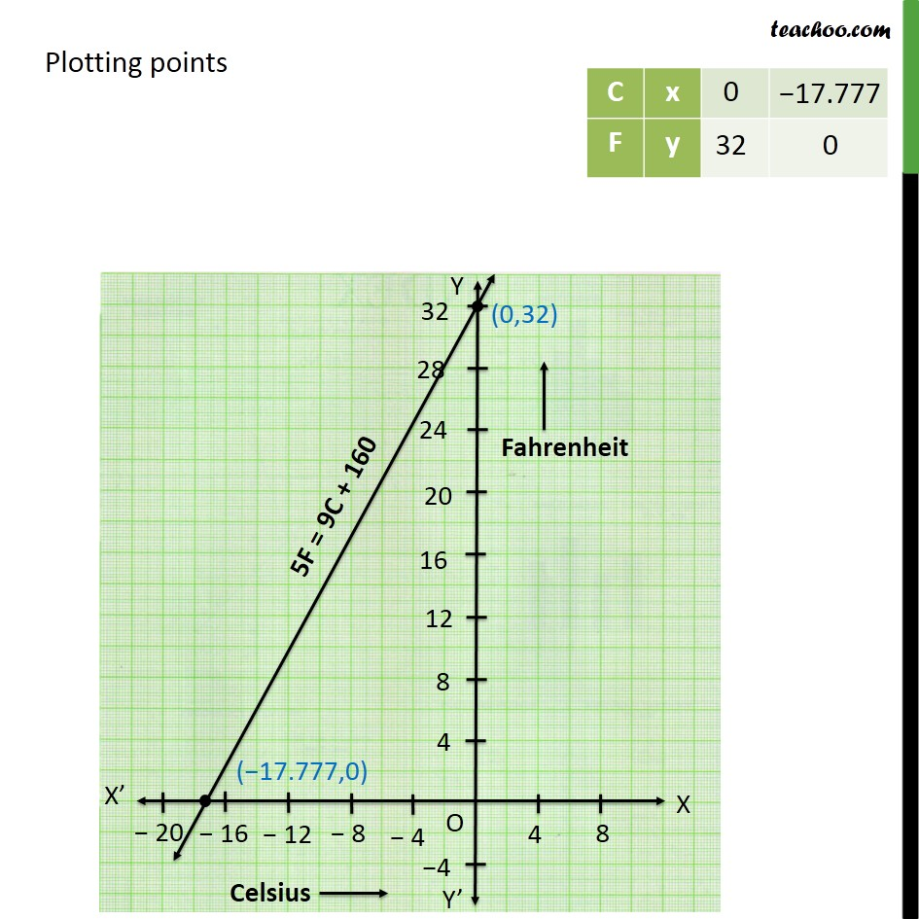

Slide 17
Homework assignment
Exercise 4.3,4.4

Slide 18
AHA
1. The cost of a notebook is 5 times the cost of a pen.Write a linear equation in two variables to represent the statement.

Slide 19
THANKING YOU
ODM EDUCATIONAL GROUP

