Slide 1


PERIOD 2
MATHEMATICS
CHAPTER NUMBER :~ 4
CHAPTER NAME :-LINEAR EQUATION IN TWO VARIABLES

Slide 2
LEARNING OUTCOME:-
1.Students will be able to solve Linear Equation In Two Variables.

Slide 3
PREVIOUS KNOWLEDGE TEST
What will be the nature of roots of quadratic equation 2x2 + 4x – n = 0?

Slide 4
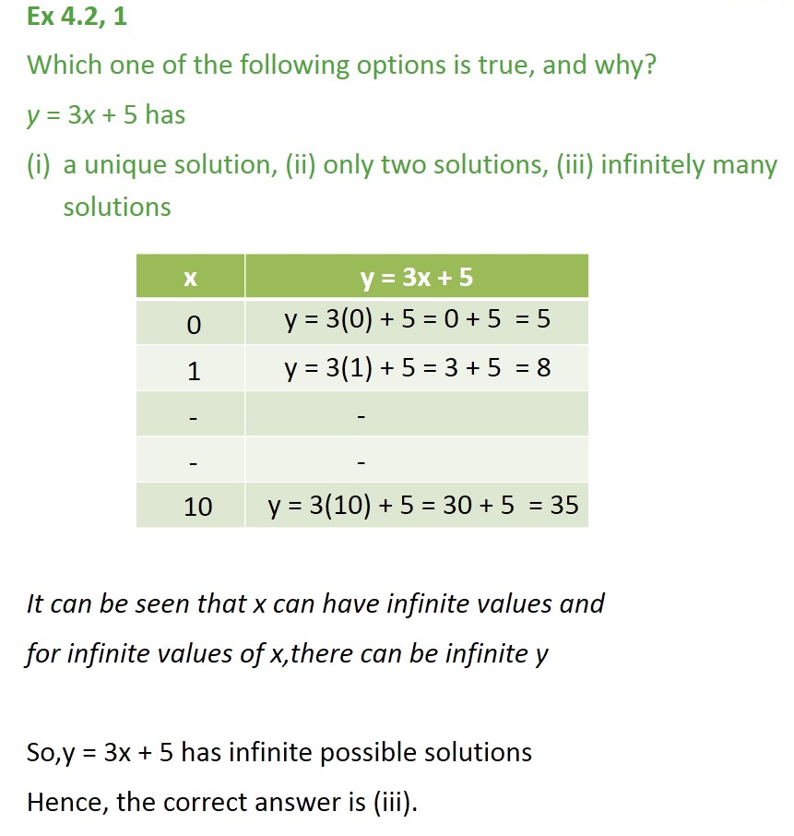


Slide 5
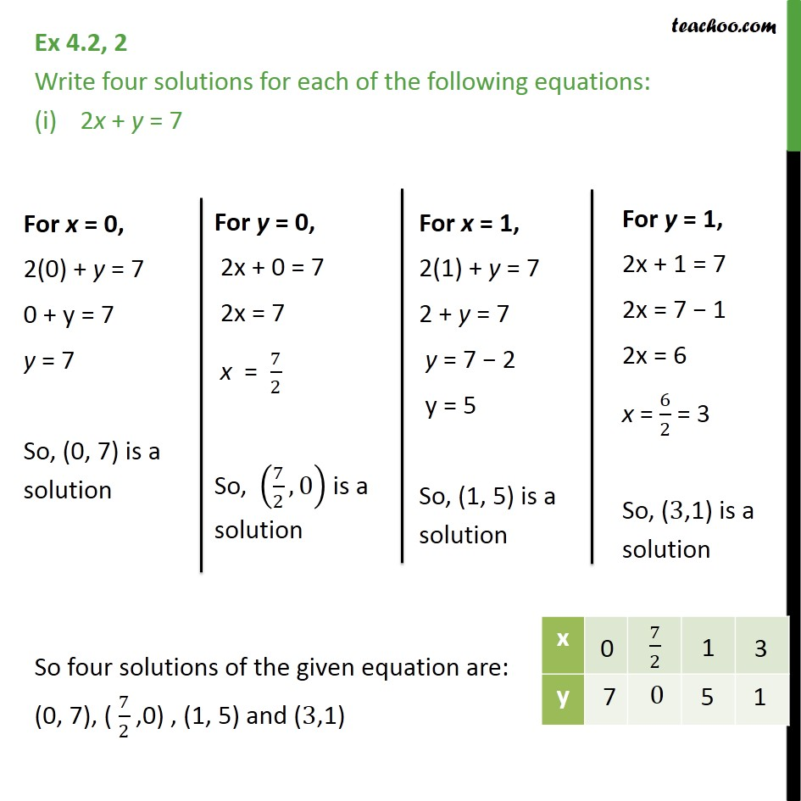

Slide 6
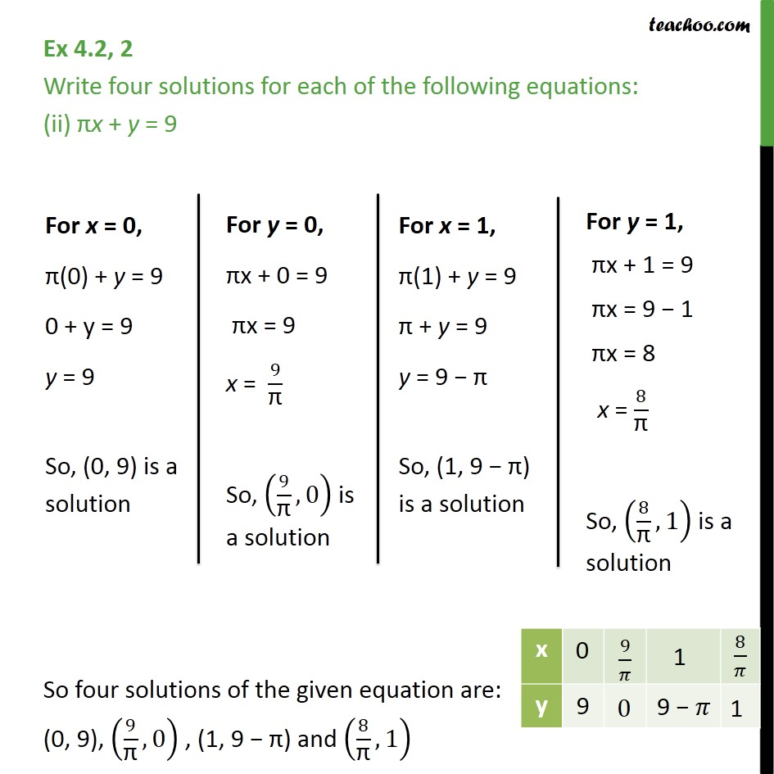

Slide 7
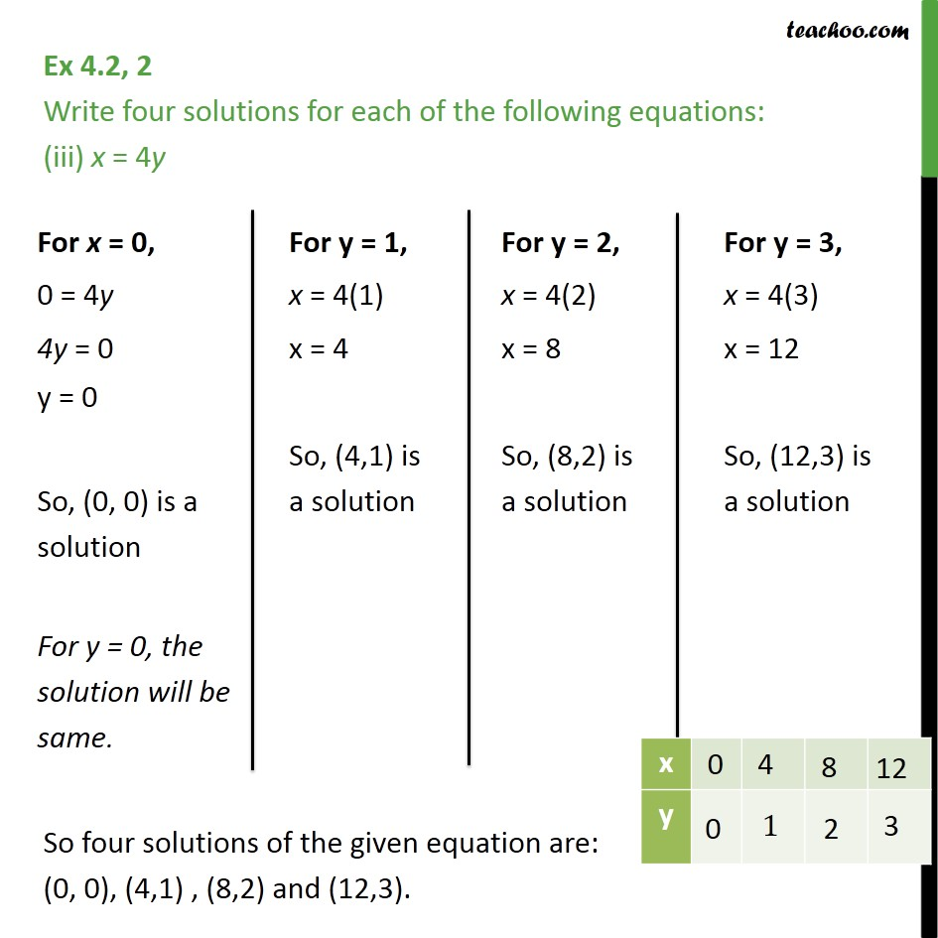


Slide 8
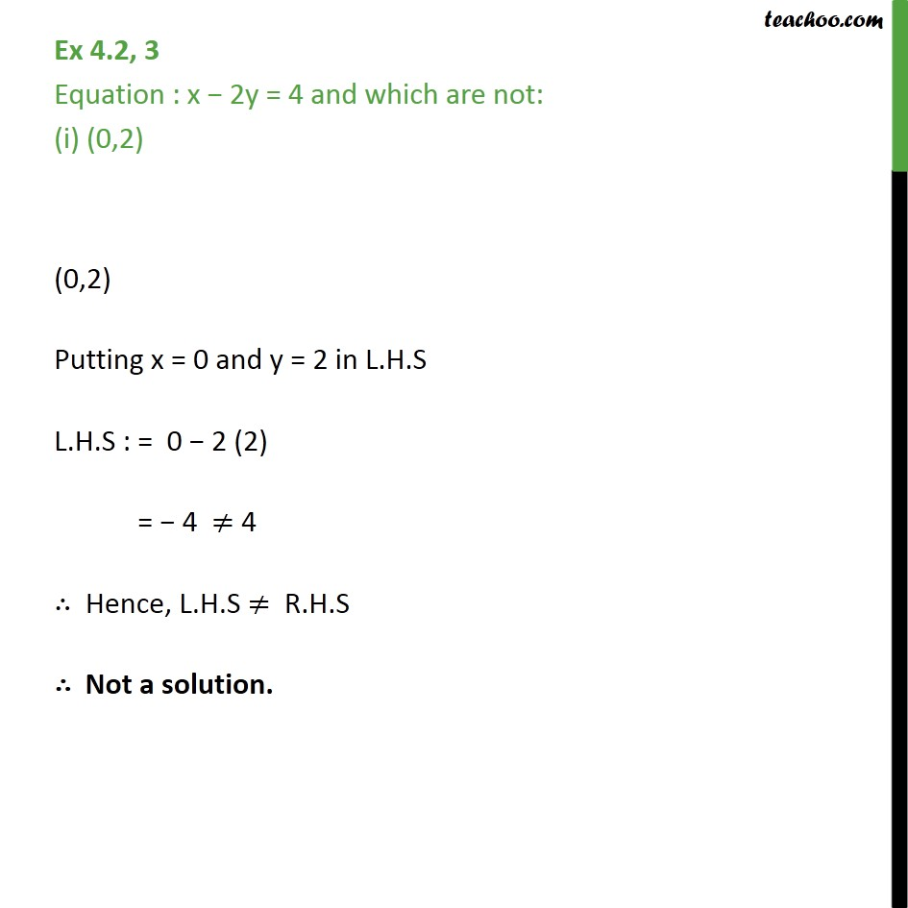


Slide 9
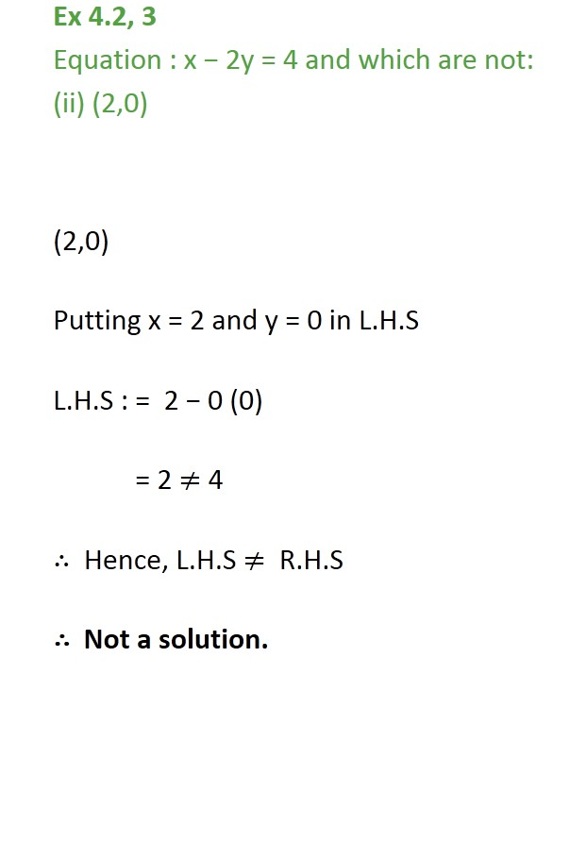


Slide 10
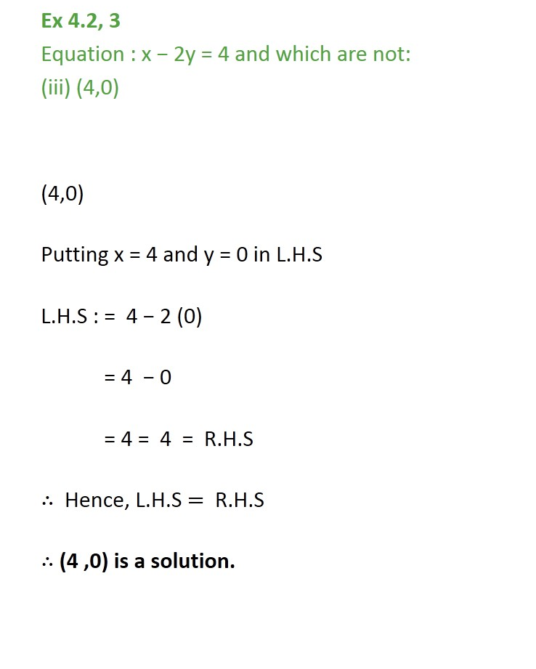

Slide 11
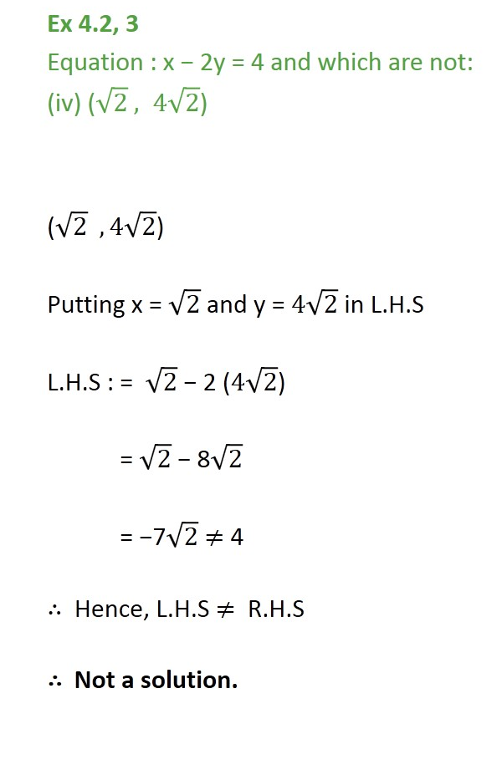

Slide 12
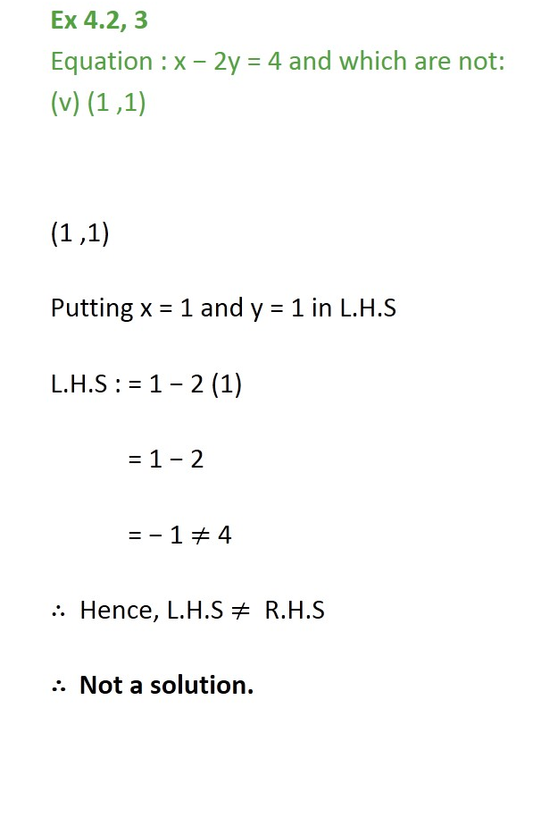


Slide 13
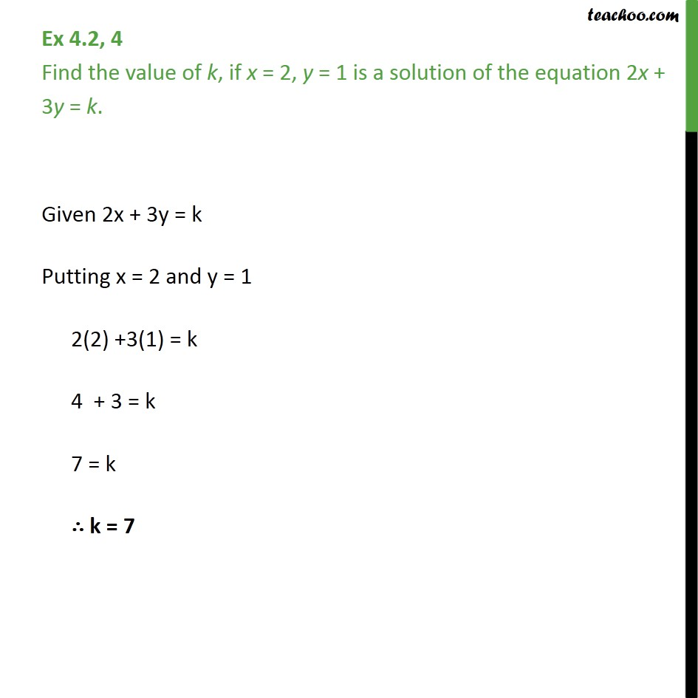


Slide 14
Homework assignment
Exercise 4.2

Slide 15
AHA
1. If 12 is a root of the equation x2 + kx – 54 = 0, then find the value of k.

Slide 16
THANKING YOU
ODM EDUCATIONAL GROUP

