Slide 1


PERIOD 1
MATHEMATICS
CHAPTER NUMBER :~ 4
CHAPTER NAME :-LINEAR EQUATIONS IN TWO VARIABLES

Slide 2
LEARNING OUTCOME:-
1.Students will be able to learn concepts about Linear Equations In Two Variables.

Slide 3
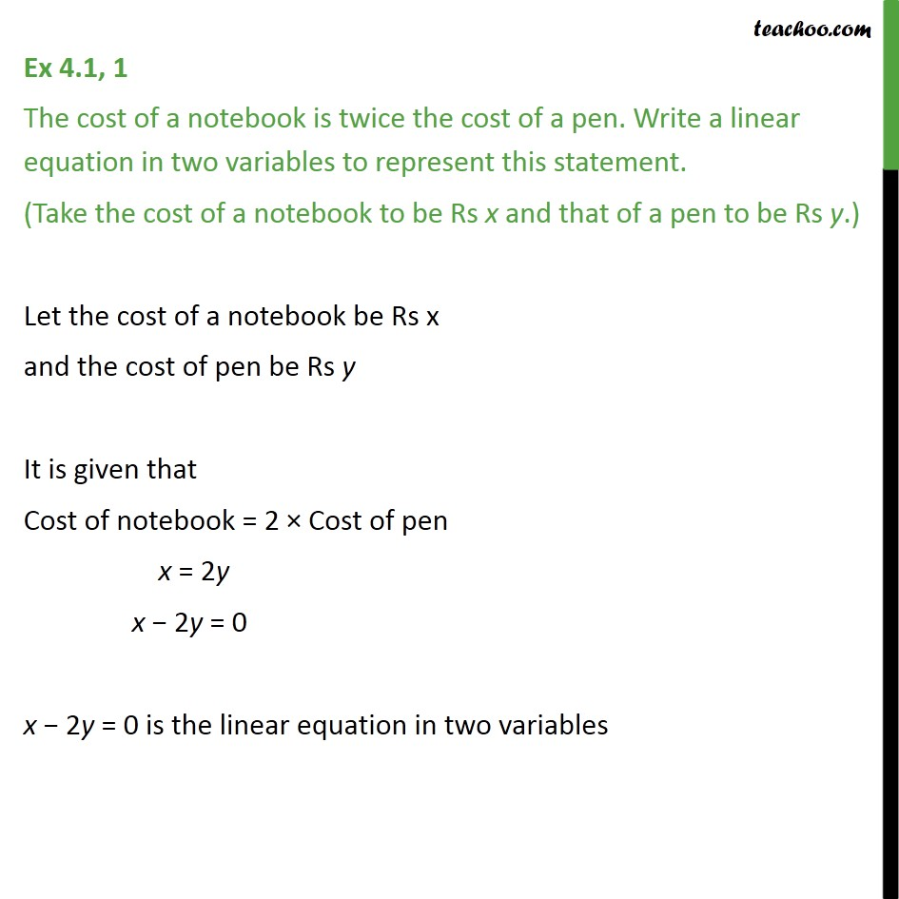


Slide 4
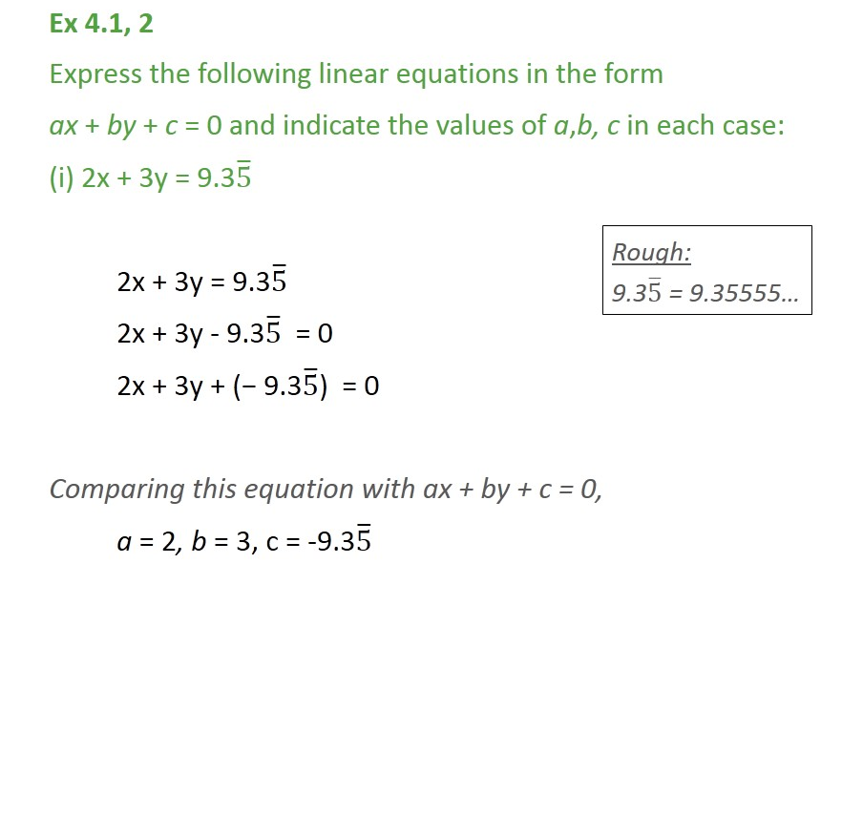

Slide 5
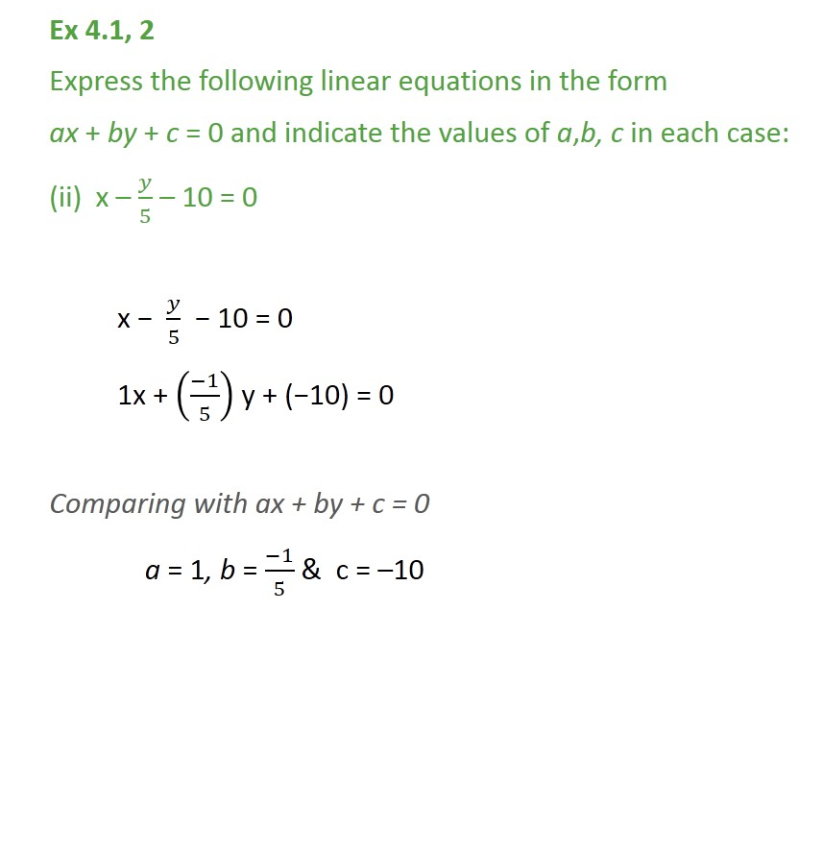

Slide 6
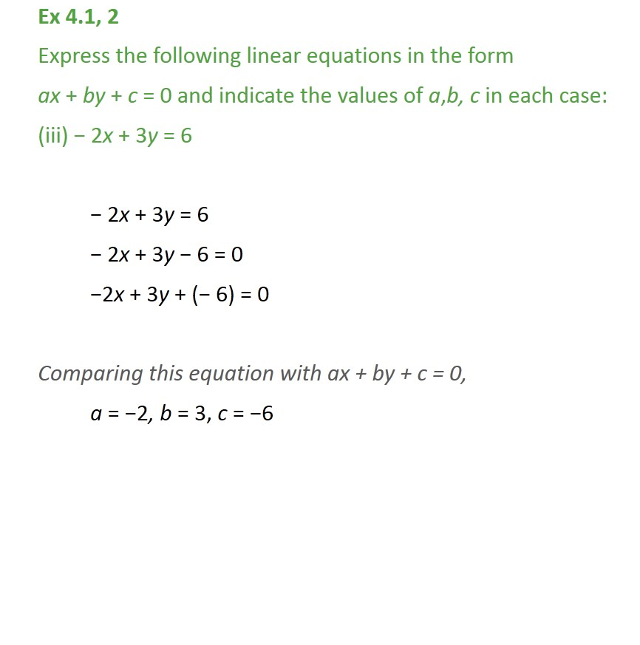


Slide 7
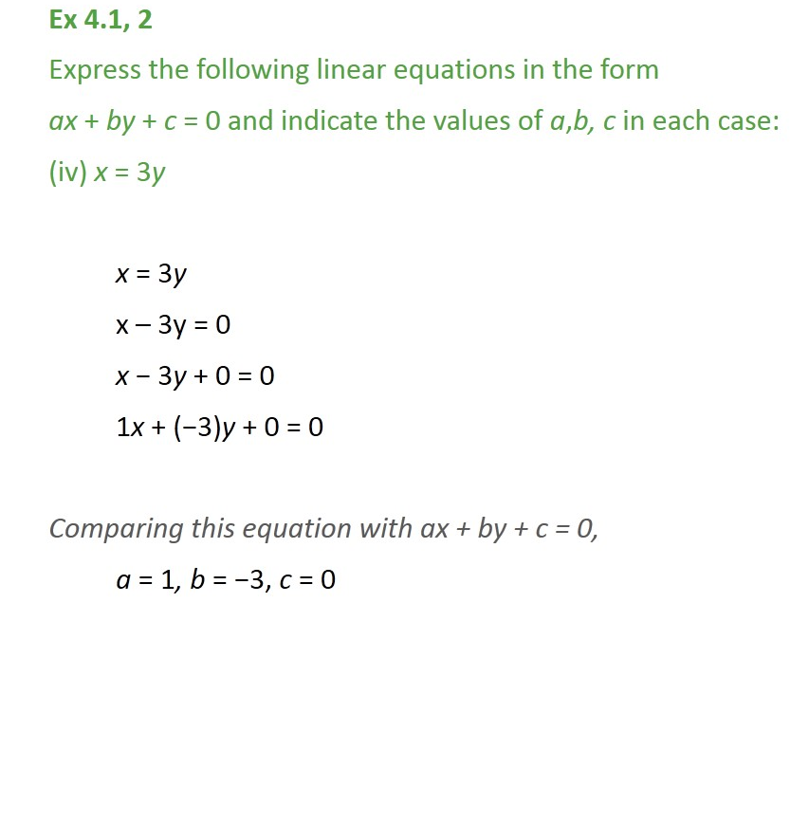


Slide 8
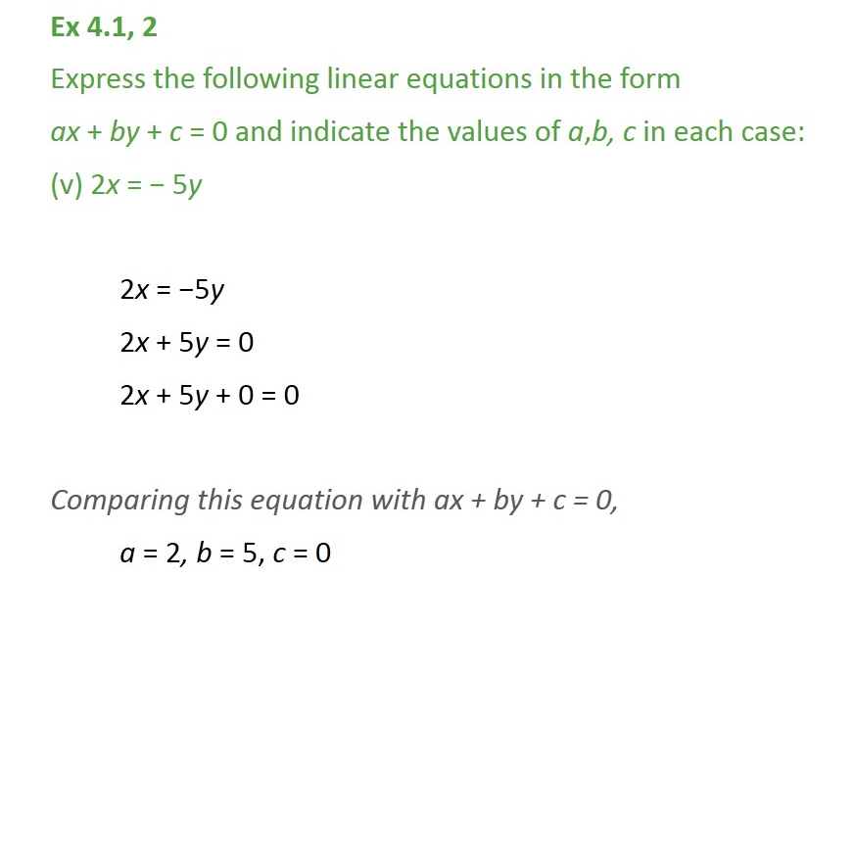


Slide 9
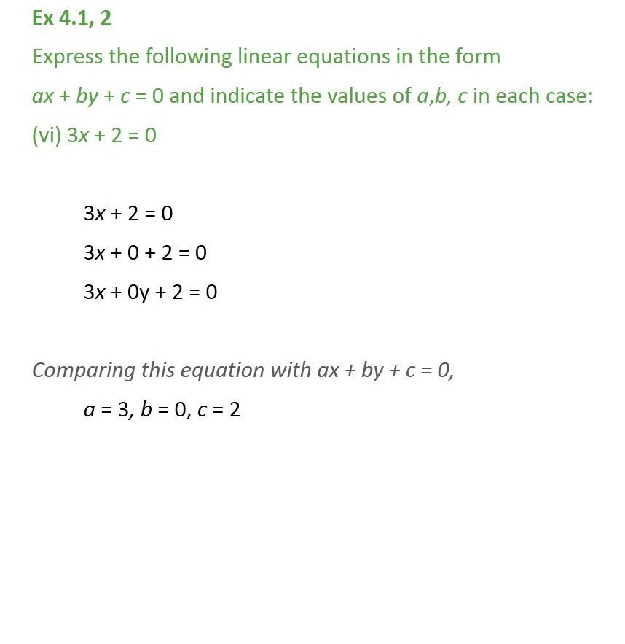

Slide 10
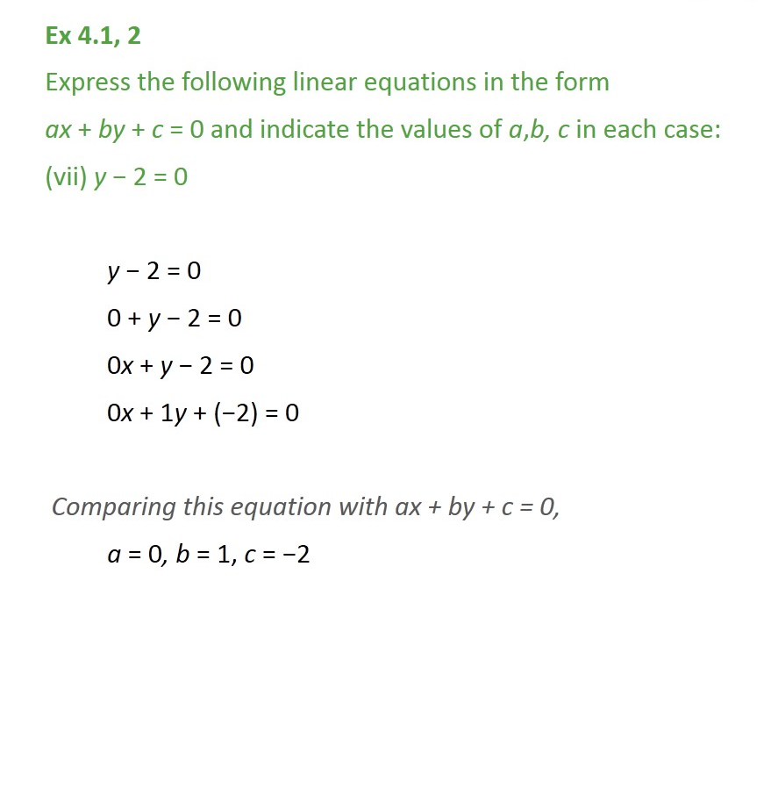

Slide 11
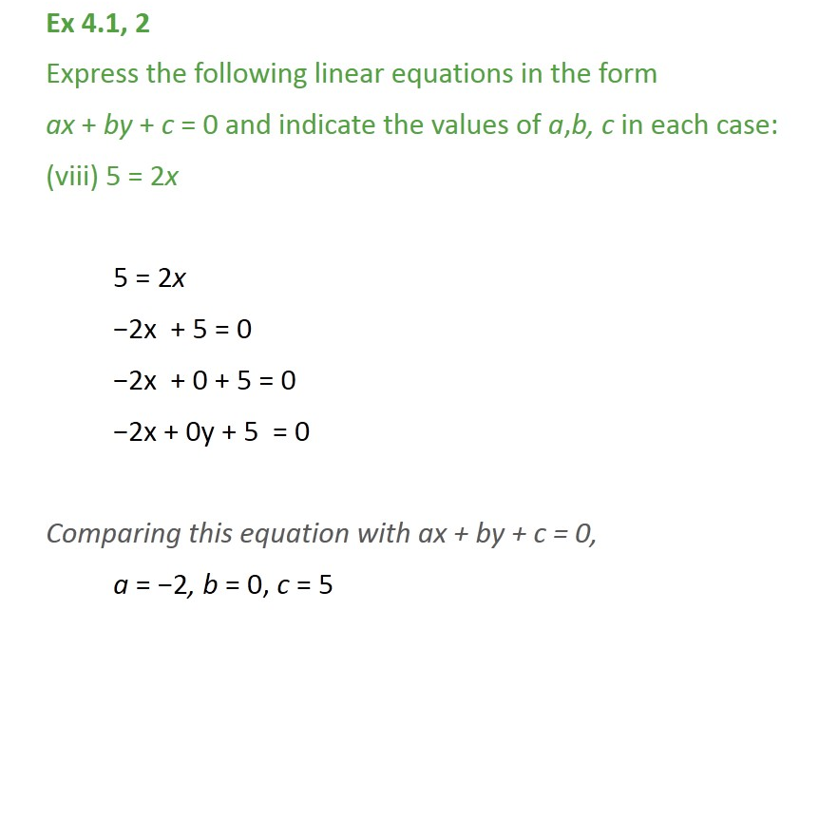


Slide 12
Homework assignment
Exercise 4.1

Slide 13
AHA
1. What will be the nature of roots of quadratic equation 2x2 + 4x – n = 0?

Slide 14
THANKING YOU
ODM EDUCATIONAL GROUP

