Slide 1

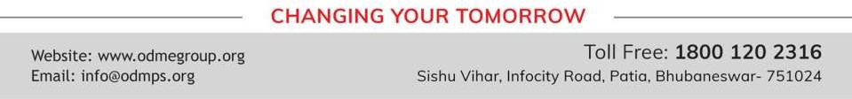
LINEAR EQUATIONS IN ONE VARIABLES
PERIOD 3
SUBJECT : MATHEMATICS
CHAPTER NUMBER: 14
CHAPTER NAME : LINEAR EQUATIONS IN ONE VARIABLES

Slide 2

Learning outcome
Students will be able to understand the concept of linear equations in one variable.
.

Slide 3



Exercise -14 C

Slide 4
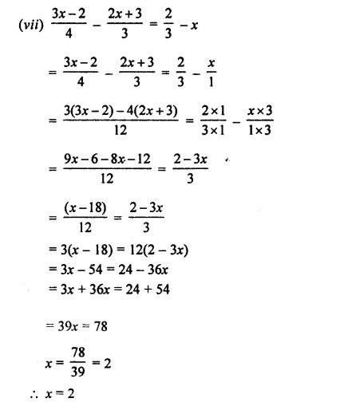

Slide 5
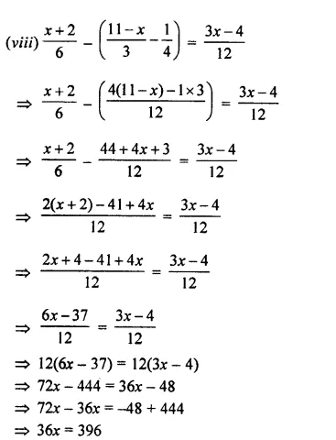


Slide 6
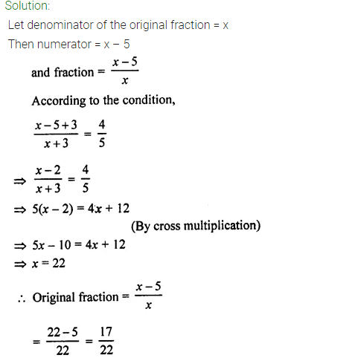
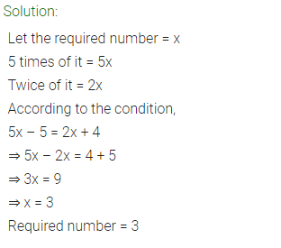

Slide 7
Home assignment
Exercise 14(C)

Slide 8
THANKING YOU
ODM EDUCATIONAL GROUP

