Slide 1

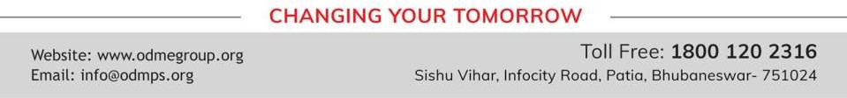
LINEAR EQUATIONS IN ONE VARIABLES
PERIOD 1
SUBJECT : MATHEMATICS
CHAPTER NUMBER: 13
CHAPTER NAME : LINEAR EQUATIONS IN ONE VARIABLES

Slide 2

Learning outcome
Students will be able to understand the concept of linear equations in one variable.
.

Slide 3




Exercise -14 A

Slide 4
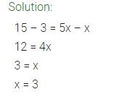
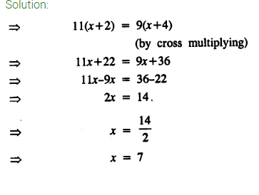
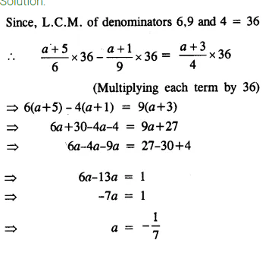

Slide 5
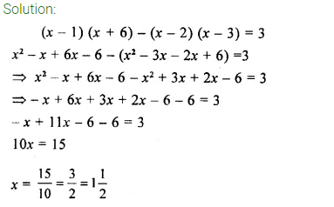

Slide 6



Slide 7
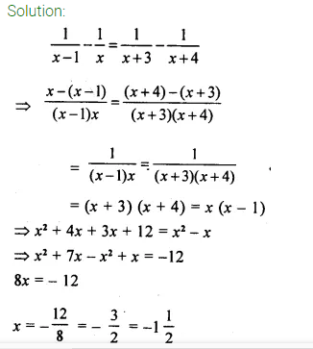
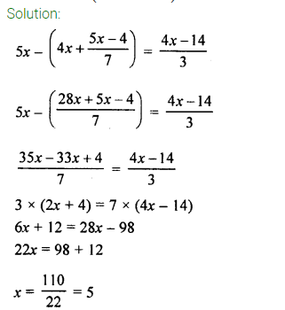

Slide 8
Home assignment
Exercise 14(A)

Slide 9
THANKING YOU
ODM EDUCATIONAL GROUP

