Slide 1
Welcome to the online class
SUBJECT : MATHEMATICS
CHAPTER NAME :DIRECTIONS

Slide 2


Slide 3
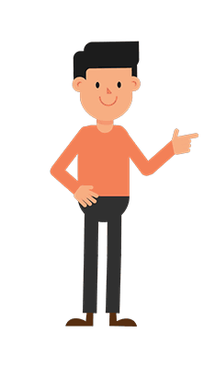



LEFT
RIGHT

Slide 4


LEFT
RIGHT

Slide 5

LEFT
RIGHT

Slide 6
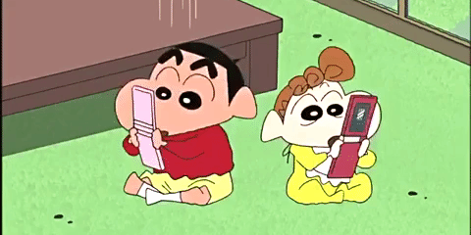
LEFT
RIGHT

Slide 7
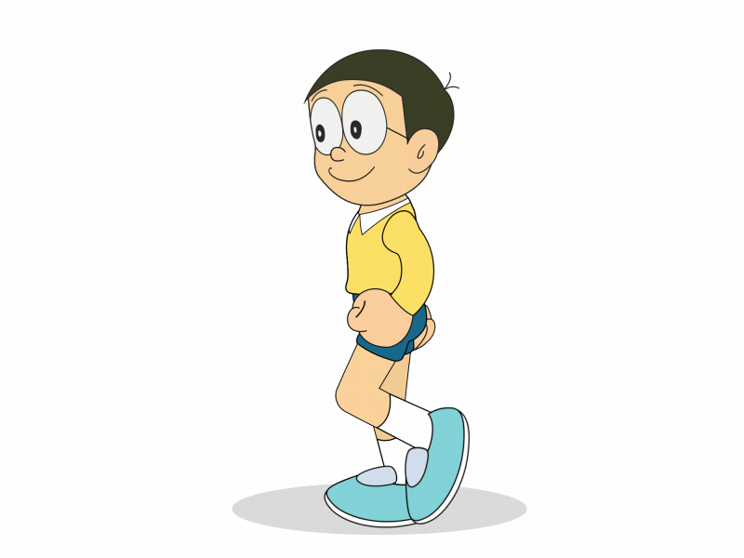

LEFT
RIGHT

Slide 8
THANKING YOU
ODM EDUCATIONAL GROUP

