Slide 1


PHYSICAL EDUCATION & SPORTS FOR CWSN
SUBJECT : PHYSICAL EDUCATION
CHAPTER NUMBER: 04
CHAPTER NAME : PHYSICAL EDUCATION AND SPORTS FOR CWSN

Slide 2


WHAT WE EXPECT TO LEARN?
01
What is Disability?
02
What is Disorder?
03
Types of disability.
04
Types of Disorder.

Slide 3
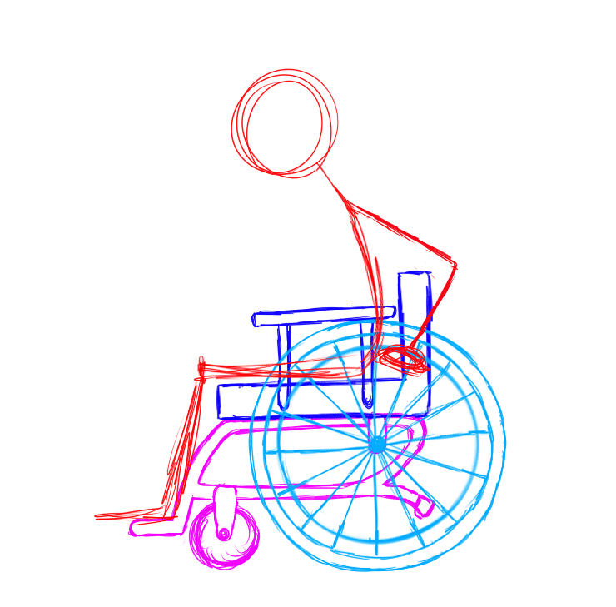
WHAT IS IMPAIRMENT?
“Any loss or abnormality of physiological, psychological or anatomical structure or function,” is called impairment.
Example – loss of foot, defective vision, etc.

Slide 4

WHAT IS DISABILITY?
Disability means inability to do work.
Disability is an impairment that may be cognitive, developmental, intellectual, mental, physical, etc.
Disability is an illness, injury or condition that makes it difficult for someone to do the things that other people do.
Disability is a disadvantage that restricts the smooth functions of movement of a person.

Slide 5
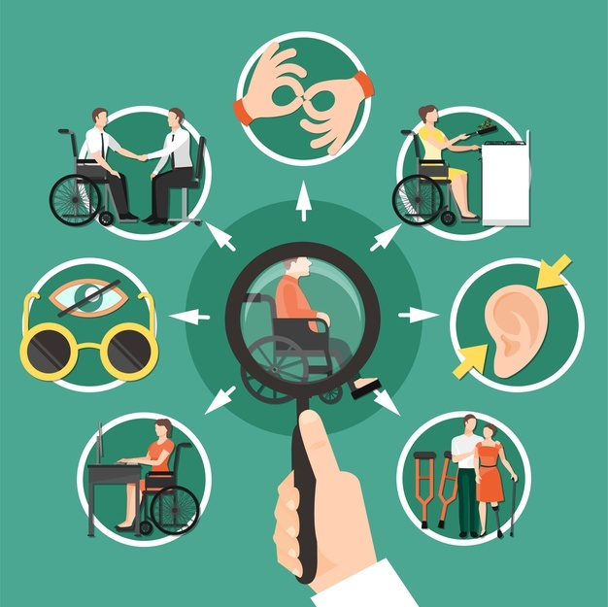
DEFINITION OF DISABILITY
01
According to WHO
“A disability is a restriction or lack (resulting from impairment) of ability to perform an activity in the manner or within the range considered normal for a human being.”

Slide 6
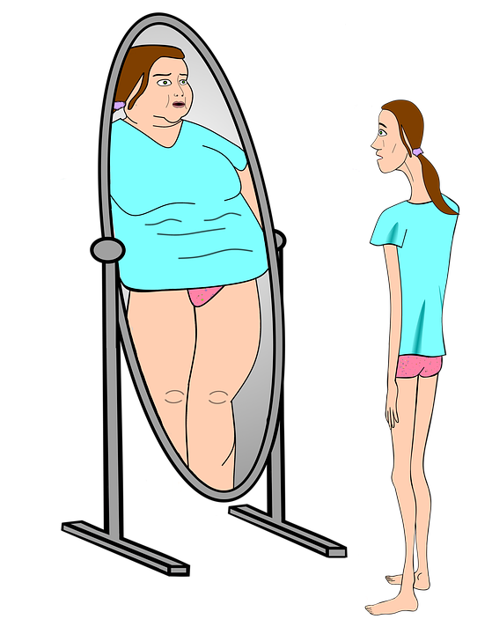
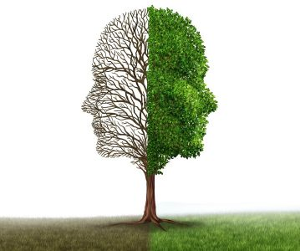
WHAT IS DISORDER?
Disorder is a condition characterized by abnormal thoughts, feelings, and behaviors.
A disorder is a blip in the usual functioning of a person. It disturbs the mental or physical health of a person.

Slide 7
DIFFERENCE BETWEEN BISABILITY AND DISORDER
DISABILITY
Disability is a disadvantage that restricts the functions or movements of a person.
No chances to become normal.
DISORDER
Disorder is the disruption caused to the normal functions of a person.
Chances to become normal.
Disability is often associated with body parts.
i.e. Cognitive , intellectual, Physical Disability.
Disorder is often associated with mental competency.
i.e. ADHD, SPD, ASD, ODD, OCD

Slide 8
TYPES OF DISABILITY
COGNITIVE DISABILITY
INTELLECTUAL DISABILITY
PHYSICAL DISABILITY

Slide 9
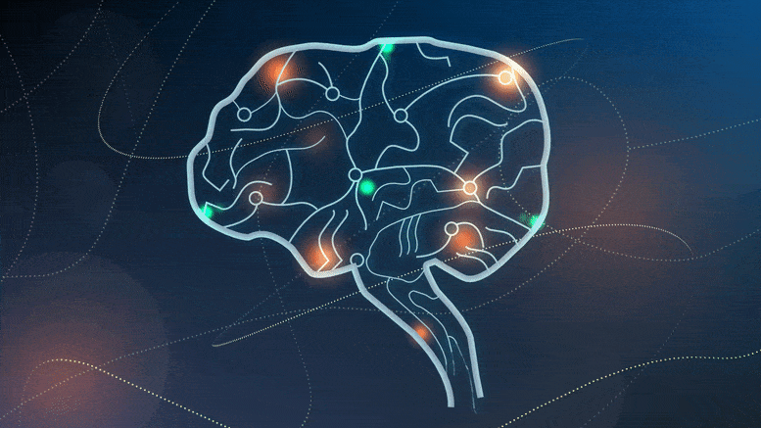
TYPES OF DISABILITY
COGNITIVE DISABILITY
It is also called invisible disability.
It is a neurological disorder that creates hindrance or obstruction for an individual to store, process and produce information.
This disability can affect an individual’s ability to read, compute, speak and write.

Slide 10
SYMPTOMS OF COGNITIVE DISABILITY
MEMORY DISORDER
HYPERACTIVITY
DYSLEXIA

Slide 11

COGNITIVE DISABILITY
MEMORY DISORDER
Who has difficulty in remembering something that he/she heard, said or saw some time ago.

Slide 12
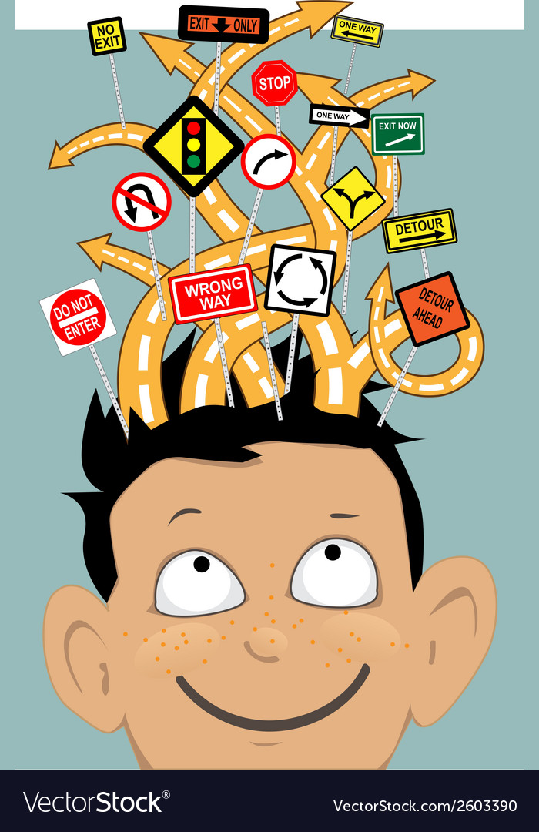

COGNITIVE DISABILITY
HYPERACTIVITY
Those may not have attention for a long period.
He/she finds it difficulty to stay at one place.
He/she usually loses concentration frequently.

Slide 13



COGNITIVE DISABILITY
DYSLEXIA
He/she may have difficulty in writing, reading, speaking, etc.

Slide 14
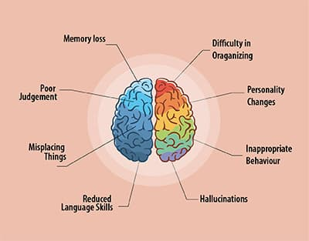
TYPES OF DISABILITY
INTELLECTUAL DISABILITY
Intellectual disability is related to a person’s thoughts, memorizing, understanding, and problems solving.
In this disability, the person has difficult to take in information and communication.
Intellectual disability begins before the age of 18 years.

Slide 15
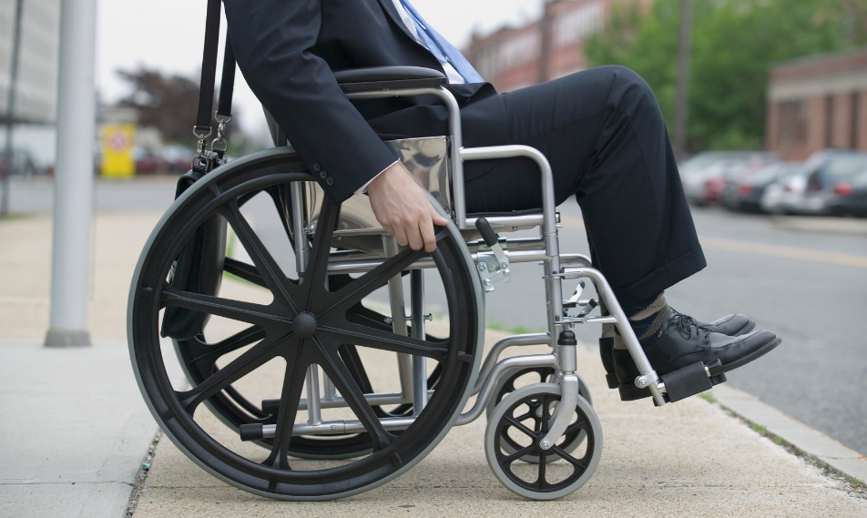
TYPES OF DISABILITY
PHYSICAL DISABILITY
It is a condition that affect the person’s mobility or movement.
Physical disability can be by birth or after birth.
It is a limitation on an individual’s physical functioning, mobility, dexterity or stamina.
Physical disability refers to person sitting, walking, jumping, doing any movement related problems.

Slide 16
TYPES OF PHYSICAL DISABILITY
MOTOR IMPAIRMENT
It is related to spine, brain damage, all the limbs.
(i.e. paralysis)
SENSORY IMPAIRMENT
It is related to visual or hearing.
(i.e. blind)
MOBILITY IMPAIRMENT
VISUAL IMPAIRMENT

Slide 17
Genetic causes
Poverty
Mental health problems
Accidents
Infectious diseases
Disturbance in endocrine glands
Malnutrition
Poor approach to health care
Nuclear accidents
Toxic materials pesticides and insecticides
Illnesses
Lack of education
Wars
Medicines and vaccines
Dangerous working environment
CAUSES OF DISABILITY

Slide 18

GENETIC CAUSES
CAUSES OF DISABILITY
Some disabilities are known to be inherited such as spinal muscular atrophy and muscular dystrophy.
Abnormalities in genes and genetic inheritance cause intellectual disability in children.
X-rays may cause genetic disorder.

Slide 19
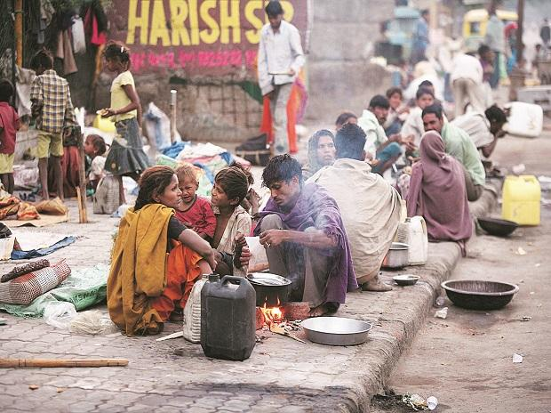
POVERTY
CAUSES OF DISABILITY
Poor persons are the most vulnerable to disability.
They live and work in unsafe environment with poor sanitation.
They have little access to education, safe drinking water and proper nutrition.
Many babies may be born with disabilities.

Slide 20

MENTAL HEALTH PROBLEMS
CAUSES OF DISABILITY
Mental health problems such as depression, bipolar disorder, etc., may lead to disability.
Mental health problems are very difficult to diagnose.

Slide 21

ACCIDENTS
CAUSES OF DISABILITY
Nowadays, life is so fast that accidents may occur anywhere, anytime and to anyone.
These accidents may happen at workplace, on the roads or in the air.

Slide 22

INFECTIOUS DISEASES
CAUSES OF DISABILITY
If the immunity power of a child is low, he is susceptible to fall sick or contact more serious illnesses such as mumps, polio, etc.

Slide 23
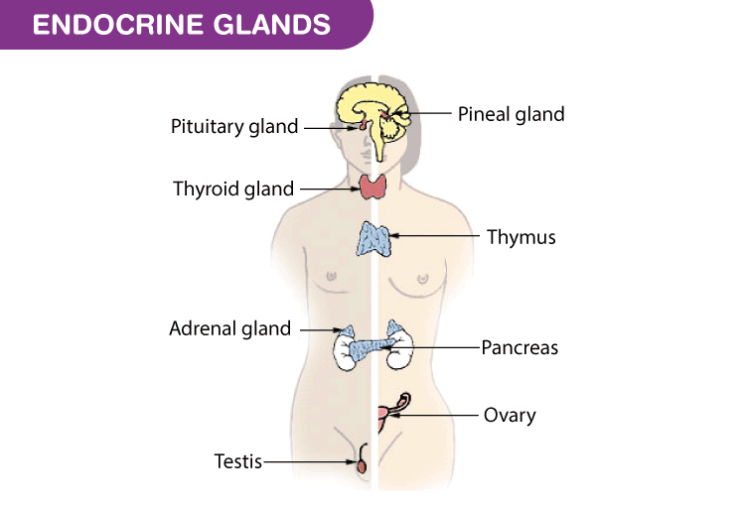
DISTURBANCE IN ENDOCRINE GLANDS
CAUSES OF DISABILITY
Disturbance in endocrine glands may also lead to disability.
Owing to such disturbance, a child may suffer from various physical and mental deficiency.

Slide 24

MALNUTRITION
CAUSES OF DISABILITY
If a child does not get appropriate nutrition, he may be physically weak.
Deficiency of calcium leads malformation of bones.
Deficiency of iodine may diminish the growth of body.
Deficiency of vitamin ‘A’ may cause blindness in children.
Deficiency of vitamin ‘B12’ may lead to loss of memory and cause paralysis.

Slide 25

POOR APPROACH TO HEALTH CARE
CAUSES OF DISABILITY
If good health care facilities are not available during difficult labour and birth.
It may cause a baby to be born with a cerebral palsy.
People who live in remote areas, do not have proper access to health care facilities.

Slide 26

NUCLEAR ACCIDENTS
CAUSES OF DISABILITY
Accidents in nuclear power plants in USA and Ukraine in 1979 and 1986.
It also happened in 1945 in Japan during 2nd World War.
At such place the number of children born with Down Syndrome.

Slide 27

TOXIC MATERIALS PESTICIDES AND INSECTICIDES
CAUSES OF DISABILITY
Toxic materials like lead and mercury, etc. found in various products, use of insecticides and pesticides and other harmful chemicals may cause disabilities.

Slide 28
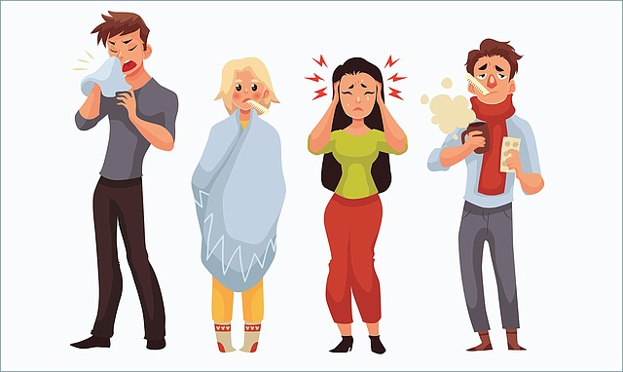
ILLNESSES
CAUSES OF DISABILITY
Major illnesses like cancer, heart attack, diabetes, etc., cause a number of long-term disabilities.
Some illnesses to pregnant woman may cause physical or learning problems to her baby when born.

Slide 29

LACK OF EDUCATION
CAUSES OF DISABILITY
Generally, labourers are not educated.
They fall prey to certain diseases which can be avoided by using scientific methods or by taking precautions.
However, they took medicine without consultation.

Slide 30

WARS
CAUSES OF DISABILITY
In wars, the most of the civilians are killed or disabled along with the soldiers.
Bomb explosions cause people to become deaf, dumb, and lose their limbs.
The individuals is also badly affected by nuclear, biological, and atomic weapons.

Slide 31

MEDICINES AND VACCINES
CAUSES OF DISABILITY
There are a number of practitioners in the medical field who are not qualified or registered.
They don’t take proper care while dealing with patients.
The use of unclean syringes may cause serious diseases like hepatitis or HIV/AIDS.
Improperly stored as well as wrong vaccines may cause allergic reactions.

Slide 32

DANGEROUS WORKING ENVIRONMENT
CAUSES OF DISABILITY
If individuals work in factories, mines or in agricultural fields under improper working environment, they may be exposed to dangerous machinery, tools or chemicals and wide variety of health hazards.

Slide 33
DISORDER
SUBJECT : PHYSICAL EDUCATION
CHAPTER NUMBER: 04
CHAPTER NAME : PHYSICAL EDUCATION AND SPORTS FOR CWSN

Slide 34
TYPES OF DISORDER
ATTENTION DEFICIT HYPERACTIVITY DISORDER
ADHD
SPD
ASD
ODD
OCD
OBSESSIVE COMPULSIVE DISORDER
SENSORY PROCESSING DISORDER
AUTISM SPECTRUM DISORDER
OPPOSITIONAL DEFIANT DISORDER

Slide 35
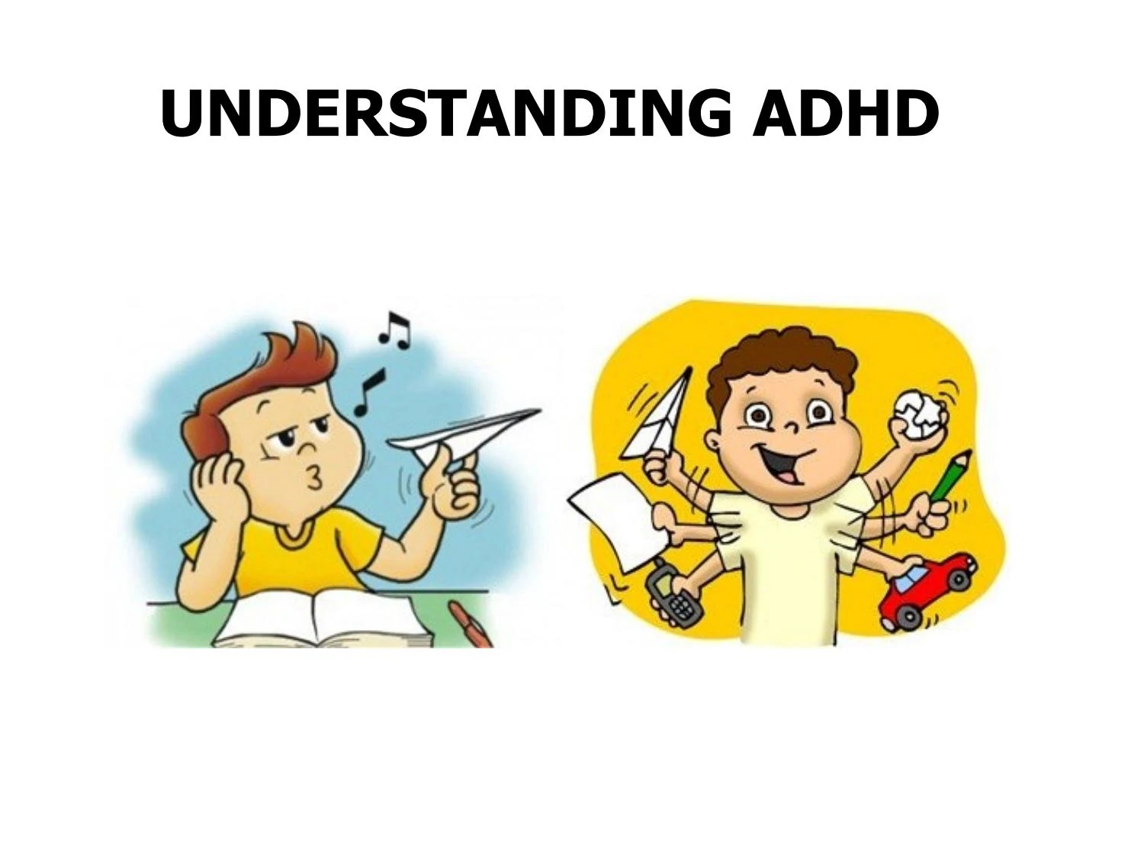
WHAT IS ADHD?
Attention deficit hyperactivity disorder is a group of behavioural symptoms that include inattentiveness, hyperactivity and impulsiveness.
It is a medical condition that affects how well can someone sit still, focus and pay attention.

Slide 36

SYMPTOMS OF ADHD
SYMPTOMS IN CHILDREN
They are usually forget about daily activities.
They have difficulties in organising routine activities.
They usually indulge in daydreaming.
They are easily distracted.
They become restless.
They usually talk excessively.
They do not pay attention and usually make careless mistakes.

Slide 37

SYMPTOMS OF ADHD
SYMPTOMS IN ADULTS
They may have anxiety attacks.
They may be impulsive.
They may have problem in controlling anger.
They usually have low self-esteem.
They usually remain unorganised.
They are easily frustrated.
Mood swings, and depression are common.

Slide 38
Genetic Factor
Brain Injuries
Low Birth Weight
Trauma and Brain Diseases
Lack of Discipline in the Family
Diet
Exposure to Toxic Substance
CAUSES OF ADHD

Slide 39

CAUSES OF ADHD
GENETIC FACTOR
Research studies have indicated that there is a strong genetic link in ADHD.
Parents, siblings and children of people with ADHD may be up to five times more likely to have the disorder than people who are not related to someone with ADHD.

Slide 40
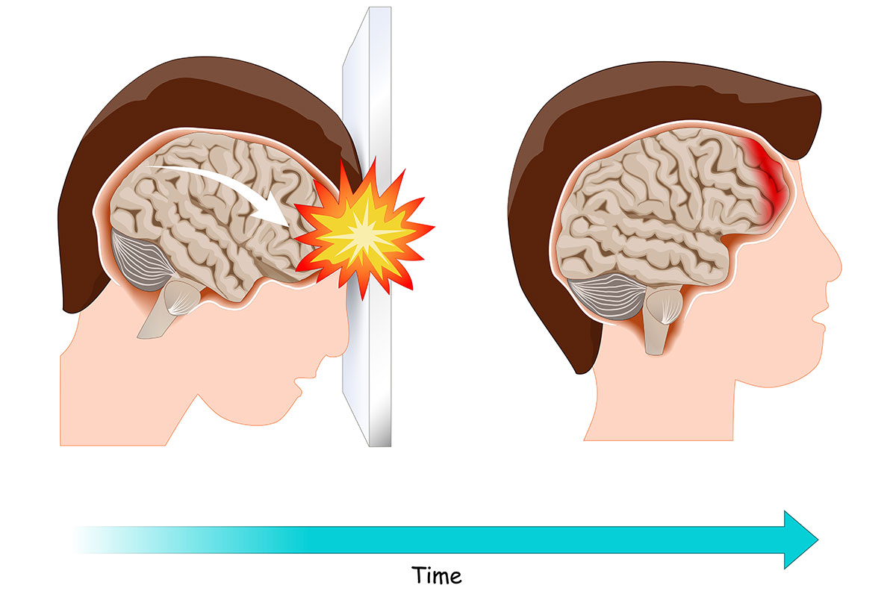
CAUSES OF ADHD
BRAIN INJURIES
When a baby’s brain is damaged before or after birth, it could make the baby more likely to develop ADHD later on.

Slide 41

CAUSES OF ADHD
LOW BIRTH WEIGHT
It is observed that children with low birth weight are more likely to develop ADHD.
Normal Birth Weight = 2.5 Kg to 4.5 Kg.

Slide 42
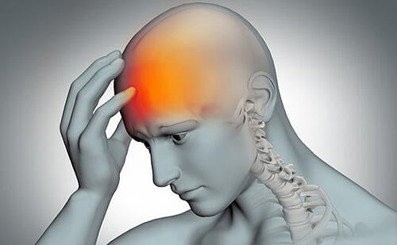
CAUSES OF ADHD
TRAUMA AND BRAIN DISEASES
Trauma during birth and brain diseases may lead to ADHD.
Alzheimer's Disease.
Brain Cancer.
Mental Disorders.
Stroke

Slide 43

CAUSES OF ADHD
LACK OF DISCIPLINE IN THE FAMILY
Lack of harmony in family, lower socio-economic status and hostile relationships between parents and children are also causes of ADHD.

Slide 44

CAUSES OF ADHD
DIET
There are a number of evidences which show that taking a particular type of food or food additives paly a significant role in causing ADHD.

Slide 45
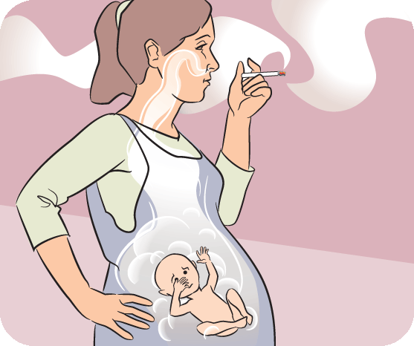
CAUSES OF ADHD
EXPOSURE TO TOXIC SUBSTANCE
Smoking, alcohol or drug abuse during pregnancy may cause ADHD.

Slide 46

WHAT IS SPD?
It is a condition in which the brain has difficulty in receiving and responding to information that comes in through the senses.
It is sort of neurological traffic jam the prevents certain parts of the brain from receiving the information required to interpret sensory information accurately.
SPD may affect on touch, sight, taste, movement, etc.

Slide 47
SYMPTOMS OF SPD
PHYSICAL
Lack of sleep
Bad body posture
MENTAL
Stressed
Fear of crowd
BEHAVIOUR
Sensitive to noise
Lack of interest
Less muscle growth
Imbalance
Depression
Fear of sudden touch
Aggressive
Sensitive to smell

Slide 48
CAUSES OF SPD
Genetic Cause
Low Birth Weight
Environmental Factor
Physical Cause

Slide 49

WHAT IS ASD?
ASD is developmental disability caused by differences in the brain.
ASD have difficulties with communication, language, social skill and behavior.

Slide 50
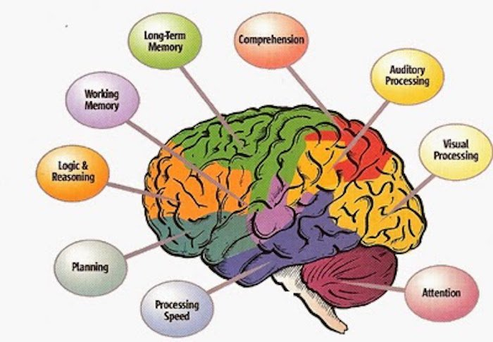
SYMPTOMS OF ASD
Difficulty in communication.
Repetitive behavior.
Does not express emotions.
Avoid eye contact.
Touching object repeatedly.
Don’t make friend.
Not interested in social activities.
Avoid social interactions.

Slide 51
CAUSES OF ASD
Genetic Factors
Brain development
Environmental Factors

Slide 52

WHAT IS ODD?
ODD is a set or group of behavioral disorders called disruptive behavior disorders.
ODD is a common mental health disorders found in children and adolescents.
It is a pattern of disobedient, hostile, rebel, argue and defiant behavior directed toward authority figures.

Slide 53
SYMPTOMS OF ODD
COGNITIVE
Does not think before speaking
Normally depressed
PSYCHOLOGICAL
Does not make friends easily
Lack of self-respect
BEHAVIOURAL
Blame others
Over aggressive
Lack of concentration
Remain stressed and worried
Irritation
Always argumentative
Fight with friends repeatedly

Slide 54
CAUSES OF ODD
Genetic or Biological Factors
Psychological Factors
Social Factors
Physical Factors

Slide 55

WHAT IS OCD?
It is a common, chronic and long-lasting disorder in which a person has uncontrollable, recurring thoughts.
Excessive thoughts (obsessions) that lead to repetitive behaviors (compulsions).
OCD is a mental disorder that causes repeated unwanted thoughts.
He/she performs the same task/activity again and again.

Slide 56

OCD
OBSESSIONS SYMPTOMS
A FEAR OF
Harm to yourself or loved one
Contamination by germs
Being embarrassed
Getting dirty
Making mistakes

Slide 57
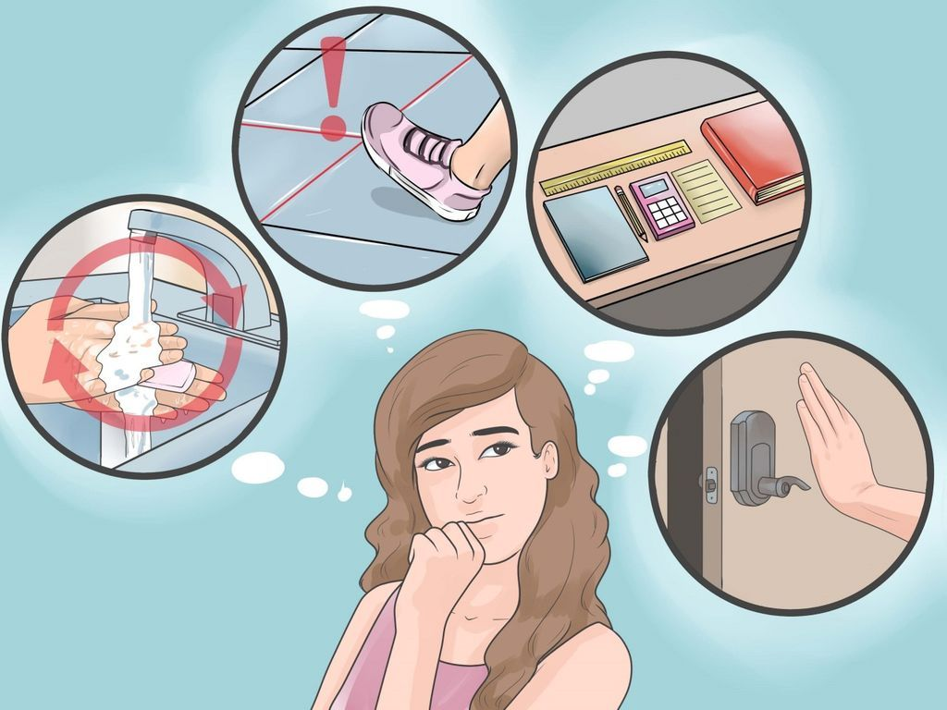
OCD
COMPULSIONS SYMPTOMS
Repeating things
Bathing or washing hands several times
Checking things over and aver again
Repeating specific words
Hoarding /collection /deposit
Persistently counting while doing usual tasks.

Slide 58
DISABILITY ETIQUETTES
SUBJECT : PHYSICAL EDUCATION
CHAPTER NUMBER: 04
CHAPTER NAME : PHYSICAL EDUCATION AND SPORTS FOR CWSN

Slide 59
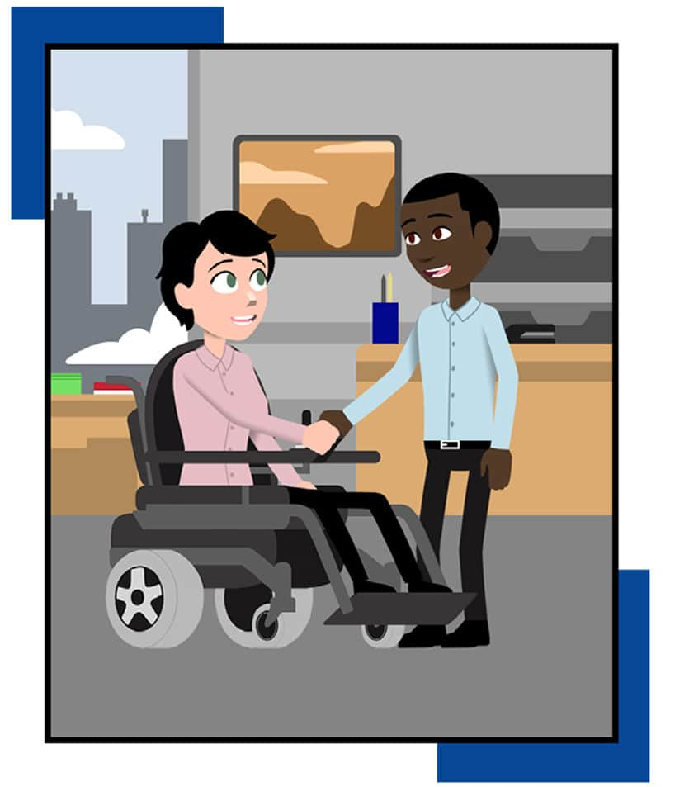
SET OF GUIDELINES
DISABILITY ETIQUETTES
If someone has a disability don’t assume he/she needs help.
Always speak directly to the persons with a disability, not to his/her friends.
Persons with disabilities are the best judge of what they can or can’t do.

Slide 60
DISABILITY ETIQUETTES
DO’S
DON'TS
Always avoid the outdated words. i.e. handicapped.
During introduction it is appropriate to shake hands.
Identify yourself, when you meet a person with a visual impairment.
A person who is blind, inform him that you are leaving and ask, need anything before you leave.
Don’t ignore of a person who is deaf.
Don’t ask any personal questions who is CWSN
Don’t pretend to understand if you are facing problem in doing so.
Don’t talk in high pitch to such individuals.
Don’t leaning or hanging on a person’s wheelchair.

Slide 61

DISABILITY ETIQUETTES
FOR SPECIAL CHILDREN
Always consider that he/she is a person, not a disease.
Always offer shake hand even if they have artificial arm.
Language to be used must be very nice and humble.
Never be rude, always be polite.
Always look at and speak directly to the person.

Slide 62
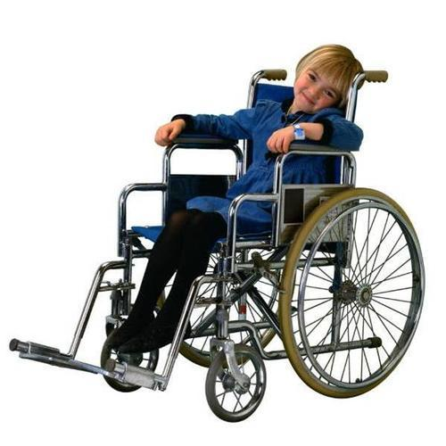
DISABILITY ETIQUETTES
FOR CHILDREN ON WHEELCHAIR
Do not touch or move any person sitting on wheelchair.
Remove obstacles in the way of the person on wheelchair.
If the person on wheelchair feels uncomfortable, then offer help.
Never move, lean on, rock, or touch the wheelchair.

Slide 63

DISABILITY ETIQUETTES
FOR PERSON WITH SPEECH DIFFICULTIES
Try to read body language and lip sync. Don’t make awkward faces.
Use short questions and answers while communication.
In case of crowded environment, take them to a quieter location to talk.
Let them complete their own sentences.

Slide 64
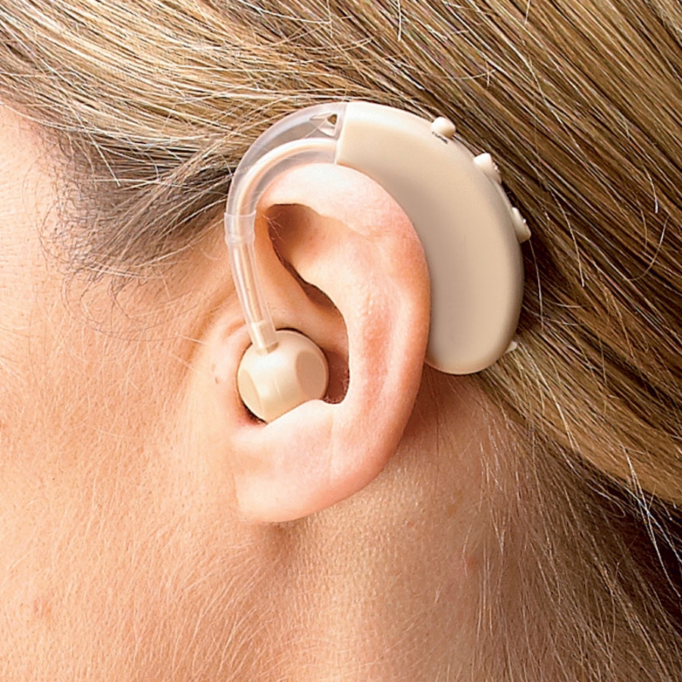
DISABILITY ETIQUETTES
FOR PERSON WITH HEARING LOSS
While meeting, always wish with flower.
Focus one thing at one time.
If a person is using hearing aids that does not mean he is able to hear clearly.

Slide 65

DISABILITY ETIQUETTES
FOR PERSONS WITH VISION LOSS
While coming in contact with a person with visual impairment always introduce and call your name.
Always hold hand gently of the person with vision loss.
They expect to be treated with the same dignity and respect that you do.

Slide 66
STRATEGIES TO MAKE PHY. ACTIVITIES ACCESSIBLE FOR CWSN
Medical check-up
Physical activities must be based on interests of children
Equipment related to physical activities should be according to the needs of children
Specific environment should be provided
A variety of different instructional strategies should be used
Rules should be modified according to the needs of children with disabilities
Children’s previous experience must be taken into consideration

Slide 67

STRATEGIES TO MAKE PHY. ACTIVITIES ACCESSIBLE FOR CWSN
MEDICAL CHECK-UP
Without medical check-up, we cannot come to know about the type of disability the child is facing.
We need to understand the type of disabilities of the children.

Slide 68
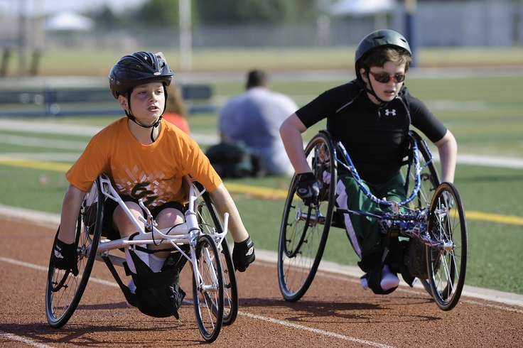
STRATEGIES TO MAKE PHY. ACTIVITIES ACCESSIBLE FOR CWSN
PHYSICAL ACTIVITIES MUST BE BASED ON INTERESTS OF CHILDREN
Physical activities must be based on the interests, aptitudes, abilities, previous experience and limitations of CWSN.after that physical activities can be made accessible for CWSN more easily.

Slide 69

STRATEGIES TO MAKE PHY. ACTIVITIES ACCESSIBLE FOR CWSN
EQUIPMENT RELATED TO PHYSICAL ACTIVITIES SHOULD BE ACCORDING TO THE NEEDS OF CHILDREN
Equipment should vary in size, shape, colour, and weight.
These equipment should be according to the capability and level of children.

Slide 70

STRATEGIES TO MAKE PHY. ACTIVITIES ACCESSIBLE FOR CWSN
SPECIFIC ENVIRONMENT SHOULD BE PROVIDED
Who have autism, they must be provided specific playing area because they may need some time to relax.
Light and sound are also vital for making good environment for CWSN.

Slide 71

STRATEGIES TO MAKE PHY. ACTIVITIES ACCESSIBLE FOR CWSN
A VARIETY OF DIFFERENT INSTRUCTIONAL STRATEGIES SHOULD BE USED
Different instructional strategies such as verbal, visual, and peer teaching should be used.
Pictorial books are also vital in terms of instructions regarding physical activities.

Slide 72
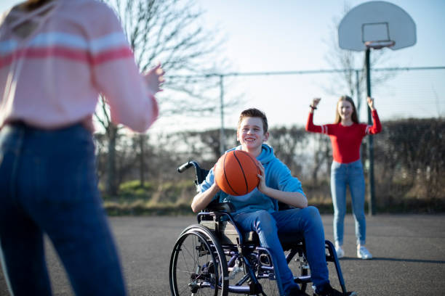
STRATEGIES TO MAKE PHY. ACTIVITIES ACCESSIBLE FOR CWSN
RULES SHOULD BE MODIFIED ACCORDING TO THE NEEDS OF CHILDREN WITH DISABILITIES
They can be provided extra time, attempt to perform a physical activity.
They can also give additional resting time before doing the next physical activity.

Slide 73
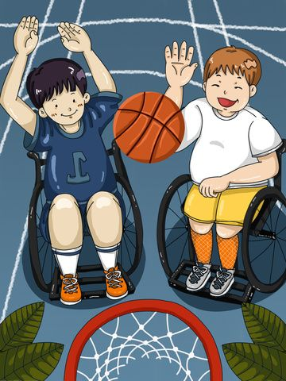
STRATEGIES TO MAKE PHY. ACTIVITIES ACCESSIBLE FOR CWSN
CHILDREN’S PREVIOUS EXPERIENCE MUST BE TAKEN INTO CONSIDERATION
Teacher should have comprehensive understanding and knowledge of children’s previous experience about physical activities.

Slide 74
THANKING YOU
ODM EDUCATIONAL GROUP

