Slide 1


YOGA AS PREVENTIVE MEASURE FOR LIFESTYLE DISEASE
SUBJECT : PHYSICAL EDUCATION
CHAPTER NUMBER: 03
CHAPTER NAME : YOGA AND LIFESTYLE

Slide 2


WHAT WE EXPECT TO LEARN?
01
Obesity
02
Diabetes
03
Asthma
04
Hypertension

Slide 3

WHAT IS YOGA?
The word 'Yoga' is derived from the Sanskrit root 'Yuj', meaning 'to join' or 'to unite’.
Yoga is a complete life style which helps an individual to keep control over mind, body, and emotions.
Yoga is considered to diminish/reduce pain and sorrow.

Slide 4
DEFINITION OF YOGA
“Checking the impulses of mind is yoga.”
ACCORDING TO MAHARISHI VED VYAS
“Yoga is attaining the pose.”
ACCORDING TO SWAMI SAMPURNANAD
“Yoga is spiritual Kamdhenu.”
ACCORDING TO AGAM
“The knowledge about Shiva and Shakti in yoga.”
ACCORDING TO SHRI BHARATI KRISHNA TIRTHA
“Oneness of man with God is known as yoga.”
ACCORDING TO LORD KRISHNA SAYS IN BHAGWAT GITA
“Skill in actions or efficiency alone is yoga.”
ACCORDING TO PATANJALI

Slide 5
Ethical discipline
ELEMENTS OF YOGA
YAMA
NIYAMA
ASANA
PRANAYAMA
PRATYAHARA
DHARANA
DHYANA
SAMADHI
A state of joy & peace
Self observation
Meditation
Posture
Concentration
Breath control
Sense withdrawal

Slide 6
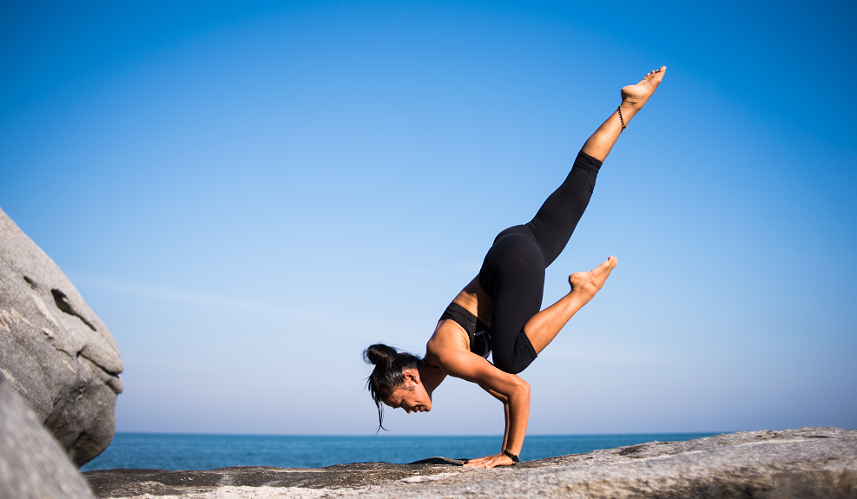
WHAT IS LIFESTYLE?
The way we live our day-to-day lives with the object of acquiring and maintaining a healthy body and mind.
The way we ;-
  Think, emote and behave
  Act and interact
  Rest and relax
  Eat and drink
  It’s a daily discipline, a dynamic process.

Slide 7

COMPONENTS OF LIFESTYLE MODIFICATION
Healthy food and drink
Regular physical exercise
Rest and relaxation
Healthy emotional relationships
Preventive measures
Management of stress
Periodical check-up
Self-examination
External & internal cleanliness & purity

Slide 8
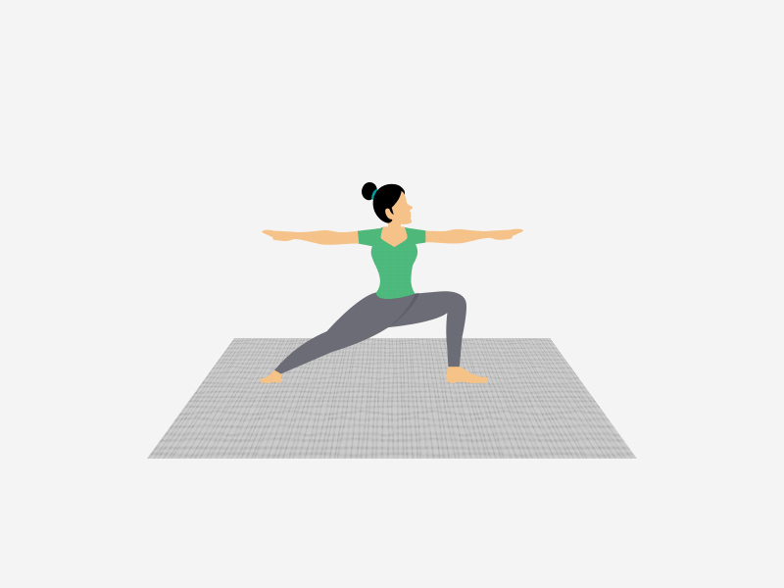
MEANING OF ASANA
Asana is the different poses of body.
It is that stage of the body wherein the body can be kept comfortably for long time.
According to Maharishi Patanjali, “Sthiram Sukham Asanam.’’
According to Brahamanopanishad,
“To sit in a comfortable position or posture for everlasting period is called asana”.

Slide 9
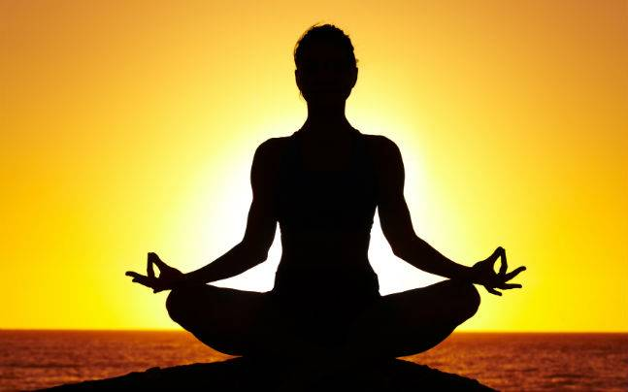
DEFINITION OF ASANAS
ACCORDING TO SAGE PATANJALI -
“STHIRAM SUKHAM ASANAM’’
i.e., STHIRAM = steady; SUKHAM = comfortable; ASANAM = posture.
“That posture which is steady and comfortable is asana.”
ACCORDING TO BRAHAMANOPANISHAD -
“To sit in a comfortable position or posture for everlasting period is called asana”.

Slide 10
CLASSIFICATION OF ASANAS
Meditative Asanas
Dhyanatmak Asanas
Relaxative Asanas
Vishramatmak Asanas
Cultural or Currective Asanas
Samvardhnatmak Asanas
Padmasana
Sidhasana
Swastikasana
Shashankasana
Shavasana
Makarasana
Sirsasana
Sarvangasana
Matsyasana

Slide 11
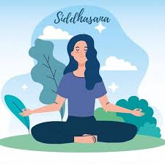
CLASSIFICATION OF ASANAS
MEDITATIVE ASANAS
Padmasana, Sidhasana, and Samasana are the main asanas of meditative asanas.
By practising these asanas, the meditation power of an individual is enhanced.
Meditation is done by remaining constant in these asanas.
It is more beneficial to perform such asanas in complete peaceful environment.

Slide 12
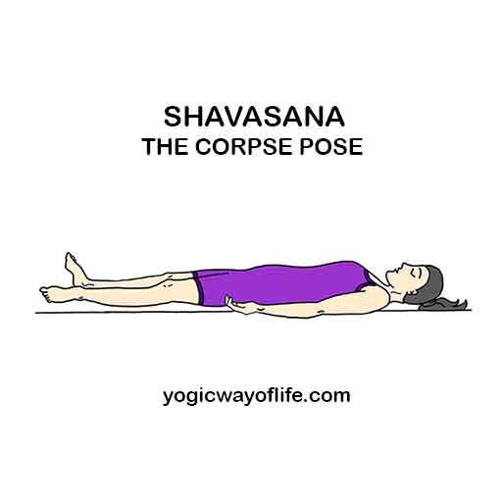
CLASSIFICATION OF ASANAS
RELAXATIVE ASANAS
Shavasana, and Makarasana are the main asanas of relaxative asanas.
The practice of these asanas removes fatigue and relaxes an individual physically and mentally.
An individual gets complete relaxation after performing such asanas.

Slide 13
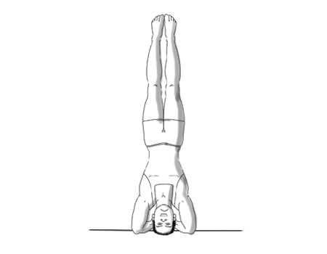
CLASSIFICATION OF ASANAS
CULTURAL OR CORRECTIVE ASANAS
Shirsasana, Sarvangasana, Matsyasana, Halasana, Bhujangasana, Shalabhasana, Dhanurasana, Chakrasana, etc.
These type of asanas regulate and systematics different activities of the body.

Slide 14
THE VARIOUS TYPES OF ASANAS, ON THE BASIS OF EFFECTS ON VARIOUS ORGANS OF BODY
TYPES OF ASANAS
MEDITATIVE ASANAS
RELAXATIVE ASANAS
CORRECTIVE ASANAS
PADMASANA,
SIDDHASANA
SHAVASANA,
MAKARASANA
BHUJANGASANA,
USHTRASANA

Slide 15
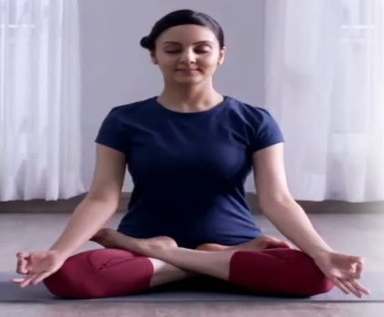
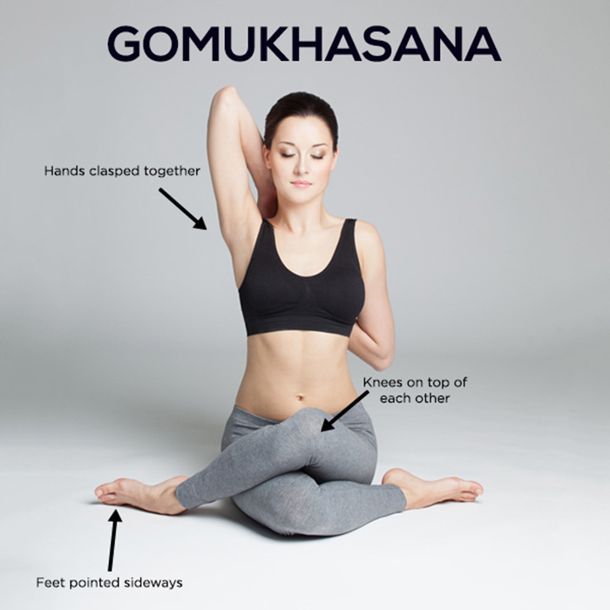

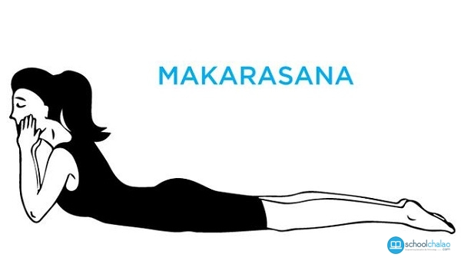
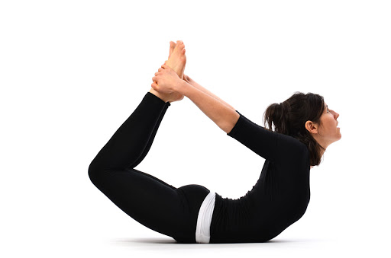
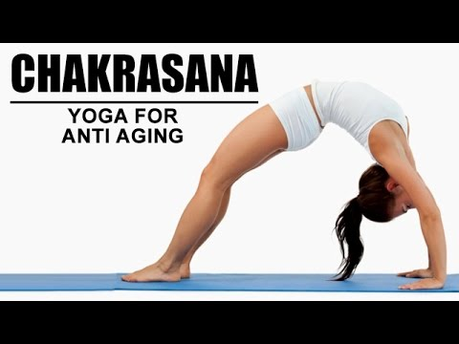
TYPES OF ASANAS
MEDITATIVE
PADMASANA
RELAXATIVE
SHAVASANA
CORRECTIVE
DHANURASANA

Slide 16
BENEFITS OF ASANAS AS PREVENTION OF DISEASES
Bones and Joints Become Strong
Muscles Become Strong
Circulation of Blood Becomes Normal
Respiratory Organs Become Efficient
Efficiency of Digestive System Increases
Immune System is Strengthened
Efficiency of Excretory System Enhances
Nervous System Strengthens
Glandular Activity is Stimulated and Regulated Properly

Slide 17
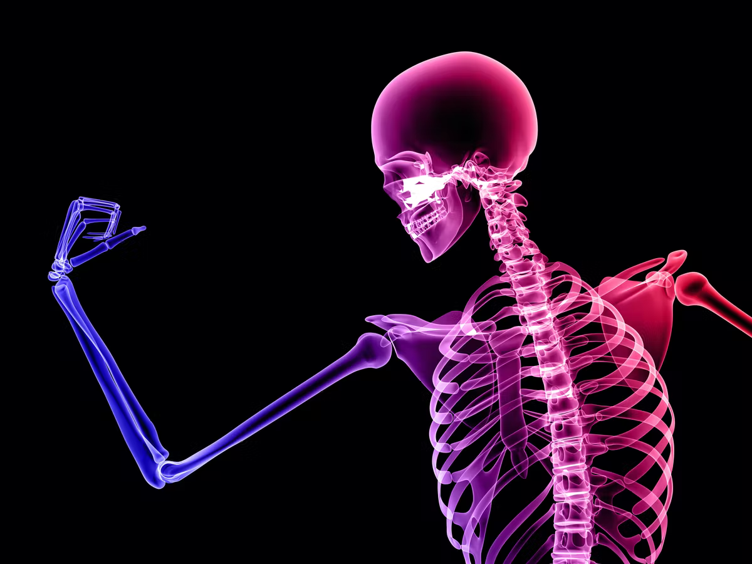
BENEFITS OF ASANAS AS PREVENTION OF DISEASES
BONES AND JOINTS BECOME STRONG
  The bones, cartilages and ligaments become strong.
  The height of children is enhanced.
  The joints are able to bear more pressure.
  Enhance the flexibility of joints and spine.
  Arthritis is also cured by performing asanas.
  Spinal injuries (back pain, sciatica, and cervical pain can be controlled.

Slide 18
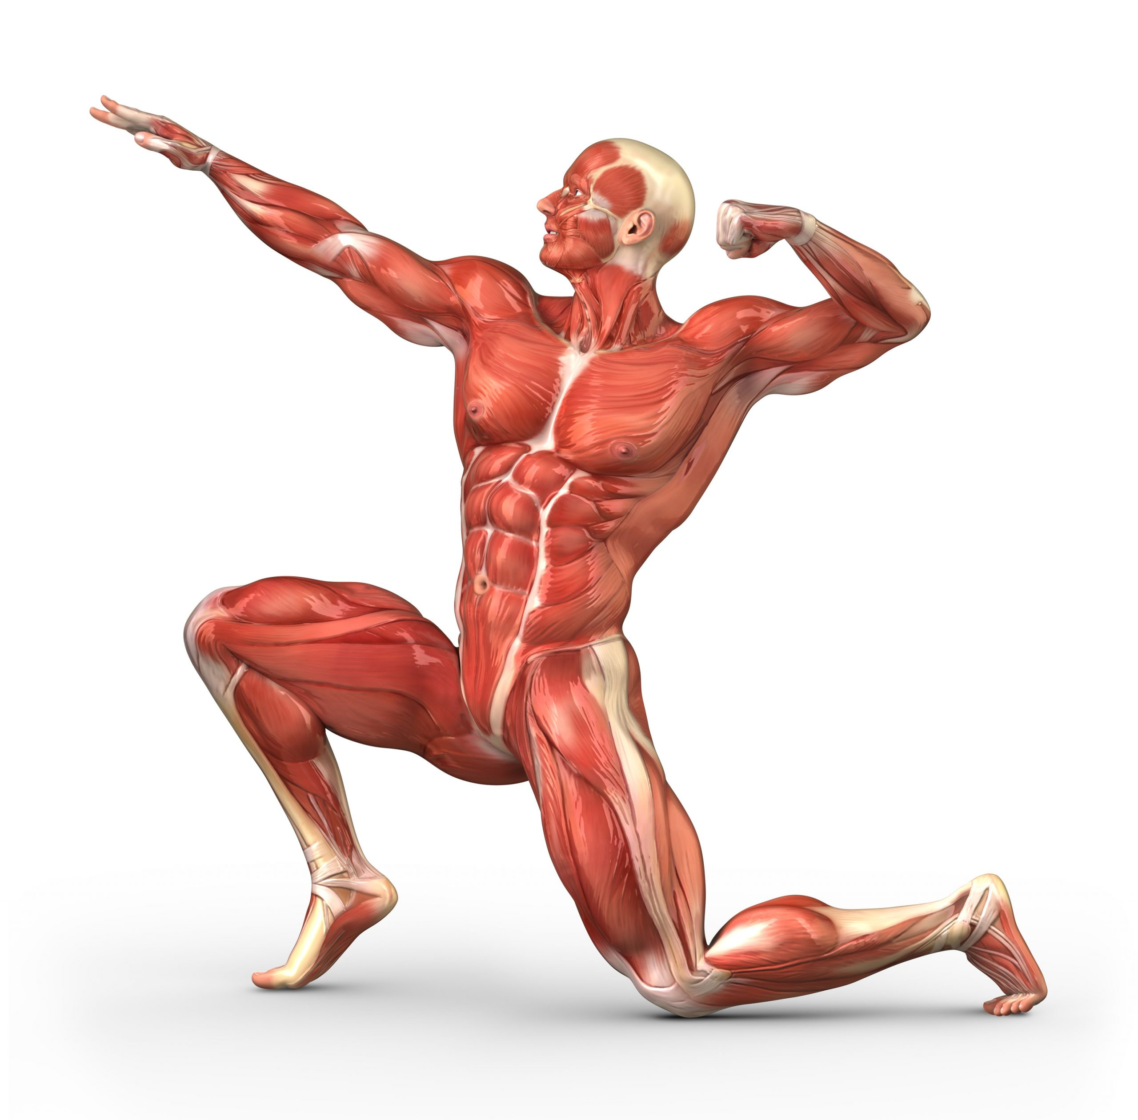
BENEFITS OF ASANAS AS PREVENTION OF DISEASES
MUSCLES BECOME STRONG
By performing asanas regularly, muscles of the body become strong.
The efficiency of muscles increases.
Fat does not accumulate in the body.

Slide 19
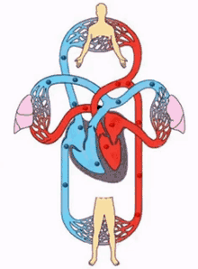
BENEFITS OF ASANAS AS PREVENTION OF DISEASES
CIRCULATION OF BLOOD BECOMES NORMAL
  The Stroke Volume, Cardiac Output increase because Cardiac muscles start working more strongly and efficiently.
  Blood circulation is improved and blood pressure normalizes and stabilizes.
  The level of blood cholesterol reduces.
  The lactic acid and acid phosphate are excreted from muscles quickly and easily, which reduce fatigue.

Slide 20
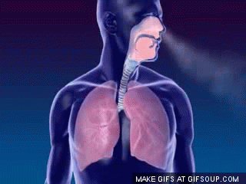
BENEFITS OF ASANAS AS PREVENTION OF DISEASES
RESPIRATORY ORGANS BECOME EFFICIENT
  The Vital Air Capacity increases up to 6000 cc.
  The size of the lungs and chest enhances.
  The will power becomes strong.
  Respiratory diseases can be prevented. (Cough, asthma, cancer of trachea)

Slide 21
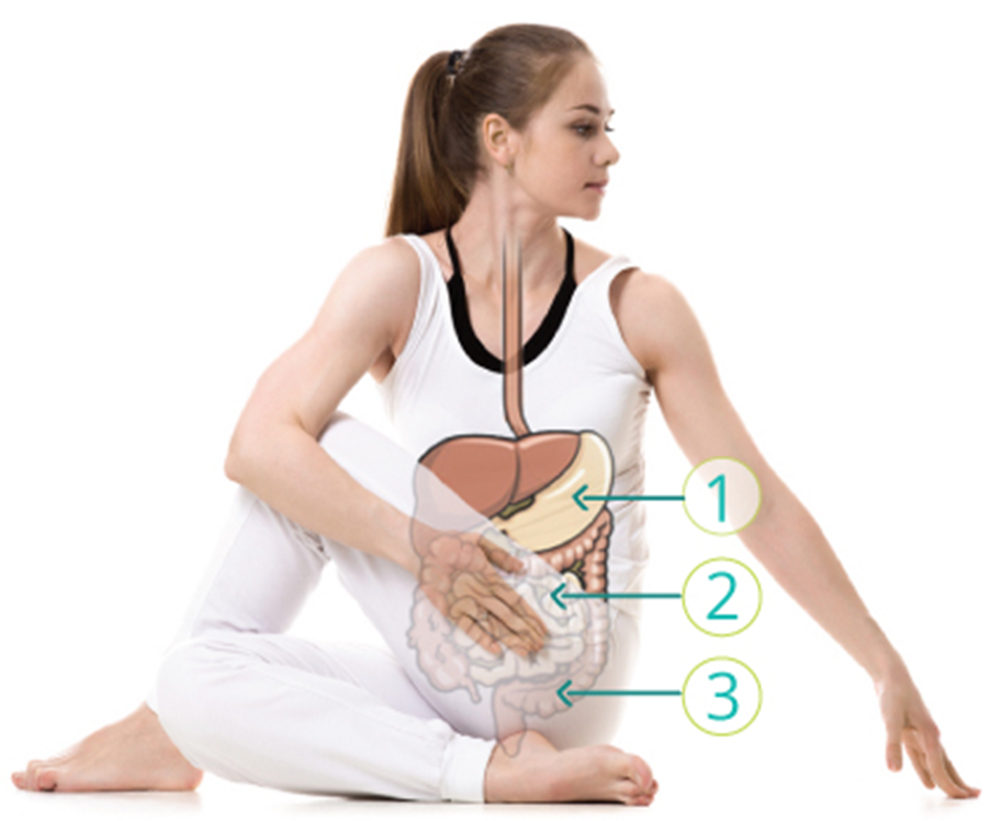
BENEFITS OF ASANAS AS PREVENTION OF DISEASES
EFFICIENCY OF DIGESTIVE SYSTEM INCREASES
  Reduce the chance of Constipation, Indigestion and gas trouble.
  The absorption of food becomes efficient.
  Appetite increases, stomach and intestines are also strengthened.

Slide 22
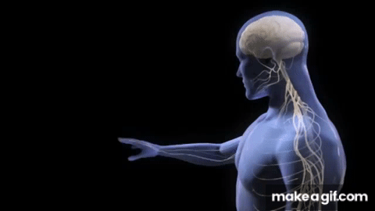
BENEFITS OF ASANAS AS PREVENTION OF DISEASES
NERVOUS SYSTEM STRENGTHENS
  The neuro-muscular coordination increases.
  Activities of our body will be done expending less energy.
  The secretion of adrenaline remains good.
  Reduce the reaction time, anxiety, stress and sleep disorders.

Slide 23
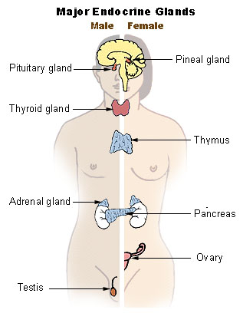
BENEFITS OF ASANAS AS PREVENTION OF DISEASES
GLANDULAR ACTIVITY IS STIMULATED AND REGULATED PROPERLY
The glandular activity is stimulated and regulated properly.
Glands start producing hormones in sufficient quantity.
The demand of insulin reduces.
Regular practice of asanas improve diabetes management.

Slide 24
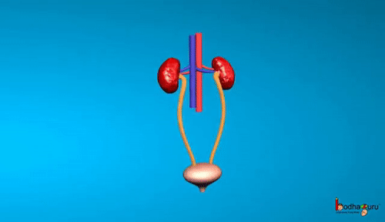
BENEFITS OF ASANAS AS PREVENTION OF DISEASES
EFFICIENCY OF EXCRETORY SYSTEM ENHANCES
  As a result, the waste products such as lactic acid, acid phosphate, urea, uric acid, sulphates, etc., are excreted quickly and properly which in turn help in delaying fatigue.

Slide 25
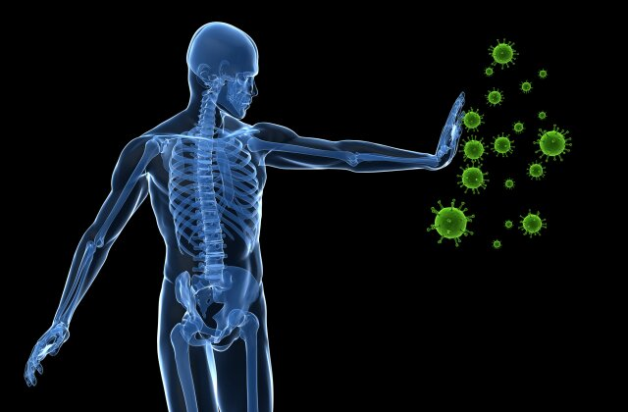
BENEFITS OF ASANAS AS PREVENTION OF DISEASES
IMMUNE SYSTEM IS STRENGTHENED
  By regular practice of asana, our immune system is strengthened.
  As a result, our body becomes less prone to various communicable diseases.

Slide 26
OBESITY
SUBJECT : PHYSICAL EDUCATION
CHAPTER NUMBER: 03
CHAPTER NAME : YOGA AND LIFESTYLE

Slide 27
VARIOUS DISEASES PREVENTED AS WELL AS CURED BY
OBESITY
VAJRASANA
PADA HASTASANA
URDHVA HASTASANA
TRIKONASANA
ARDHMATSEYENDRASANA
DIABETES
BHUJANGASANA
PASCHIMOTTANASANA
PAWANMUKTASANA
ARDHMATSEYENDRASANA
ASTHMA
SUKHASANA
CHAKRASANA
GOMUKHASANA
PARVATASANA
BHUJANGASANA
PASCHIMOTTANASANA
MATSYASANA

Slide 28
VARIOUS DISEASES PREVENTED AS WELL AS CURED BY
HYPERTENSION
TADASANA
VAJRASANA
PAWANMUKTASANA
ARDH CHAKRASANA
BHUJANGASANA
SHAVASANA
BACK PAIN
TADASANA
ARDHMATSEYENDRASANA
VAKRASANA
SHALABHASANA
BHUJANGASANA

Slide 29
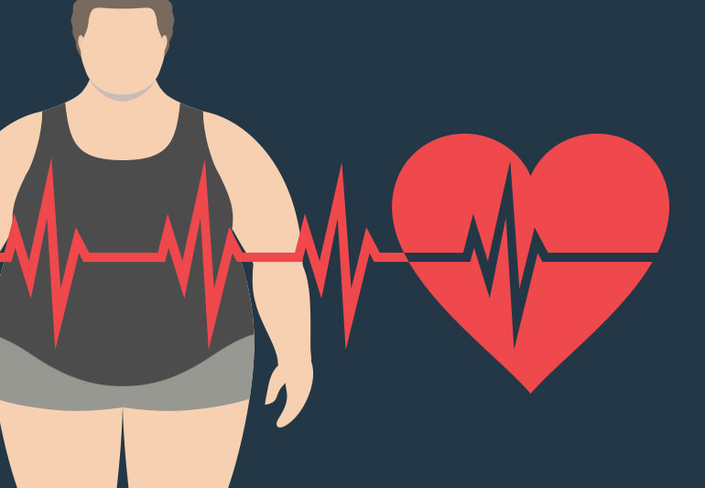
WHAT IS OBESITY?
“Obesity is that condition of the body in which the amount of fat increases to extreme levels.”
“The condition when an individual weight 20% more than the Ideal Weight / Healthy Body Weight.”

Slide 30

TREATMENT OF OBESITY
Obesity means having excess body fat.
Obesity is a risk factor for a number of cancers.
Obesity is difficult to treat .
The chances of long-term successful weight loss are enhanced if the doctor works with a team of professionals, including dietitians, psychologists, and exercise professionals.

Slide 31
MOST COMMON CAUSES OF OBESITY
OBESITY
PHYSICAL INACTIVITY
OVEREATING
GENETICS
FREQUENCY OF EATING
SOCIAL ISSUES
DISEASES

Slide 32
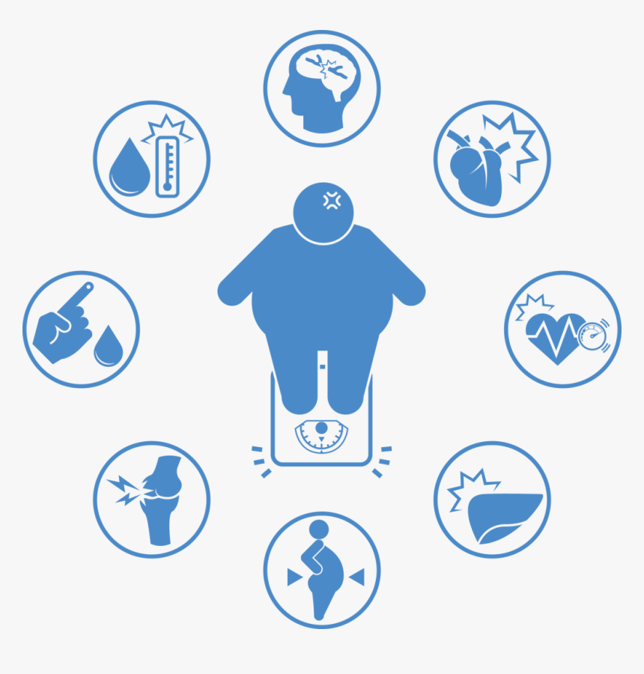
SYMPTOMS OF OBESITY
Having short breath.
Excessive sweating
Double chin
Breathlessness
Increase in body weight.
Pain in joints and bones.
Less moisture in skin.
Feeling tried after any physical activity.

Slide 33
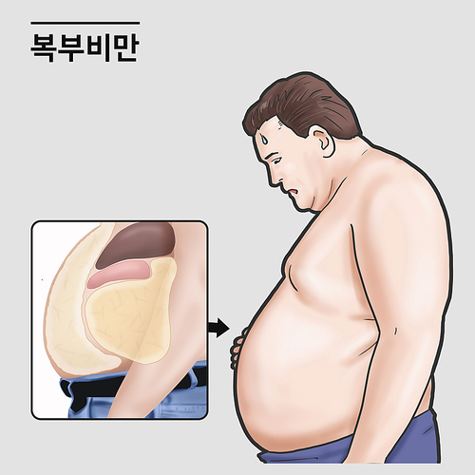
DISEASES DUE TO OBESITY
Diabetes
High blood pressure
Cardiovascular diseases
Cancer
Arthritis
Osteoarthritis
Flatfoot
Respiratory problems

Slide 34
DIFFERENT METHODS TO KNOW OBESITY
According to first method
Just by observing
According to second method
Height and Weight chart
According to third method
The body fat percentage is calculated

Slide 35
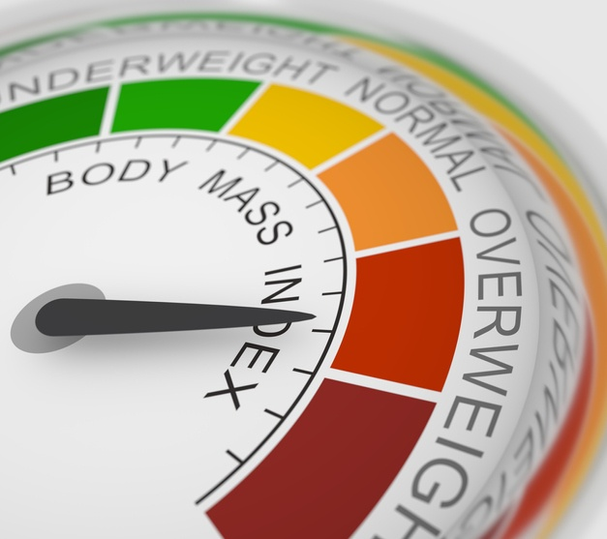

METHOD TO CALCULATE BMI
BMI $=\frac{WEIGHT IN KG}{HEIGHT X HEIGHT IN M}$

Slide 36






BMI & CATEGORY
<18.5
18.5 – 24.9
25 – 29.9
30 – 34.9
35 – 39.9
>40
UNDER WEIGHT
NORMAL WEIGHT
OBESITY CLASS I
OBESITY CLASS II
OBESITY CLASS III
OVERWEIGHT

Slide 37
VARIOUS DISEASES PREVENTED AS WELL AS CURED BY
ASANAS | DISEASES
VAJRASANA | OBESITY, HYPERTENSION
PADA HASTASANA | OBESITY
URDHVA HASTASANA | OBESITY
TRIKONASANA | OBESITY
ARDHMATSEYENDRASANA | OBESITY, DIABETES, BACK PAIN
BHUJANGASANA | DIABETES, ASTHMA, HYPERTENSION, BACK PAIN
PASCHIMOTTANASANA | DIABETES, ASTHMA
PAWANMUKTASANA | DIABETES, HYPERTENSION
SUKHASANA | ASTHMA
CHAKRASANA | ASTHMA
GOMUKHASANA | ASTHMA
PARVATASANA | ASTHMA
MATSYASANA | ASTHMA
TADASANA | HYPERTENSION, BACK PAIN
SHAVASANA | HYPERTENSION
ARDH CHAKRASANA | HYPERTENSION
VAKRASANA | BACK PAIN
SHALABHASANA | BACK PAIN

Slide 38
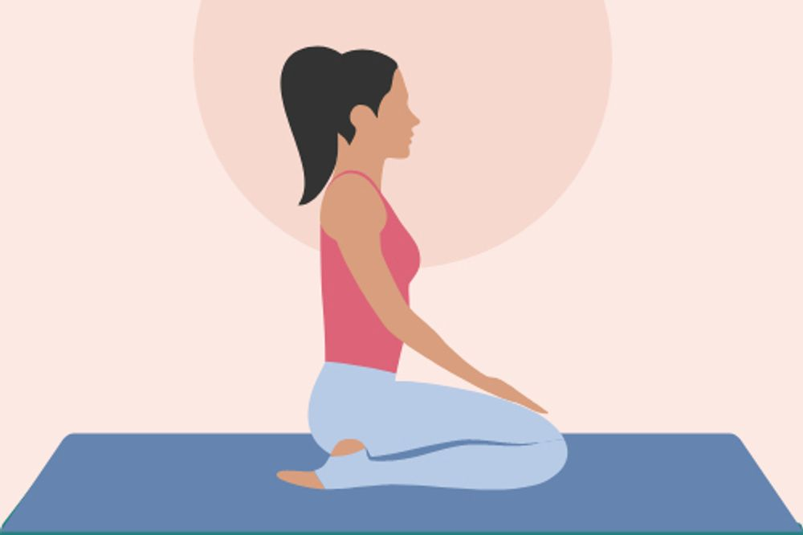
IDENTIFY THE ASANAS
VAJRASANA
THUNDERBOLT POSE, DIAMOND POSE
OBESITY, HYPERTENSION

Slide 39
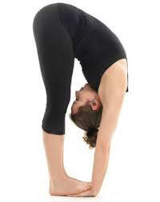
IDENTIFY THE ASANAS
PADA HASTASANA
HAND UNDER FOOT POSE
OBESITY

Slide 40
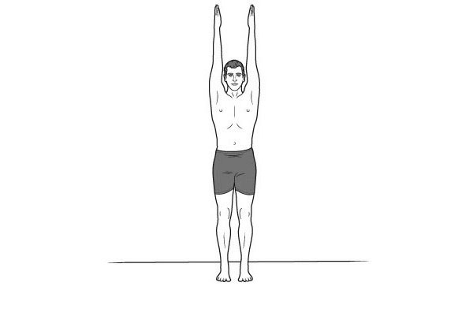
IDENTIFY THE ASANAS
URDHVA HASTASANA
PALM TREE POSITION
OBESITY

Slide 41
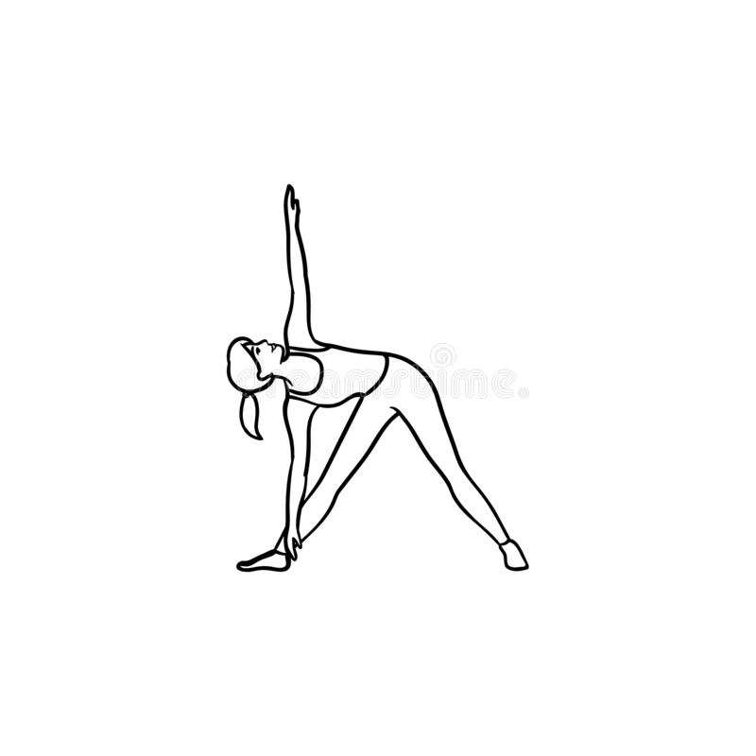
IDENTIFY THE ASANAS
TRIKONASANA
TRIANGLE POSE
OBESITY

Slide 42
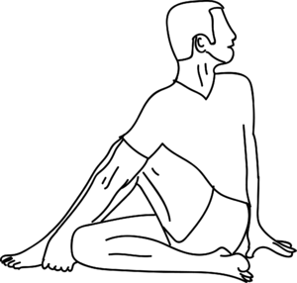
IDENTIFY THE ASANAS
ARDHMATSEYENDRASANA
HALF LORD OF THE FISH POSE
OBESITY, DIABETES, BACK PAIN

Slide 43
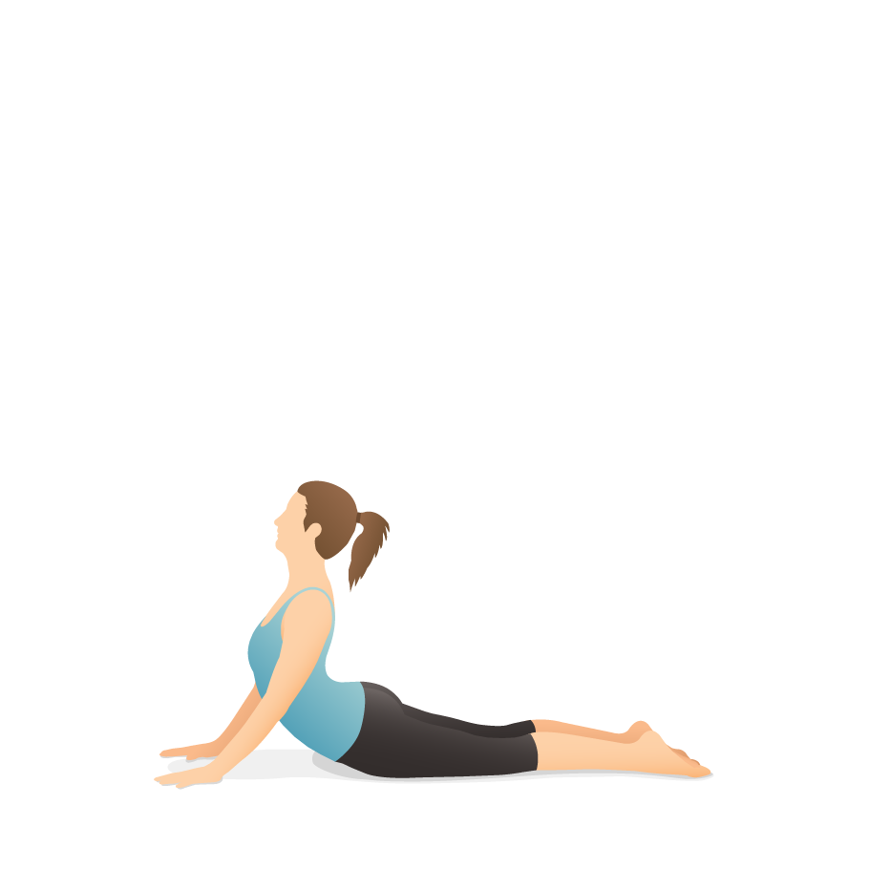
IDENTIFY THE ASANAS
BHUJANGASANA
COBRA POSE
DIABETES, ASTHMA, HYPERTENSION, BACK PAIN

Slide 44
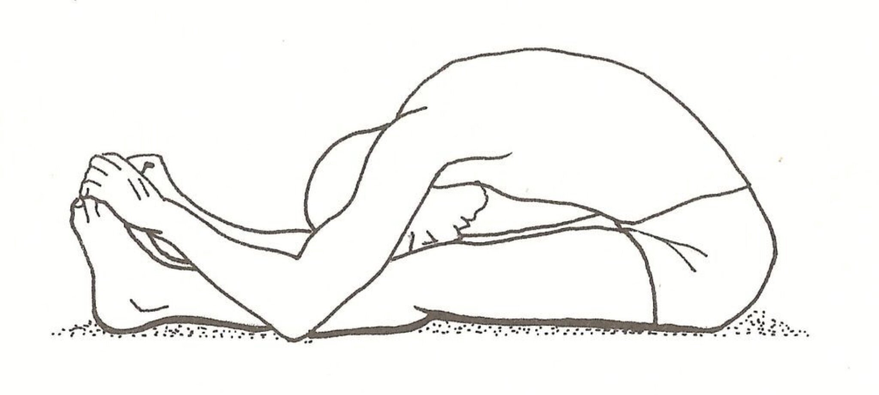
IDENTIFY THE ASANAS
PASCHIMOTTANASANA
SEATED FORWARD BEND
DIABETES, ASTHMA

Slide 45
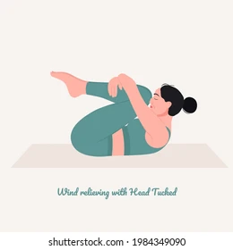
IDENTIFY THE ASANAS
PAWANMUKTASANA
WIND-RELIEVING POSE
DIABETES, HYPERTENSION

Slide 46
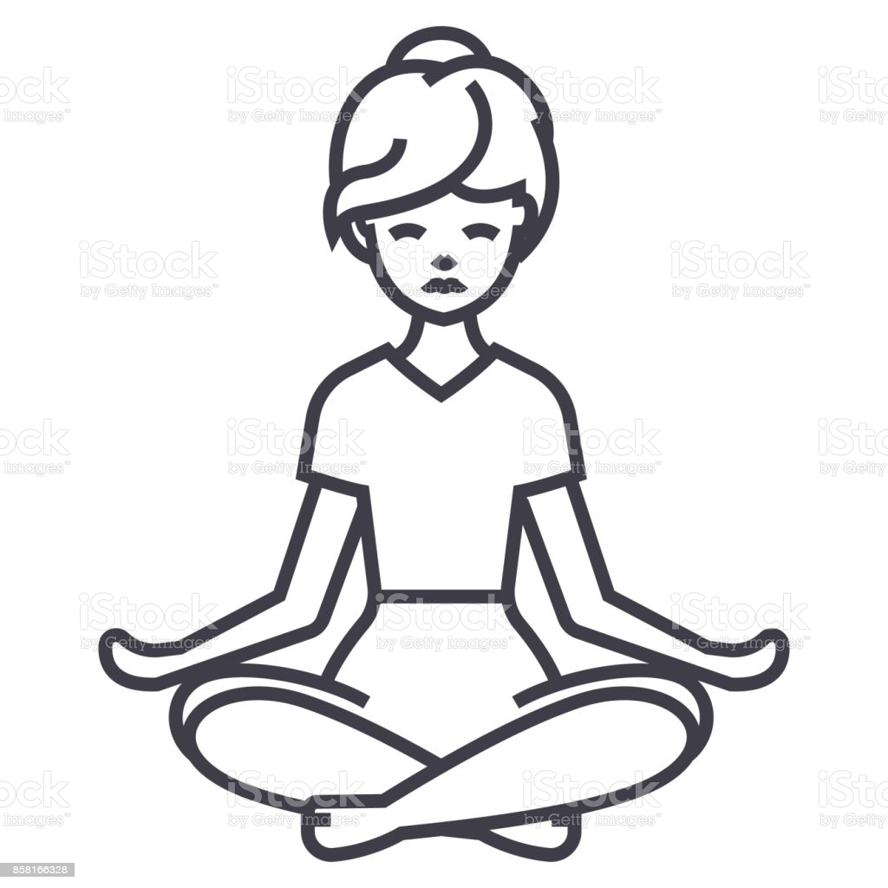
IDENTIFY THE ASANAS
SUKHASANA
EASY POSE, DECENT POSE
ASTHMA

Slide 47
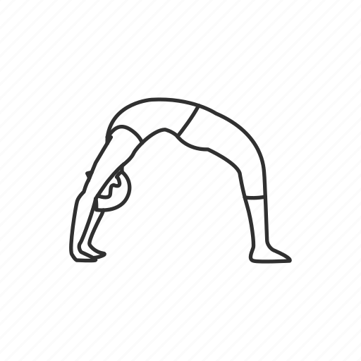
IDENTIFY THE ASANAS
CHAKRASANA
WHEEL POSE
ASTHMA

Slide 48
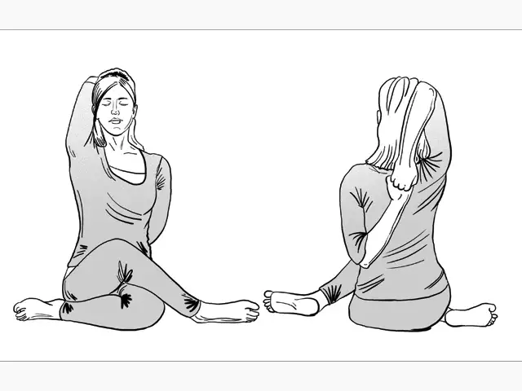
IDENTIFY THE ASANAS
GOMUKHASANA
COW FACE POSE
ASTHMA

Slide 49
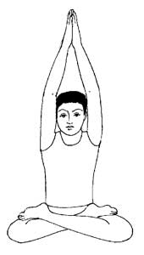
IDENTIFY THE ASANAS
PARVATASANA
MOUNTAIN POSE
ASTHMA

Slide 50
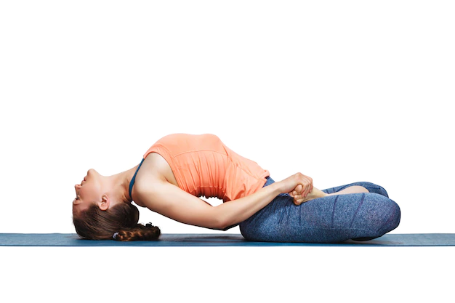
IDENTIFY THE ASANAS
MATSYASANA
FISH POSE
ASTHMA

Slide 51
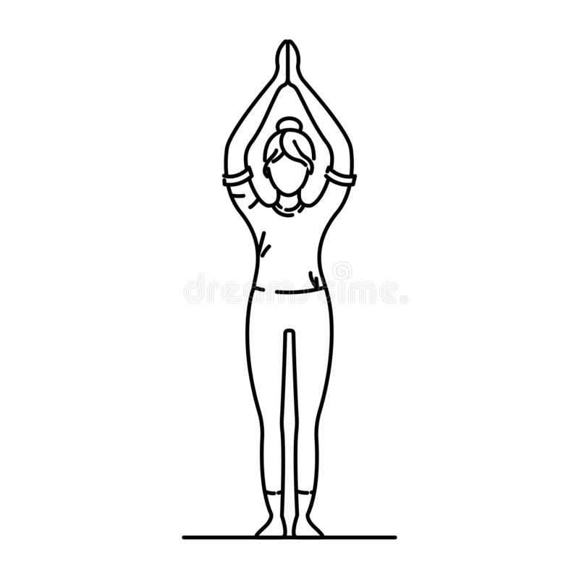
IDENTIFY THE ASANAS
TADASANA
MOUNTAIN POSE
HYPERTENSION, BACK PAIN

Slide 52
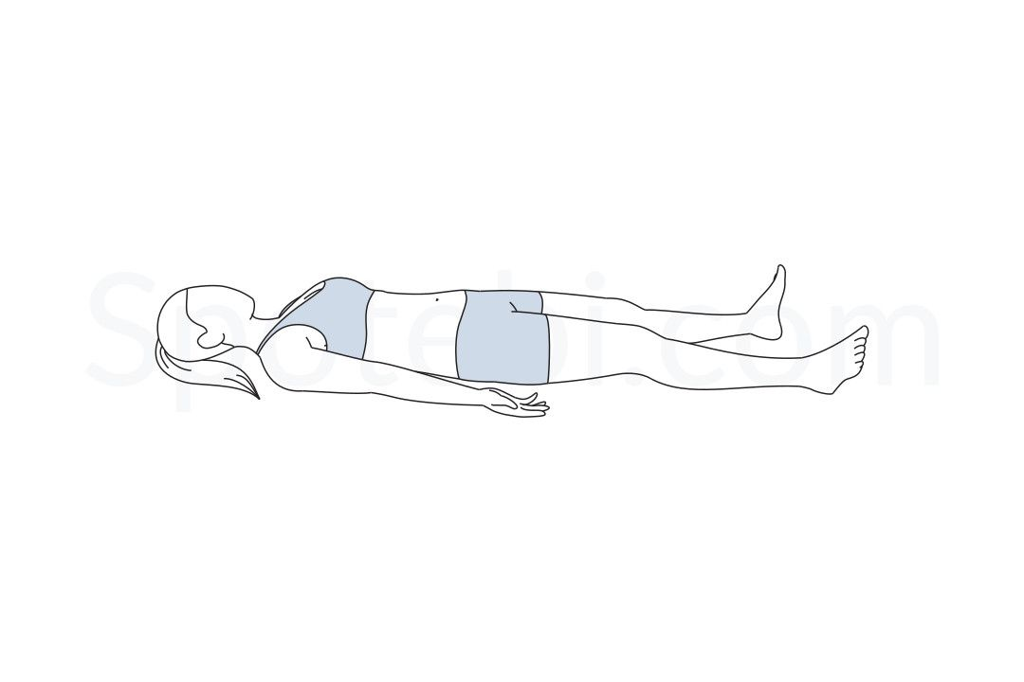
IDENTIFY THE ASANAS
SHAVASANA
CORPSE POSE
HYPERTENSION

Slide 53
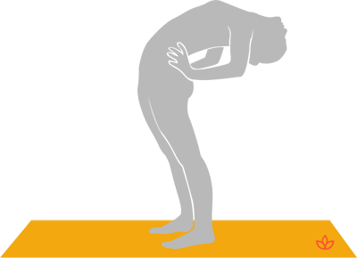
IDENTIFY THE ASANAS
ARDH CHAKRASANA
HALF WHEEL POSTURE
HYPERTENSION

Slide 54
OBESITY CAN BE PREVENTED AS WELL AS CURED BY
VAJRASANA
PADA HASTASANA
URDHVA HASTASANA
TRIKONASANA
ARDHMATSEYENDRASANA

Slide 55
VAJRASANA
PROCEDURE
Pull your knees and ankles together and point your feet in line with your legs. The bottoms of your feet should face upward with your big toes touching.
Improved blood circulation in the lower pelvic area of the body.
CONTRAINDICATIONS
Joint pain.
BENEFITS
Increased efficiency of the digestive system.
Preventing acidity issues and lowering risks of ulcer in the stomach.
Helpful for inducing a meditative state of mind.
Is of great help to people suffering from lower back pain or injuries.
Spinal column problem.
Difficulty in movement.
VAJRASANA
THUNDERBOLT POSE, DIAMOND POSE

Slide 56
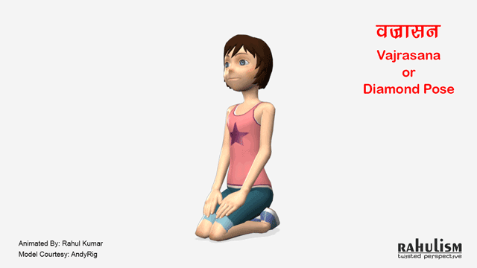

Slide 57
PADAHASTASANA
PROCEDURE
Distance your legs hip-width apart.
CONTRAINDICATIONS
BENEFITS
Inhale and slowly raise your arms upwards. ...
Exhale and slowly bend the trunk forward from your hips till your hands reach your feet.
Next, place the palms of your hands under the soles.
Elbows remain slightly bent pointing outwards.
Loosen up the shoulders and let the arms relax.
back pain
Massages the digestive organs.
Alleviates constipation and indigestion.
Spinal nerves are stimulated and toned.
Increases blood circulation.
Improves the metabolism.
Improves concentration.
Helps with nasal and throat diseases.
high blood pressure
heart problems
knee problems
sciatica
PADAHASTASANA
HAND UNDER FOOT POSE

Slide 58

PADAHASTASANA

Slide 59
TRIKONASANA
PROCEDURE
Now bend towards the right and slightly bend the knees and touch the right foot with the hands. Look up at the left hand. Exhale when you are bending down to touch the foot. Keep the eyes open throughout the practice.
BENEFITS
migraine
Strengthens the legs, knees, ankles, arms and chest.
Return to the standing position.
Repeat this with the left hand touching the left foot.
Practise as many rounds as is comfortable.
Stretches and opens the lower back region, hamstrings, calves, shoulders, chest and spine.
Increases mental and physical equilibrium.
Helps improve digestion.
Reduces anxiety, stress, back pain and sciatica Contraindications.
Avoid doing this if suffering from migraine, diarrhoea, neck and back injuries.
CONTRAINDICATIONS
diarrhea
blood pressure problems and
injuries of the neck and back
TRIKONASANA
TRIANGLE POSE

Slide 60
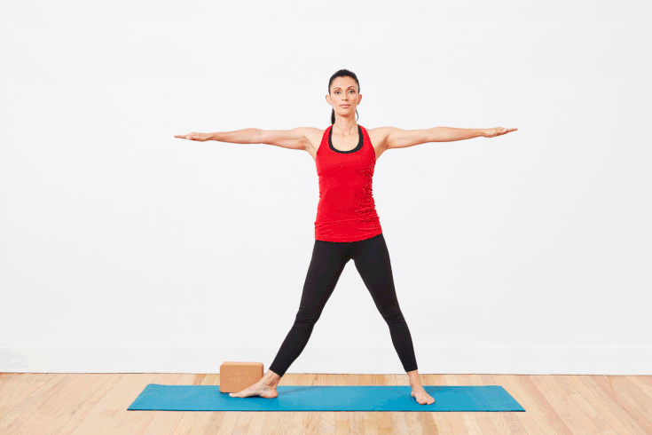
TRIKONASANA

Slide 61
ARDHA MATSYENDRASANA
PROCEDURE
Exhaling bend the left knee and place the sole to the right hip from outside.
BENEFITS
back or neck pain
It strengthens and tones your obliques and abs.
CONTRAINDICATIONS
injuries of the neck and back
Inhaling raise the left arm up,
Exhaling the catch the right big toe from outside of the right leg,
Maintain the final position with normal breathing.
Gaze at the right side while in the final position.
Repeat the practice on another side after 5 breathing.
The pose energizes and stretches the spine.
Open your shoulders, hips and neck.
Increase the flexibility in your spine and hips.
It also cleanses your internal organs.
It will improves digestion as well as elimination of the wastes.
slip disc problems
ARDHA MATSYENDRASANA
HALF LORD OF THE FISH POSE

Slide 62
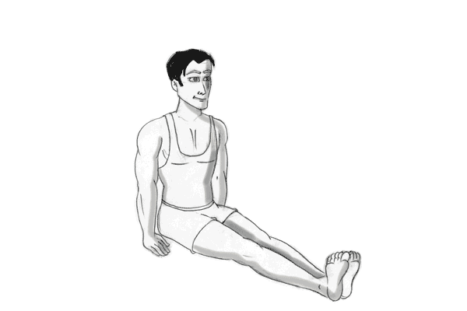
ARDHA MATSYENDRASANA

Slide 63
URDHVA HASTASANA
PROCEDURE
You must begin by assuming Tadasana.
BENEFITS
During shoulder or neck injuries.
CONTRAINDICATIONS
It gives the belly a good stretch.
Stand with your arms at your sides. Make sure that your arms are parallel to each other.
Your arms must be straight at all times such that they are activated all throughout, till your fingertips.
Move your gaze upwards.
Straighten your legs, but do not lock your knees.
It improves digestion.
It relieves stress and anxiety.
It enhances body posture.
It increases the capacity of the lungs.
It improves blood circulation in the body.
It eases sciatica.
It helps in tightening the abdomen.
Experiencing dizziness.
URDHVA HASTASANA
PALM TREE POSITION

Slide 64
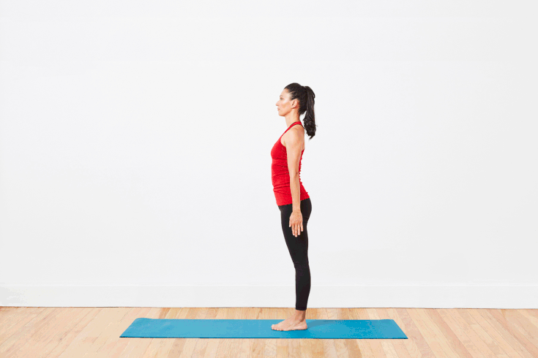
URDHVA HASTASANA

Slide 65
DIABETES
SUBJECT : PHYSICAL EDUCATION
CHAPTER NUMBER: 03
CHAPTER NAME : YOGA AND LIFESTYLE

Slide 66
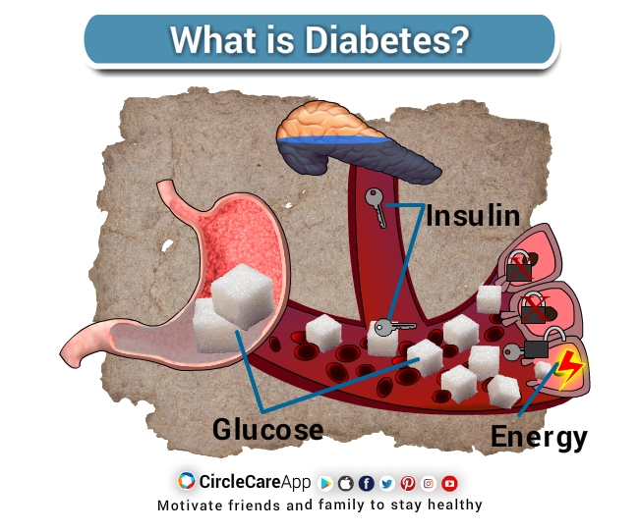
WHAT IS DIABETES?
Diabetes is a disease that occurs when your blood glucose, also called blood sugar, is too high.
Diabetes is a chronic disease that occurs either when the pancreas does not produce enough insulin or when the body cannot effectively use the insulin it produces.
Insulin is a hormone that regulates blood sugar.

Slide 67
TYPES OF DIABETES
DIABETES
Type I diabetes
Type II diabetes
Gestational Diabetes Mellitus (GDM)
Body does not produce enough insulin
Body produces insulin but can’t use it well
A temporary condition in pregnancy

Slide 68



WHAT IS DIABETES?

Slide 69
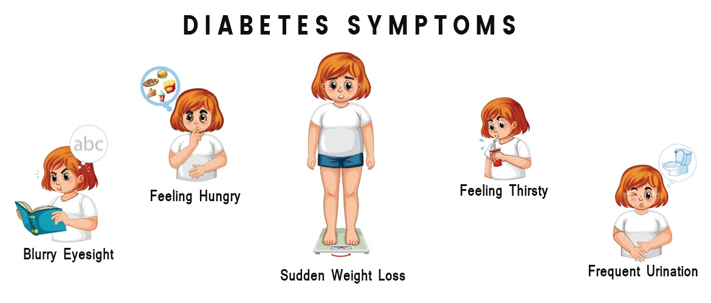
SYMPTOMS OF DIABETES
Frequent infections
Frequent urination
Feeling very thirsty
Feeling very hungry
Extreme fatigue
Blurred vision
Weight loss
Irritability

Slide 70
DIABETES CAN BE PREVENTED AS WELL AS CURED BY
PAVANAMUKTASANA
BHUJANGASANA
PASCHIMOTTANASANA
ARDHMATSEYENDRASANA

Slide 71
OBESITY CAN BE PREVENTED AS WELL AS CURED - ARDHA MATSYENDRASANA
PROCEDURE
Exhaling bend the left knee and place the sole to the right hip from outside.
BENEFITS
back or neck pain
It strengthens and tones your obliques and abs.
CONTRAINDICATIONS
injuries of the neck and back
Inhaling raise the left arm up,
Exhaling the catch the right big toe from outside of the right leg,
Maintain the final position with normal breathing.
Gaze at the right side while in the final position.
Repeat the practice on another side after 5 breathing.
The pose energizes and stretches the spine.
Open your shoulders, hips and neck.
Increase the flexibility in your spine and hips.
It also cleanses your internal organs.
It will improves digestion as well as elimination of the wastes.
slip disc problems
ARDHA MATSYENDRASANA
HALF LORD OF THE FISH POSE

Slide 72
ARDHA MATSYENDRASANA

Slide 73
DIABETES CAN BE PREVENTED AS WELL AS CURED - PAVANAMUKTASANA
PROCEDURE
Inhale and raise your legs at 90 degree
BENEFITS
Suffering from heart problems.
Its helps to strengthen the abdominal muscles.
CONTRAINDICATIONS
Exhale, bend your legs and try to bring your knees towards your chest.
Clasp your knees by interlocking your fingers.
Raise your head and made touch your forehead with your knees.
Do normal breathing while maintaining the pose.
First bring your head down and followed by your legs.
This is the one round.
Do 2 to 3 rounds.
Its cures constipation, indigestion, diarrhea and acidity.
It also effectively massages the intestines as well as stimulates the internal organs of the digestive system, thus releasing the trapped gases as well as improving digestion.
Hyper acidity.
High BP
Slipped disc
Pregnant women
PAVANAMUKTASANA
WIND-RELIEVING POSE

Slide 74
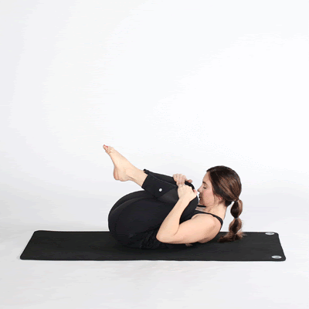
PAVANAMUKTASANA

Slide 75
BHUJANGASANA
PROCEDURE
BENEFITS
Suffering from hernia
Relieves the discomfort in back muscles.
• Doing Bhujangasana for a long run helps with stress and anxiety.
• It helps in relieving menstrual pain and helps with irregularities.
• Cobra pose helps in decreasing stiffness of the lower back.
• Massages your digestive system.
• Improves blood circulation of the body.
• Strengthens your shoulders, upper back and spine.
• It is useful in relief from slipped disc, back pain and sciatica.
CONTRAINDICATIONS
Pregnant women
1. Lie down in prone position on the flat surface area.
2. Keep your feet together and toes against the floor, facing upwards.
3. Now keep our hand palms by the side of your chest.
4. Your arms should be close to your body and elbows pointing upwards.
5. Now raise your shoulders using the strength of your arms. Using your back muscles, raise your chest.
6. Now use the strength of your arms to raise your trunk. Look upward trying to hold your breath.
7. Keep this position for 15-20 seconds.
Back injuries
headaches
BHUJANGASANA
COBRA POSE

Slide 76
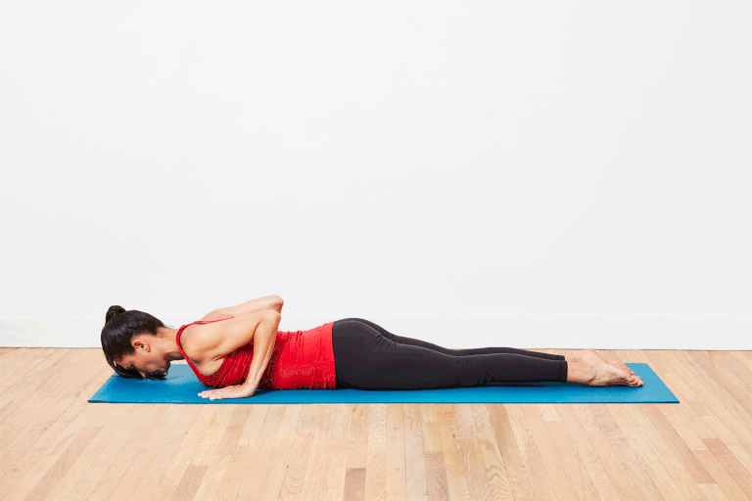
BHUJANGASANA

Slide 77
PASCHIMOTTANASANA
PROCEDURE
BENEFITS
Suffering from enlarged liver.
It stretches hamstrings, spine, shoulders and hip joints.
CONTRAINDICATIONS
Pregnant women
Reach forwards and hold the big toes in a lock with the middle and index fingers.
Respiratory diseases
Spinal problems
Inhale, lengthen the torso, bring the sternum forward.
Exhale, bring the chest and abdomen down to the thighs and the elbows out to the sides.
Stay in this position for 5 deep breaths and relax the muscles while exhale.
Focus on stretching the hamstrings rather than getting the head to the knees.
It massages the pancreas and improves
It relieves menstrual discomfort and improves fertility.
It reduces headache, anxiety, insomnia and sinusitis.
It reduces abdominal fats and helps metabolism.
PASCHIMOTTANASANA
SEATED FORWARD BEND

Slide 78
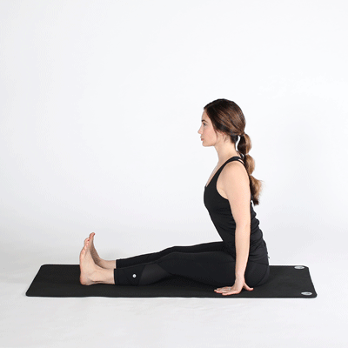
PASCHIMOTTANASANA

Slide 79
ASTHMA
SUBJECT : PHYSICAL EDUCATION
CHAPTER NUMBER: 03
CHAPTER NAME : YOGA AND LIFESTYLE

Slide 80
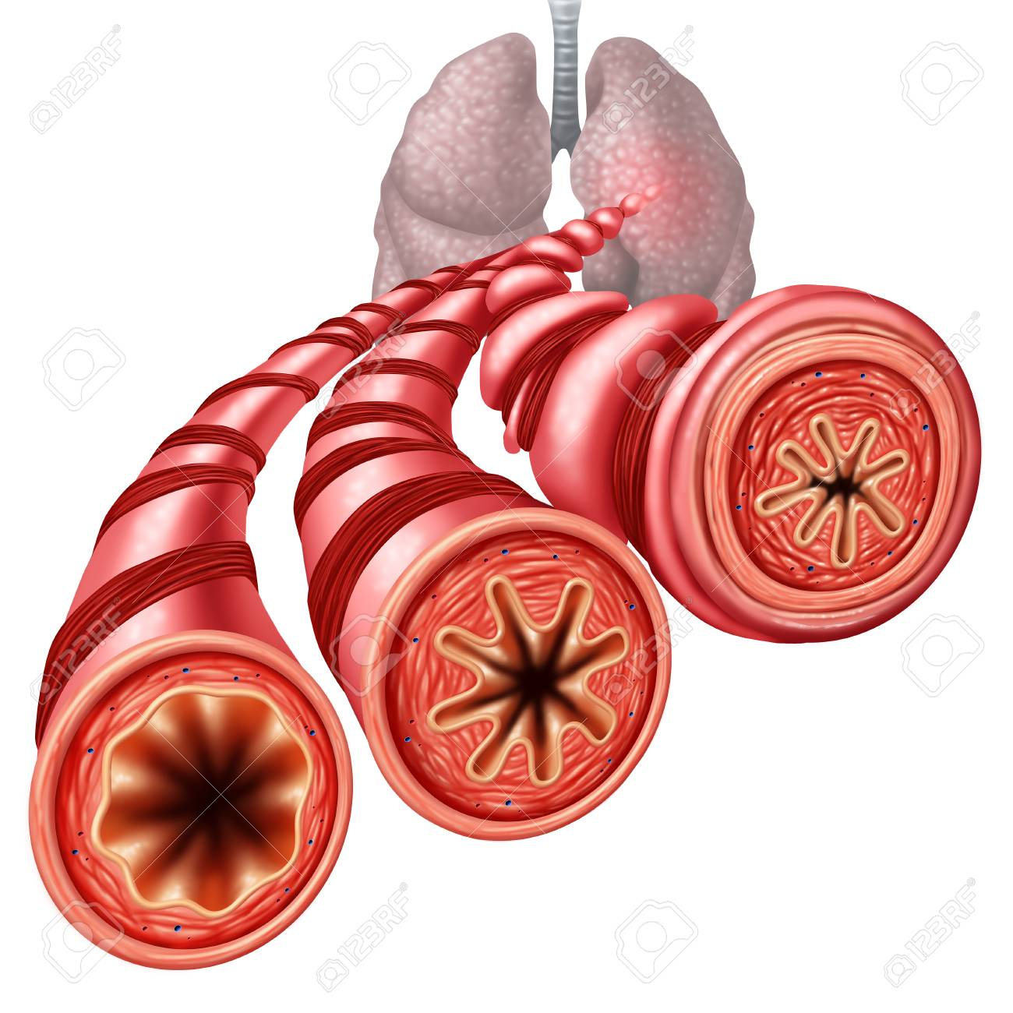
WHAT IS ASTHMA?
Asthma is a disease of lungs in which the airways become blocked or narrowed.
A condition in which a person's airways become inflamed, narrow and swell and produce extra mucus, which makes it difficult to breathe.
Asthma is a chronic (long-term) condition that affects the airways in the lungs.

Slide 81

CAUSES OF ASTHMA
Genetic
Pollution
Smoking
Household chemicals
Fatty food
Dust
Bacteria and viruses
Perfumes or scented soaps

Slide 82

SYMPTOMS OF ASTHMA
Shortness of breath
Difficulty breathing
Wheezing
Frequent coughing
Chest tightness
Sleep problems
Common cold
Feeling tired

Slide 83
ASTHMA CAN BE PREVENTED AS WELL AS CURED BY
SUKHASANA
BHUJANGASANA
PASCHIMOTTANASANA
MATSYASANA
CHAKRASANA
GOMUKHASANA
PARVATASANA

Slide 84
MATSYASANA
PROCEDURE
BENEFITS
Those suffering from high blood pressure, low blood pressure or insomnia should not practice this asana.
Good for diabetes, asthma, cold, cough etc. Pituitary glands, located in the brain are stimulated and toned.
CONTRAINDICATIONS
Bend the right leg and keep the right foot on the left thigh.
Bend the left leg and place it on the right thigh.
With the help of your elbows lift the back, arch the back maximum and rest the crown on the ground.
Hold the big toes with the hands.
Relieves tension in your neck, throat, and shoulders.
Stretches and tones the front of your neck and your abdominals.
Stretches and stimulates the organs of your belly and throat. Strengthens your upper back and the back of your neck
People with knee injury should not practice Padmasana (Lotus Pose).
While bending, don't put excessive stress on your back as it can lead to serious injury.
MATSYASANA
FISH POSE

Slide 85

MATSYASANA

Slide 86
PARVATASANA
PROCEDURE
BENEFITS
People suffering from spinal injury and spinal abnormalities.
Parvatasana helps develop a proper breathing technique.
CONTRAINDICATIONS
After this, inhaling slow and deep about 3 seconds and join the palms in namaskar mudra and stretch the hands upward over the head.
Now pull the body and hands well upwards with keeping your hips on the floor and feel the deep stretch in the body.
Maintain the final pose for 30-40 seconds.
With the breathing normally and then release the pose and slowly return to the starting pose.
With regular practice of the pose, your lung capacity will increase.
Parvatasana helps reduce flab from the abdomen, tummy, hips and the waist.
The pose has a slimming effect on the physique.
The spine and ribs are stretched.
Frozen shoulder.
Hypertension and serious cardiac complaints (especially Variation-3)
PARVATASANA
MOUNTAIN POSE

Slide 87

PARVATASANA

Slide 88
CHAKRASANA
PROCEDURE
BENEFITS
Those with high blood pressure should be avoided
Increases the flexibility of the body.
CONTRAINDICATIONS
Take a long and deep breath and slowly start raising your body.
Arch your back while raising the body supporting the weight of your upper body on the back and top of your head.
Lift your head and trunk from the ground and straighten your hands and legs as much as possible.
Arch the back as high as possible but do not strain. The neck should be relaxed.
Stay in this posture while breathing normally for as long as you feel comfortable and return to the floor slowly while exhaling. Slowly lower the body to the floor.
Strengthens the bones and muscles of the body and is mainly beneficial in strengthening the legs.
strengthens the respiratory system as by doing it, the chest enhances and the lungs get oxygen to its fullest.
Relives all the stress and tension as it strengthens the nervous system and refreshes the brain.
Helpful in reducing the fat of the abdomen and to get rid of the bloated belly.
Beneficial for the digestive system, gastric problems and for all the disorders of the female reproductive system.
Ensures better functioning of the heart, liver, and kidneys. Helpful in curing hernia.
Pregnant women are advised against taking up this asana.
Person having back injury, hernia and heart problem should be avoided.
CHAKRASANA
WHEEL POSE

Slide 89

CHAKRASANA

Slide 90
GOMUKHASANA
PROCEDURE
BENEFITS
It is not advised for the people with the chronic injuries of the knees and shoulder joints.
This asana induces a deep state of relaxation.
CONTRAINDICATIONS
Exhaling bend the left knee so that, left sole touches the right hip.
Inhaling raises the right arm and interlock the fingers with the left hand from a backside.
Looking straight maintain the pose for 5 breaths.
Exhaling brings down the arms.
Inhaling keep the right leg straight, Exhale.
Inhaling keep the left leg straight.
Repeat the procedure on the other side.
Brings the peace of mind and serenity, concentration
Helps in relieving the stress and the tendencies of the anxiety
Good for improving the strength and flexibility of the shoulder joints through the actions of deltoids and rotator cuffs. This helps in preventing the drooping and frozen shoulders.
Strengthens the spinal column and relieves the back and neck pain.
Expansion of the chest enhances the lung capacity.
Stimulates the peristalsis and relieves the digestive disorders.
Promotes the range of motion of the hips joints and the flexibility of the muscles in the pelvic girdle.
Promotes the health of the reproductive organs
Brings the good postural health.
GOMUKHASANA
COW FACE POSE

Slide 91

GOMUKHASANA

Slide 92
SUKHASANA
PROCEDURE
BENEFITS
Backache: Individuals who are experiencing backache shouldn't stay in this position for more than 5 mins.
Being a meditative pose it has relaxing effects on mind and body.
CONTRAINDICATIONS
Rest the outer edge of your feet on the floor.
Adjust the body and legs to get comfortable in the pose.
The head, neck and spine must be erect (without strain).
Place the palms on the knees or thighs.
Keep the shoulder relaxed and elbows a bit bent.
Close your eyes and relax the whole body, take slow and deep breaths.
Feel each and every breath moving in and out of the body.
Practice for a minute or less if you feel discomfort.
Practice twice by interchanging the position of the legs.
Works as a preparatory pose for more difficult meditative poses.
Builds physical and mental balance.
Helpful in reducing stress and anxiety.
Excellent for people having a stiff body.
Creates flexibility in ankle, knee and hip joints.
Improves concentration for achieving an effective meditation practice.
Arthritis in Knees: Someone with severe arthritis would find it difficult to sit on the floor as there would be too much pressure at the knees.
SUKHASANA
EASY POSE, DECENT POSE

Slide 93

SUKHASANA

Slide 94
HYPERTENSION
SUBJECT : PHYSICAL EDUCATION
CHAPTER NUMBER: 03
CHAPTER NAME : YOGA AND LIFESTYLE

Slide 95

WHAT IS HYPERTENSION?
Hypertension is another name for high blood pressure.
A condition in which the force of the blood against the artery walls is too high.
Usually hypertension is defined as blood pressure above 140/90, and is considered severe if the pressure is above 180/120.

Slide 96
SYSTOLIC & DIASTOLIC BLOOD PRESSURE
SYSTOLIC BLOOD PRESSURE
When the heart contracts, it pushes the blood through blood vessels consequently the blood pressure increases in arteries.
Normal = 120
DIASSTOLIC BLOOD PRESSURE
The pressure between two heartbeats is called diastolic blood pressure.
Normal = 80

Slide 97
THE VARIOUS STAGE OF HYPERTENSION
normal
120/80 mmHg
Stage 1
130-140/80-90 mmHg
Stage 2
Over 180/110 mmHg
Stage 3 (critical)
140-179/90-109 mmHg

Slide 98

CAUSES 0F HYPERTENSION
Genetics disorders
Smoking
Being overweight or obese
Lack of physical activity
Too much salt in the diet
Too much alcohol consumption
Stress
Older age

Slide 99

SYMPTOMS 0F HYPERTENSION
Morning headaches
Nosebleeds
Irregular heart rhythms
Vision changes
Buzzing in the ears
Fatigue, nausea, vomiting, confusion, anxiety, chest pain, heart attacks
Heart failure and an irregular heartbeat, which can lead to a sudden death
As well as kidney damage, Which can lead to kidney failure

Slide 100
HYPERTENSION CAN BE PREVENTED AS WELL AS CURED BY
VAJRASANA
PAWANMUKTASANA
TADASANA
ARDHA CHAKRASANA
BHUJANGASANA
SHAVASANA

Slide 101
TADASANA
PROCEDURE
BENEFITS
Low blood pressure patient should not practice because blood may begin to flow to the lower part of the body.
Stretches your whole body from feet to head.
CONTRAINDICATIONS
Now take a deep breath and raise your both the hands up.
Interlock your fingers and raise your heels up to stand on your toes.
Hold this position for few seconds and keep breathing deeply.
Feel the stretch in your legs, arms, and chest.
Now while exhaling bring down your hands and heels to come to the starting position.
Repeat this for 10 times.
Strengthens chest, thighs, legs, ankles, and hands.
Effective exercise to increase height.
Relieves sciatica.
Regulate menstrual cycle.
Effective to cure indigestion.
Reduces flat feet.
Improves posture.
Regulates respiratory system.
Increases flexibility.
Avoid if you are suffering from a headache or insomnia.
Do not practice during pregnancy.
TADASANA
MOUNTAIN POSE

Slide 102
ARDHA CHAKRASANA
PROCEDURE
BENEFITS
Those with serious hip or spinal problems should avoid this asana as well as those with high blood pressure and brain ailments.
Stretches the front upper torso.
CONTRAINDICATIONS
Breathing in, extend your arms overhead, palms facing each other.
Breathing out, gently bend backwards pushing the pelvis forward, keeping the arms in line with the ears, elbows and knees straight, head up, and lifting your chest towards the ceiling.
Hold. Breathing in, come back up.
Breathing out, bring the arms down and relax.
Tones the arms and shoulder muscles.
It cures menstrual disorder.
It reduces fat in the waist and thigh.
It helps to alleviate upper back pain.
It improves digestion.
Peptic or duodenal ulcers and hernia patients should avoid this pose.
Pregnant woman should avoid this pose.
ARDHA CHAKRASANA
HALF WHEEL POSTURE

Slide 103

ARDHA CHAKRASANA

Slide 104
SAVASANA
PROCEDURE
BENEFITS
People who are not advised to lie on back should avoid this pose.
Calms the body: It helps to make the body and mind fresh & afresh.
CONTRAINDICATIONS
Rest your arm on each side of your body and have a gap as wide as mat between your legs.
Hand should face upward.
Eyes should be closed.
Now try to feel your body and its parts.
Try to make synchronization between your body and breathing.
It can be practiced between 5-10 minutes. It can also be practiced for 20-30 minutes.
Stress: It is one of the important yoga poses to make the body stress free.
Nervous system: It is extremely beneficial for nervous system.
Blood pressure: It is good to normalize the blood pressure, relaxes your heart and reduces the level of anxiety.
Memory: It increases the concentration and memory.
Increases energy level: The regular practice of the asana helps to increase the level of energy in the body.
Insomnia: The patients of insomnia should practice the asana to get relief from it.
Vata dosha: If somebody has imbalance of air element, he should practice the yoga pose to overcome the problem.
Muscles relaxation: It removes fatigue and depression, good for muscle relaxation.
himself/herself to lying on the back because food pipe may displease your body system.
SAVASANA
CORPSE POSE

Slide 105
THANKING YOU
ODM EDUCATIONAL GROUP

Slide 106


BACK PAIN
Pain in the cervical, thoracic or lumbar region.
Cause Of Back Pain :-
Overweight, lack of physical activity or exercise, excessive smoking, lack of flexibility.
Symptoms Of Back Pain :-
Not able to do their work smoothly and efficiently, pain, etc.

