Slide 1


PSYCHOLOGY AND SPORTS
SUBJECT : PHYSICAL EDUCATION
CHAPTER NUMBER: 09
CHAPTER NAME : PSYCHOLOGY AND SPORTS

Slide 2


WHAT WE EXPECT TO LEARN?
01
What is Psychology?
02
Meaning of Sports psychology.
03
Various psychological factors.
04
Importance of sports psychology.

Slide 3
SOUL
‘PSYCHE’
‘LOGAS’
PSYCHOLOGY
The science of soul.
The science of mind.
The science of consciousness.
The science of behavior.
SCIENCE

Slide 4
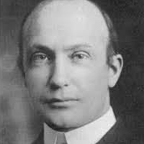
“First, psychology lost its soul. Then it lost its mind. Then it lost its consciousness. It still has behavior of a sort.”
Robert S. Woodworth

Slide 5

DEFINITION OF PSYCHOLOGY
01
According to Pillsbury
“Psychology is the science of human behaviour.”
02
According to Crow and Crow
“Psychology is the study of the human behaviour and human relationship.”

Slide 6

DEFINITION OF PSYCHOLOGY
03
According to Woodworth
“Psychology deals with the activities of the individual in relation to his environment.”
04
According to Watson
“Psychology is positive science of behaviour.”

Slide 7
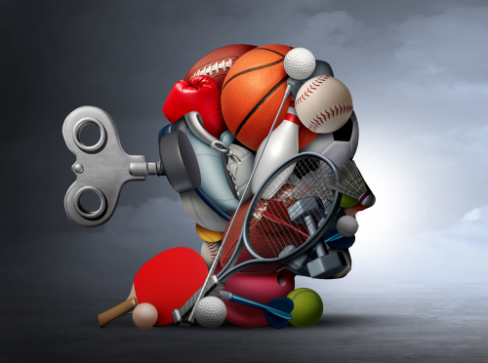
DEFINITION OF SPORTS PSYCHOLOGY
01
According to John Lauther
“Sports psychology is an area which attempts to apply psychological facts and principles to learning performance and associated human behavior in whole field of sports.”
02
According to K M Burns
“Sports psychology for physical education is that branch of psychology which deals with the physical fitness of an individual through his participation in games and sports.”

Slide 8
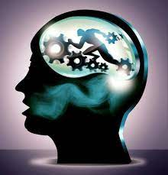
SPORTS PSYCHOLOGY DEALS WITH……..
Increasing performance by managing emotions and minimizing the psychological efforts of injuries and poor performance.

Slide 9
IMPORTANCE OF SPORTS PSYCHOLOGY
Enhances Physiological Capacities
Assists to Learn Motor Skills
Aids in Understanding Behavior
Helps in Controlling Emotions
Prepares Athletes Psychologically for Competitions
Supports Emotional Needs of Sportspersons

Slide 10
VARIOUS PSYCHOLOGICAL FACTORS AFFECT SPORTS PERFORMANCE
Motivation
Interest
Attitude
Learning
Emotions
Stress
Anxiety

Slide 11
MEANING OF PERSONALITY
SUBJECT : PHYSICAL EDUCATION
CHAPTER NUMBER: 09
CHAPTER NAME : PSYCHOLOGY AND SPORTS

Slide 12

MEANING OF PERSONALITY
The word ‘personality’ is derived from the Latin word ‘Persona’, which means ‘mask’.
Personality usually means that an individual is much more than his outer appearance.
Personality is a dynamic.

Slide 13
DEFINITIONS OF PERSONALITY
01
According to Munn
“Personality is the most characteristic integration of an individual’s
Structures
Modes of interest
Attitudes
Behaviors
Capacities
Abilities
Aptitudes.”
02
According to Morton Prince
“Personality is the sum total of all the biological innate dispositions, impulses, tendencies, appetites and instincts of the individual and the disposition and tendencies acquired by experience.”

Slide 14
DEFINITIONS OF PERSONALITY
03
According to Allport
“Personality is the dynamic organisation of these psycho-physical systems that determine an individual’s adjustment to his environment.”
04
According to MC Dougall
“Personality is a synthetic unity of all mental and physical functions in their intimate interplay.”

Slide 15
DEFINITIONS OF PERSONALITY
05
According to Burgess
“Personality is the integration of all habits which determine the role and status of the person in society.”
06
According to Freeman
“Personality is the integrated organisation of all cognitive, conative, affective and physical characteristics that impose on individual and his uniqueness.”

Slide 16
DEFINITIONS OF PERSONALITY
07
According to Warren
“Personality is the entire organization of a human being at any stage of his development.”
08
According to Eysenck
“Personality is the sum total of the actual or potential behaviour patterns of the organism.”
09
According to Cattell
“Personality is that quality which permits a prediction of what a person will do in a given situation.”

Slide 17
DIMENSIONS OF PERSONALITY
Physical Dimension
Mental Dimension
Social Dimension
Emotional Dimension

Slide 18
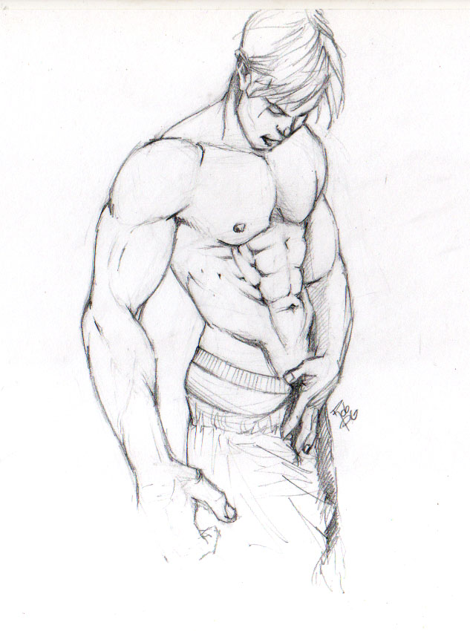
DIMENSIONS OF PERSONALITY
PHYSICAL DIMENSION
It is based on “first impression is the last impression.”
It is related to good physique, good appearance, good health, etc.
All individuals are impressed by persons who have good height, weight, good posture, sturdy body, bright face, etc.
Physique is the foundation of personality which has the beginning effect on the viewers.
How to improve your Physical Dimension?

Slide 19
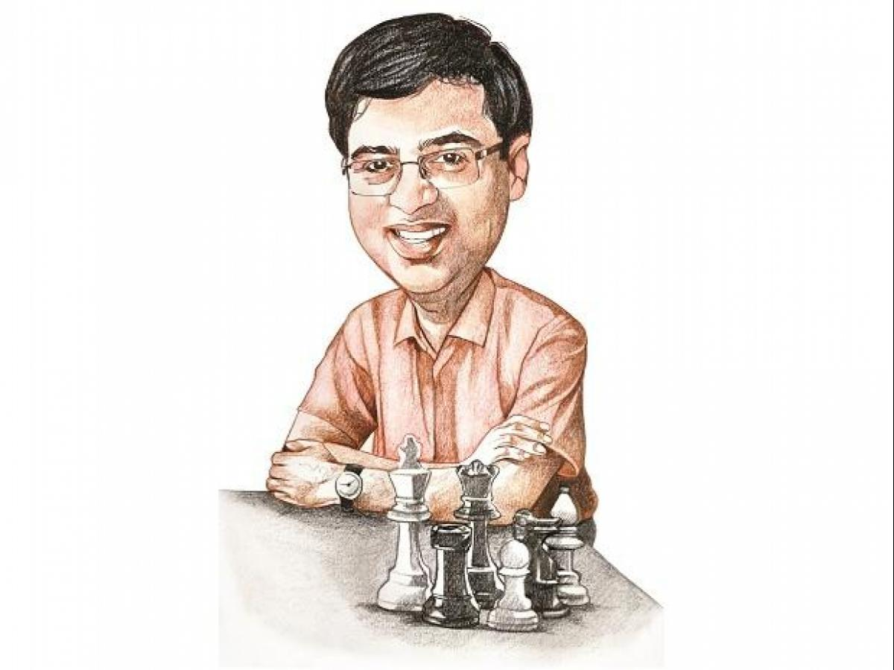
DIMENSIONS OF PERSONALITY
MENTAL DIMENSION
Mental dimension is the most significant attribute of personality.
It is related to mental and intellectual strength and abilities.
The real identification of personality lies in mental dimension.
Those who are not mentally sound, have nothing to offer others.
Many great personalities of the world were not good looking but they possessed mental and intellectual qualities.
How to improve your Mental Dimension?

Slide 20
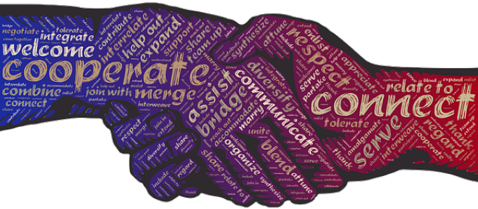
DIMENSIONS OF PERSONALITY
SOCIAL DIMENSION
We does not live for ourselves, we lives for others too.
Sociability is inherent in man’s biological nature.
We influenced in the first stance by behavioural patterns, customs, traditions, norms, standards and manners prevalent in the society.
We learns by imitation, examples, perception, etc.
How to improve your Social Dimension?

Slide 21
SOCIAL DIMENSION
How to improve your Social Dimension?
CHARACTER
MORALITY
ETIQUETTES
MANNERS
WORK ETHICS
FRIENDLINESS
GOOD ATTITUDE
HELPFUL NATURE
COOPERATION
SYMPATHY
KINDNESS

Slide 22

DIMENSIONS OF PERSONALITY
EMOTIONAL DIMENSION
Emotional dimension is related to emotional stability.
It means that one must have proper control over various emotion.
Such as fear, hate, jealousy, anger, disgust, distress, amusement, happiness, etc. in different situations.
Example – many sportspersons feel excited when they win but start crying, abusing the umpires when they lose.
Such situations show one’s emotional status, otherwise it is not accepted as a sign of good personality.
It is sing of immaturity.
How to improve your Emotional Dimension?

Slide 23
TYPES OF PERSONALITY
SUBJECT : PHYSICAL EDUCATION
CHAPTER NUMBER: 09
CHAPTER NAME : PSYCHOLOGY AND SPORTS

Slide 24
TIPES OF PERSONALITY
Type ‘A’
Type ‘B’
Type ‘C’
Type ‘D’

Slide 25
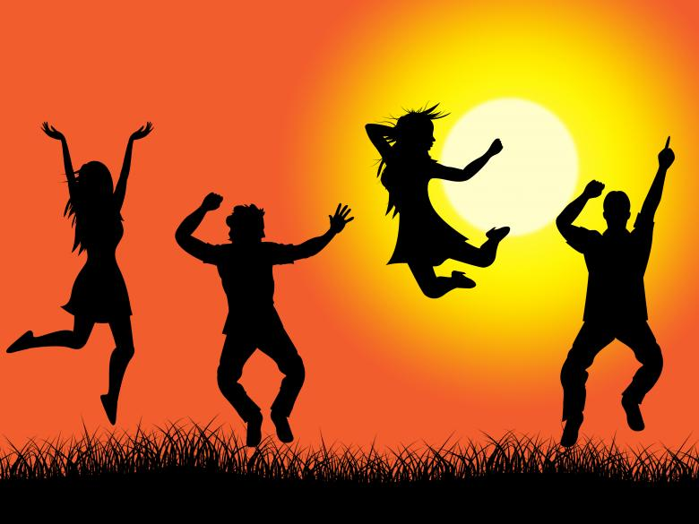
TYPES OF PERSONALITY
TYPES ‘A’ PERSONALITY
what they are
Very competitive in nature
Self-critical
High working involvement
Easily excited
Fall prey to hypertension
Sense of urgency (respect time)
Always a deadline in their mind
Always struggling against the clock
Easily provoke to anger, hostility

Slide 26

TYPES OF PERSONALITY
TYPES ‘B’ PERSONALITY
what they are
Not competitive in nature
Easy going and patient
Do not become angry and hostile
Able to express their emotions appropriately.
Able to cope with stress effectively
Not overachievers and overambitious
Quite satisfied with their lives
Successful persons in life

Slide 27
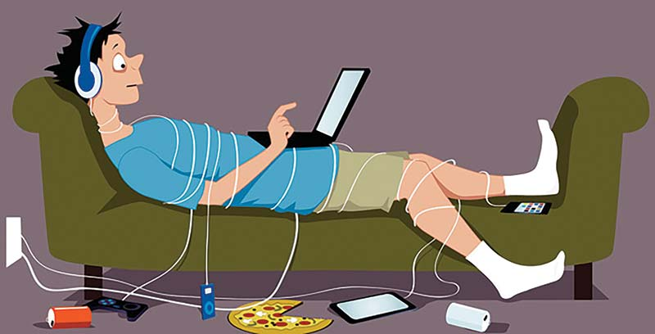
TYPES OF PERSONALITY
TYPES ‘C’ PERSONALITY
what they are
Pleasing and appeasing nature
Unable to express their emotions
Able to suppress their emotions
Lethargic, passive, hopeless, and pessimistic
Deny their own needs
Feel alone at an early age
May enhance the risk of cancer

Slide 28

TYPES OF PERSONALITY
TYPES ‘D’ PERSONALITY
what they are
Suffer from high degree of distress
Persistently suppress their feelings
Don’t share their emotions with other
Prone to heart ailments, high BP
Lead a poor quality of life
Great risk of premature death

Slide 29
SOMATOTYPES OR BODY TYPES
SUBJECT : PHYSICAL EDUCATION
CHAPTER NUMBER: 09
CHAPTER NAME : PSYCHOLOGY AND SPORTS

Slide 30
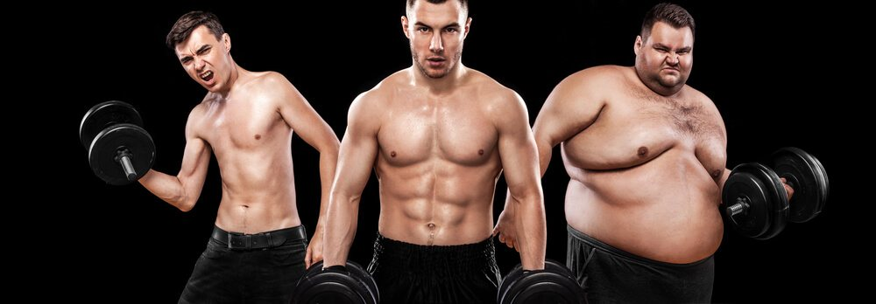
WHAT IS SOMATOTYPES OR BODY TYPES?
Somatotypes is the word used by the famous psychologist William Herbert Sheldon to describe a body-type using his methods of classifying the human physique.
Somatotypes refer to the underlying physique and are not changed by overeating or training.
In the 1940s, Sheldon developed a theory that there are three basic body types.

Slide 31
CLASSIFICATION BY W H SHELDON
ENDOMORPH
MESOMORPH
ECTOMORPH

Slide 32
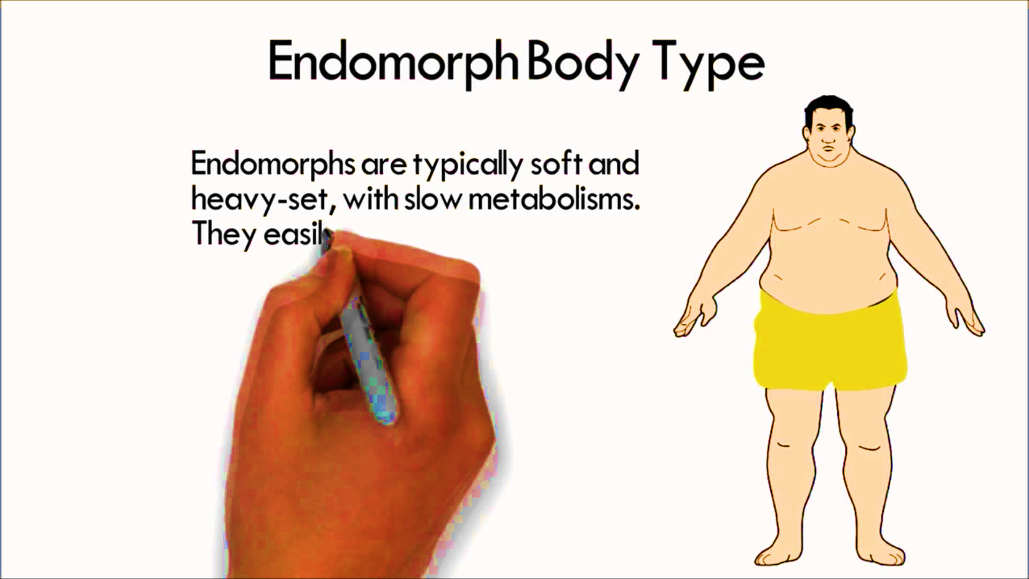
WHAT THEY HAVE
ENDOMORPH
Short arms and legs.
Round physique.
Lot of deposits of adipose tissues.
Upper parts of arms and legs are significantly thicker than the lower part.
Soft body.
Underdeveloped muscles.
A capacity for high fat storage and become fat easily.
Pear shaped body.
It is very hard for them to loss weight.

Slide 33
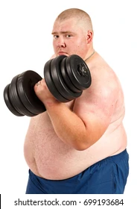


ENDOMORPH
What are the benefits for Endomorph?
Their body is perfect for weight lifting so they can be good weight lifters.
They can perform better in athletic events such as Hammer-throw, Shot-put, and Discuss throw, etc.
What are the pitfalls for Endomorph?
These players body structure is of low status so they can’t be good players.
Their body weight does not allow them to do activities like agility, speed or aerobic exercises.
They can’t be good runners.

Slide 34
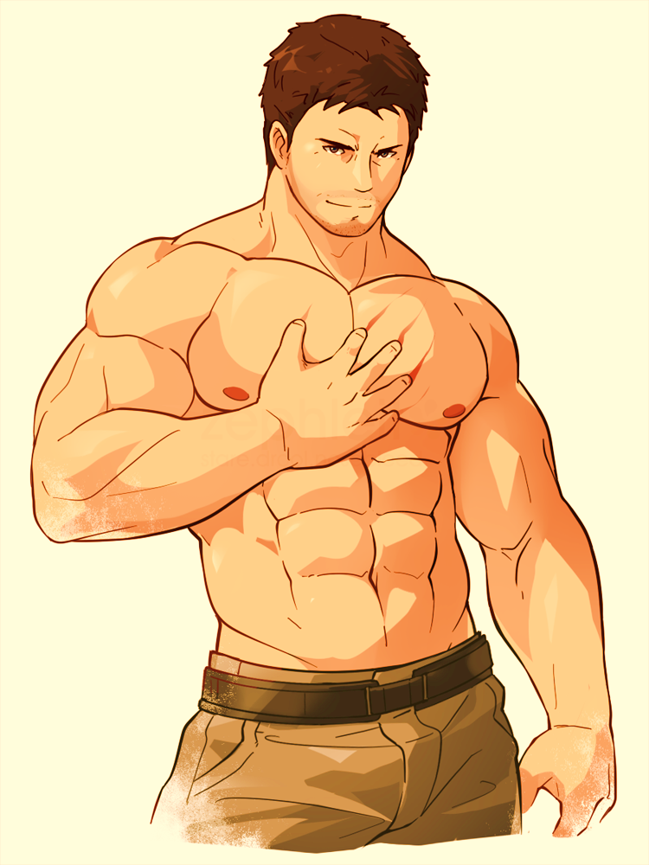
WHAT THEY HAVE
MESOMORPH
Athletic physique.
Balanced body composition.
Ability to increase muscle size quickly and easily.
Well-developed rectangular shaped body.
Thick bones and muscles.
Large and broad shoulder in comparison to waistline.
Capability of doing a lot of physical activities.

Slide 35
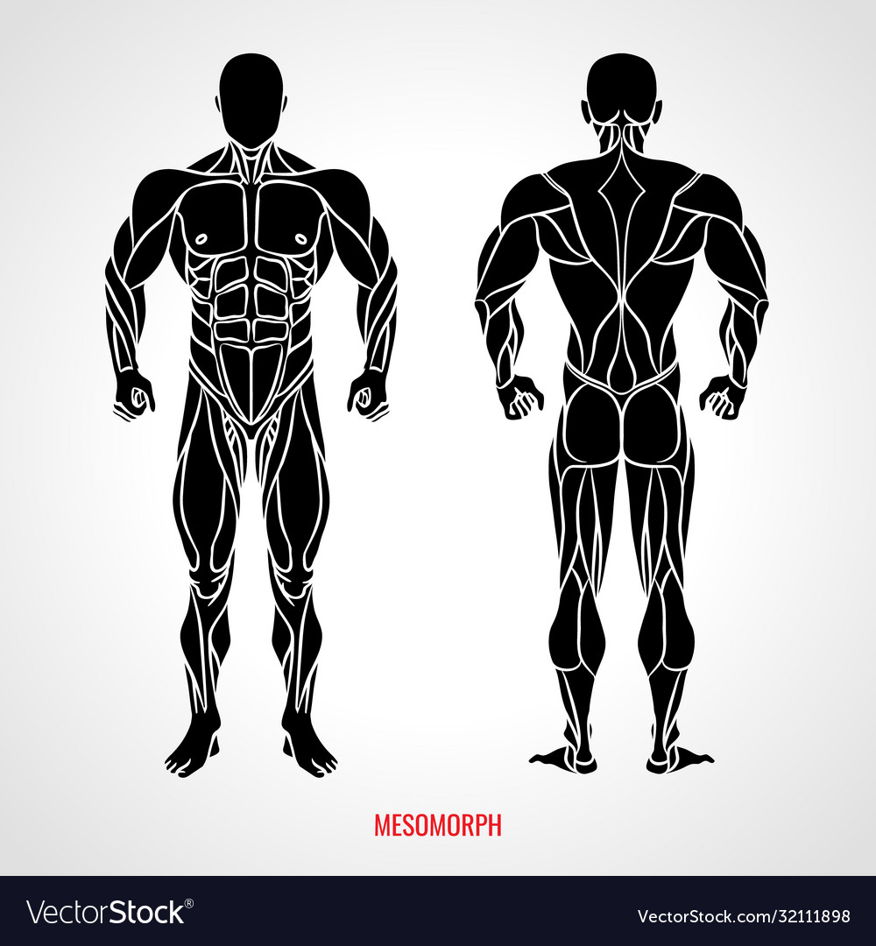
MESOMORPH
What are the benefits for Mesomorph?
They can get the perfection in strength, agility, and speed based activities due to the accumulation of proper fat in the body.
Their height and weight make them suitable for athletic events.
They are suitable for aerobic and resistance based training.
What are the pitfalls for Mesomorph?
They have some low endurance and flexibility.
They have the tendency to accumulate the fat easily when they are not doing any exercise.

Slide 36
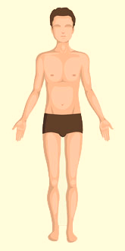
WHAT THEY HAVE
ECTOMORPH
Elongated muscles and limbs.
Weak constitution of body.
Great difficulties in gaining weight.
Flat chests.
Less muscle mass.
Dominate the endurance but don’t strength.
A quick metabolism to burn fat.
A tendency to stick what they do best.
SUITABLE GAMES & SPORTS -
Gymnastics, High Jump, long distance run, aerobic activities, etc.

Slide 37
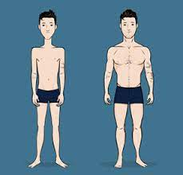
ECTOMORPH
What are the benefits for Ectomorph?
They have a quick metabolism to burn fat.
These body type players can play the below games:-
High jump, Volleyball, gymnastics, and basketball.
They have capability on activities based on endurance, speed, and flexibility.
What are the pitfalls for Ectomorph?
Their body is not suitable for power sports.
Their body can be damaged by participating in power sports.
They can’t increase their weight easily.

Slide 38
C G JUNG’S CLASSIFICATION
SUBJECT : PHYSICAL EDUCATION
CHAPTER NUMBER: 09
CHAPTER NAME : PSYCHOLOGY AND SPORTS

Slide 39
ON THE BASIS OF SOCIABILITY CHARACTER
C G JUNG’S CLASSIFICATION OF PERSONALITY
AMBIVERTS
EXTROVERTS
INTROVERTS

Slide 40
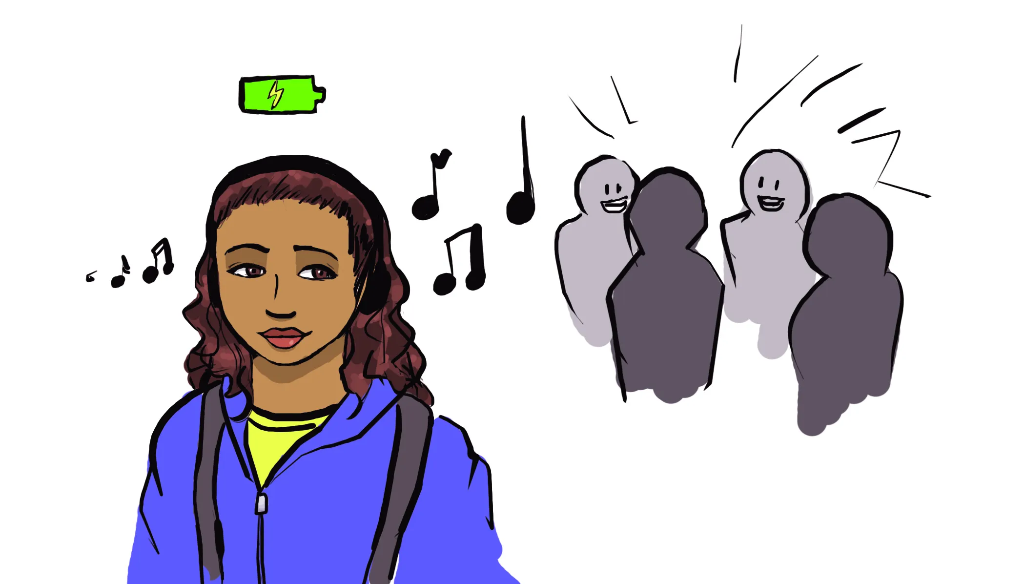
ON THE BASIS OF SOCIABILITY CHARACTER
INTROVERTS
what they are
Shyness
Social withdrawal
Tendency to talk less
self-centred
Unable to adjust easily
Very sensible
Rigid in ideas and future oriented

Slide 41
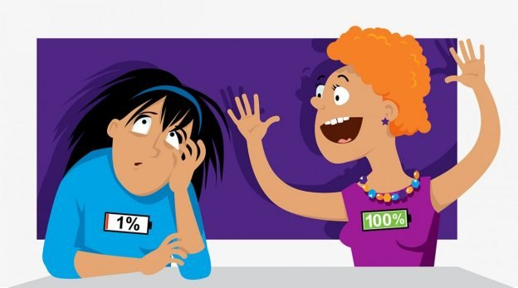
ON THE BASIS OF SOCIABILITY CHARACTER
EXTROVERTS
what they are
Friendly
Outgoing
Talkative
Social contacts
Generous
Supportive
Courageous
Happy-go-lucky
Don’t have hesitation
Not affected by difficulties

Slide 42

ON THE BASIS OF SOCIABILITY CHARACTER
AMBIVERTS
what they are
Both the qualities or traits of introverts and extroverts

Slide 43
BIG FIVE PERSONALITY THEORY
SUBJECT : PHYSICAL EDUCATION
CHAPTER NUMBER: 09
CHAPTER NAME : PSYCHOLOGY AND SPORTS

Slide 44
O - Openness
C - Conscientiousness
E - Extroversion
A - Agreeableness
N - Neuroticism
BIG FIVE PERSONALITY THEORY
Openness
Conscientiousness
Extroversion
Agreeableness
Neuroticism

Slide 45

BIG 5 PERSONALITY THEORY
OPENNESS
Who like to learn new things, new concepts and enjoy new experiences.
They are imaginative, insightful, and having a variety of interests.

Slide 46

BIG 5 PERSONALITY THEORY
CONSCIENTIOUSNESS
Who have a high degree of conscientiousness are reliable and prompt.
They are organized, systematic, laborious, and complete in all respects.

Slide 47
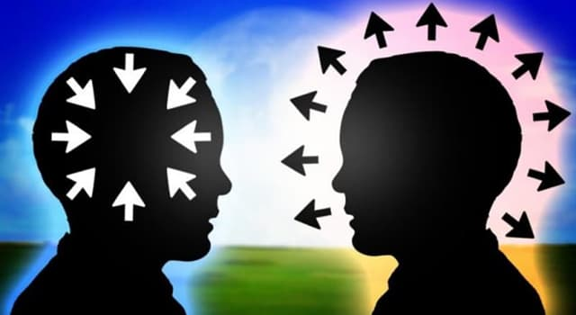
BIG 5 PERSONALITY THEORY
EXTROVERSION
Who get their energy from interacting with other individuals.
But introverts get their energy from within themselves.
They are energetic, talkative, and assertive.

Slide 48

BIG 5 PERSONALITY THEORY
AGREEABLENESS
Those who are friendly, cooperative, compatible, kind and gentle.
They are usually generous, affectionate, and sympathetic.

Slide 49

BIG 5 PERSONALITY THEORY
NEUROTICISM
It also called emotional stability.
This domain relates to one’s emotional stability and the degree of negative emotions.
They are moody and tense.

Slide 50
MOTIVATION
SUBJECT : PHYSICAL EDUCATION
CHAPTER NUMBER: 09
CHAPTER NAME : PSYCHOLOGY AND SPORTS

Slide 51

MEANING OF MOTIVATION
Motivation is key to accomplishment, be is in academics, or in physical activities and sports.
Motivation is the direction and intensity of behaviour.
In absence of motivation either there will be no learning or very little learning.
The word motivation is derived from a Latin word ‘movere’ meaning ‘to change’ or ‘to move’.
Motivation means to be inspired to do something. (Motive)
Motivation is an abstract concept.

Slide 52
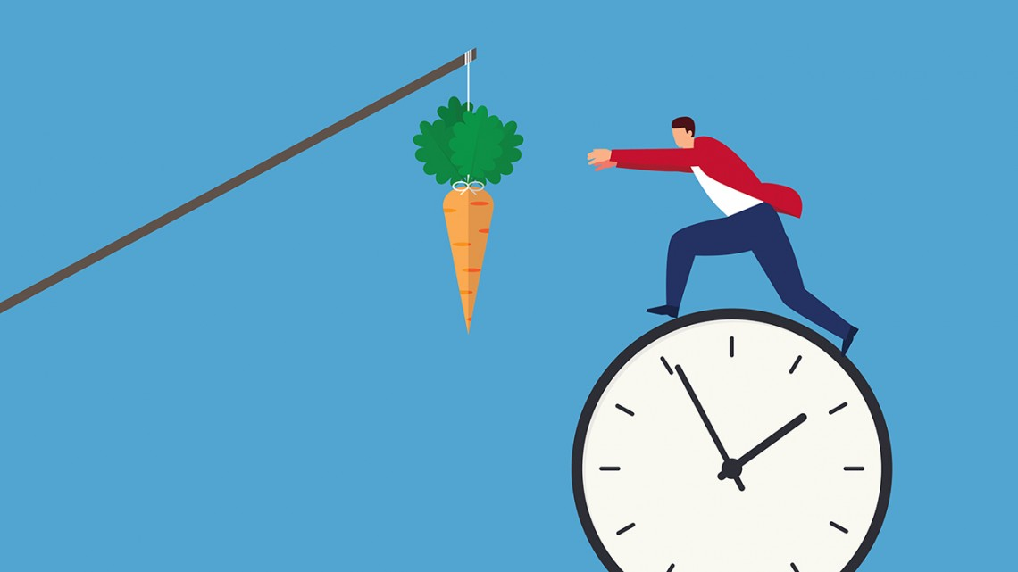
WHAT IS MOTIVE?
Motive is an energetic force or tendency working within an individual to act for satisfying.
As we know that need arises only when motives demand satisfaction.
There are many types of motives.
Example – hunger motive, thirst motive, aggressive motive, achievement motive, urge to play motive, etc.

Slide 53

DEFINITIONS OF MOTIVATION
01
According to Crooks and Stein
“Any condition, that might energise and direct our actions” is called motivation.
02
According to Sage
“The drive to strive” is called motivation.
03
According to Alderman
“Motivation is the general level of arousal to action in an individual.”

Slide 54
TYPES OF MOTIVATION
Intrinsic Motivation
Extrinsic Motivation

Slide 55

TYPES OF MOTIVATION
INTRINSIC MOTIVATION
Intrinsic motivation is internal.
When motives comes from within oneself.
When athletes take part in the activity for the pleasure and satisfaction they trying to understand something new.
Athletes engage themselves in an activity for their own sake.

Slide 56
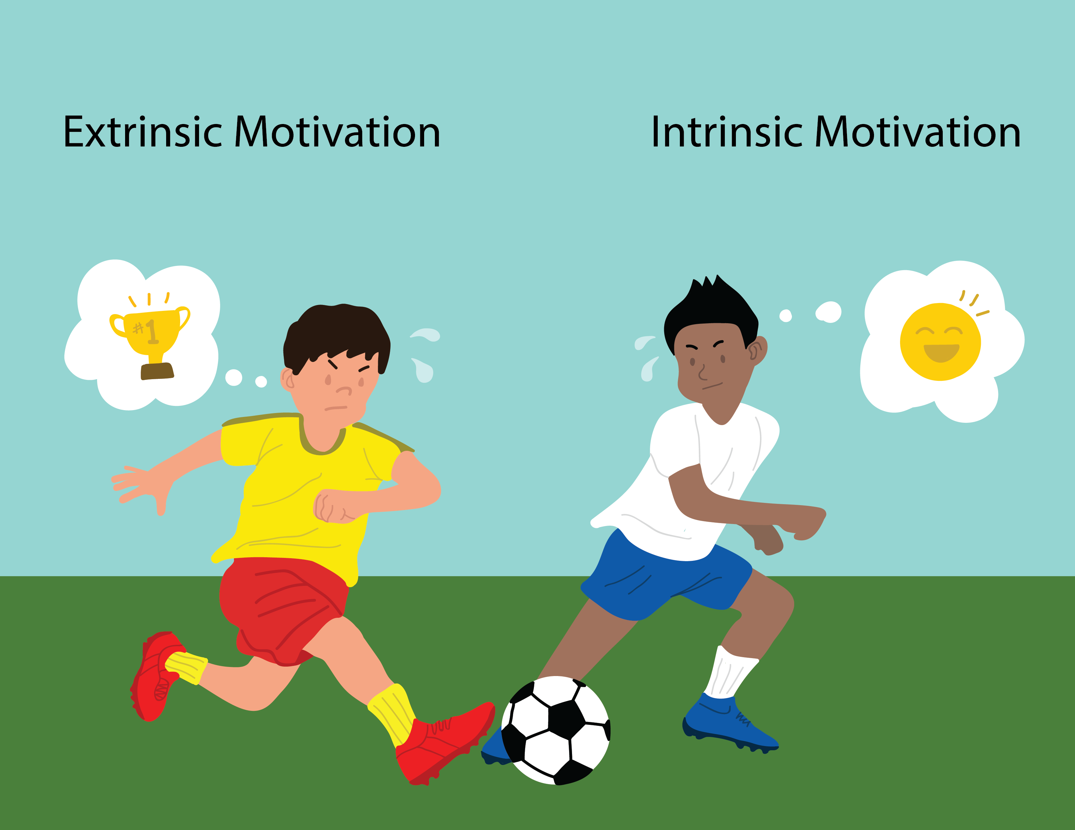
TYPES OF MOTIVATION
EXTRINSIC MOTIVATION
Extrinsic motivation is external.
When an individual initials and sustains an activity as a result of external pulls, attractions, forces, incentive, etc. it is called extrinsic motivation.
Example – rewards, prizes, punishment, praise, blame, position, approval, prestige, status, etc.

Slide 57
TECHNIQUES OF MOTIVATION
Goal setting /Level of aspiration
Arrangements of competition
Spectators
Verbal comments
Hypnotism
Healthy sports environment
Knowledge of results
Praise/Appreciation or blame/Criticism
Cash prizes, certificates, trophies
Motivational music
Positive attitude
Positive self-talk

Slide 58
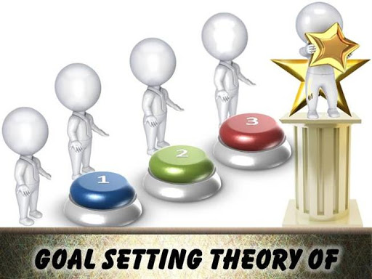
TECHNIQUES OF MOTIVATION
GOAL SETTING /LEVEL OF ASPIRATION
Long-term goals
Medium-term goal
It is necessary to set realistic goals based on one’s own abilities.
Setting up too high goals, or too low goals will adversely affect the level of motivation.
The goal should be difficult one but should be realistic, specific and attainable.
Short-term goals

Slide 59
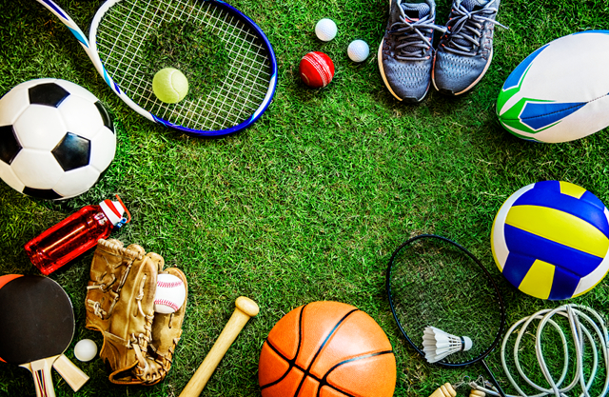
TECHNIQUES OF MOTIVATION
ARRANGEMENTS OF COMPETITION
Sportspersons perform better in competition when the arrangements of competition are elaborate.
Without extensive arrangements of competitions, good sportspersons also cannot perform well in such competitions.

Slide 60
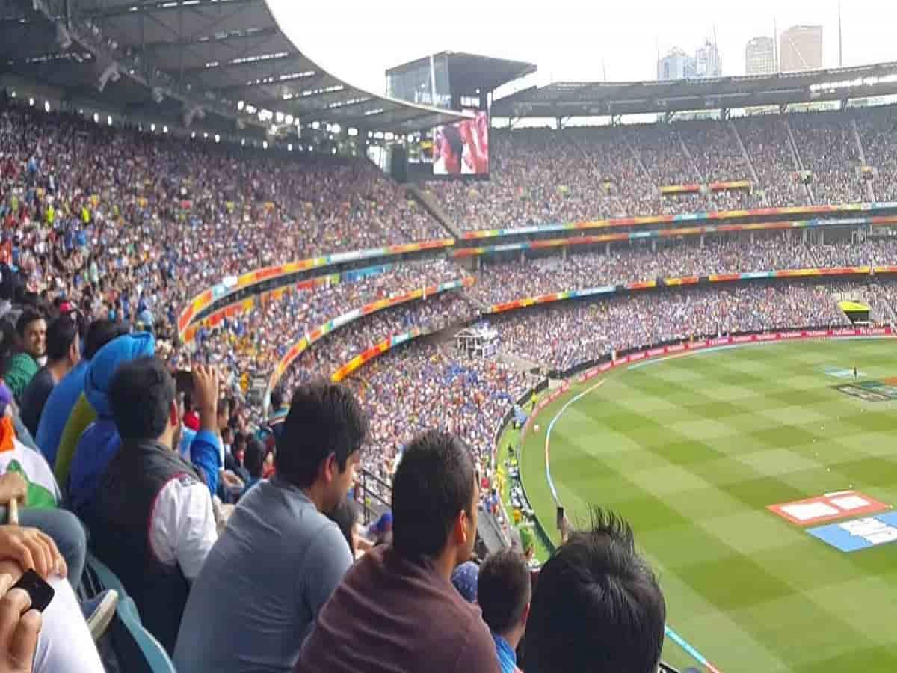
TECHNIQUES OF MOTIVATION
SPECTATORS
A huge number of spectators, it will have a positive effect on payers.
Effectiveness depends upon the experience and maturity.
An inexperienced athlete is usually overpowered by fear.

Slide 61
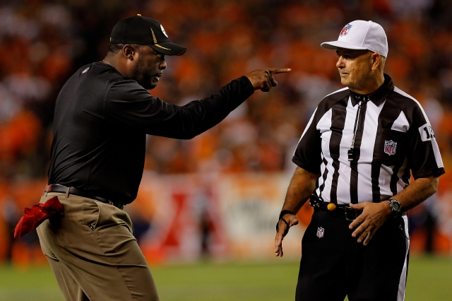
TECHNIQUES OF MOTIVATION
VERBAL COMMENTS
Verbal comments should be applied during competition.
Experienced players are not generally motivated by verbal comments.
Beginners are motivated by this factor.
Verbal comments should be used at appropriate time, “hit the iron when it is hot”

Slide 62

TECHNIQUES OF MOTIVATION
HYPNOTISM
Motivation through hypnotism can be effective but, it is discarded by the public.
It has its scientific base.
Several studies show its positive effects.
Simple and direct strength may be improved through hypnotism if it is properly employed by a trained person.

Slide 63
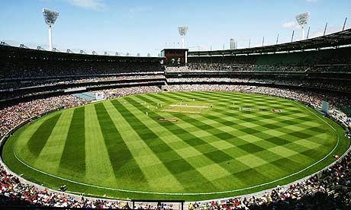
TECHNIQUES OF MOTIVATION
HEALTHY SPORTS ENVIRONMENT
Good climate
Proper weather
Humidity and temperature
Smooth and clean sports fields
Good quality of sports equipment

Slide 64

TECHNIQUES OF MOTIVATION
PRAISE/APPRECIATION OR BLAME/CRITICISM
Praise or Blame are effective factors of motivation(proper time and in appropriate amount)
Blame is given at improper time, it can be dangerous.
Praise is also better but not too much, can destroy the future of the sportsmen.

Slide 65

TECHNIQUES OF MOTIVATION
CASH PRIZES, CERTIFICATES, TROPHIES
It is a good incentive to the sportspersons, it motivates the individual.
Case prizes, Certificates and Trophies lay the vital role to improve the motivation.

Slide 66

TECHNIQUES OF MOTIVATION
MOTIVATIONAL MUSIC, POSITIVE ATTITUDE
Motivational song and talk is particularly a good way to motivate in training.
Fast music during circuit training
Slow music during recovery period.
They should lay proper emphasis on “can be” mindset of players.

Slide 67
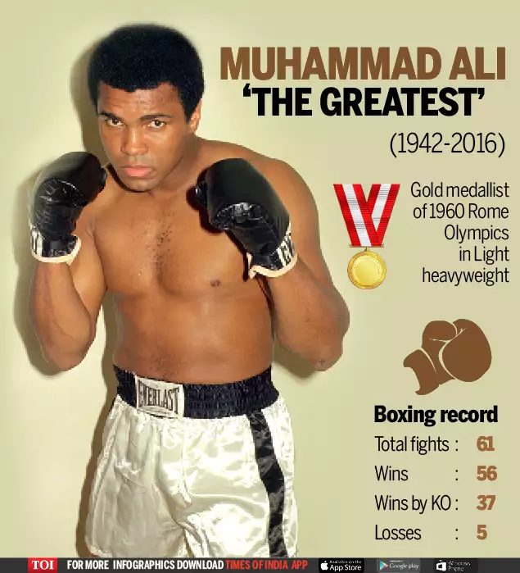
TECHNIQUES OF MOTIVATION
POSITIVE SELF-TALK
Positive self-talk is a technique that can be used to enhance motivation.
Its improve Belief- System
i.e. Mohammed Ali, the world famous boxer of USA used to apply this technique – “I am the greatest.”

Slide 68
AGGRESSIONS IN SPORTS
SUBJECT : PHYSICAL EDUCATION
CHAPTER NUMBER: 09
CHAPTER NAME : PSYCHOLOGY AND SPORTS

Slide 69
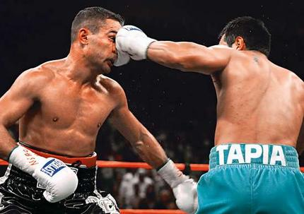
MEANING AND CONCEPT OF AGGRESSION
According to Baron and Richardson,
“Aggression is a behavior with a goal of harming or injuring another living being who is motivated to avoid such treatment.”
Aggression is an international behavior.
Accidental harm is not aggression.
Aggression involves harm or injury of living being.
According to Webster’s dictionary,
“Aggression is hostile, injurious or destructive behavior or Outlook especially when caused by frustration.”

Slide 70
THREE FACTORS FOR AN ACT TO BE AGGRESSION
The act either physically or verbally. (thinking is not enough)
It must harm another person either physically or emotionally.
It must be an intentional action.
ACCORDING TO GILL

Slide 71
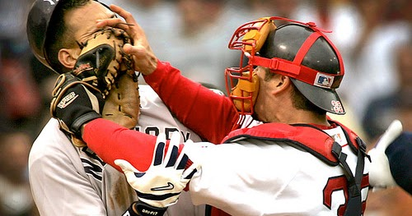
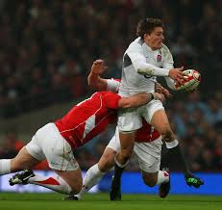
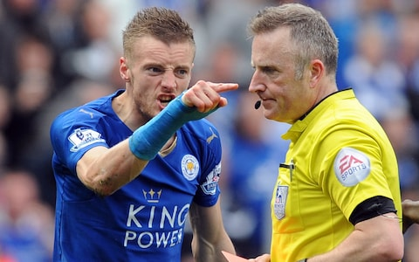
TYPES OF AGGRESSION IN SPORTS
HOSTILE AGGRESSION
INSTRUMENTAL AGGRESSION
ASSERTIVE BEHAVIOR

Slide 72
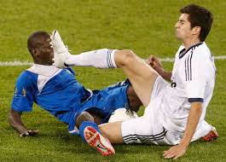
TYPES OF AGGRESSION IN SPORTS
HOSTILE AGGRESSION
Reactive aggression and can be accompanied by anger.
The main aim is to cause injury to other sportsperson.
The intention is on causing pain and suffering.
When the primary aim is to cause physical harm to your opponent.

Slide 73
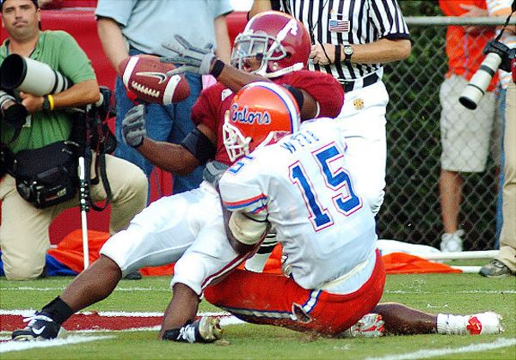
TYPES OF AGGRESSION IN SPORTS
INSTRUMENTAL AGGRESSION
It is also known as channeled aggression.
It is not accompanied by anger.
This type of aggression comes in contact sports.
For achieve money, praise or victory.
The aggressive act is to win the competition.
Player using aggression to tackle his opponent to win.

Slide 74

TYPES OF AGGRESSION IN SPORTS
ASSERTIVE BEHAVIOR
The use of legitimate physical or verbal force to achieve one’s purpose.
Legitimate force with no rules broken.
Its related to 4 main criteria. i.e.
Goal oriented
Not intended to harm
Uses only legitimate force
Dose not break any rule of the game or sport.

Slide 75

What is personality? State any three dimensions of personality.
Explain about big 5 theory.
What do you mean by motivation? Explain the various techniques to improves motivation.
What is aggression? Explain all the types of aggression in sports.

Slide 76
THANKING YOU
ODM EDUCATIONAL GROUP

